Slide 1


Does school kill creativity?
Pros and cons of schools and creativity

Slide 2


Creativity
PRESENTED BY :
RACHEL OYUGI
SHANKLINE ATURINDE
AMINA BIRABWA
JOY

Slide 3

CREATIVITY

Slide 4
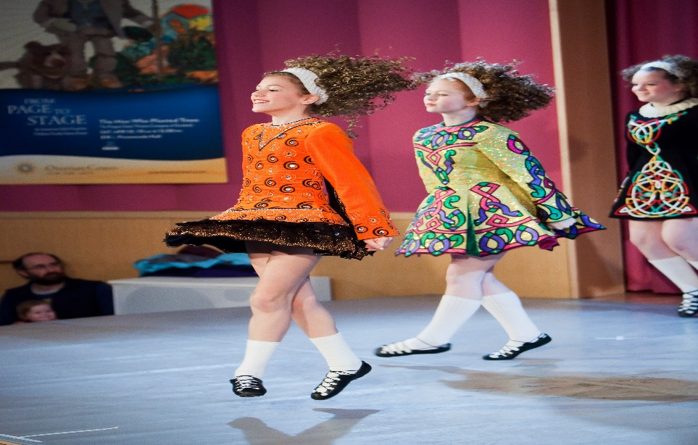
Creativity
Creativity is a broad topic with so much arguments by great scholars.
Sir ken Robinson argues that schools actually kill creativity for the students don’t grow in it but out of it. He further explains that kids actually get educated out of it and are being trained to be like professors.

Slide 5

Pros of creativity
Creativity actually nurtures inborn skills like music, poetry ,art ,athletics and so much more inbuilt talents.
“creativity is as important as literacy and we should afford it the same status”.

Slide 6
Cons of killing creativity in young kids
Creative possibilities are everywhere. If you doubt that, watch your kids. They stir dirt, leaves and pool water into pretend pies. They turn wine boxes into parking garages for toy cars. During play, creativity is automatic.

Slide 7

Cons of killing creativity
The perfectionist theory-forcing kids to act in a particular way kills their creativity and shuts down their critical thinking and brain.
Crude education system – discourages creativity for they are taught more to be theoretical than being practical. This kills their self esteem and confidence.

