Slide 1

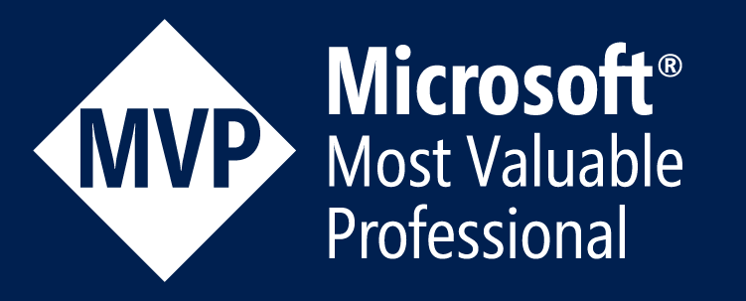


AZ-203: Developing Solutions for Microsoft Azure
Onur Yüksektepeli

Slide 2




Onur Yüksektepeli | @oyuksektepeli
Nephocraft Founder, CEO, Chief Technology Officer
Entrepreneur, Technology Enthusiast
Microsoft MVP, Microsoft MCT
Mshowto Community Lead
15+ Experience
Public Speaker, Author
www.nephocraft.com
https://twitter.com/oyuksektepeli
https://www.linkedin.com/in/onuryuksektepeli/
https://github.com/oyuksektepeli
https://notebooks.azure.com/oyuksektepeli/
http://www.youtube.com/c/onuryuksektepeli
https://www.facebook.com/onuryuksektepeli/

Slide 3

About Exam
Skills measured
Develop Azure Infrastructure as a Service compute solution (10-15%)
Develop Azure Platform as a Service compute solution (20-25%)
Develop for Azure storage (15-20%)
Implement Azure security (10-15%)
Monitor, troubleshoot, and optimize solutions (10-15%)
Connect to and consume Azure and third-party services (20-25%)
https://docs.microsoft.com/en-us/learn/certifications/exams/az-203

Slide 4

Connect to Azure
Azure Portal
Azure Cloud Shell
Azure Powershell
Azure CLI v2.0
Azure SDKs

Slide 5
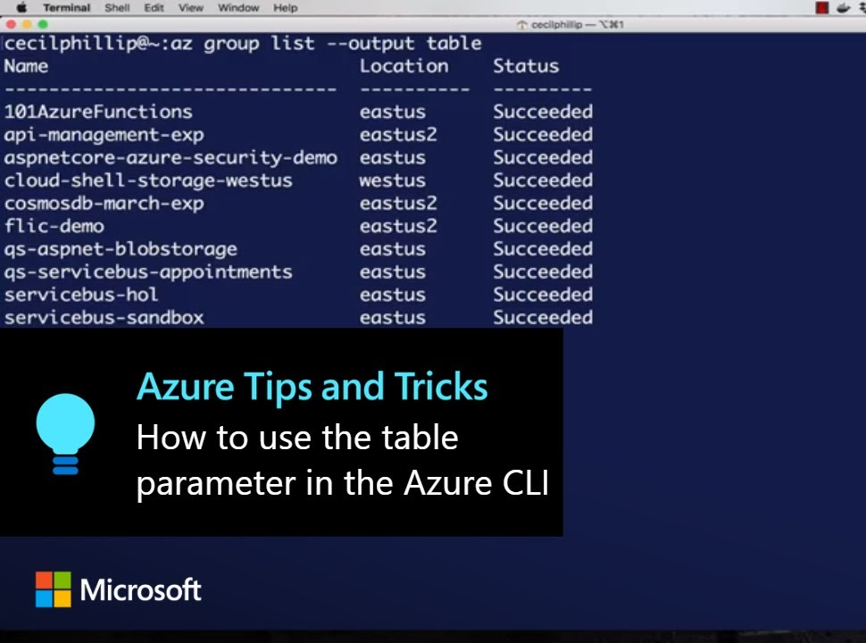
Azure CLI
Windows MSI Installer
macOS brew package
Linux
Available from package managers from apt, yum etc.
Windows Subsystem for Linux (WSL)
Docker container available
https://docs.microsoft.com/en-us/cli/azure/install-azure-cli?view=azure-cli-latest

Slide 6

Azure Powershell
Azure resource can be controlled with cmlets
Windows Powershell (Windows Only, included with OS)
Powershell Core
Cross Platform, Windows, Linux, MacOS and Container image
Install-Module -Name Az -AllowClobber -Scope AllUsers

Slide 7
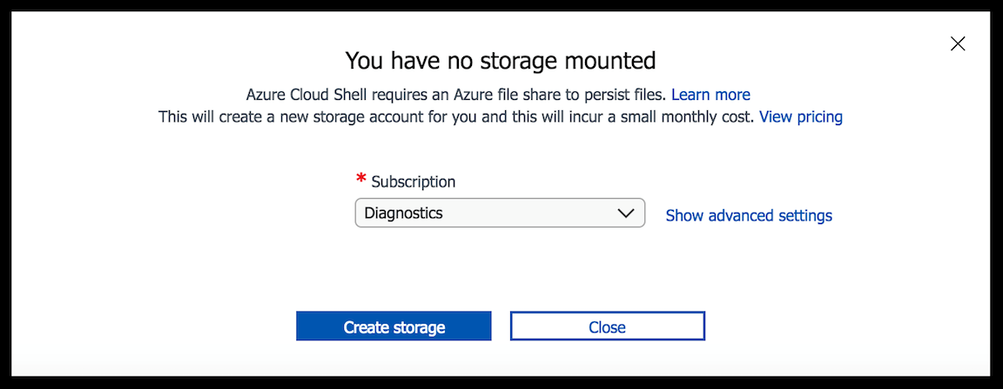
Azure Cloud Shell

Slide 8
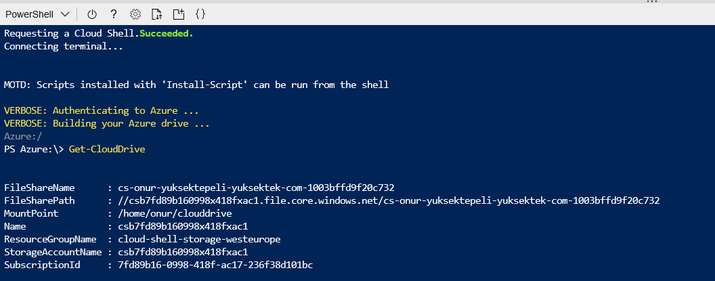
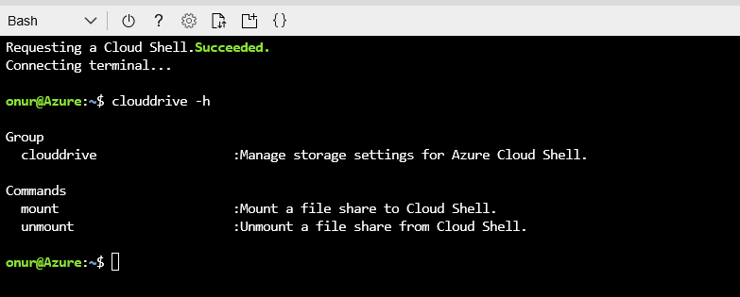
Azure Cloud Shell

Slide 9
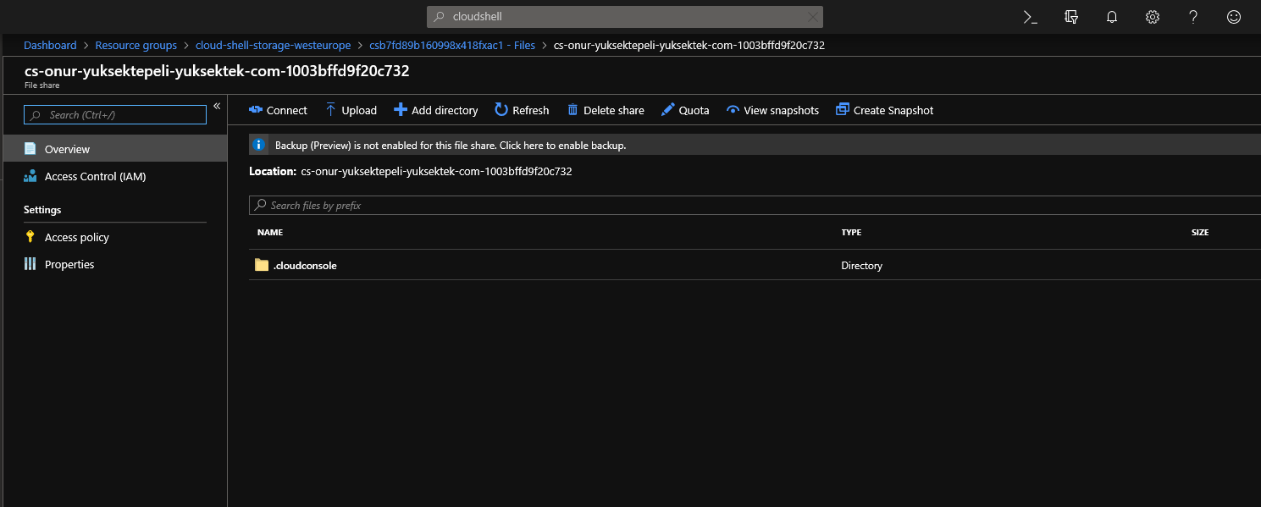
Azure Cloud Drive

Slide 10
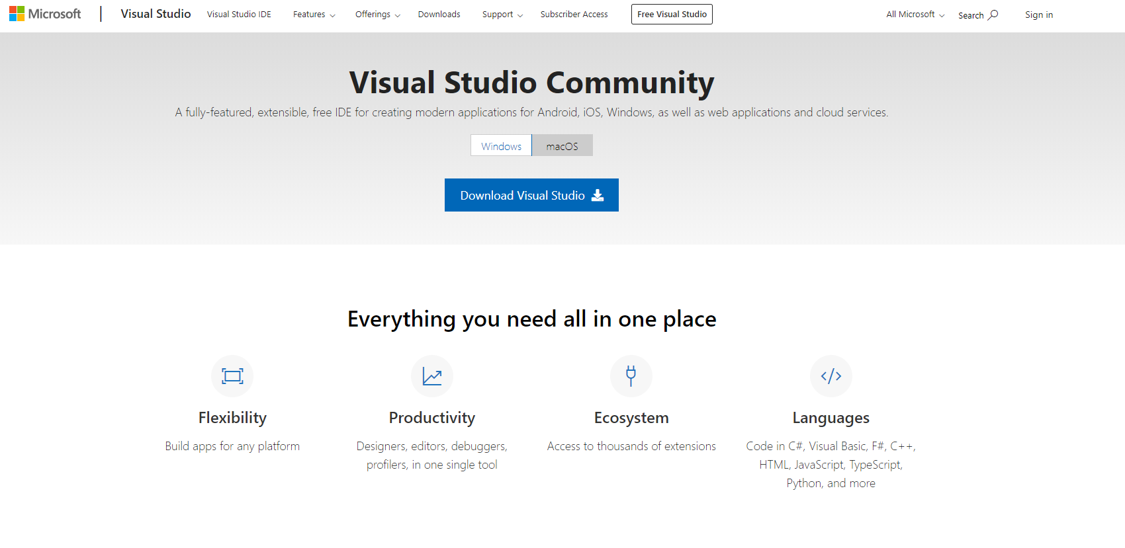
Visual Studio
https://visualstudio.microsoft.com/vs/community/

Slide 11
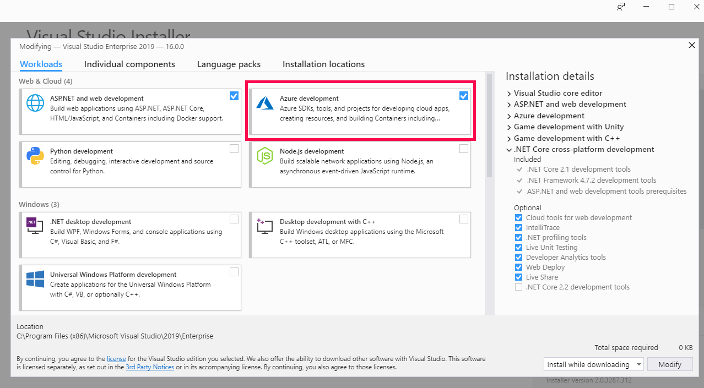
Azure Development

Slide 12
Azure Resource Groups
Resources in a resource group should share the same lifecycle
Each resource can only exist in one resource group
Resources can be added or removed to a resource group at any time
Resources can be moved from one resources group to another
Resource groups can contain resources that reside in different regions
Resources can interact with resources in other resources groups

Slide 13
Resource Group Management
Tags
Locks
Access Control (IAM)
Policies

Slide 14
Sample Resource Group
Ms-net-rg
Purpose: Isolate the Virtual networks
Need: Prevent unwanted changes to any of the network resources
Admin: It will deploy and maintain RG
Notes: Resources in other RGs will use the resources int this group
Dept: IT
Owner: Onur YUKSEKTEPELI

Slide 15

Demo
Creating a Resource

Slide 16
Azure Resource Tags
Logically organize resources. Each tag has a name and a value. Allows related resources from different resource groups to be identified. Organize by billing and management.

Slide 17
TAG Rules
Tags are NOT inherited
Names can't contain these characters: <,>, %, &, \, ?, /
Tag name is limited to 512 characters
Tag value is limited to 256 characters

Slide 18
Demo
Create Tag

Slide 19
Resource Group Locks
Prevent accidental deletion or changes to resources in resource groups. Consists of two locks:
CanNotDelete
ReadOnly

Slide 20
Demo
Create Resource Locks

Slide 21
Access Control (IAM)
A system that provides fine-grained access Management of resources in Azure. Grant only the amount of Access to users needed to perform their jobs

Slide 22
Demo
Access Control (IAM)

Slide 23
Azure Policy
Allows you to manage and prevent IT issues with policy definitions that enforce rules and effects for your resources. Policies allow you to keep compliant with corporate standards and SLAs.

Slide 24
Demo
Azure Policy

Slide 25

Azure Compute
Azure Champ

Slide 26
Azure Compute
Azure Compute Unit
The concept of the Azure Compute Unit (ACU) provides a way of comparing compute (CPU) performance across Azure SKUs. This will help you easily identify which SKU is most likely to satisfy your performance needs. ACU is currently standardized on a Small (Standard_A1) VM being 100 and all other SKUs then represent approximately how much faster that SKU can run a standard benchmark.

Slide 27
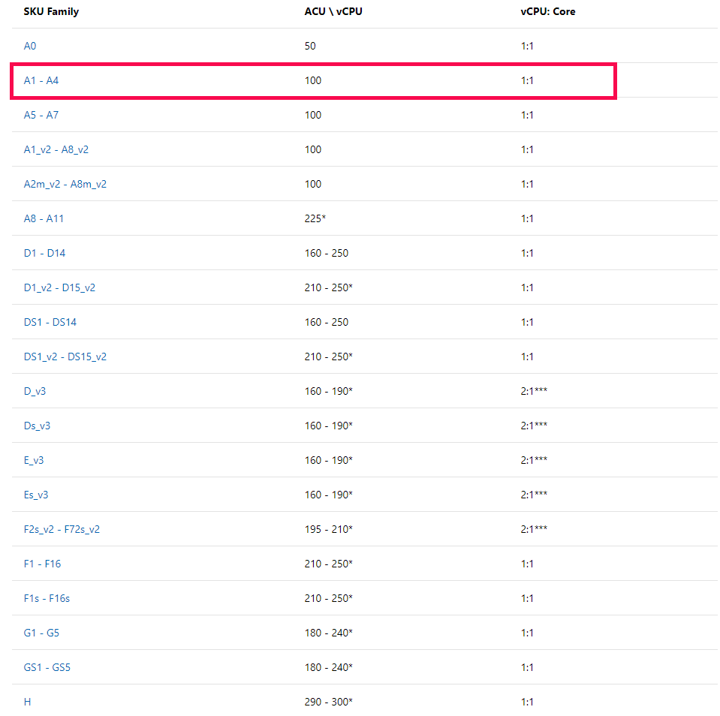
Azure Compute Unit(ACU)

Slide 28
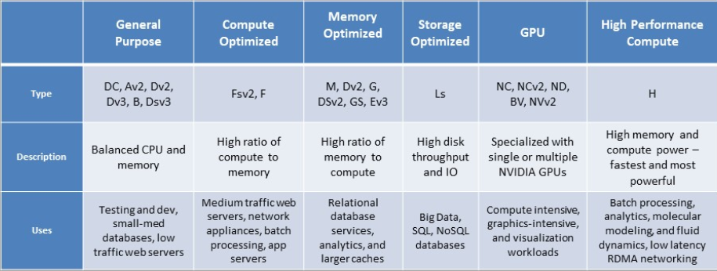
Azure Virtual Machines

Slide 29
Standard vs. Premium Storage Disks
Standard Disks | Premium Disks
Backed by cost-effective HDDs | Backed by high-speed SSDs
Stored in Azure storage account | IOPS values are predictable, expected performance levels
Standard SSD (Preview) available for managed disks (dev/test/entry level production applications) | Pre-pay for all storage used (fixed disk sizes P10, 128 GB, 500 IOPs, 50 MB/sec
Standard storage provides maximum IOPS values for each VHD

Slide 30
Managed vs. Unmanaged Disks
Unmanaged Disks | Managed Disks
Original method to store VM VHDs | Azure manages the disks, so you don't have to worry about storage account level IOPS restrictions
VHDs stored as page blobs in an Azure storage account | Pre-pay for disk size (no need for Storage Account) S10, 128 GB, 500 IOPS, 60 MB/sec
Maximum 256 TB of storage per VM | Supports Standard and Premium SSD and Standard HDD
You need to manage storage account availability
20,000 IOPS limit across all VM disks in a standard storage account

Slide 31
Ultra SSD – the next generation of Azure Disks technology
Ultra SSD
supported VM types will be limited
Ultra SSD Disks come in several fixed sizes from 4 GiB up to 64 TiB and feature a flexible performance configuration model that allows you to independently configure IOPS and throughput.
Ultra SSDs support IOPS limits of 300 IOPS/GiB, up to a maximum of 160K IOPS per disk. To achieve the IOPS that you provisioned, ensure that the selected Disk IOPS is less than the VM IOPS.
With Ultra SSD Disks, the throughput limit of a single disk is 256 KiB/s for each provisioned IOPS, up to a maximum of 2000 MBps per disk (where MBps = 10^6 Bytes per second).

Slide 32
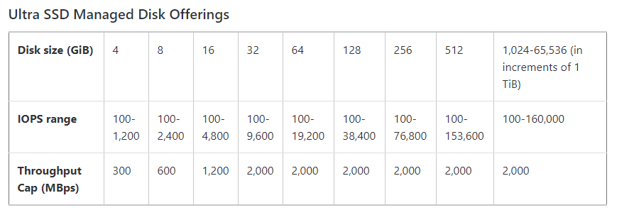
Azure Ultra SSD

Slide 33
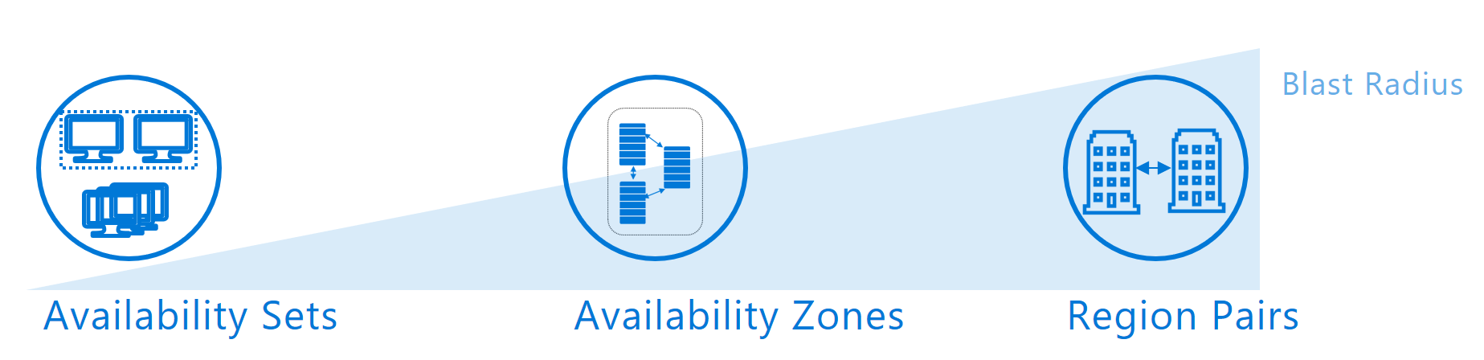
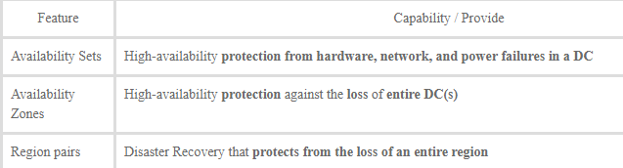
Planning High Availability

Slide 34
Availability Sets
%99.95 Availability SLA with Availability set
Must be configured at VM Deployment
Otherwise %99.9 single instance SLA with Premium storage
FD 0
FD 1
VM
VM
UD 0
UD 1
VM
UD 2
VM
VM

Slide 35
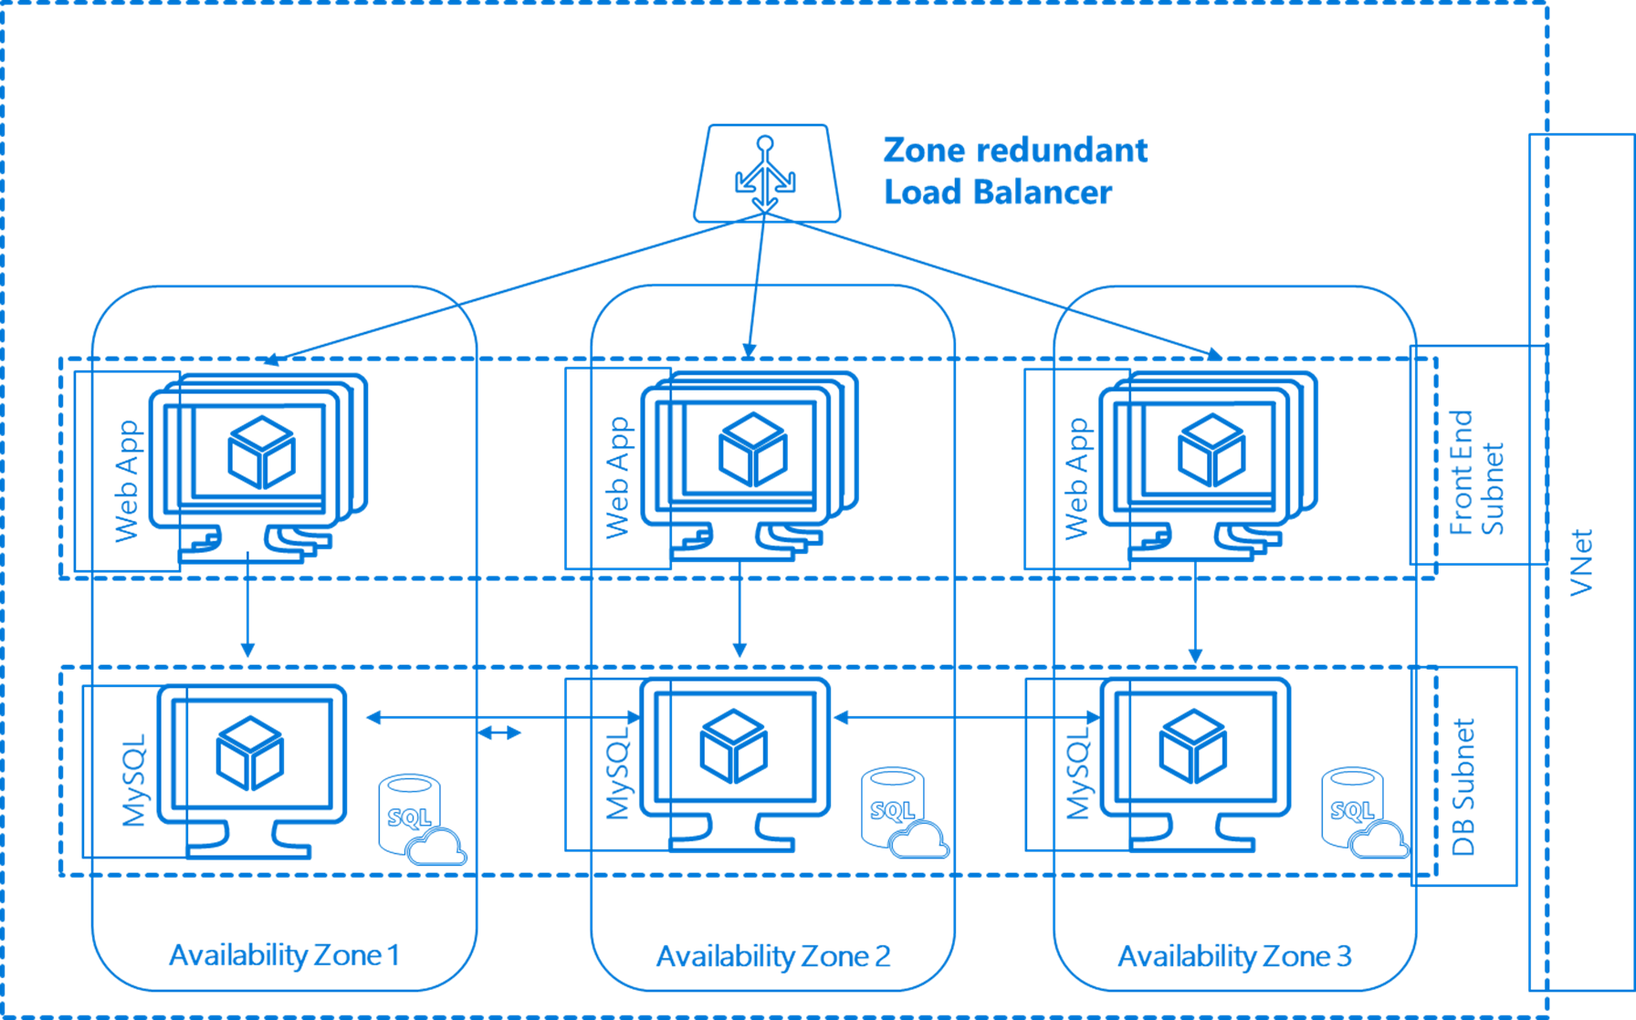
Availability Zone
http://aka.ms/azoverview

Slide 36
Supported Linux Distributions in Azure
Debian
CoreOS
Centos
Oracle Linux
Red Hat Enterprise Linux
Ubuntu
OpenSUSE
Suse Enterprise Linux
https://docs.microsoft.com/en-us/azure/virtual-machines/linux/endorsed-distros

Slide 37
Azure Deployment Tools
Azure Portal
Azure Cloud Shell
Azure Powershell
Azure CLI v2.0
Azure SDKs
ARM Templates

Slide 38
Demo
Deploy a Linux VM in Azure
Deploy a Windows VM in Azure with Visual Studio

Slide 39
Demo
Connect Windows VM via Serial

Slide 40
Azure VM Disk Types
OS Disk | Data Disk | Temporary Disk
Generation 1 .VHD | # dependent on VM instance size | D: or /dev/sdb1
Registered as SATA drive | Registered as SCSI disk | Bound to the hardware host
Max capacity 2 TB | Max capacity 4 TB | Do not store permanent data!
https://docs.microsoft.com/en-us/azure/virtual-machines/linux/disks-types
https://docs.microsoft.com/en-us/azure/virtual-machines/windows/disks-types

Slide 41
Demo
Add Data Disk to VM

Slide 42
Demo
Deploy VM from Existing Managed Disk

Slide 43
Demo
Extend the Managed Disk

Slide 44
Demo
Convert to Managed Disk

Slide 45
Demo
Azure Disk Encryption

Slide 46
Move Azure Resources
https://docs.microsoft.com/en-us/azure/azure-resource-manager/resource-group-move-resources

Slide 47
Demo
Move Azure Resources

Slide 48
Virtual Machine Scale Set
Azure Champ

Slide 49
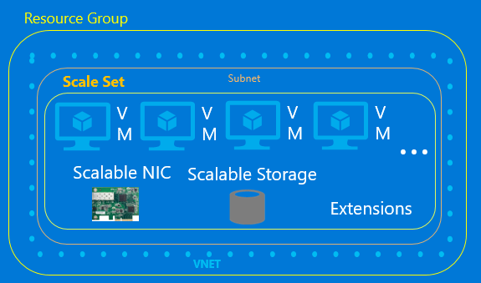
Azure Virtual Machine Scale Set
Control it like IaaS, scale it like PaaS

Slide 50
Demo
Azure Virtual Machine Scale Test

