Slide 1

DS 6306 DDS Analytics case study
Hayoung Cheon

Slide 2
0. Task
Goals
[ 1 ]
[ 2 ]
Find the three factors that impacted employee’s attrition the most.
Create a prediction model that can predict employee’s attrition based on those three factors.

Slide 3
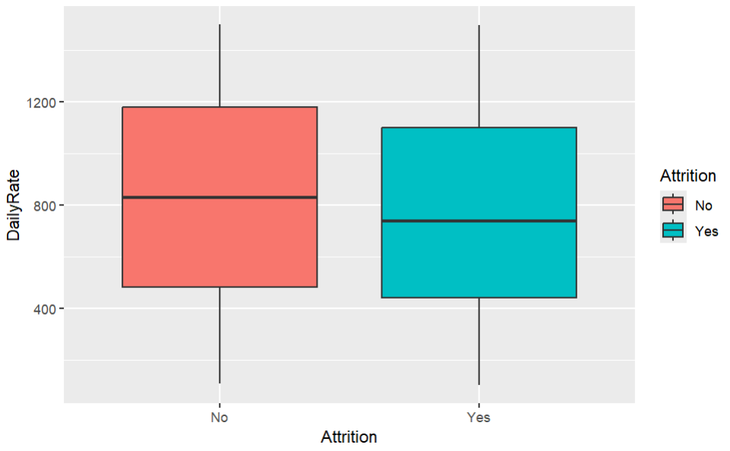
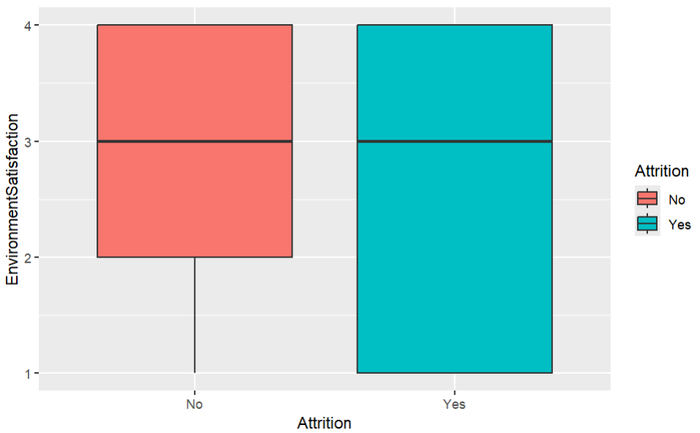
1. Data exploration
Exploration of variables by contingency tables and boxplots
Attrition vs. Department
 | Human Resources | Research & Development | Sales
No | 0.8285 | 0.8665 | 0.7839
Yes | 0.1714 | 0.1335 | 0.2161
Attrition vs. Gender
 | Female | Male
No | 0.8285 | 0.8665
Yes | 0.1714 | 0.1335

Slide 4
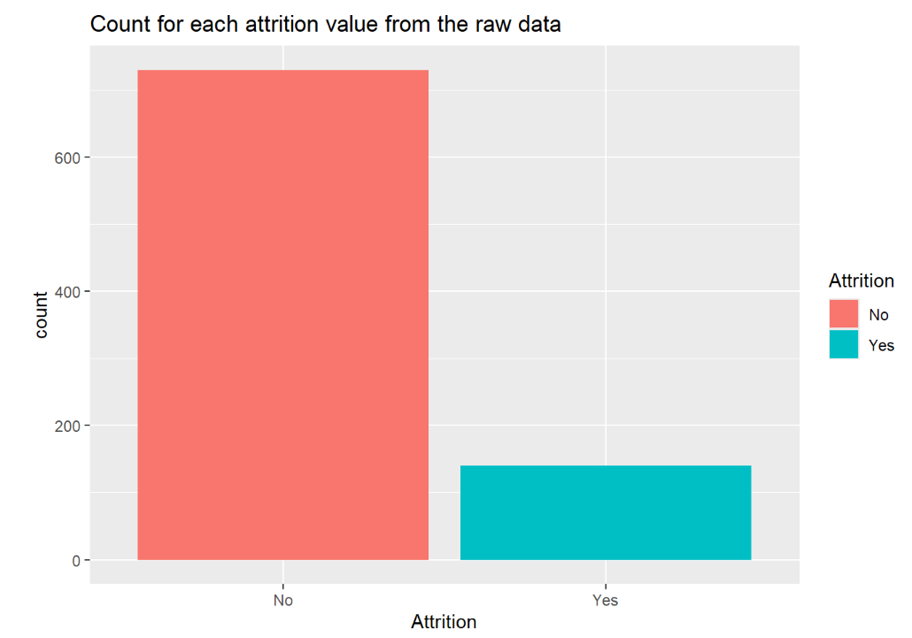
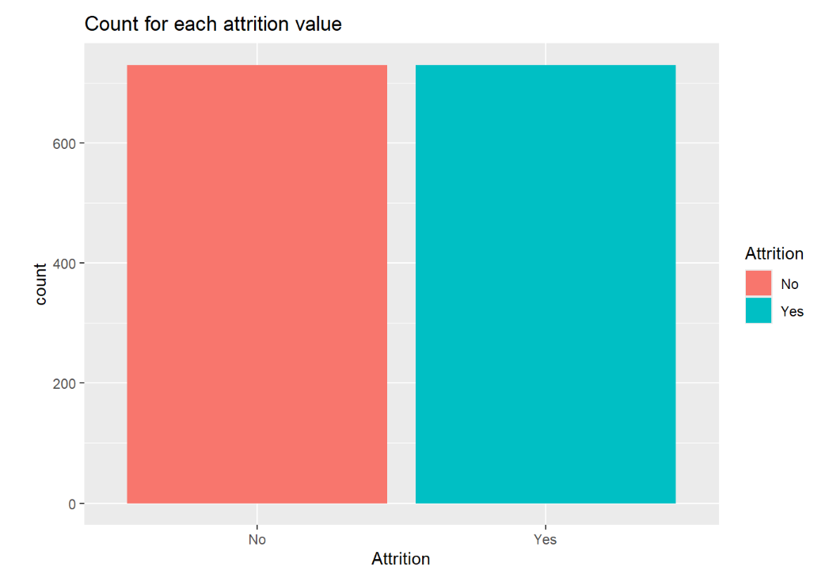
2. Tidying the data
Imbalance detected in attrition
OVERSAMPLING!
 | No | Yes
Count | 730 | 140
Perc. | 84% | 16%
 | No | Yes
Count | 730 | 730
Perc. | 50% | 50%

Slide 5
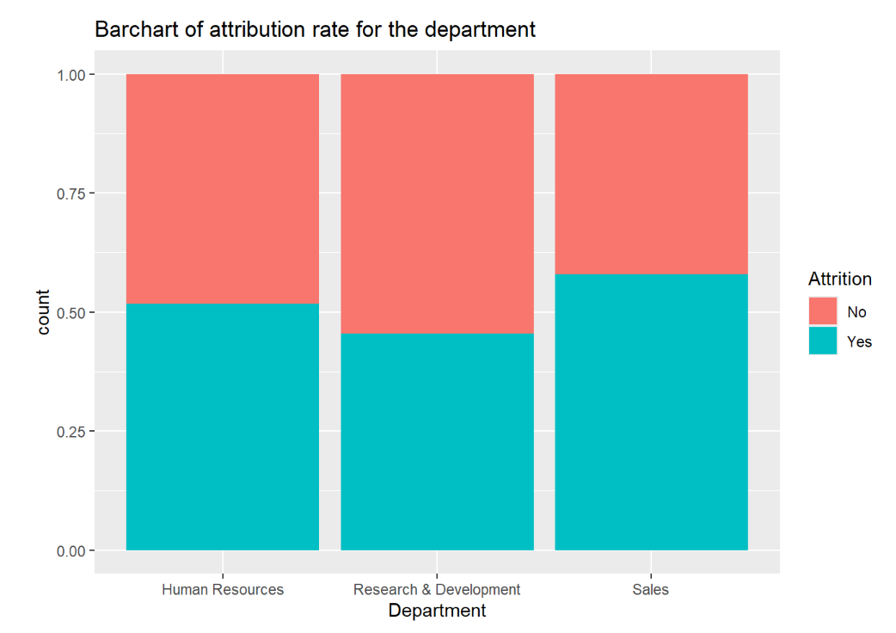
3. Data analysis
Question of interest 1 : Department
Does Department have to do with attrition?

Slide 6
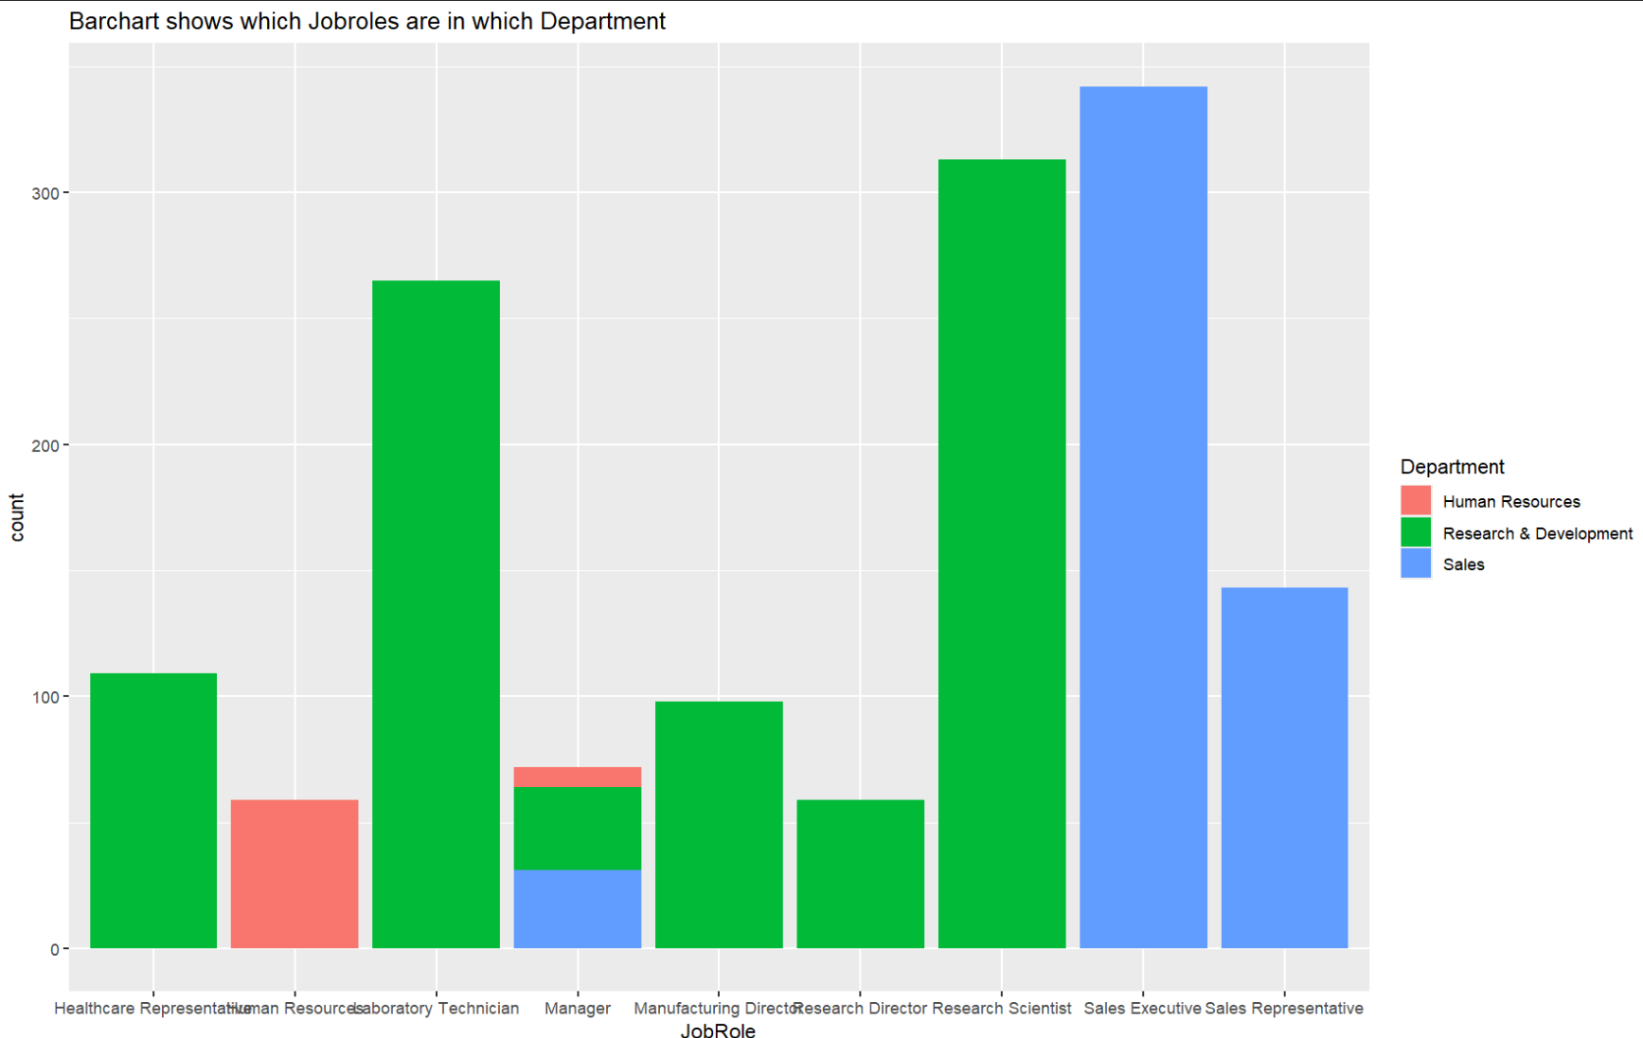
3. Data analysis
Question of Interest 2 : Job Role
Department | Job roles
Sales | Sales Executive Representative
Human resources | Human resources
Research & Development | Healthcare Representative Laboratory Technician Manufacturing Director Research Director Research Scientist.
All three Departments | Manager

Slide 7
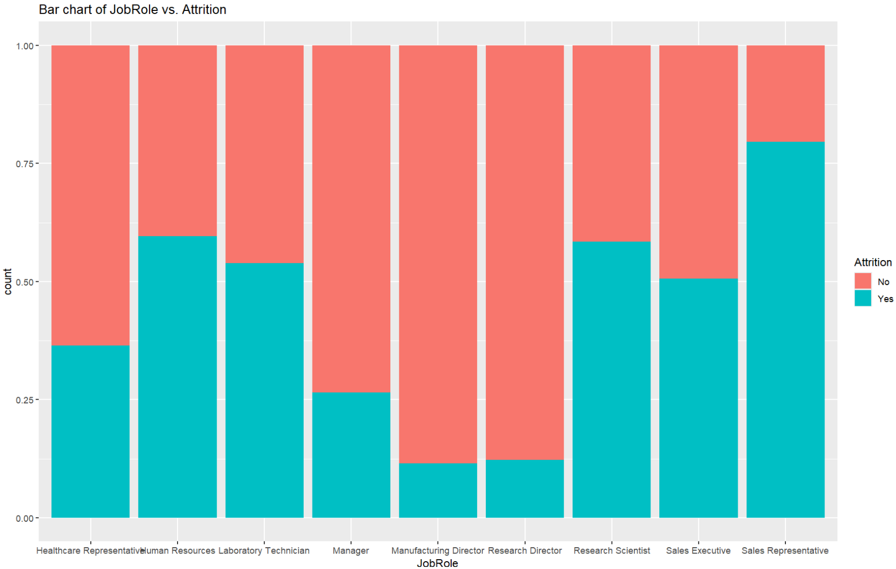
3. Data analysis
Question of Interest 2 : Job Role & Attrition
Department | Job roles
Sales | Sales Executive Sales Representative
Human resources | Human resources
Research & Development | Healthcare Representative Laboratory Technician Manufacturing Director Research Director Research Scientist.
All three Departments | Manager

Slide 8
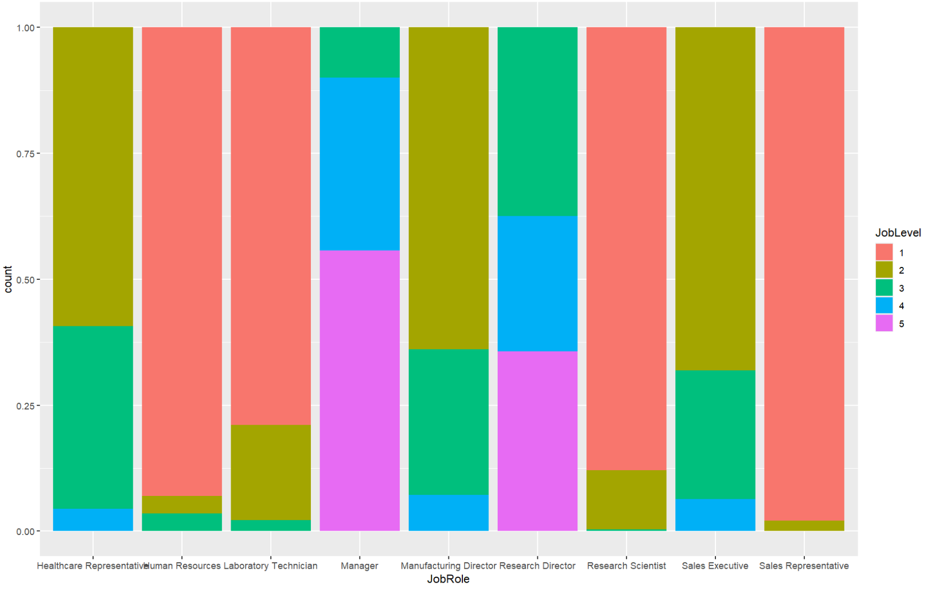
3. Data analysis
Question of Interest 3 : Job Level
Department | Job roles
Sales | Sales Executive Sales Representative
Human resources | Human resources
Research & Development | Healthcare Representative Laboratory Technician Manufacturing Director Research Director Research Scientist.
All three Departments | Manager

Slide 9
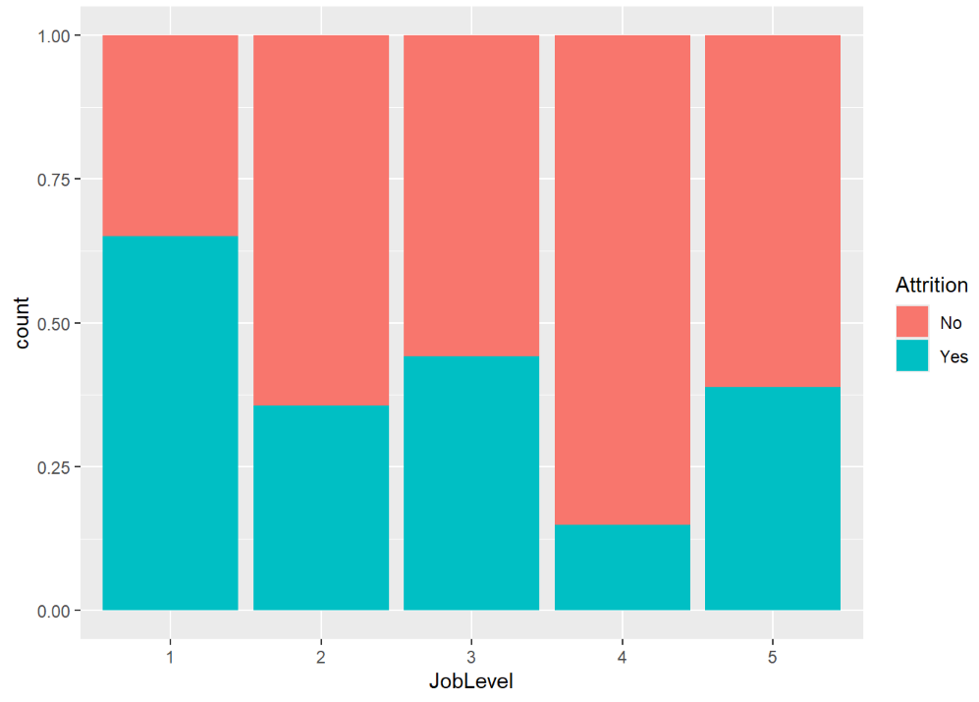
3. Data analysis
Question of Interest 3 : Job Level
Level 1: has the highest attrition rate

Slide 10
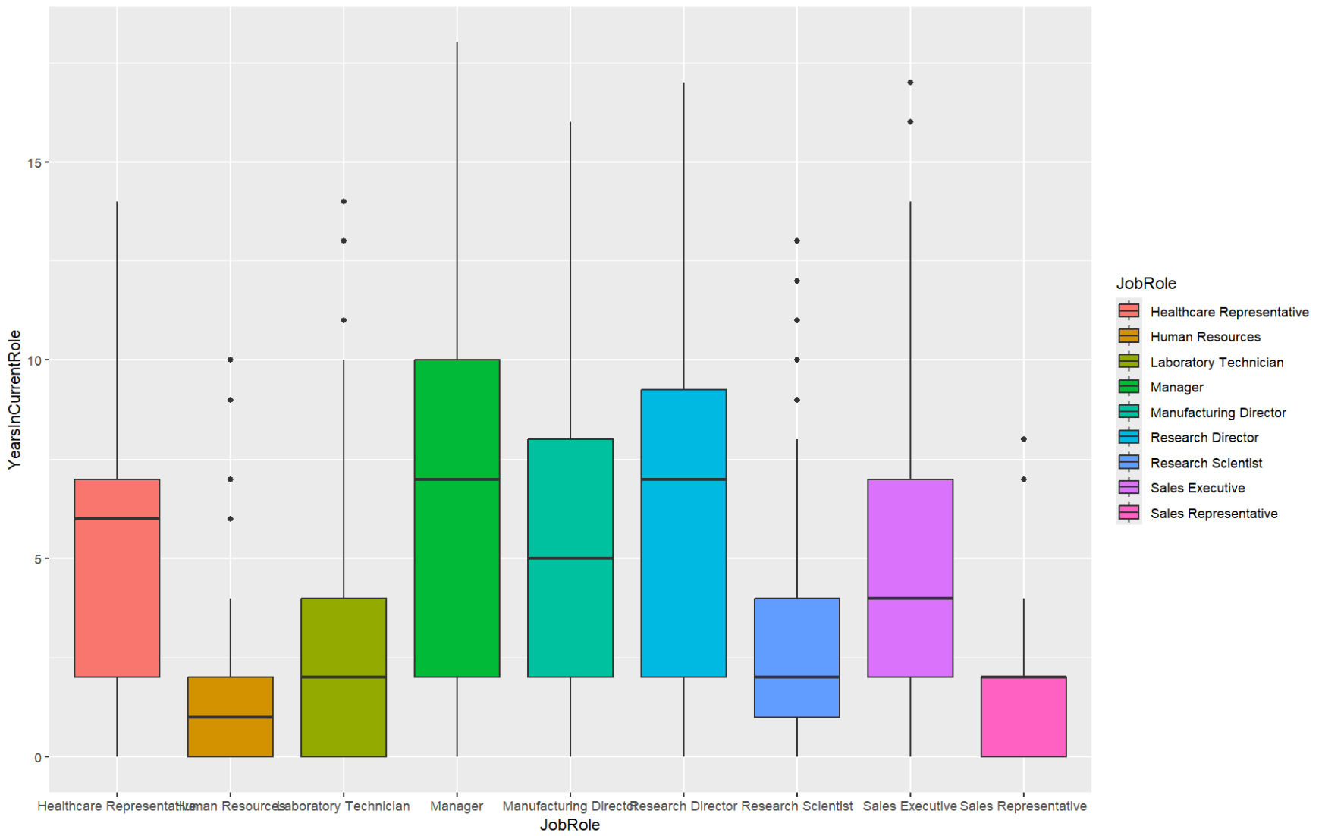
3. Data analysis
Question of Interest 4 : Years In Current Role
Department | Job roles
Sales | Sales Executive Sales Representative
Human resources | Human resources
Research & Development | Healthcare Representative Laboratory Technician Manufacturing Director Research Director Research Scientist.
All three Departments | Manager

Slide 11
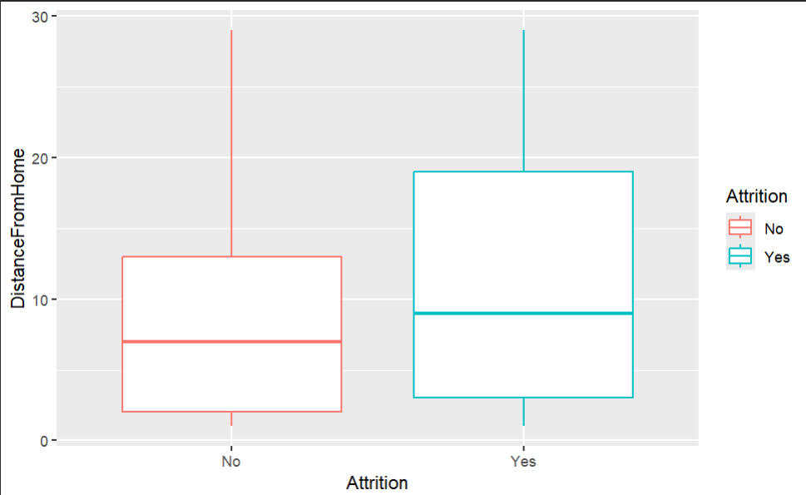
3. Data analysis
Another Factor to consider: Distance from home
The median of ‘yes’ is higher.
The 50% of distribution of yes is larger.

Slide 12
3. Data analysis
Conclusion:
Three factors
[ 1 ]
[ 2 ]
[ 3 ]
Job role
Job Level
Distance
From
Home

Slide 13



4. Prediction model
<Naïve bayes Model>
With three factors Job Role, Job Level and Distance From Home
Observation
Statistic | Probability
Accuracy | 71.51%
Sensitivity | 71.28%
Specificity | 71.75%
 | No | Yes
No | 139 | 48
Yes | 56 | 122
Calssification
Accuracy =$\frac{(139+122)}{(139+48+56+122)}$
Sensitivity =$\frac{(139)}{(139+56)}$
Specificity =$\frac{(122)}{(48+ 122)}$

Slide 14
Overall Conclusion
Human Resources and sales department show higher attrition.
Job Roles with the lower level tend to leave the company.
The median of distance from home was greater for the group who left company.
With three factors which are job role, job level and distance from home, we were able to achieve over 70% for accuracy, sensitivity and specificity.

Slide 15
Thank You!

