Slide 1
Assignment

Slide 2
Case Study : E-Commerce app
Buyer - Profile page
Buyer - Delivery address page
Buyer - Catalogue page
Buyer - Purchase history page
Buyer - Wishlist page
Buyer - Active transaction page
Seller - Store profile page
Seller - Product page
Seller - Purchase report page
Seller - Market insight (e.g. most purchased item in the e-commerce)
Seller - Active transaction page
Currency page (https://free.currencyconverterapi.com/)
News page (https://newsapi.org/s/indonesia-news-api)

Slide 3
To-Do
Create functional requirements (Meeting #13)
Create technical requirements (Meeting #13)
Create UI/UX design (Meeting #14)
Create test scenario (Meeting #14)
Develop prototype (Meeting #15)

Slide 4
Guideline
It’s a group assignment (4 people)
Work with other teams
Define assumptions and/or out-of-scope when creating requirements
Be open and creative
Use dummy data for development

Slide 5
Guideline
Form a group
Each group to send email with a list of group member to otniel.y.viktorisa@gmail.com
Task will be assigned based on time of arrival (first come first serve)

Slide 6
Guideline
Clone class repo
Create new branch (branch name = feature name)
Put task files on the branch

Slide 7
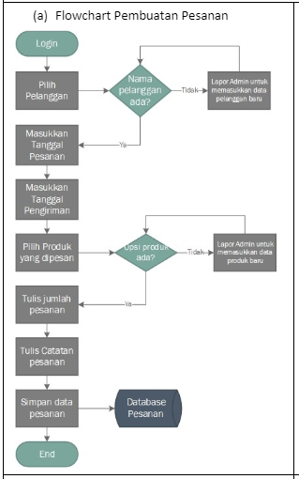
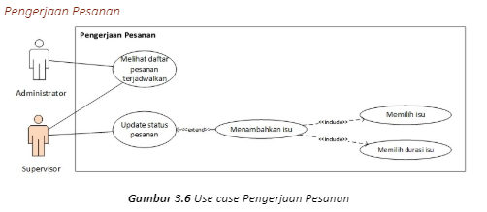
Functional requirements
What user can do
Feature specification
Diagram (e.g. use case diagram, flowchart)

Slide 8
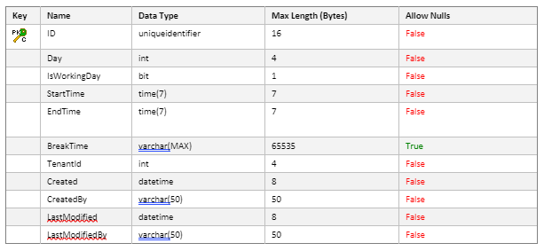
Technical requirement
Data model
API design

Slide 9
UI/UX design
Wireframe
Tools : Figma, Pencil, etc

Slide 10
Test scenario
Given <condition>, when <action>, then <result>
Cover both positive and negative scenario

