Slide 1

DFD & Flowchart
Otniel Y. Viktorisa

Slide 2
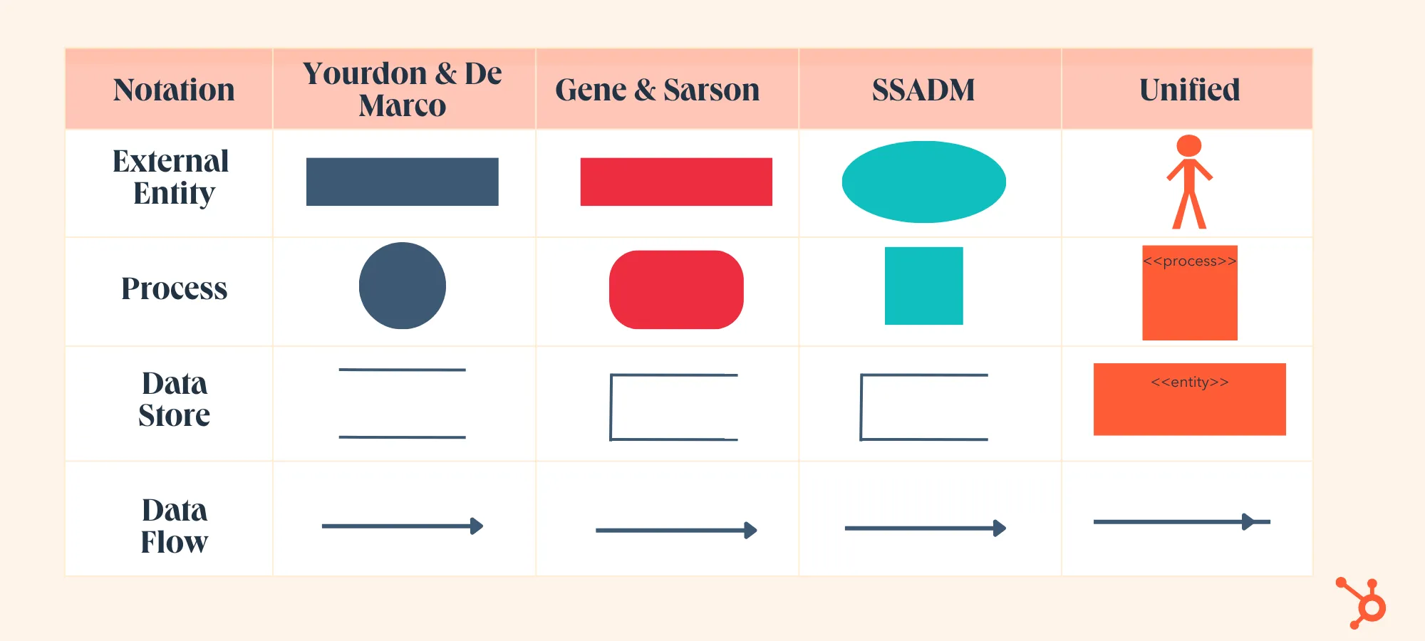
Data flow diagram
Visualize the flow of the data in the system
Originated from activity diagram used in the structured analysis and design technique methodology
Multi-level diagram
Source : https://blog.hubspot.com/marketing/data-flow-diagram

Slide 3
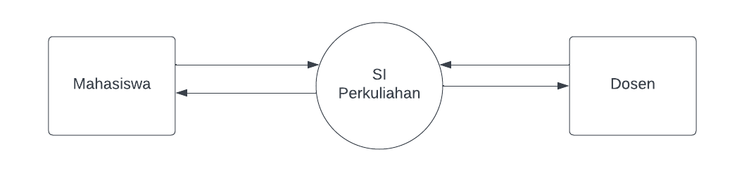
DFD Context

Slide 4
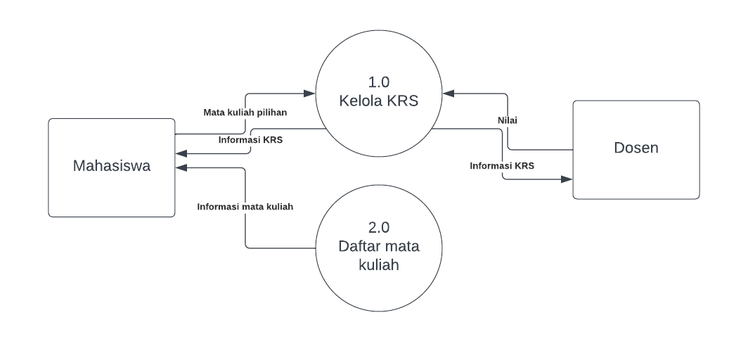
DFD Level 1

Slide 5
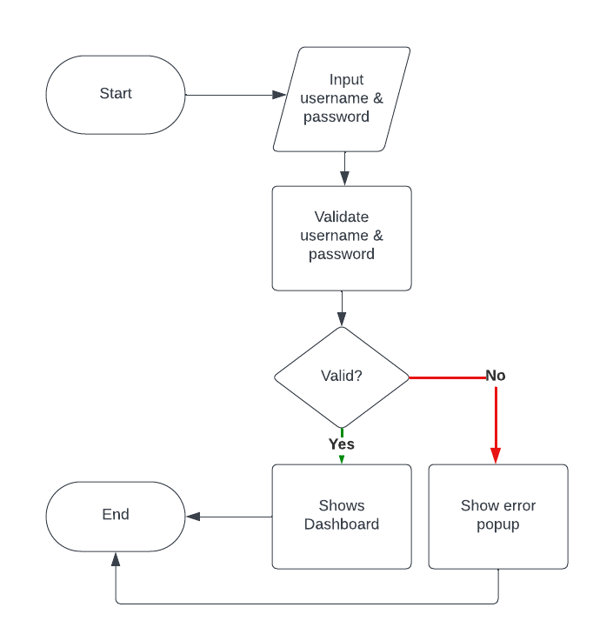
Flowchart
Visualize process, system, or algorithm

