Slide 1
Food Delivery Logistics Platform
By Øyvind Hauge

Slide 2
Introduction
A platform for delivery companies and restaurants
Restaurants display their menu in the system, while delivery companies transport orders from restaurants to the end-users
Special offers are made available to end-users based on currently active routes that delivery personnel travel
System consist of a backend, an admin dashboard and an iOS app

Slide 3
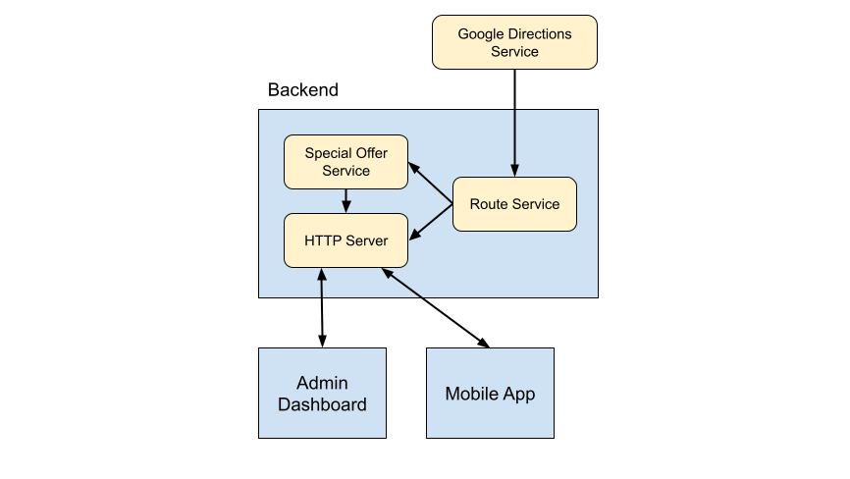
High-level Architecture

Slide 4
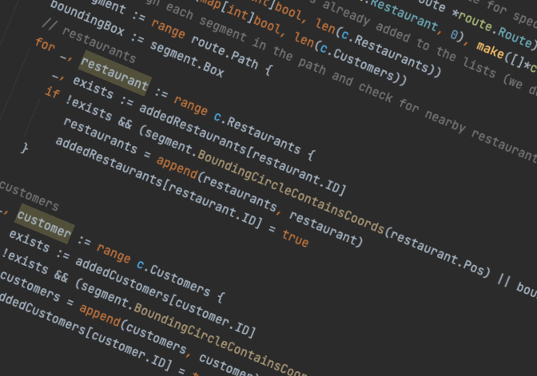
Backend
Made using Go (https://golang.org/)
The main part of the system. Handles all the business logic.
Handles orders, calculates routes for transportation personnel as well as the calculation of special offers
Communicates with the Google Directions service
Serves data to clients (mobile app and admin dashboard)

Slide 5
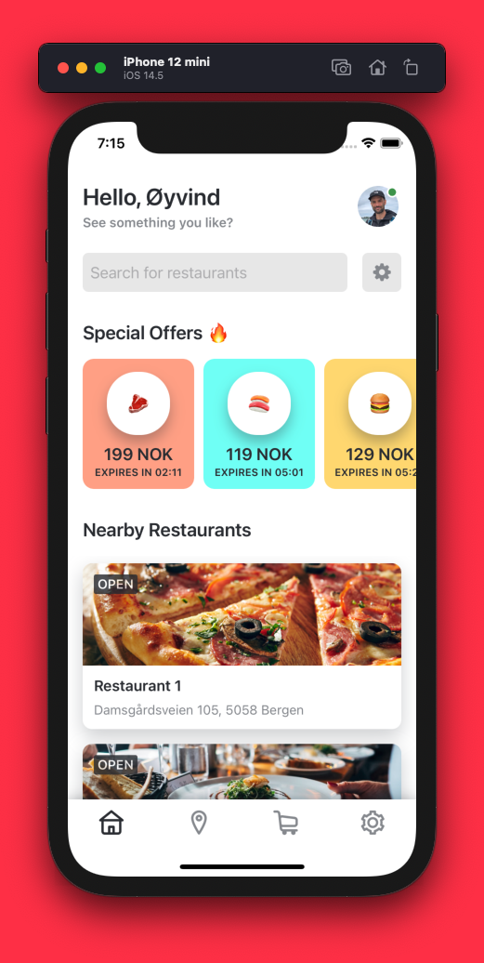
Mobile App
iOS app made using Swift
Works on all moderns iPhones and iPads
End-users are able to browse menus of nearby restaurants, place orders and view active orders

Slide 6
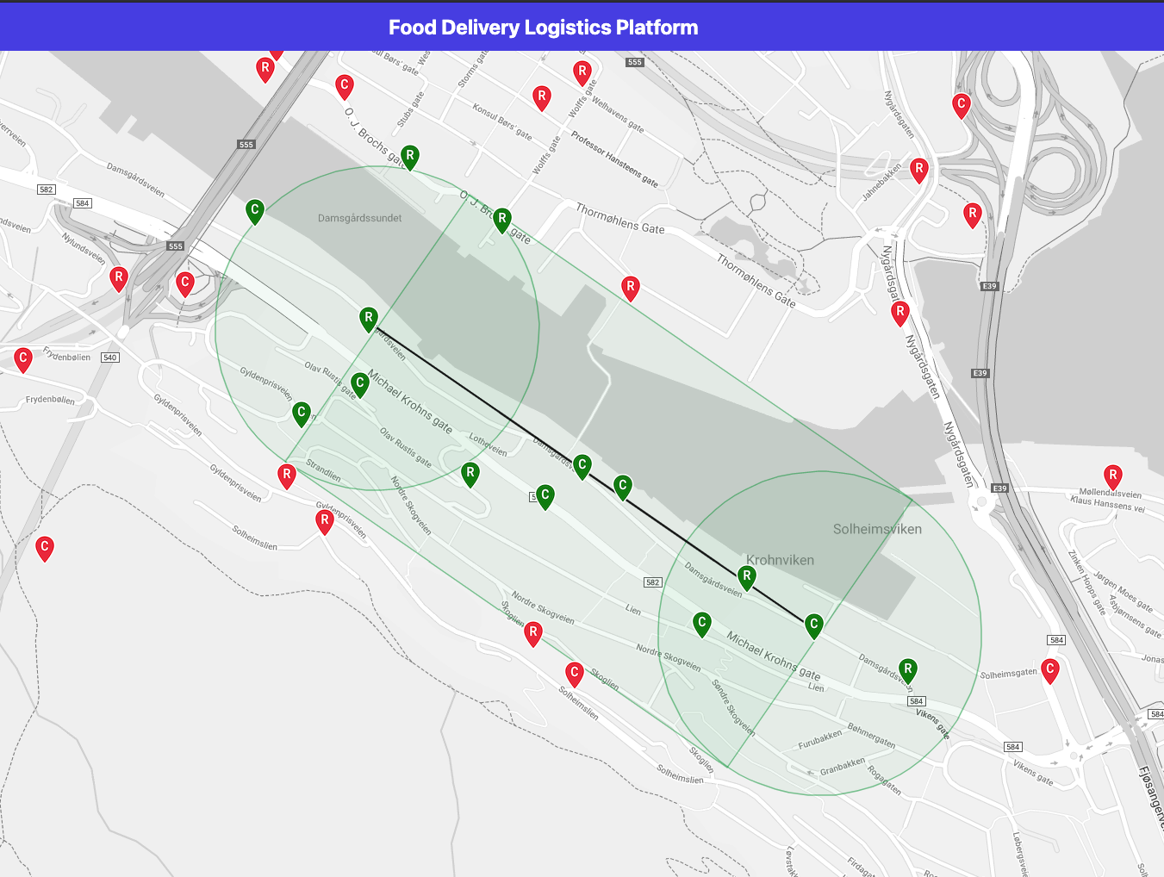
Admin Dashboard
Written using HTML/CSS and JavaScript
Uses WebSockets for real-time data
Meant for administrators of the platform
Shows all restaurants and customers on a map
Provides a visual representation of all active routes including special offers

Slide 7
Demonstration!

