Slide 1
Parse.com
One backend to rule them all

Slide 2


Slide 3
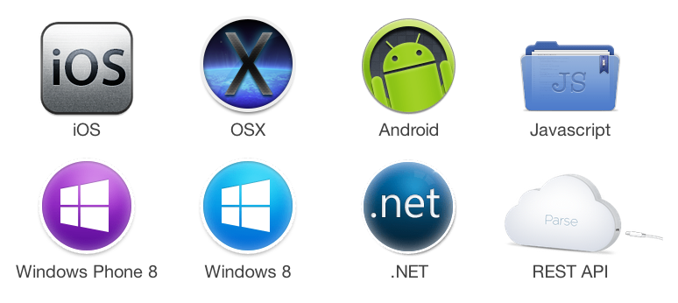

Slide 4

60.000 apps

Slide 5


Slide 6




Parse Data
Parse Push
Parse Social
Cloud Code

Slide 7
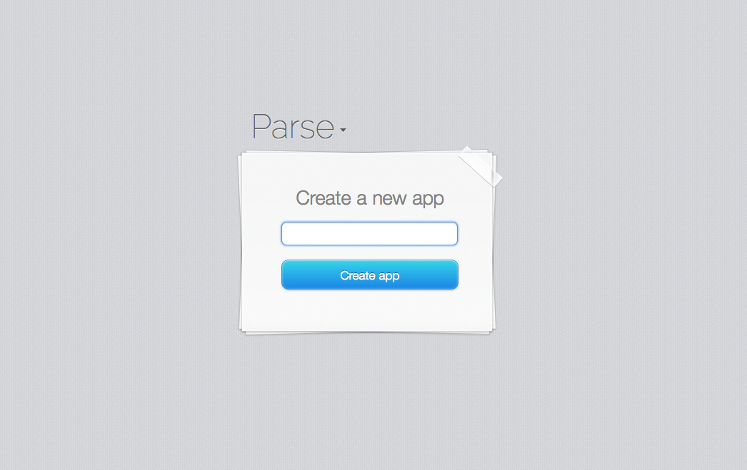

Slide 8
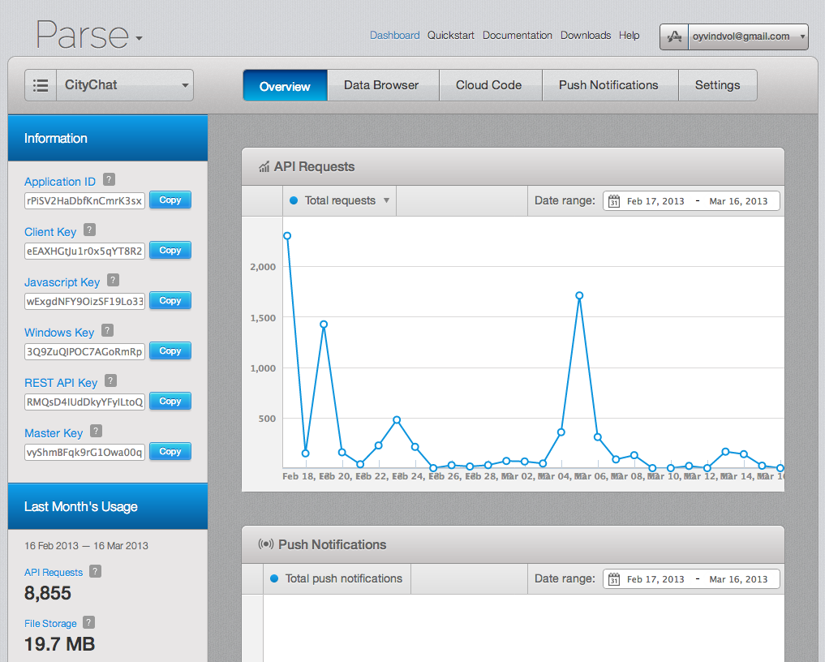

Slide 9
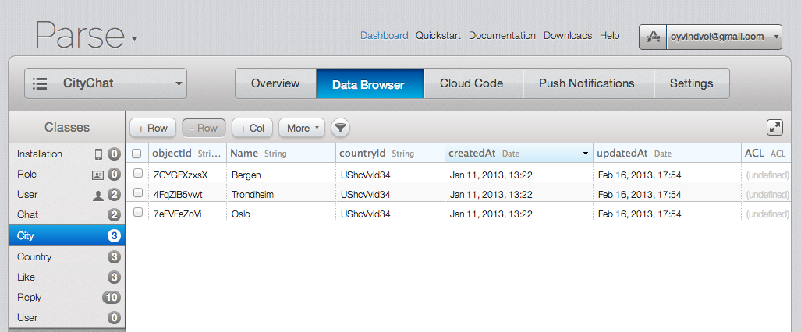

Slide 10
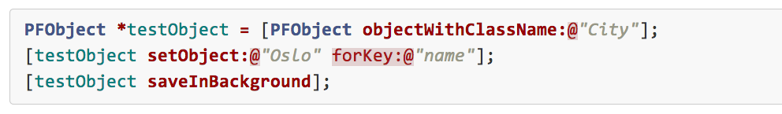
Saving

Slide 11
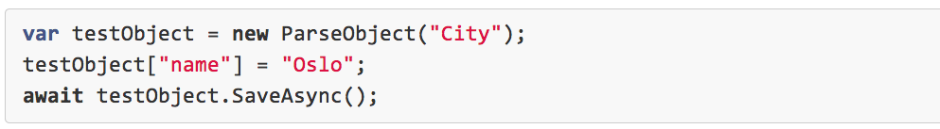
Saving – C#

Slide 12
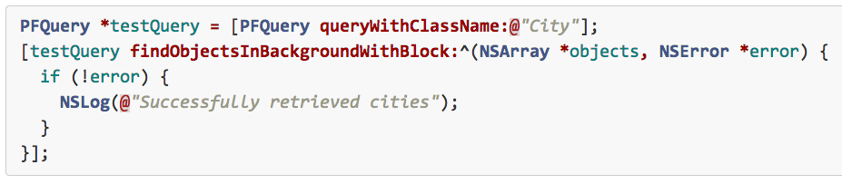
Retrieving

Slide 13
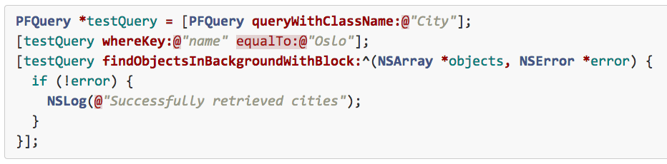
Retrieving – with constraints

Slide 14
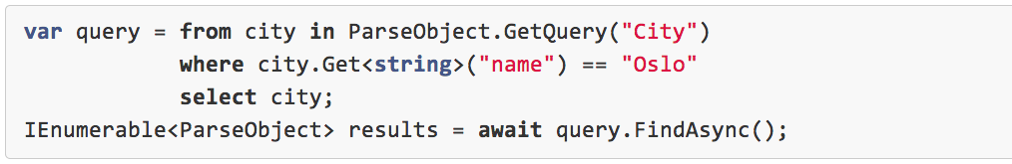
Retrieving – C#

Slide 15
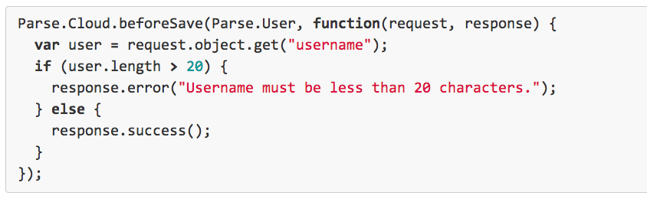
Cloud Code

Slide 16
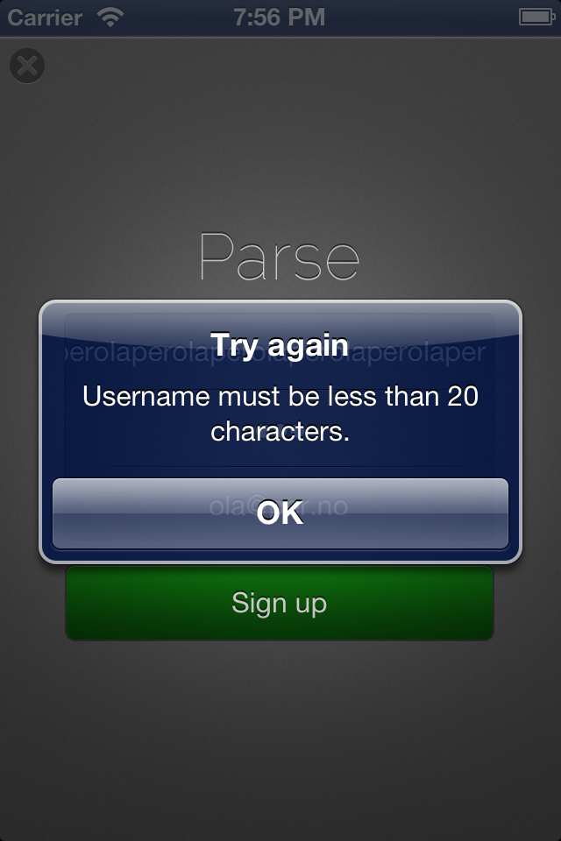

Slide 17
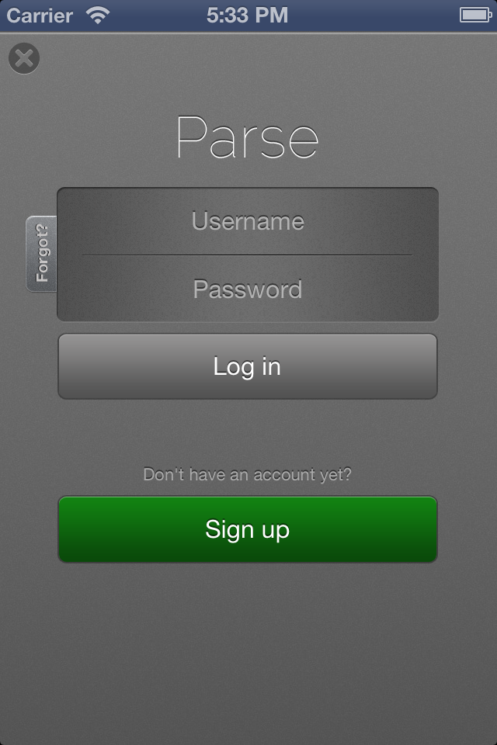

Slide 18
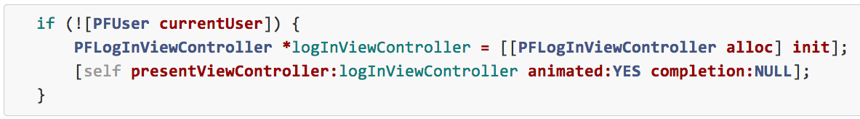
PFLogInViewController

Slide 19
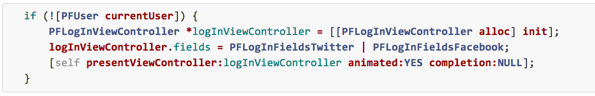
Facebook & Twitter

Slide 20
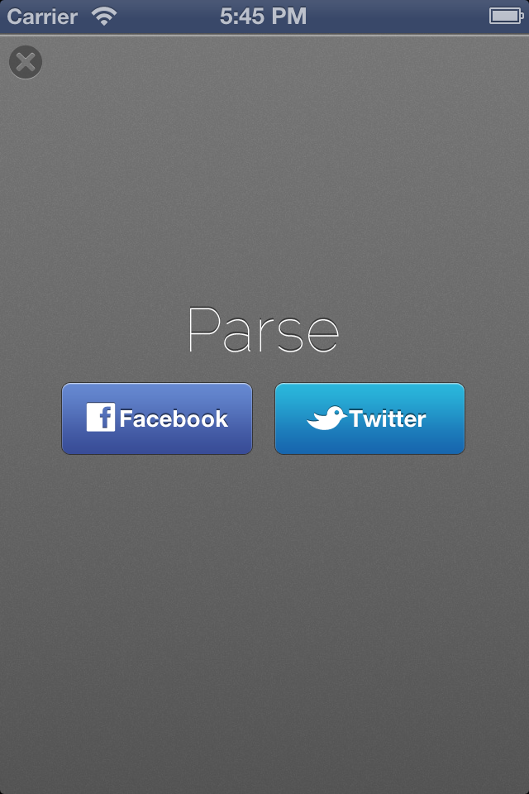

Slide 21
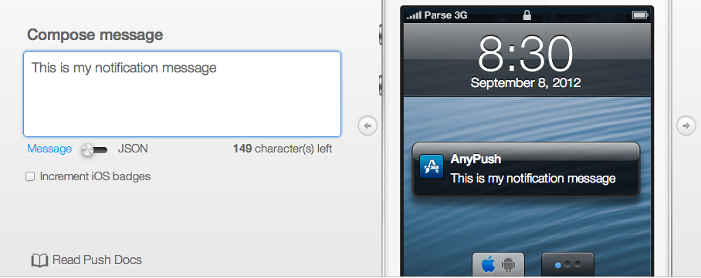
Push Console

Slide 22
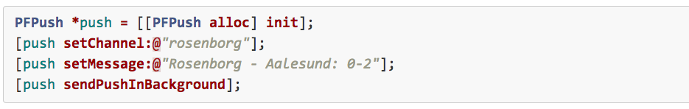
Push + App

Slide 23
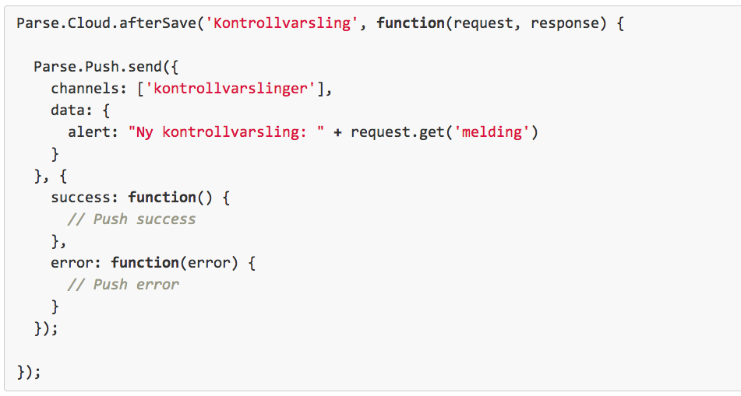
Push + Cloud Code

Slide 24

Øyvind Voldsund @oyvindvol

