Slide 1

(1) How age, sex, region, smoke, relate with American hospital charges.
(2) How smoke relates with American bmi
Team-21
Xixiang Ouyang
Yanbo Yuan

Slide 2
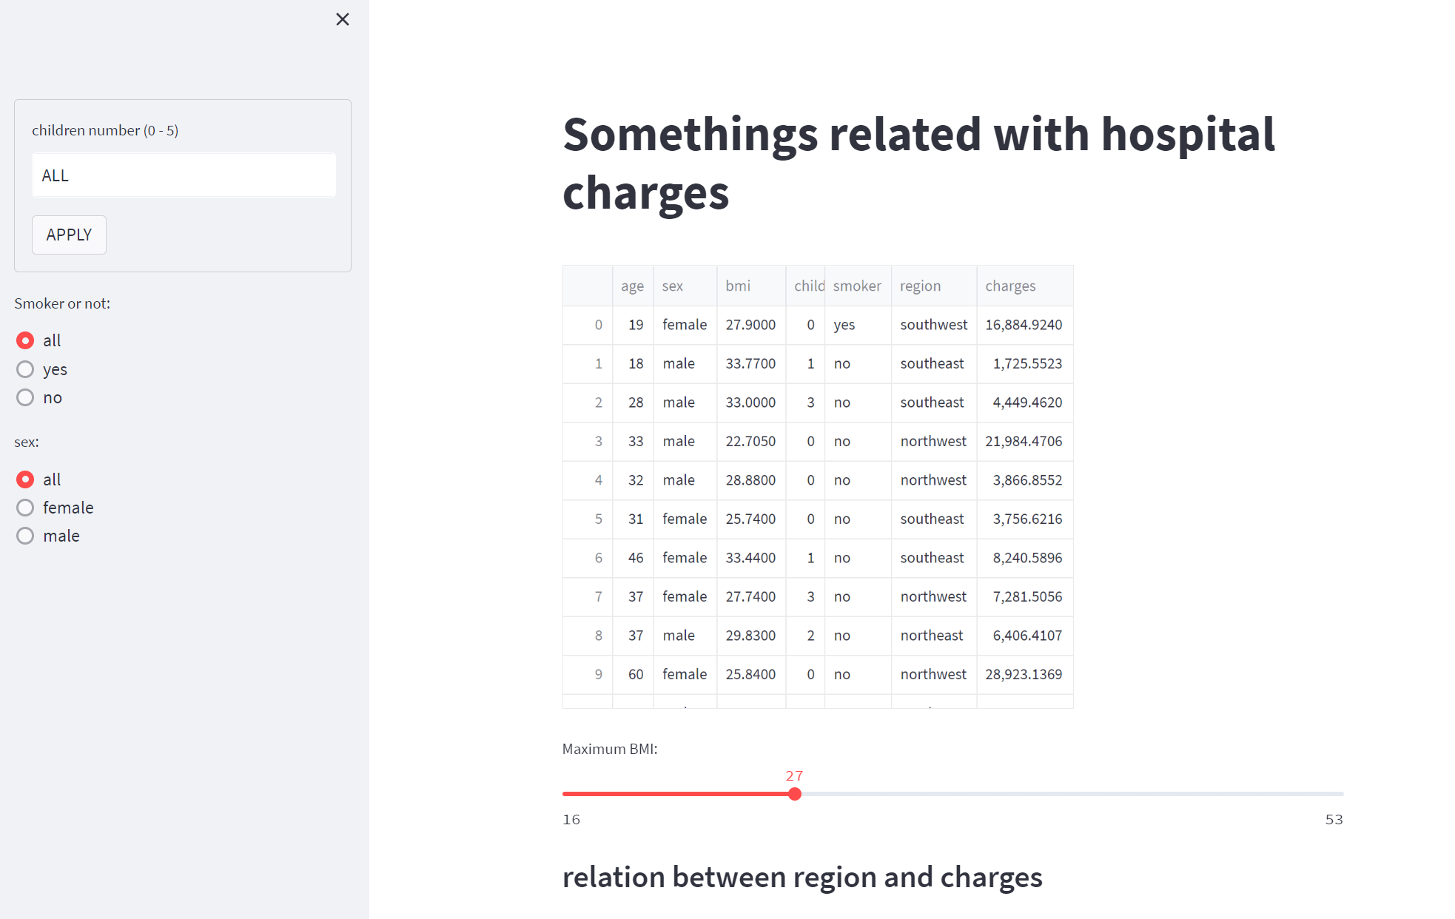
Data set & page

Slide 3
How we get solution
Keep irrelevant variables consistent
(2) Adjust target variables
(3) Analysis

Slide 4
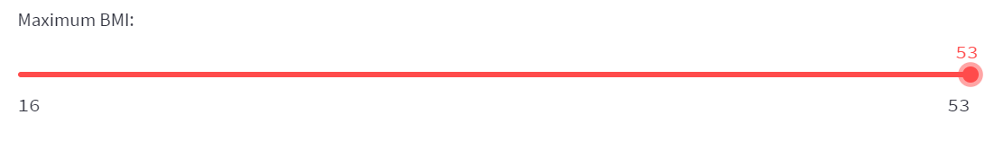
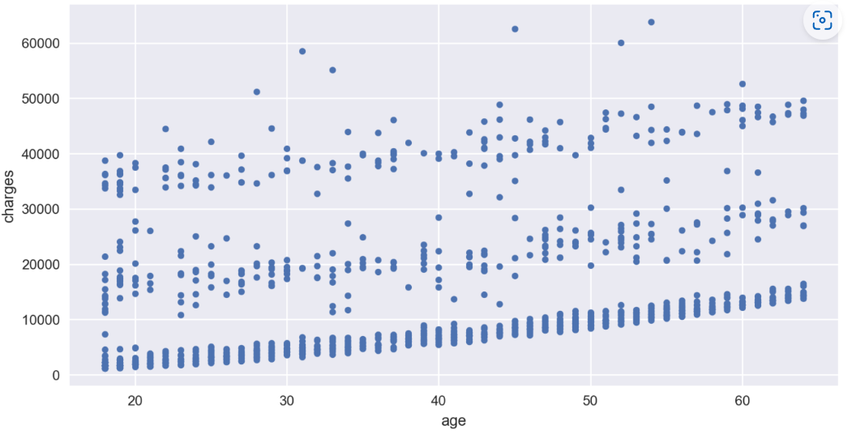
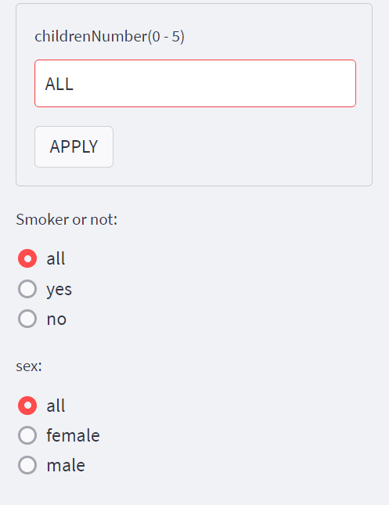
How age relates with hospital charges
situations
Output
It is easy to see that when the age get older, the more hospital charges will be made

Slide 5
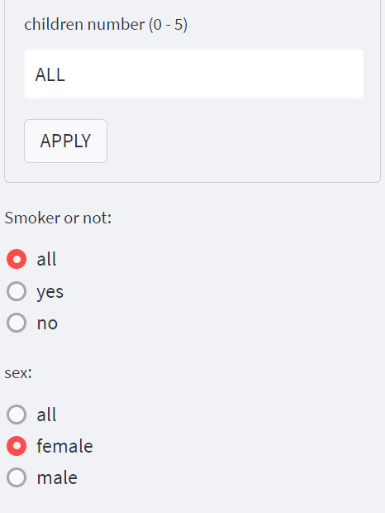
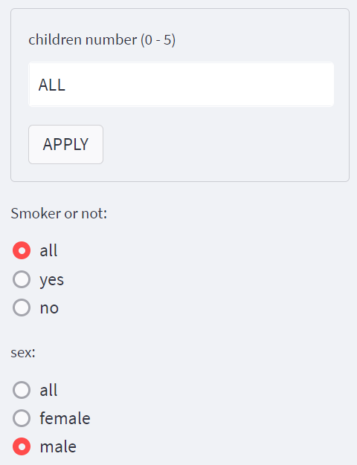
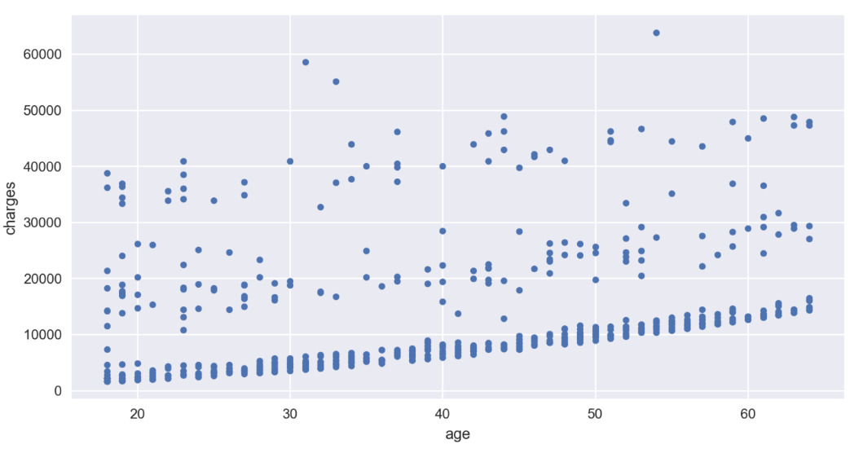
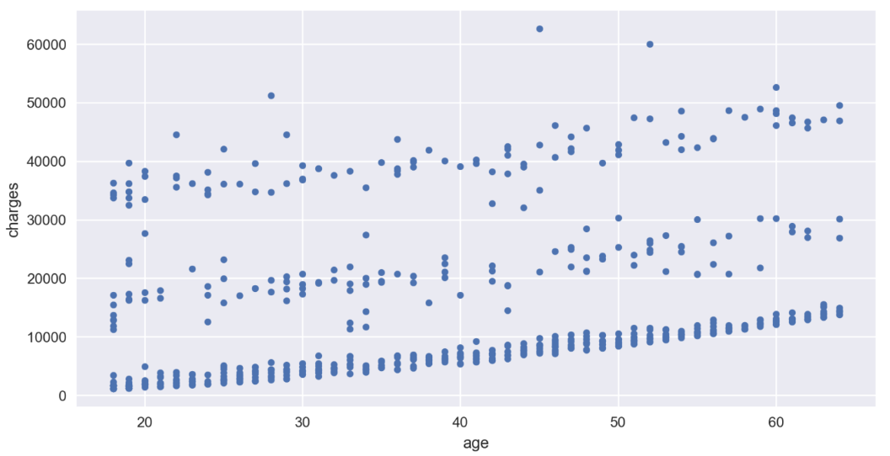
How sex relates with hospital charges
Situation(1)
Situation(2)
Output(1)
Output(2)
Number of male and female who’s hospital charges less than 20,000 are almost the same. But the number of male who spend hospital charges more than 30,000 are much more than female

Slide 6
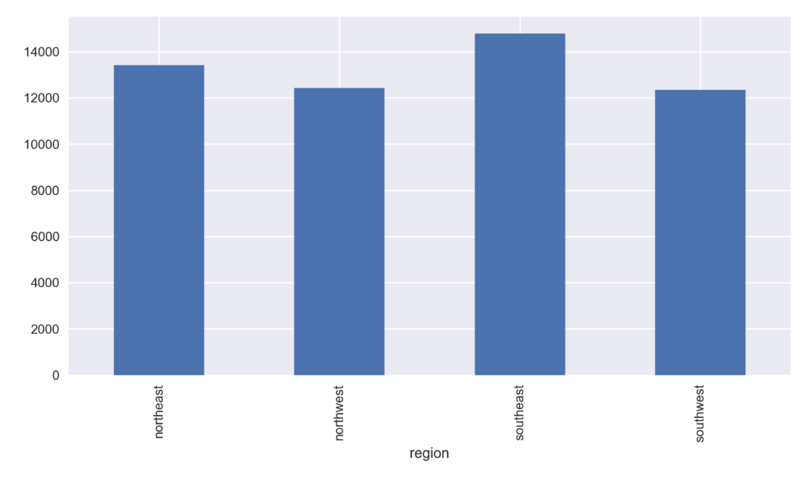
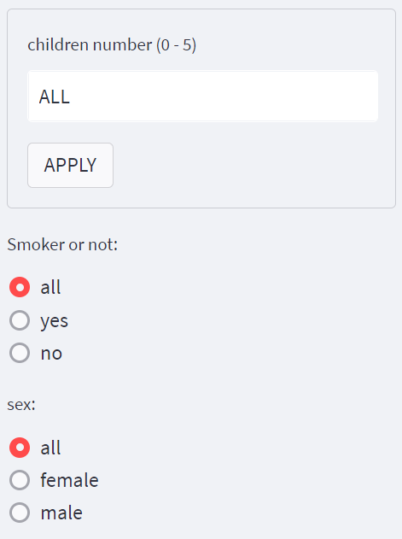
How region relates with average hospital charges
Situations
Output
The biggest average hospital charge is people live in southeast, the lowest average charge is people live in southwest. And the average charge of northwest is almost the same to the average of southwest

Slide 7
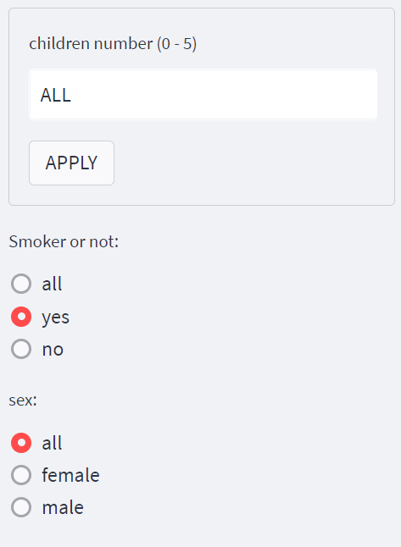

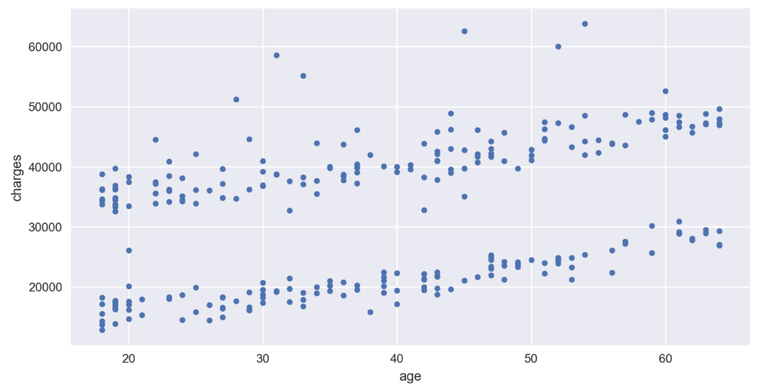
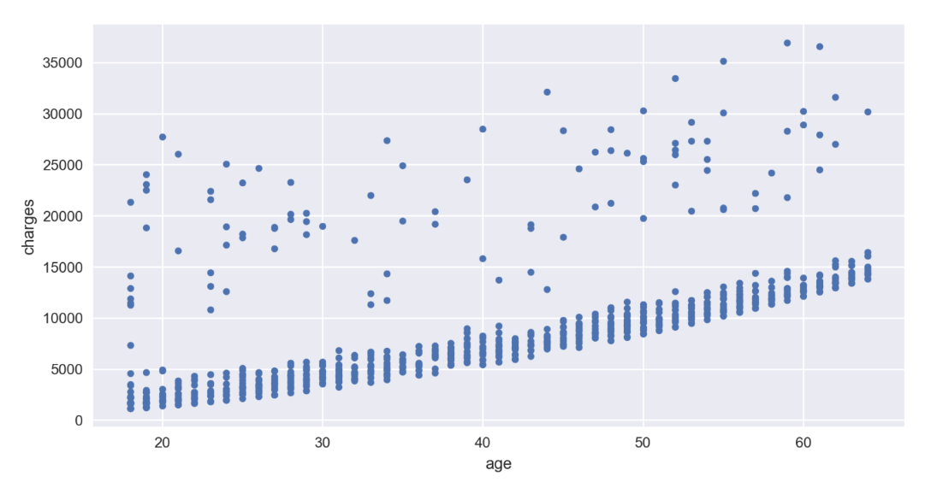
How smoke relates with hospital charges
Situations(1)
Situations(2)
Output(1)
Output(2)
The ratio of pay a lot of hospital charges in smokers is much more than the non-smokers

Slide 8
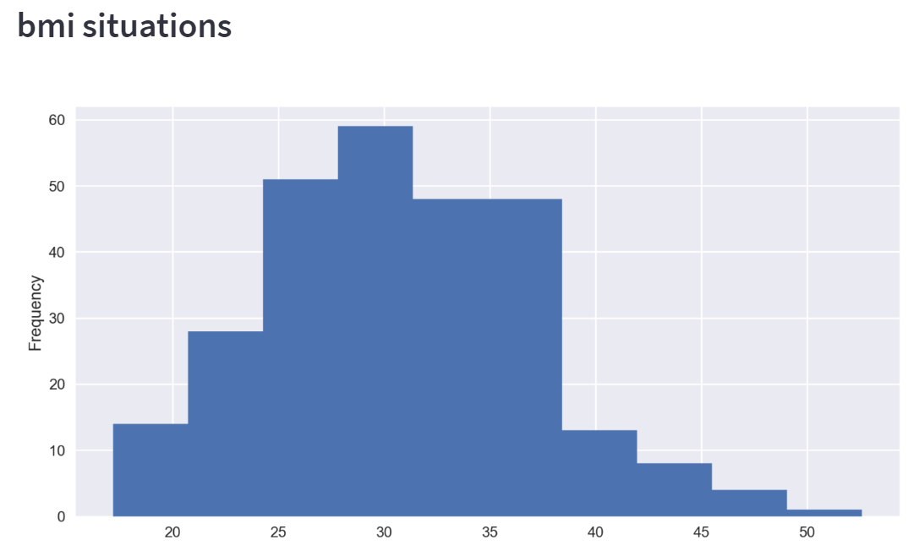
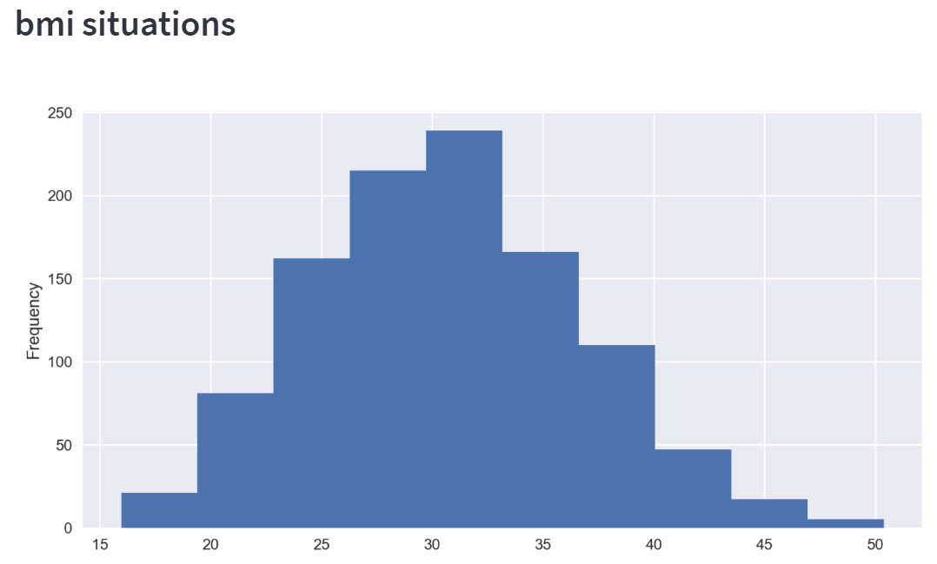
How smoke relates with bmi
Situations(1)
Situations(2)
Output(1)
Output(2)
Smokers are more likely to have a high bmi index

