Slide 1
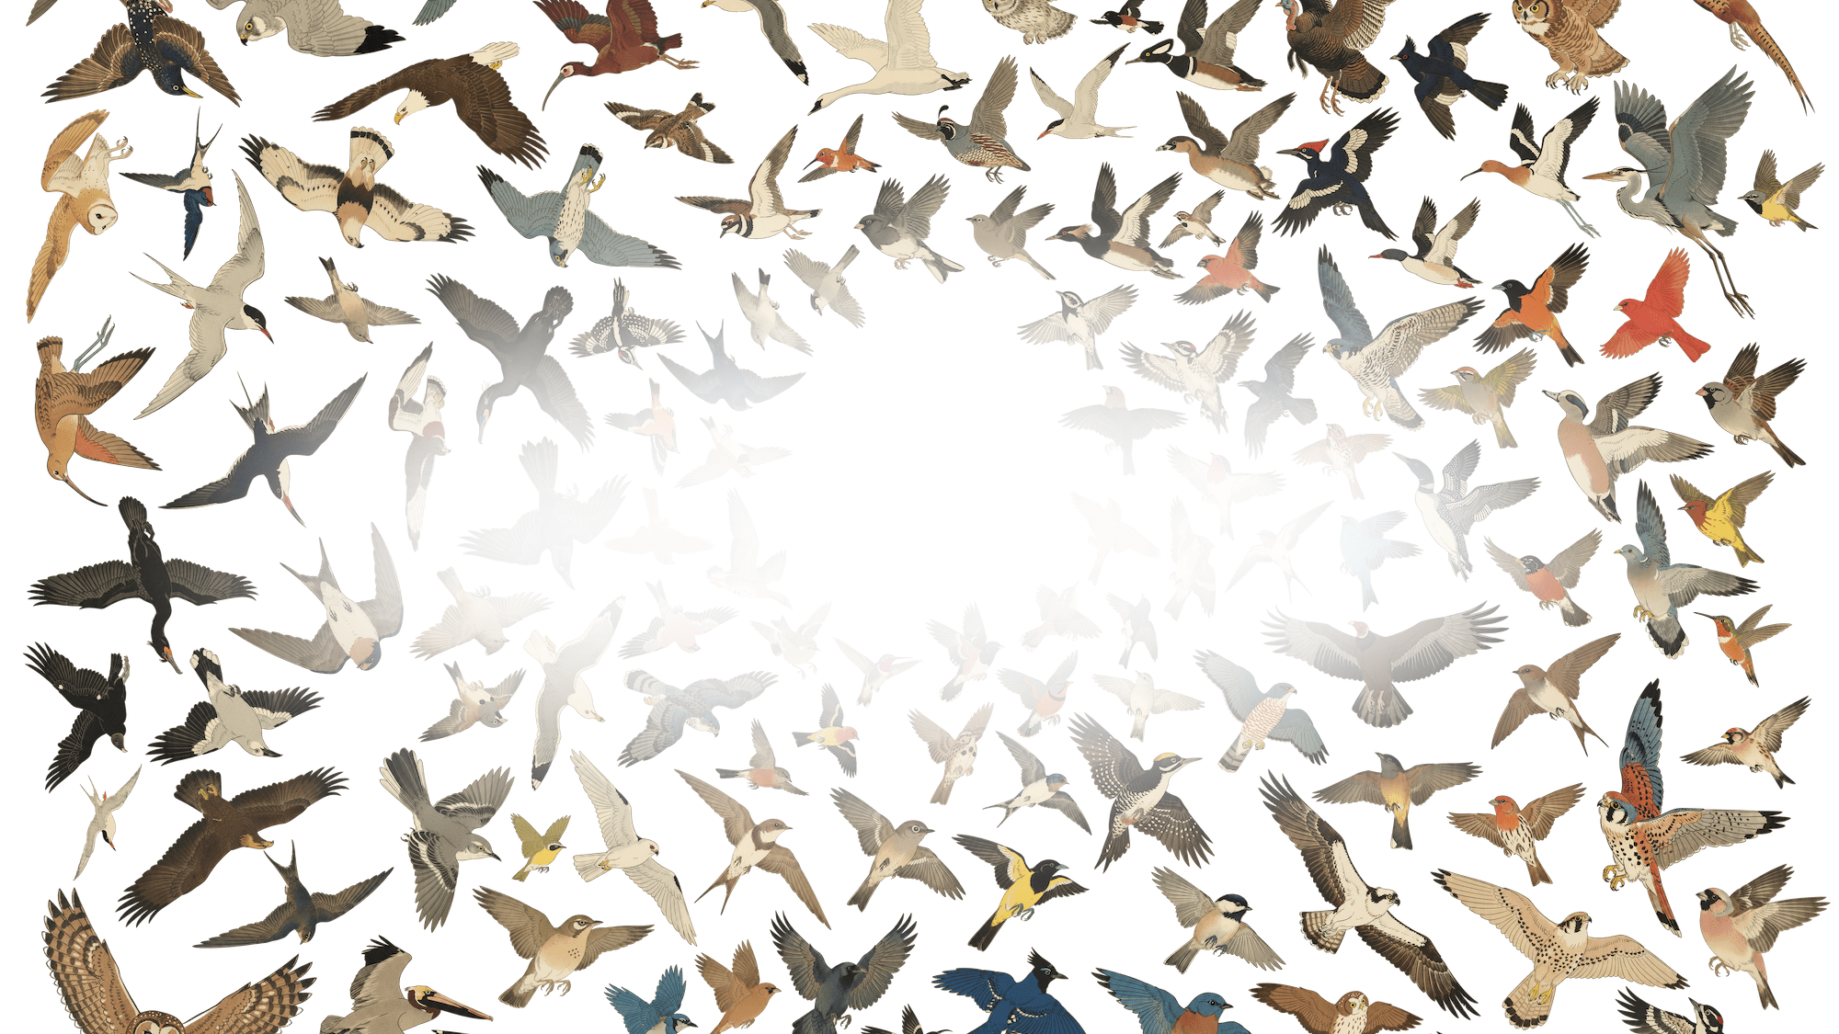

CIJE · GETTING STARTED
From Box to Branch
Setting up your CIJE Birdwatcher, from unboxing to your first AI-powered sighting
Self-paced · about 60 minutes · DFR1154 ESP32-S3

Slide 2



THE HARDWARE
What's inside your Birdwatcher
One small board carries everything: eyes, ears, a voice, and a line to OpenAI.
ON THE BOARD
IN THE CLOUD
Hardware
AI capabilities
ESP32-S3R8
Dual-core 240MHz + 8MB PSRAM
GPT-4 Vision
Identifies birds & analyzes images
OV3660 Camera
160° wide-angle, infrared capable
Whisper STT
Speech-to-text from the mic
PDM Microphone
Built-in I2S digital mic
TTS Playback
OpenAI text-to-speech via speaker
MAX98357 Amp
I2S speaker output for TTS audio
Live Streaming
Real-time camera feed in browser
SD Card Slot
Expandable media storage
Gallery Manager
Timestamped SD card file system
16MB Flash
Ample firmware + asset storage
Export Packages
Download analysis + media bundles
Under the hood: a $35 board plus OpenAI's cloud. A complete AI birdwatcher in the palm of your hand.

Slide 3
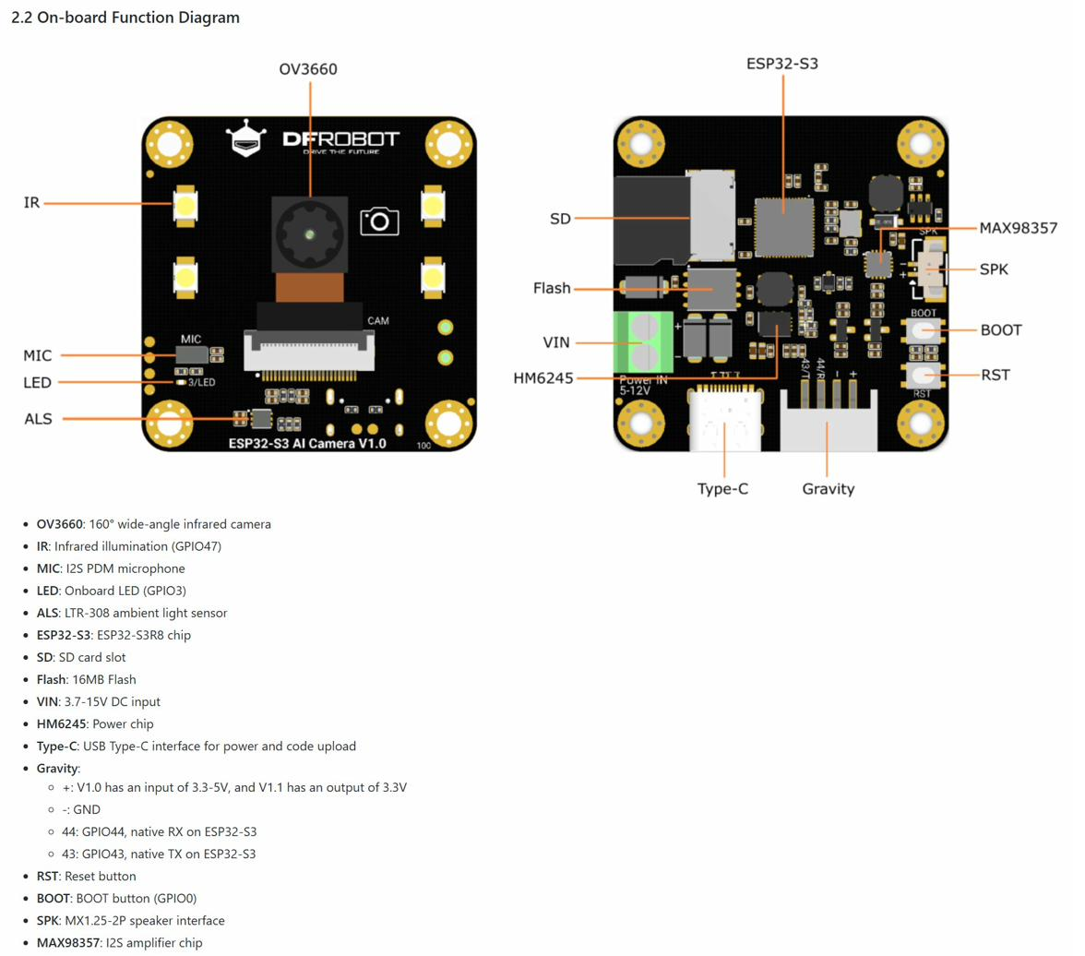
THE BOARD
Every port and sensor, at a glance
OV3660 Camera
160° wide-angle lens, IR capable
PDM Microphone
GPIO 38/39, I2S interface
MAX98357A Speaker
I2S amplifier, GPIO 45/46/42
IR Illumination
GPIO 47, for low-light imaging
ALS Sensor
LTR-308 ambient light, GPIO 8/9
SD Card Slot
Up to 16GB, SPI interface
Type-C USB
Power input + code upload port
Gravity Connector
GPIO 43 (TX) / 44 (RX) for Arduino
One USB-C cable does it all: power, firmware upload, and the serial monitor.

Slide 4



BEFORE YOU START
What you need
REQUIRED HARDWARE
SOFTWARE SETUP
ACCOUNTS & KEYS
DFR1154 module (your Birdwatcher)
USB-A to USB-C data cable
Laptop (Windows, Mac, or Linux)
WiFi network with internet access
Optional: AI Camera tripod kit
Optional: small speaker (MX1.25-2P)
Arduino IDE 2.x (free download)
ESP32 board package by Espressif
ArduinoJson library v7.4.2+
Board: ESP32S3 Dev Module
USB CDC On Boot: Enabled
PSRAM: OPI PSRAM
OpenAI account (platform.openai.com)
Personal OpenAI API key (sk-...)
API credits (a few dollars is plenty)
WiFi SSID + password (home or school)
GitHub account (optional)
SD card 8–32GB, FAT32 formatted
Estimated cost: board ~$35 | analysis ~$0.05–0.10 per request | Arduino IDE free

Slide 5
REFERENCE
GPIO pin cheat sheet
Bookmark this page. You will not need it during setup, but it earns its keep the day you start extending the firmware.
CAMERA (OV3660)
MIC (PDM)
SPEAKER
SD CARD
OTHER
XCLK
5
VSYNC
1
CLK
38
BCLK
45
MO
11
LED
3
Y9
4
HREF
2
DATA
39
LRCLK
46
MI
13
IR
47
Y8
6
PCLK
15
DIN
42
SCLK
12
BOOT
0
Y7
7
SIOD
8
GAIN
41
CS
10
TX
43
Y6
14
SIOC
9
MODE
40
RX
44
Camera and audio share I2S_NUM_0, so they cannot run at the same time. Recording briefly pauses the stream. That is by design.

Slide 6

STEP 01 · ARDUINO IDE
1
Point Arduino at the ESP32
Three one-time setup moves in Arduino IDE 2.x. You will never repeat these.
A. BOARD MANAGER
B. BOARD SETTINGS (TOOLS MENU)
C. LIBRARY
1
Open File > Preferences
Board
ESP32S3 Dev Module
2
Add to Additional Boards Manager URLs:
USB CDC On Boot
Enabled
ArduinoJson
by Benoit Blanchon
v7.4.2 or newer
raw.githubusercontent.com/espressif/
arduino-esp32/gh-pages/package_esp32_index.json
Flash Size
16MB (128Mb)
Tools > Boards Manager: install esp32 by Espressif Systems
Partition
16M (3MB APP/9.9MB FATFS)
3
Sketch > Include Library > Manage Libraries
PSRAM
OPI PSRAM
Install timing out? Add connection_timeout: 600s under network: in arduino-cli.yaml, restart the IDE, and retry.

Slide 7

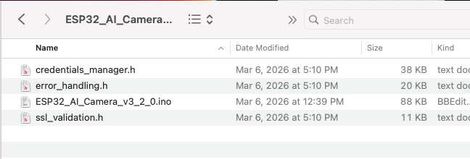
STEP 02 · GET THE CODE
2
Download the firmware from GitHub
THE REPO
WHAT YOU SHOULD SEE
oyyeahhh / birdwatch-cam
1
Open github.com/oyyeahhh/birdwatch-cam
2
Navigate to ai_camera/firmware/standalone
3
Download ai_camera_3.2.0.zip
ESP32_AI_Camera_v3_2_0.ino
credentials_manager.h · error_handling.h · ssl_validation.h
4
Unzip and keep the .ino together with all three .h files in one folder
While you are there: can you find the CAD files for the tripod?
Prefer a no-code path? The repo's ai_camera/GETTING_STARTED.md walks through a browser-based flasher. No Arduino IDE needed.

Slide 8

STEP 03 · CREDENTIALS
3
Tell it your WiFi, and hand it the key
ESP32_AI_Camera_v3_2_0.ino · around lines 46–48
GOOD TO KNOW
const char* ssid = "YourWiFiSSID";
const char* password = "YourWiFiPassword";
const char* OPENAI_API_KEY = "sk-proj-xxxxxxxxxxxx";
// Save > Verify (✓) > Upload (→)
Your network
Use your own WiFi
The camera and your browser must be on the same network.
2.4 GHz works best
The ESP32 does not join 5 GHz-only networks.
Replace all three placeholder values with your own, then save.
Never commit real credentials to GitHub. The repo's secrets_template.h pattern exists exactly so keys stay out of your commits.

Slide 9

STEP 03 · THE KEY
3
Get your OpenAI API key
This is what lets your Birdwatcher talk to GPT-4 Vision. It takes about three minutes.
Sign in at platform.openai.com (create an account if needed)
COSTS
1
Pennies, not dollars
2
Open the API Keys page and click “Create new secret key”. Name it Birdwatcher.
Each analysis costs roughly $0.05–0.10.
Set a monthly cap
Settings > Limits in the OpenAI dashboard, so there are no surprises.
3
Copy the key (it starts with sk-...) and store it somewhere safe. You cannot view it again.
4
Paste it into the OPENAI_API_KEY line from the previous page.
Your key is personal. Treat it like a password: never share it, and never paste it into a public repo.

Slide 10
STEP 04 · UPLOAD
4
Upload the firmware, watch it boot
Connect the board via USB-A to USB-C
SERIAL MONITOR
1
====================================
ESP32-S3 OpenAI Interface v3.2.0
====================================
SD Card OK
Camera OK
PDM Microphone OK
Speaker OK
Connecting to WiFi...
WiFi connected
IP: 192.168.0.181
2
Tools > Port: select your camera's COM port
3
Click Upload (the → arrow)
4
Wait ~2–3 minutes for compile + upload
5
Open Serial Monitor at 115200 baud
6
Watch for the IP address in the output
See the IP? Open a browser on the same WiFi and type it in, e.g. http://192.168.0.181 — that page is your Birdwatcher.

Slide 11
CHECKPOINT
Your setup checklist
Steps 1–4 in one place. Tick each box on your way through.
TASK A · HARDWARE
TASK B · IDE & FIRMWARE
TASK C · UPLOAD & CONNECT
1
Unbox the DFR1154 camera module
1
ESP32 board package installed
1
Select the right COM port
2
Attach tripod bracket (if using)
2
Board: ESP32S3 Dev Module
2
Click Upload (→)
3
Connect USB-A to USB-C to laptop
3
Apply the 5 settings from Step 1
3
“Done uploading” appears
4
Board powers on (LED lights)
4
Open ESP32_AI_Camera_v3_2_0.ino
4
Serial Monitor at 115200 baud
5
Open Arduino IDE
5
Enter WiFi SSID, password, API key
5
Note the IP address shown
Success looks like: the Birdwatcher web interface loading at your camera's IP address.

Slide 12


THE INTERFACE
The web app, left to right
No app to install. Everything lives on one page served by the camera itself.
LEFT PANEL
RIGHT PANEL
Camera & controls
Audio & files
Pairing Workflow Banner
Yellow bar shows your current step
Audio Playback Bar
Plays back recorded WAV files
Start / Stop Stream
Toggles the live camera feed
Record
Starts/stops the PDM mic recording
Capture
Takes a still photo, saves to SD card
Speaker
Controls TTS playback volume
Review
Previews the most recent capture
Image for Export
The photo you will send to OpenAI
LIVE Indicator
Green dot: stream is broadcasting
Audio for Export
Your spoken prompt for Whisper
Camera Preview
Live MJPEG from the wide-angle lens
Resources
All SD files: save to PC, export, delete
Browser says “Not Secure”? Expected. The camera uses a self-signed certificate on your local network.

Slide 13



THE INTERFACE
Where the AI answers
Send to OpenAI
Replay TTS
Export Package
Ships your image + spoken prompt to GPT-4 Vision and Whisper. The reply is displayed, then spoken aloud.
Re-plays the last spoken response through the speaker, without calling the API again.
Downloads a ZIP with the image, your audio prompt, and the AI's response text.
THE RESULTS BOX
The large text area under the video shows the GPT-4 Vision response, speaks it through the speaker, and archives it to the SD card in /analysis/[timestamp]/.
A real reply: “That is a Northern Cardinal, a male based on the bright red plumage, perched on the feeder's left arm...”

Slide 14






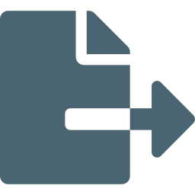


THE WORKFLOW
The loop you'll run every session
1
2
3
4
5
START
STREAM
CAPTURE
IMAGE
RECORD
PROMPT
ADD TO
EXPORT
SEND TO
OPENAI
Live feed begins
Frame it, save to SD
Speak your question
Pick image + audio
Answer is spoken
AFTER THE ANALYSIS
Replay TTS
Export package
Delete files
Reset & repeat
Stream, capture, ask, send. After a couple of rounds the whole loop takes under a minute.

Slide 15
TROUBLESHOOTING
When something squawks
Board not found / no COM port
Upload fails: brownout / timeout
Install the CH340 or CP2102 USB driver. Swap in a data cable (many are charge-only). Hold BOOT while plugging in.
Set Flash Size 16MB and the 16M partition scheme in Tools. Try a powered USB hub.
Camera stream not showing
OpenAI returns 401 / 403
Enable USB CDC On Boot, then refresh the browser. Recording audio pauses the stream briefly.
Check the key has no extra spaces and billing is enabled at platform.openai.com.
TTS / speaker silent
SD card not detected
Check the SPK connector wiring (MX1.25-2P). The amp uses GPIO 45 / 46 / 42.
Reformat as FAT32, use a 16GB-or-smaller card, and re-seat it before power-up.
Still stuck? wiki.dfrobot.com/SKU_DFR1154 has the full hardware reference for the board.

Slide 16
FAQ
Quick answers
Q: Is the “Not Secure” warning a problem?
Q: Why does the page freeze during analysis?
No. The firmware keeps traffic encrypted but uses a self-signed certificate, which browsers flag on local networks.
The ESP32 is single-threaded. It pauses 15–30 seconds while talking to OpenAI. Normal.
Q: Why can't I record while streaming?
Q: How big can the SD card be?
Camera and mic share one I2S bus. Recording briefly takes it over, then the stream resumes.
FAT32, 32GB max. 8–16GB is the sweet spot.
Q: Does the mic sound quiet?
Q: Can it drive other hardware?
Audio gets 10x software amplification. Speak within a few feet of the board.
Yes. The Gravity connector (TX 43 / RX 44) speaks serial to an Arduino UNO. See the automation agent firmware.
Most “bugs” are design choices of a tiny computer doing big things. The Known Limitations section of the repo README explains each one.

Slide 17
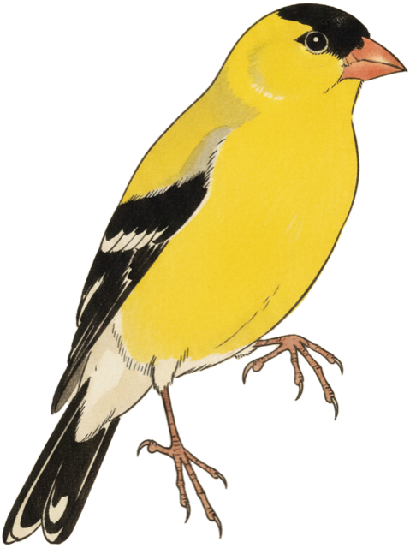
WHAT'S NEXT
Make it yours
YOUR NEXT STEPS
KEEP EXPLORING
1
Mount your Birdwatcher near a feeder or window
Birdwatcher repo
github.com/oyyeahhh/birdwatch-cam
2
Keep a log of the species your camera spots
DFRobot wiki
wiki.dfrobot.com/SKU_DFR1154
3
Try the Automation Agent firmware next
OpenAI platform
platform.openai.com
4
Design ONE lesson that integrates AI vision
Arduino IDE
arduino.cc/en/software
5
Share what you built with your department or PLN
ESP32 tutorials
randomnerdtutorials.com
6
Explore the repo, then fork it and make it yours
AI4K12 framework
ai4k12.org
Every fork keeps this project alive. When you extend the Birdwatcher, you become part of the lineage that started with BirdNET.

Slide 18
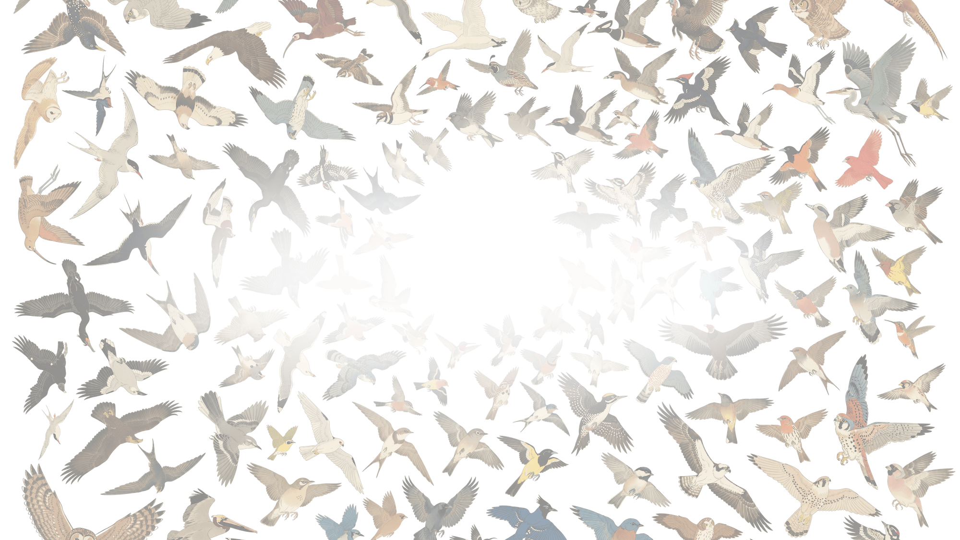
Happy birdwatching.
Questions? The CIJE Innovation team is a message away.
github.com/oyyeahhh/birdwatch-cam

