Slide 1
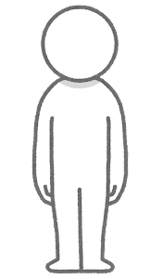
grid_dim
m_per_cell
h < height_diff_threshold
h > height_diff_threshold
h > height_diff_threshold

