Slide 1
Youtube Usage analysıs
Ozan kaçmaz 32123

Slide 2
My motıvatıon
My main motivation was to learn how do I use Youtube in terms of daily number of videos I watched and their durations. Since YouTube is one the most used social media platform, I thought it will be interesting to analyze. I researched and found that I can download my data from google takeout website. This data had my Youtube watch history which is the thing I need. It had the title, channel name, and watched date information.

Slide 3
Data processing
At first, I did not have a clue about where to start but then I decided to get more details about my watch history. I used youtube-dlp to get metadata of my watched videos. I added like, view, duration information to my dataframe. I used youtube api v3 to get video descriptions.
I cleaned my video titles and descriptions in the dataset lowercase process them. I did lowercasing and stop-word removal, and lemmatization. This will be helpful to analyze my textual data and to build ML models and wordcloud.
I built 4 ML models to classify categories of the videos. I get the labeled data from YouTube APİ V3.
After some time, A new idea came to my mind. Why wouldn’t I build a recommendation app using my previous watched videos. I decided to continue with that. I wanted to build a program that ask a video title name and suggest me a video from my watched videos dataset.

Slide 4
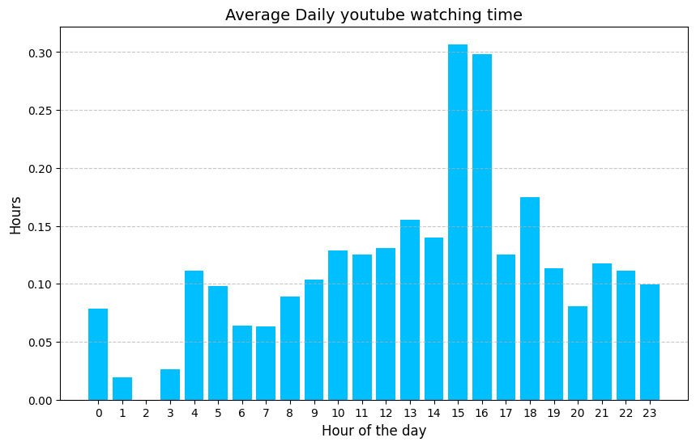
Findings
While I was trying to build that recommendation app, I analyzed and created graphs from my youtube data.
As expected, I am watching YouTube mostly after 3pm Since most of my classes are in the mornings.

Slide 5
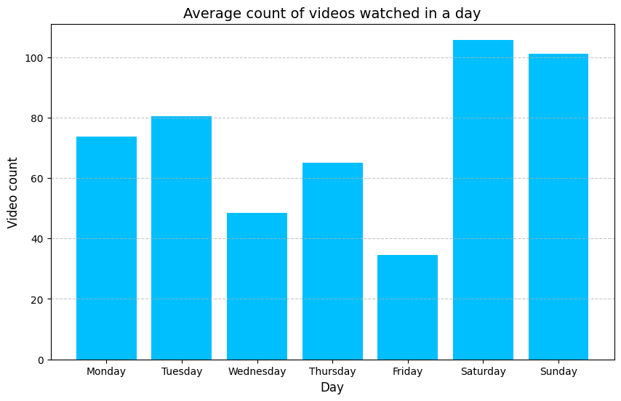
This is the average number of videos I watch in a week. Weekends are higher than the weekdays since I do not have to go to classes. I have more free time.
Friday is the day that I watch the less. Actually I
was not expecting this because I have less
classes on Friday. I thought I would have
watched more on Friday.

Slide 6
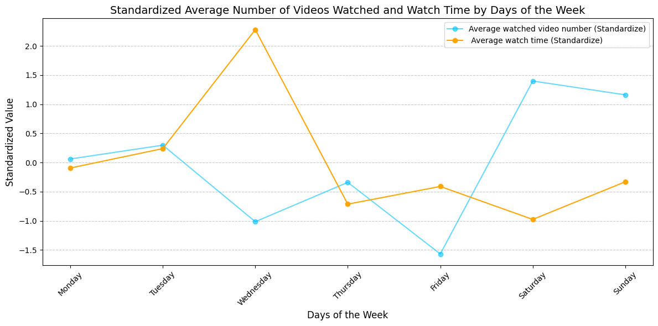
I calculated pearson correlation coefficient and it turned out to be -0.44.
It makes sense because I am watching more but short videos some particular days.

Slide 7
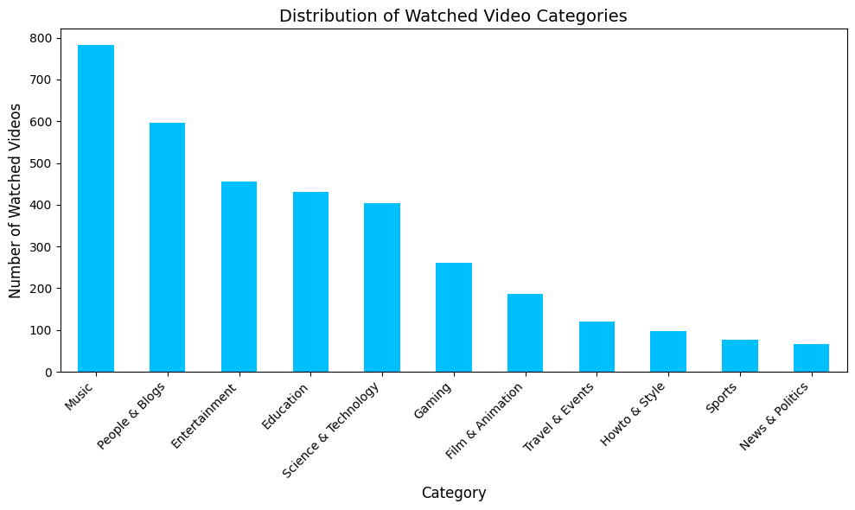
As I expected I was listening music a lot on Youtube since I bought Youtube Premium
which gives access to Youtube Music. That is the main reason there are over 700 music videos I watched. I learned about myself while I was doing these analysis. It was surprising to
see that I was not using Youtube to education as I thought. I was thinking education category would be number 1.

Slide 8
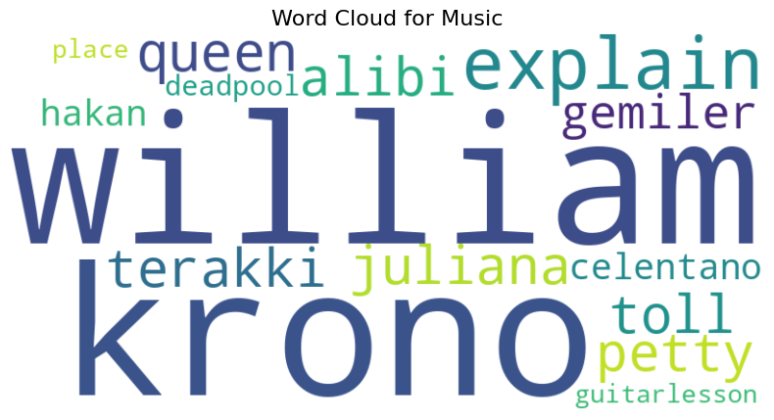
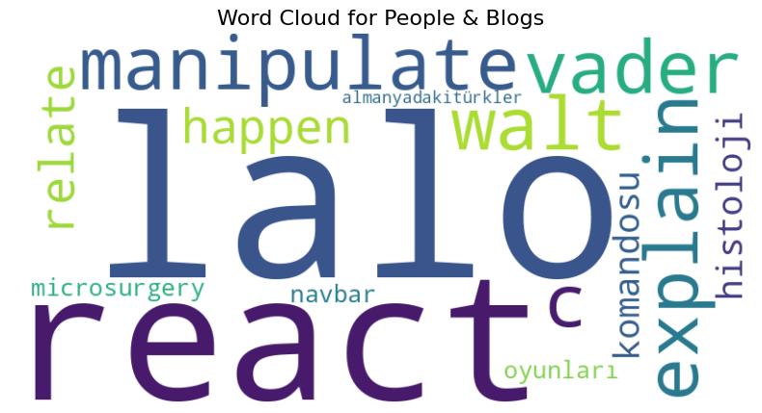
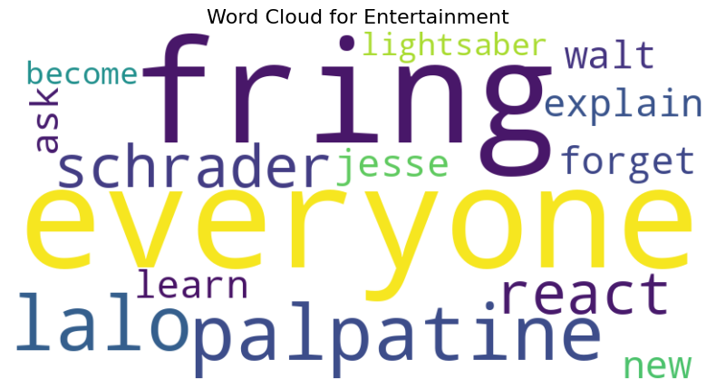
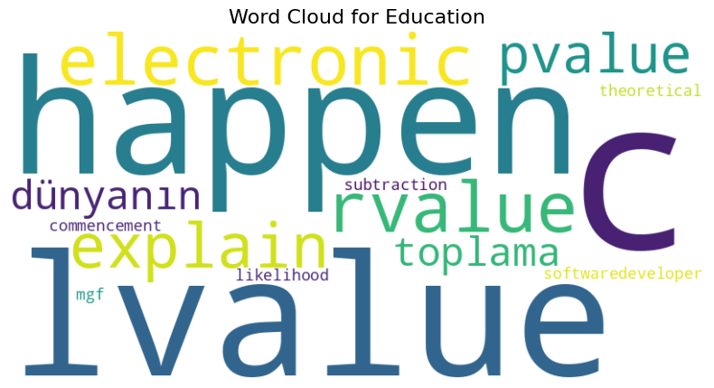
Wordcloud

Slide 9
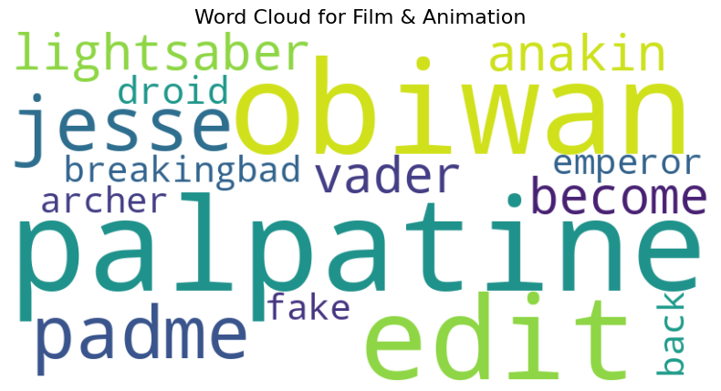
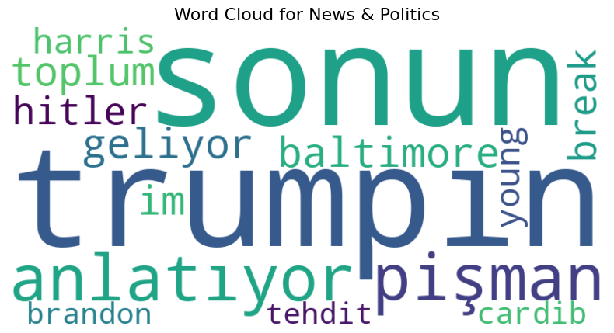
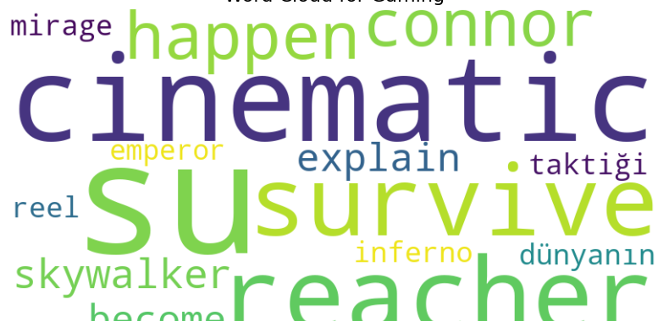
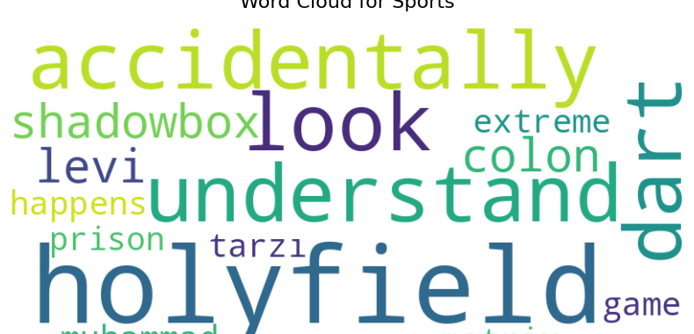

Slide 10


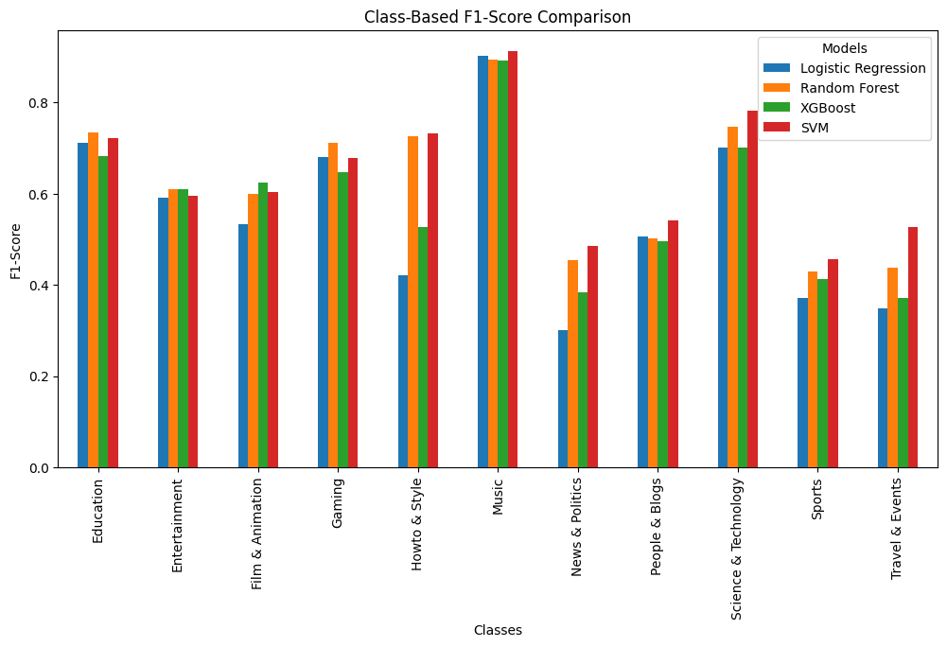
Comparison OF the ML Models by category

Slide 11

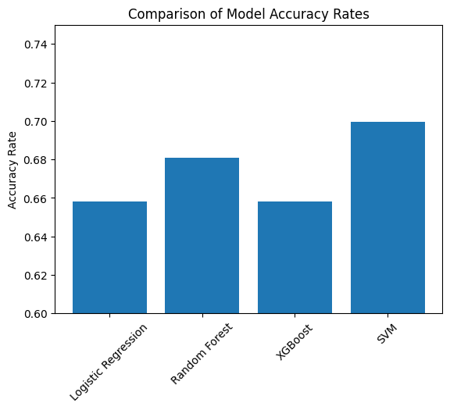

Slide 12
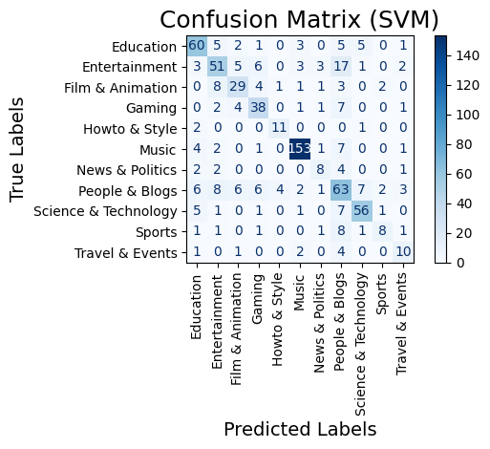

Slide 13
Recommendation app
I built a content-based recommendation app step by step.
First, I gathered my YouTube watch history data and cleaned it using pandas and nltk .
During this cleaning process,
I made sure to fill in any missing values and keep important columns like the original video title. I processed title by using nltk.
I turn all titles to lowercase, then I removed stop words then I lemmatized the titles
so that I can correctly analyze the words in the titles . After that cleaned titles are ready for the text analysis.
Next, I used TF-IDF vectorization from scikit-learn to turn the cleaned titles into numerical values,
which makes it easy to compare different titles.
After that, I calculated cosine similarity scores between the user’s input title and all the videos in my dataset,
so the most similar videos would appear at the top of the recommendation list.
To present these results in a friendly way,
I built a web-based user interface using Streamlit.
This interface lets users type a new video title and then see the recommended videos instantly.
Finally, I needed to share my app from Google Colab, so I used ngrok to create a public link.
This link allows anyone with internet access to open the Streamlit app and try out my recommendation system,
even though it is running inside Google Colab.

Slide 14
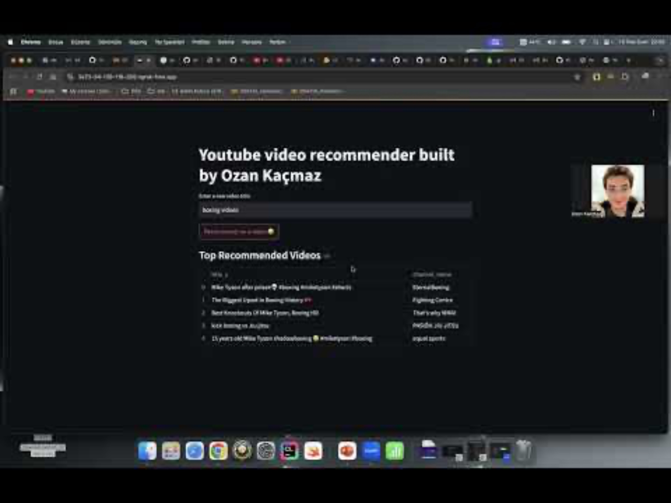
Video of how recommendation works
https://youtu.be/m4NalCWmxvk

Slide 15
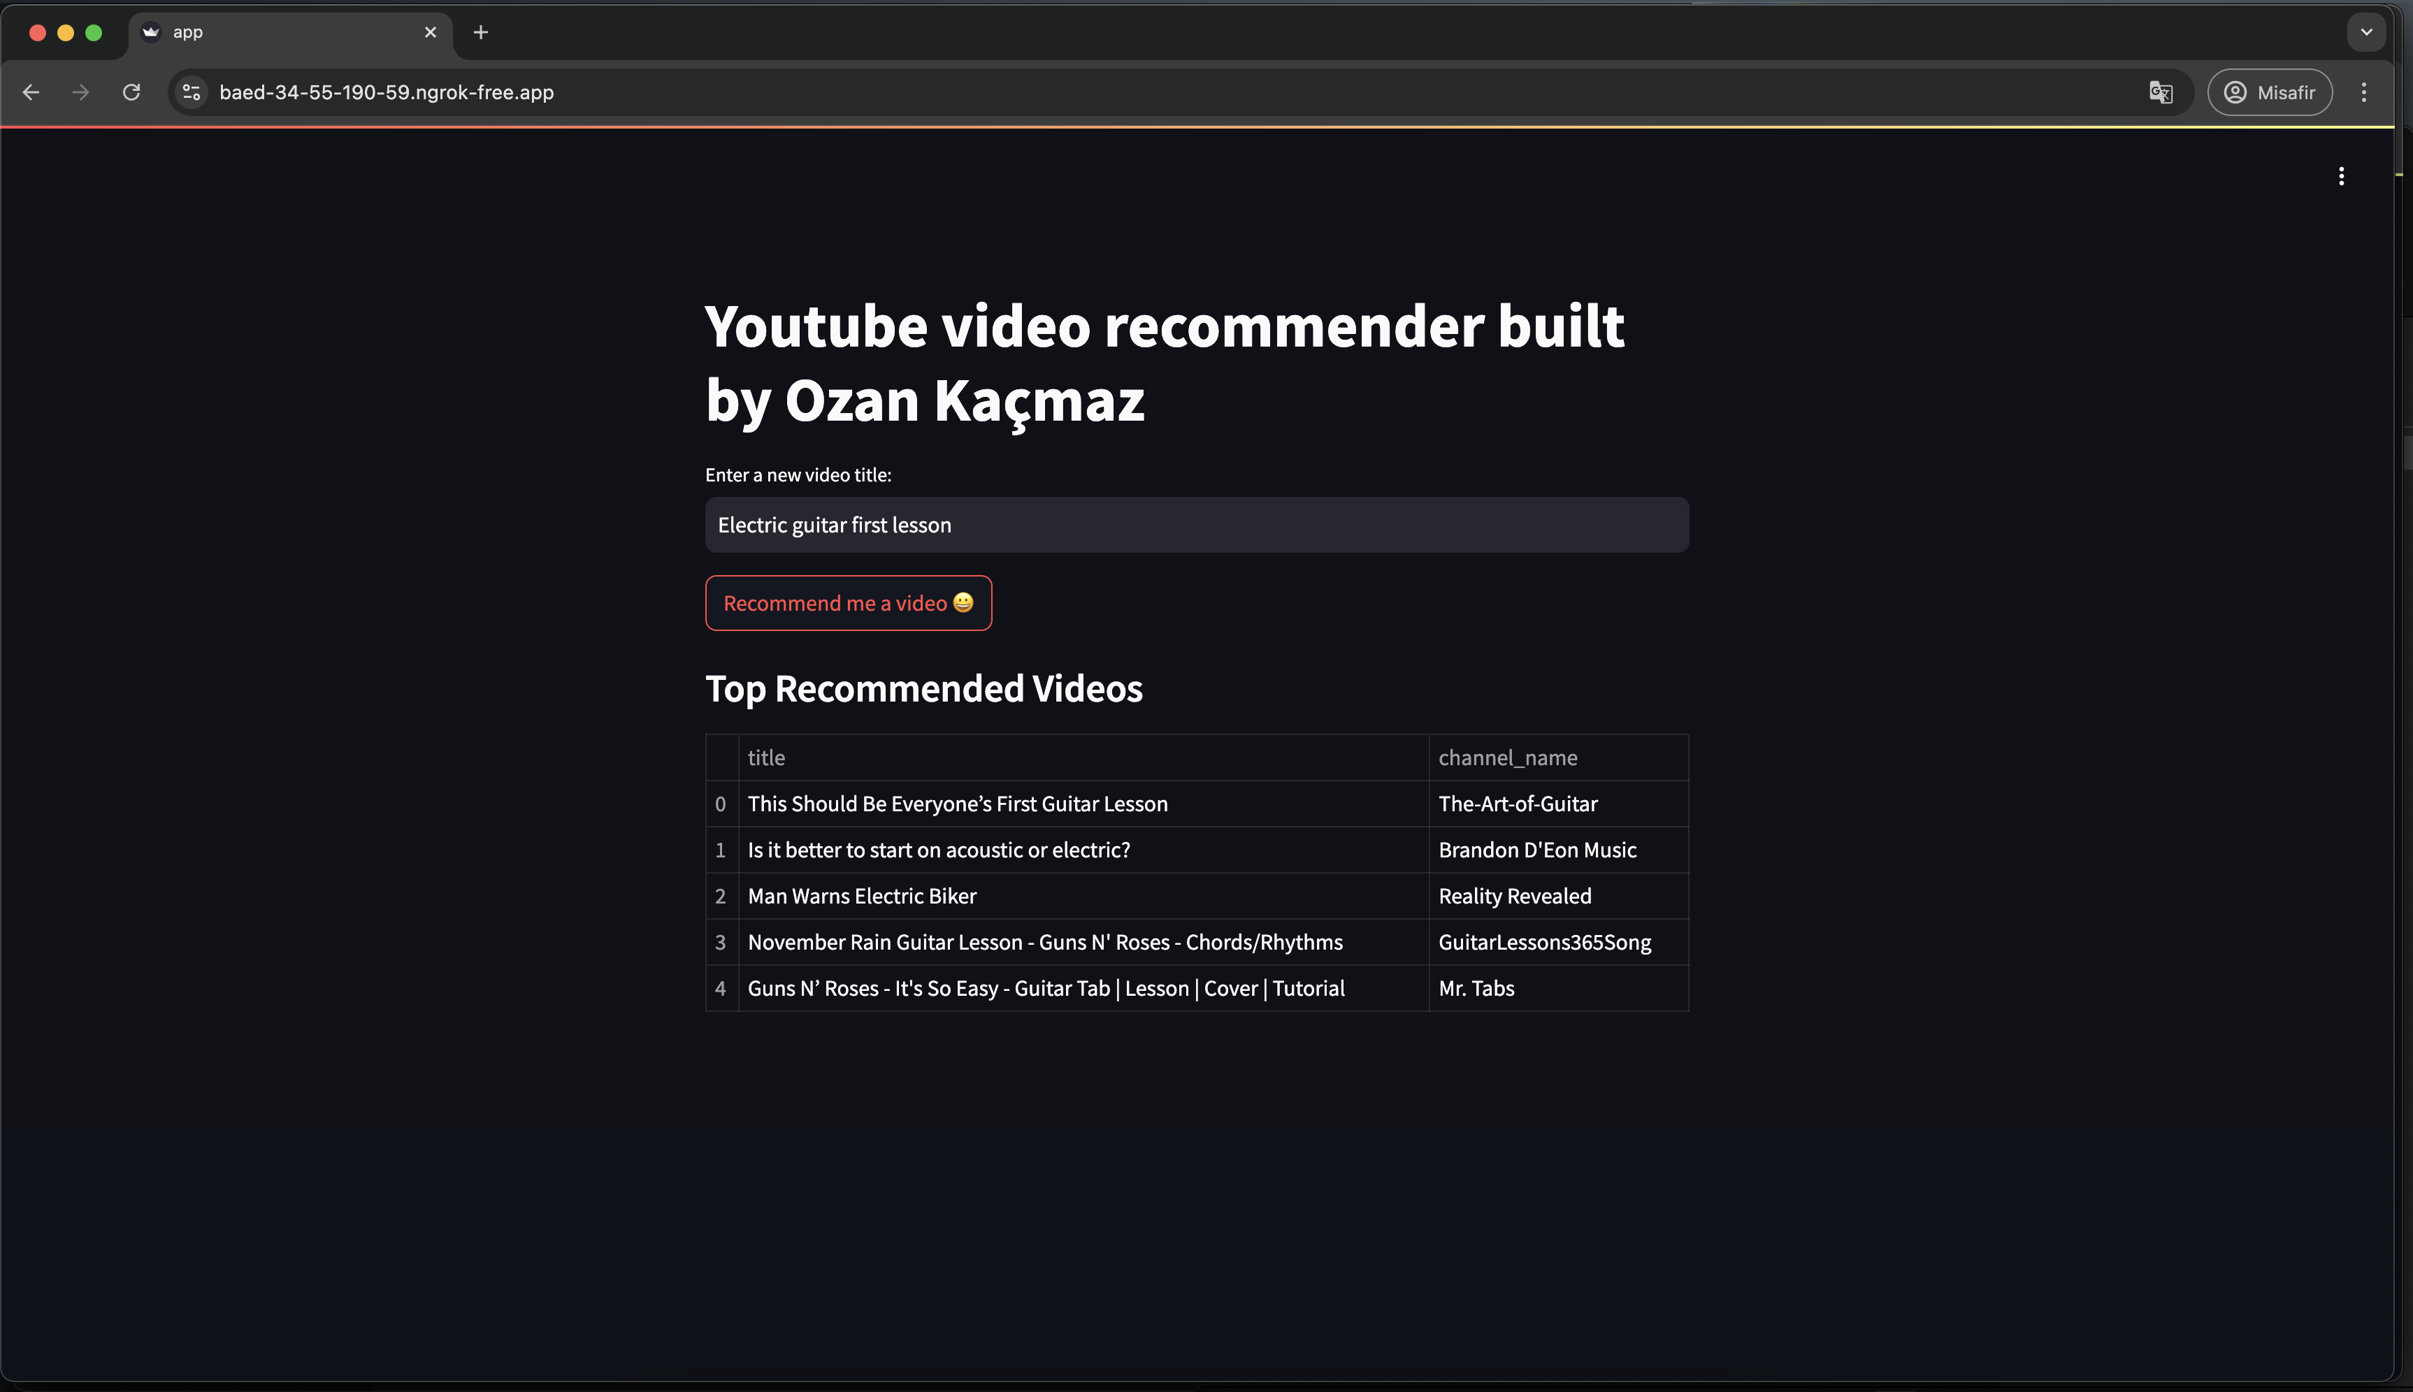
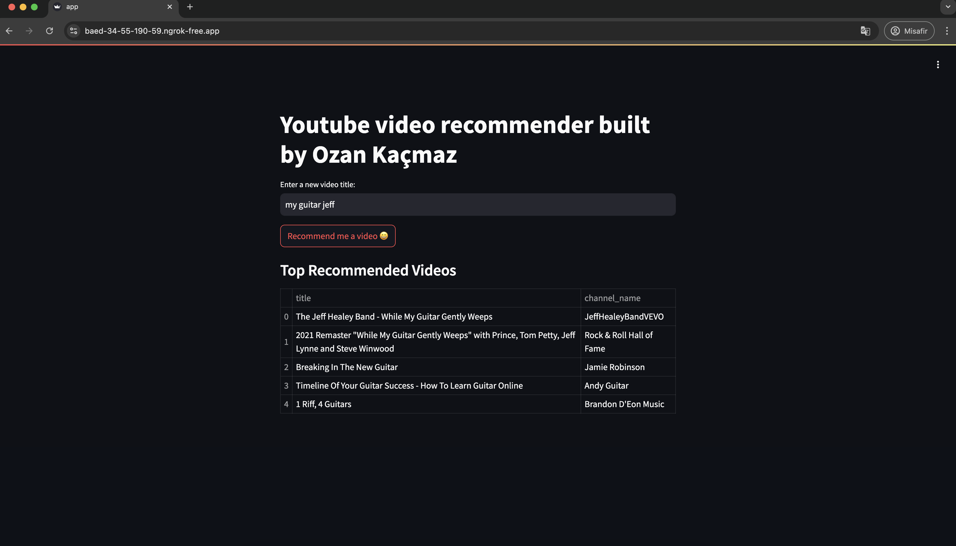
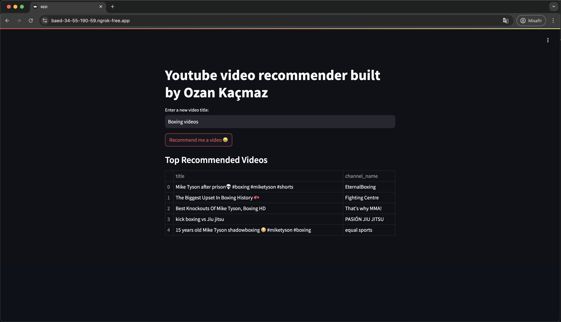
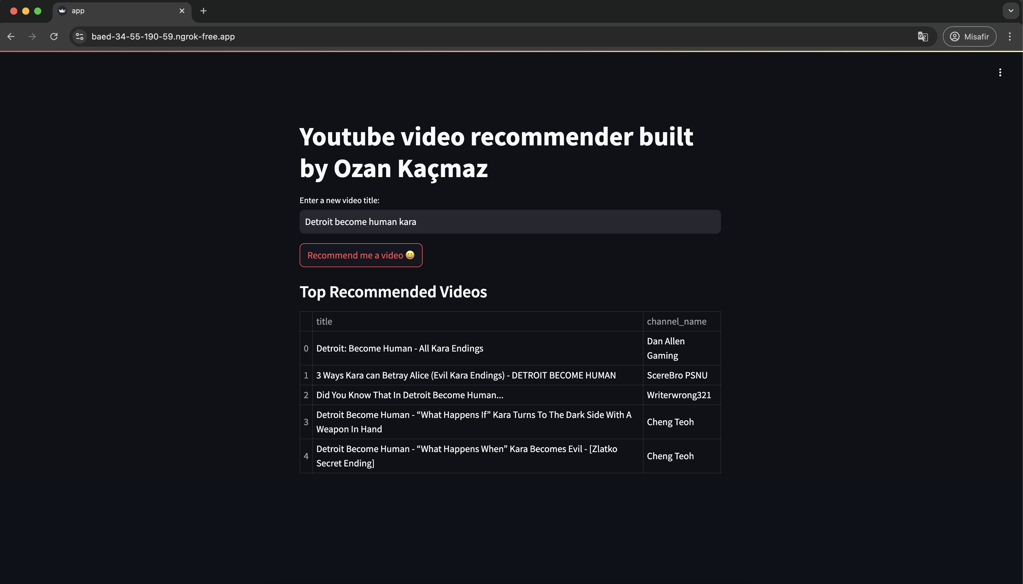
Example recommendations

Slide 16
FUTURE work and limitation
My limitations was my dataset. I tried to cluster them but I did not like the results. There was a one big cluster and I could not solve it. I tried different clustering algorithms but I failed everytime. I will learn mode about cleaning the dataset and gathering data free from noise. I think I am able to achieve correct clustering after learning how to clean the outliers and noise.
My future plan is I will try to expand recommendation system to multiple dataset and larger dataset. For example it will
give a recommendation and also it will ask whether you like it or not. Then the ML model will learn from that and make
more precise recommendations.
I hope you liked my presentation. I tried everything I can to make it not so long to not bore people with many words. I believe it is going to take 5 minutes to look at this presentation. I think it is enough time to get someone's attention to
my project . As I said, I hope I did not bored you with words.

