Slide 1
EARTHSCAPE CLIMATE AGENCY
EarthScape
Climate data analysis and monitoring
Project demonstration and technical overview
01

Slide 2
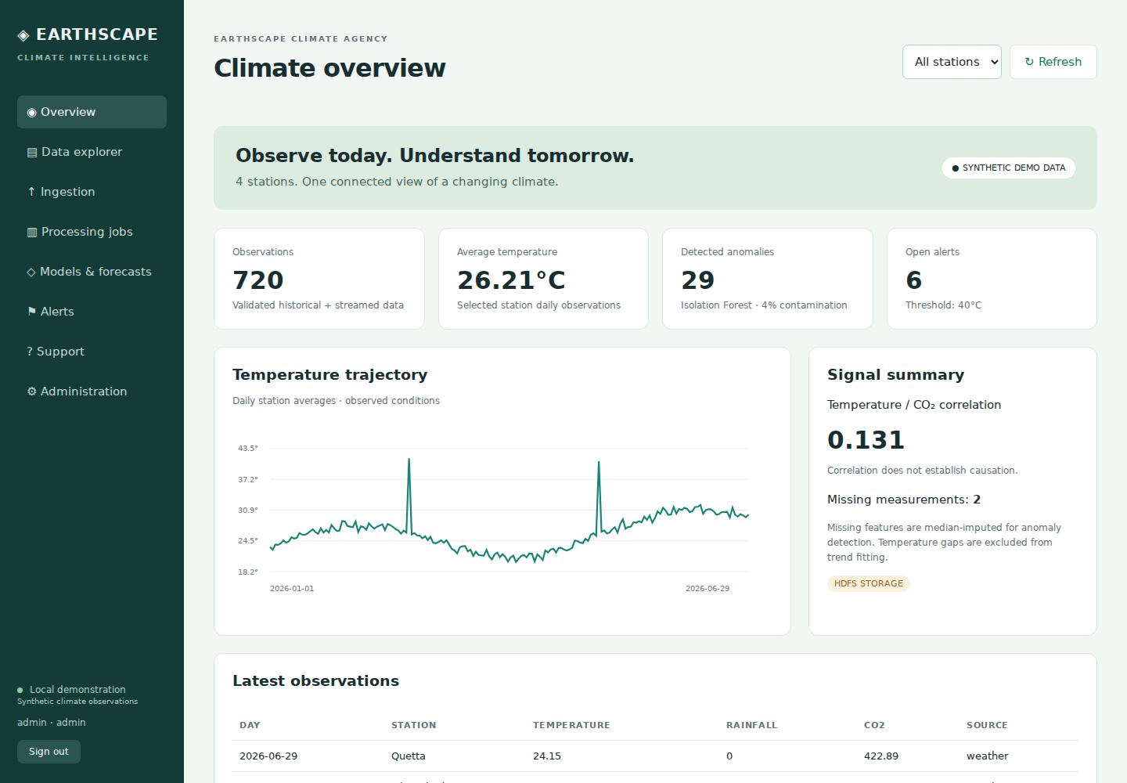
The project
EarthScape brings climate observations into one application.
Users import records, explore station trends, inspect predictions and respond to temperature alerts.
02

Slide 3
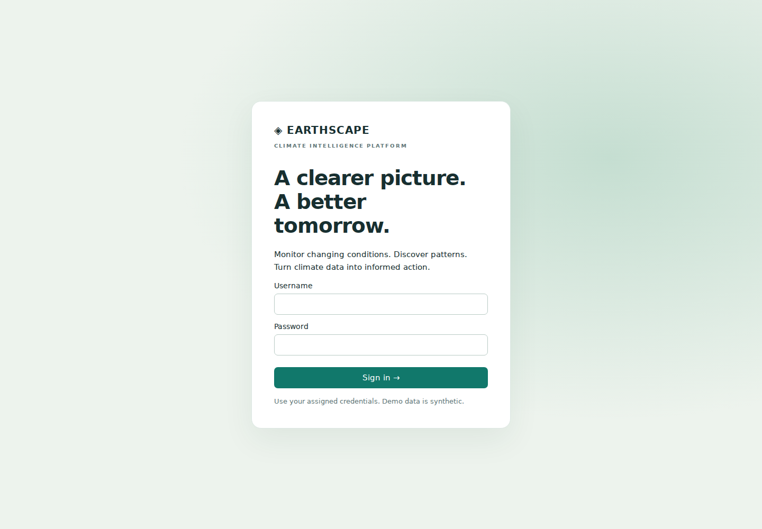
Users and access
Administrator
Accounts, thresholds, backups and audit review
Analyst
Imports, processing and alert acknowledgment
Viewer
Read analysis and submit support tickets
03

Slide 4
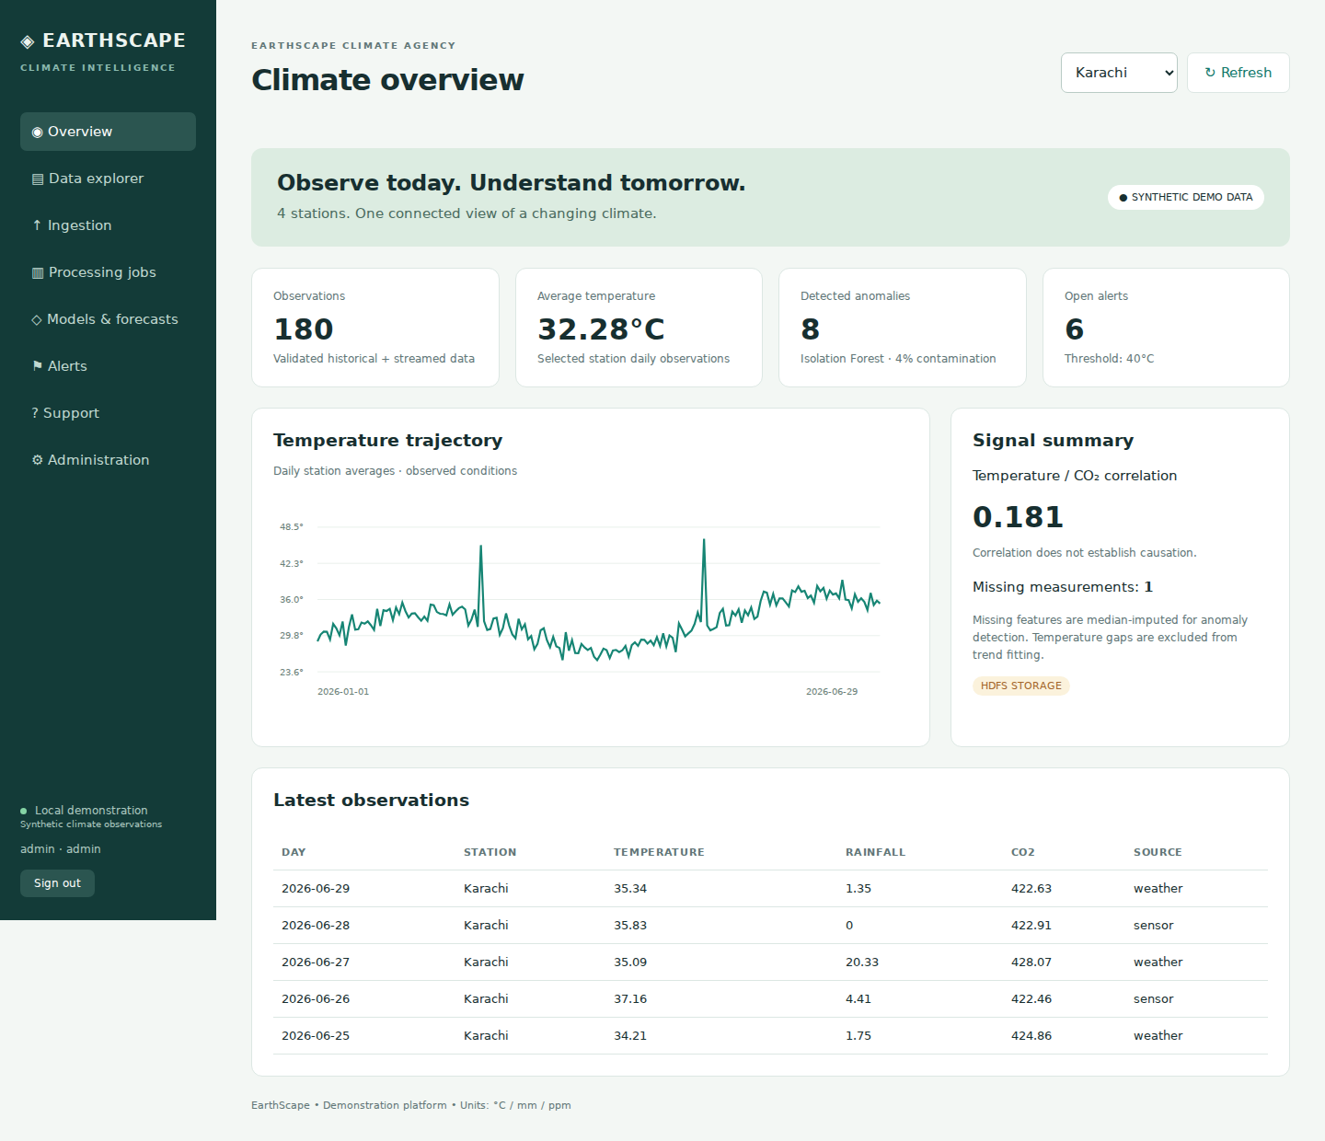
Climate overview
720 synthetic observations
Four stations across 180 dates
Station filters support local comparisons.
The seed data supports repeatable evaluation.
04

Slide 5
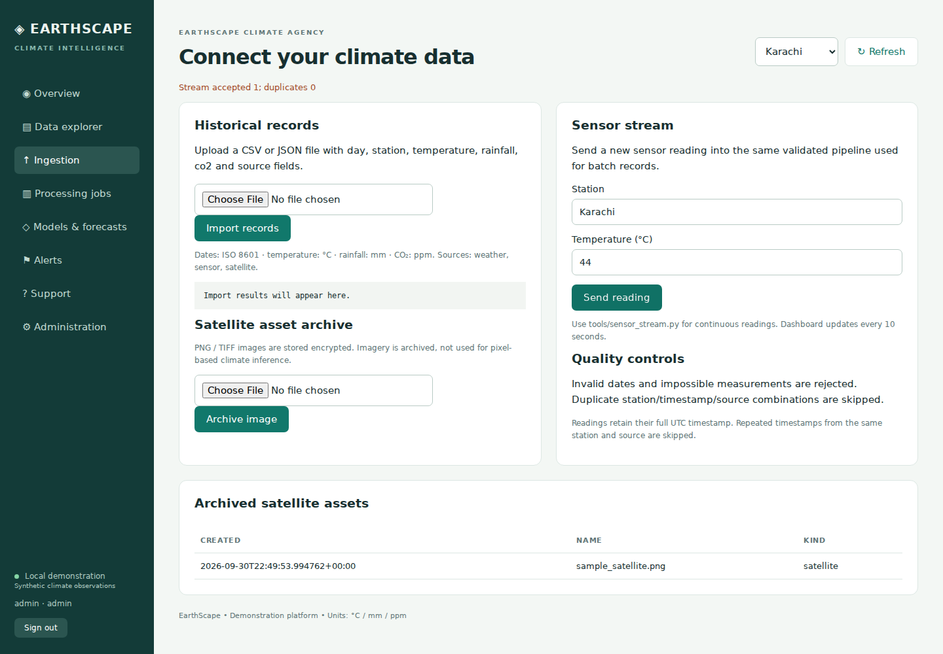
Data ingestion
CSV and JSON records share validation.
Timestamped sensor readings preserve multiple readings per day.
PNG and TIFF satellite assets enter an encrypted archive.
05

Slide 6
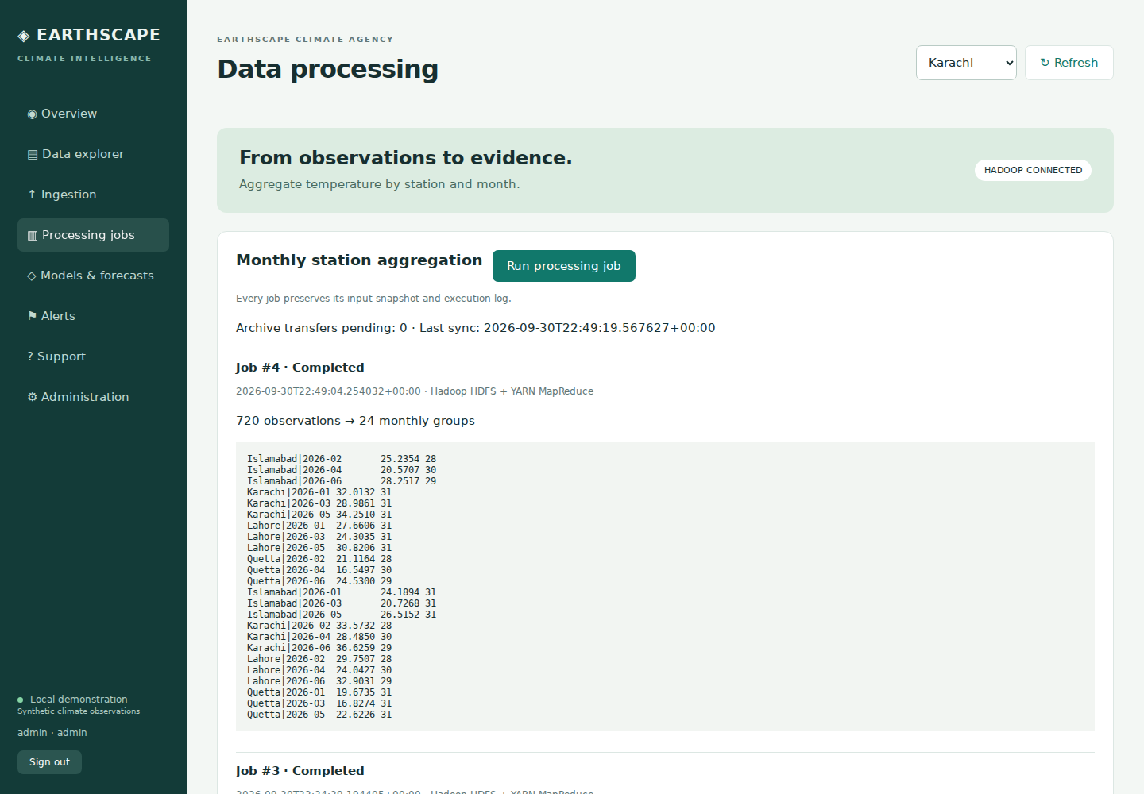
Data processing
Local mode runs mapper and reducer scripts on one computer.
Hadoop mode uses HDFS and YARN with two reducers.
Jobs calculate station/month temperature means.
06

Slide 7
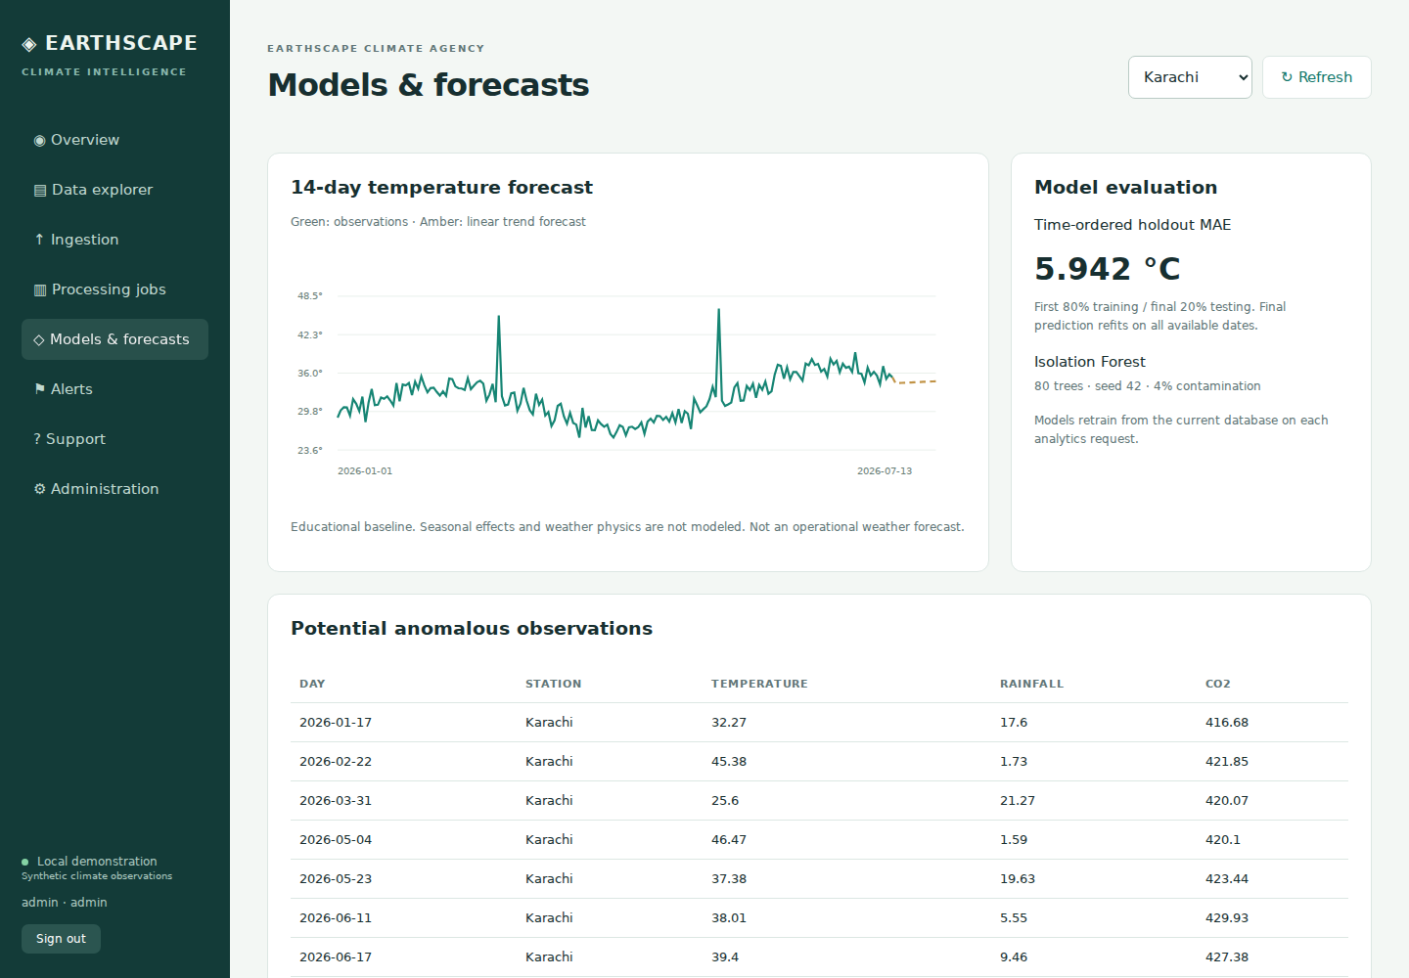
Forecasts and anomalies
A linear regression baseline predicts 14 days.
The final 20% of dates supplies the forecast test set.
Isolation Forest flags unusual observations for review.
07

Slide 8
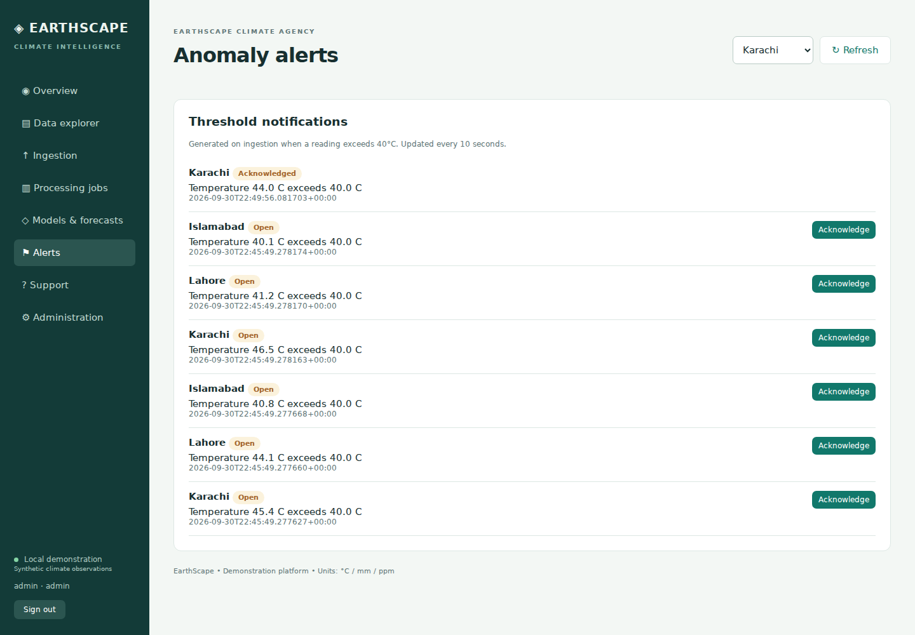
Alerts and support
New readings above the configured threshold create alerts.
Administrators and analysts can acknowledge alerts.
Users submit private tickets for administrator resolution.
08

Slide 9
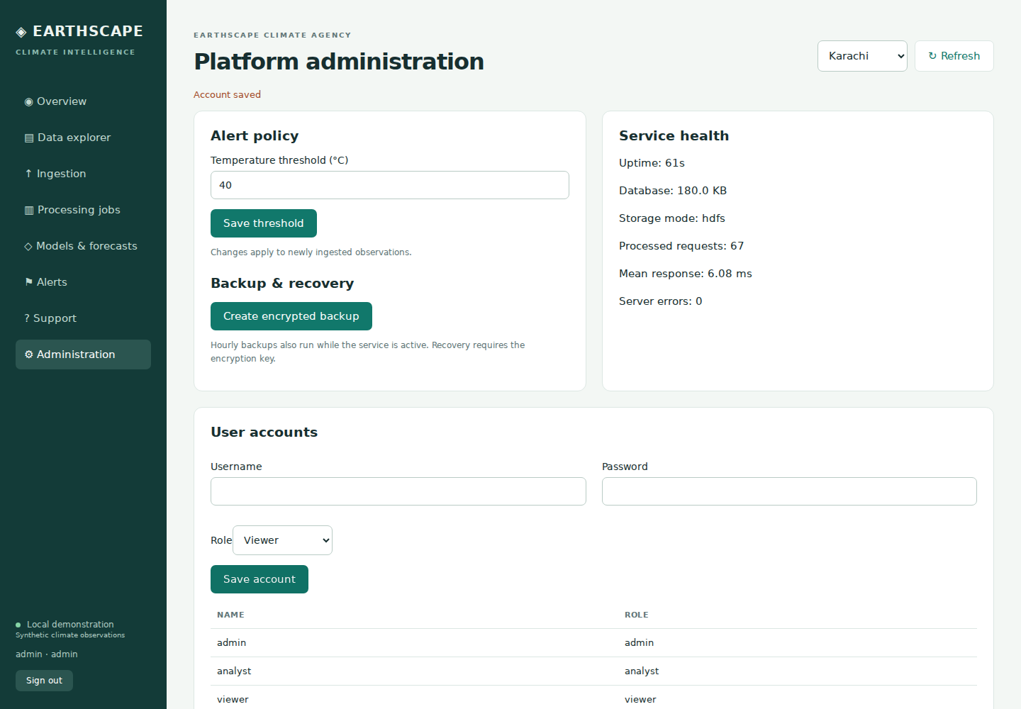
Administration
Administrators manage accounts and thresholds.
The interface includes backup actions, process metrics and audit history.
09

Slide 10
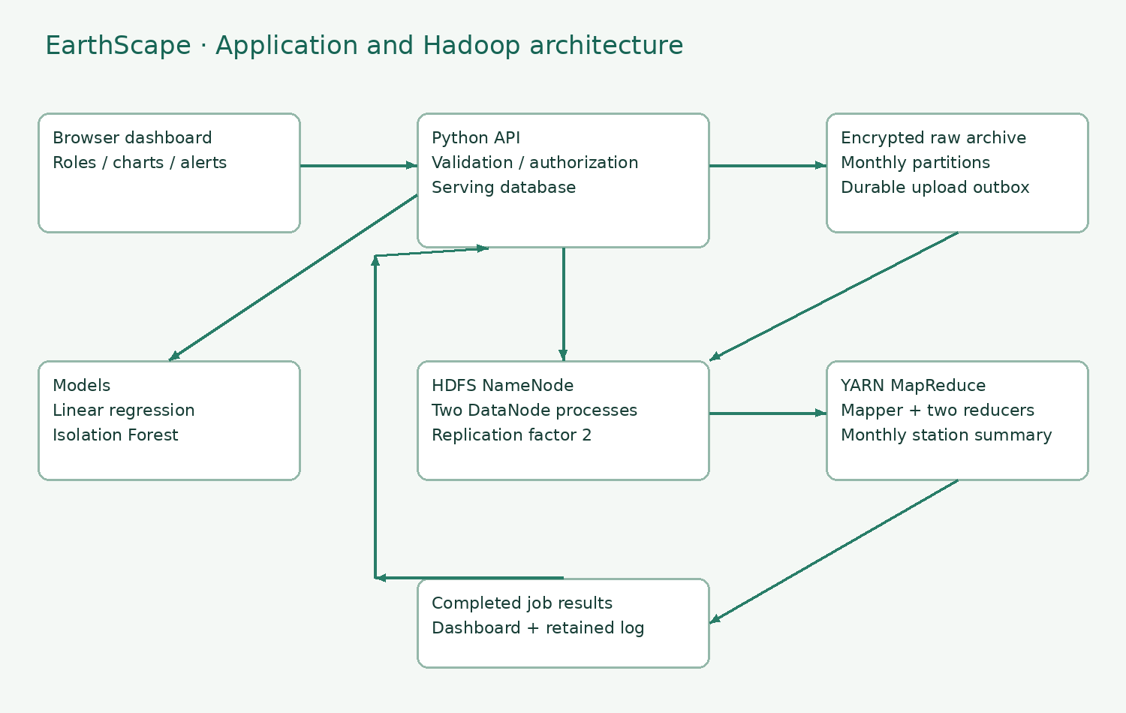
System architecture
The browser uses a Python JSON API.
SQLite serves operational queries.
A background worker manages encrypted archives and Hadoop jobs.
10

Slide 11
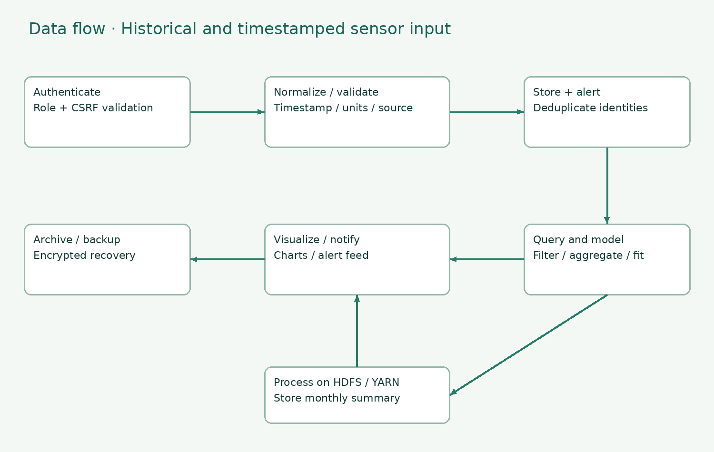
Data flow
Validation normalizes UTC timestamps and checks measurement ranges.
Unique timestamp, station and source identities prevent duplicates.
Archives enter a durable transfer queue.
11

Slide 12
Security and recovery
Salted PBKDF2 password hashes
Server-side role checks and CSRF tokens
One-hour authenticated sessions
Encrypted archives and backup snapshots
Production requires TLS, managed keys and protected storage.
12

Slide 13
Setup and demonstration
Windows offline setup
Extract all files, then run START_EARTHSCAPE.bat.
Open http://127.0.0.1:8080.
Full Hadoop setup
Start Docker Desktop, then run START_FULL_STACK.bat.
The first build requires an internet connection.
13

Slide 14
Validation and limits
18 unit tests passed in this review.
10 HTTP integration checks passed in this review.
The supplied package also retains browser and Hadoop evidence.
Windows launch and Docker Desktop were not executed in this Linux review.
Synthetic data and baseline models support an educational demonstration.
14

Slide 15
Project handover
The package includes the runnable application, Windows runtime, database, source code, reports, diagrams, screenshots and demonstration video.
Add genuine student, batch and group details before the final institutional submission.
15

