Slide 1

GTU CSE 454 Data mining project presentation
Ozan GEÇKİN
1801042103

Slide 2

Project Definition
In this project, the satisfaction status of the airline passengers is predicted with feature engineering, feature selection and classification techniques on the satisfaction surveys
The aim of this project is to analyze and classify the available data in order to increase customer satisfaction of the airline company and to find out which classification method is suitable for estimating the satisfaction status with classification techniques.

Slide 3
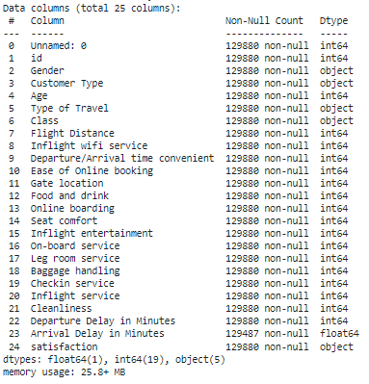
Dataset
The dataset used in the project is the survey data of an aircraft company received via Kaggle. It is divided into train and test. With the train data, the classification methods will be trained, and the target variable satisfaction will be estimated with the test data.

Slide 4

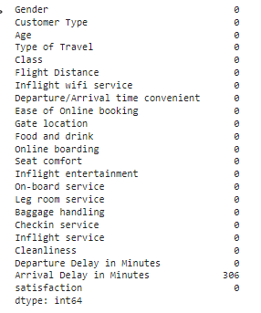
Data operation
Removed features that would not be useful for our predictions.
Data containing nan values were determined and nan places were filled with the median value to avoid data loss.

Slide 5
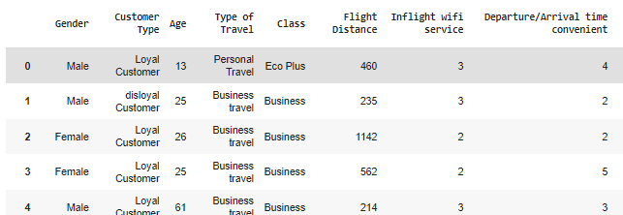
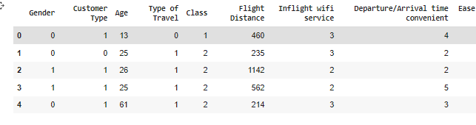
Data operation
Encode Categorical Value (converted the string data to binary number)

Slide 6
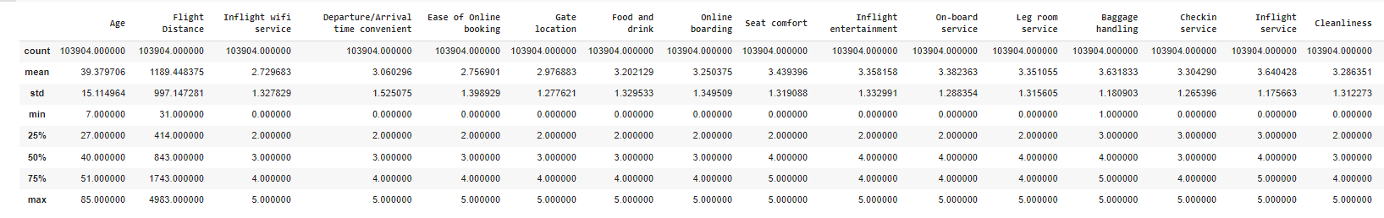
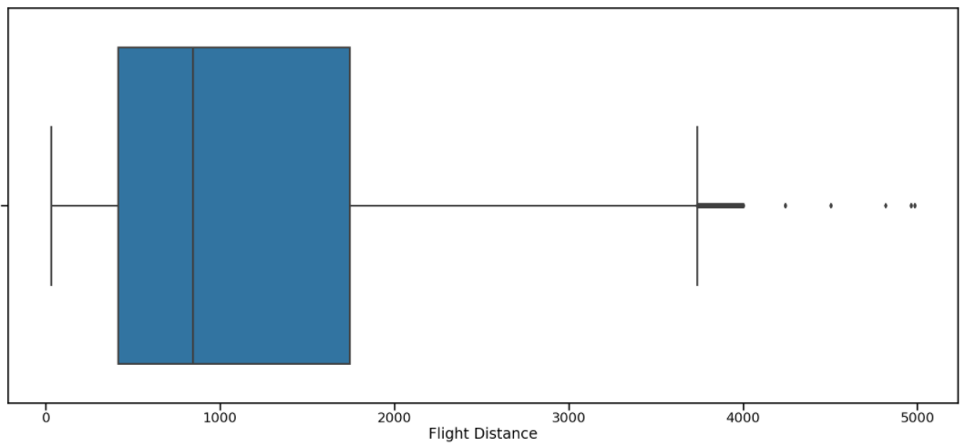
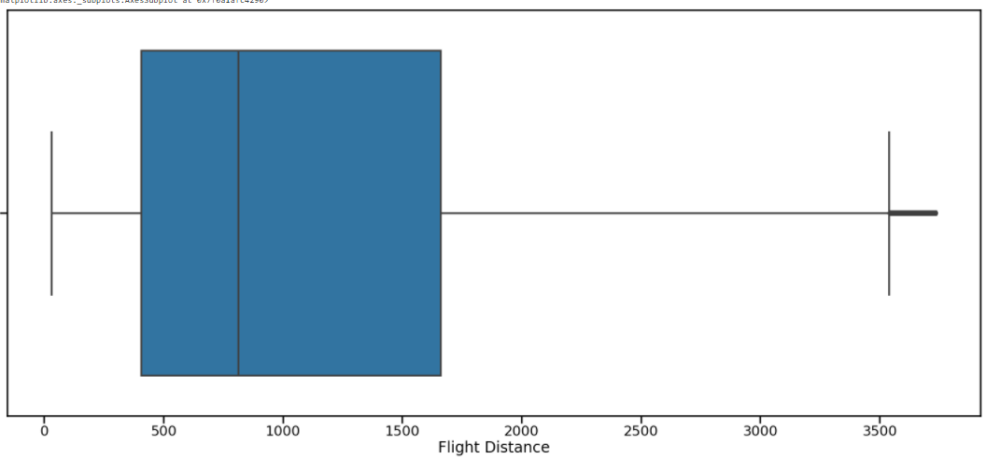
Outlier detection
General state of my datasets with the describe function.

Slide 7
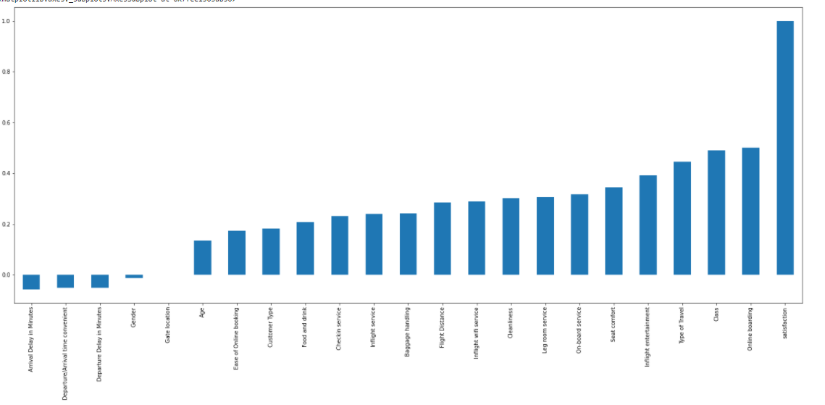
Pearson correlation
The relationship of my target satisfaction attribute with other attributes.

Slide 8
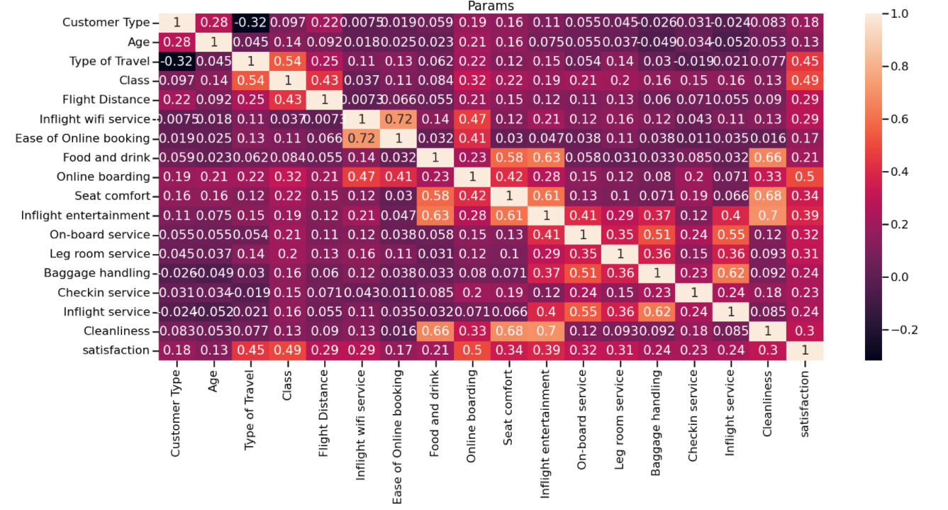
Correlation Matrix
The relationship between parameters.

Slide 9
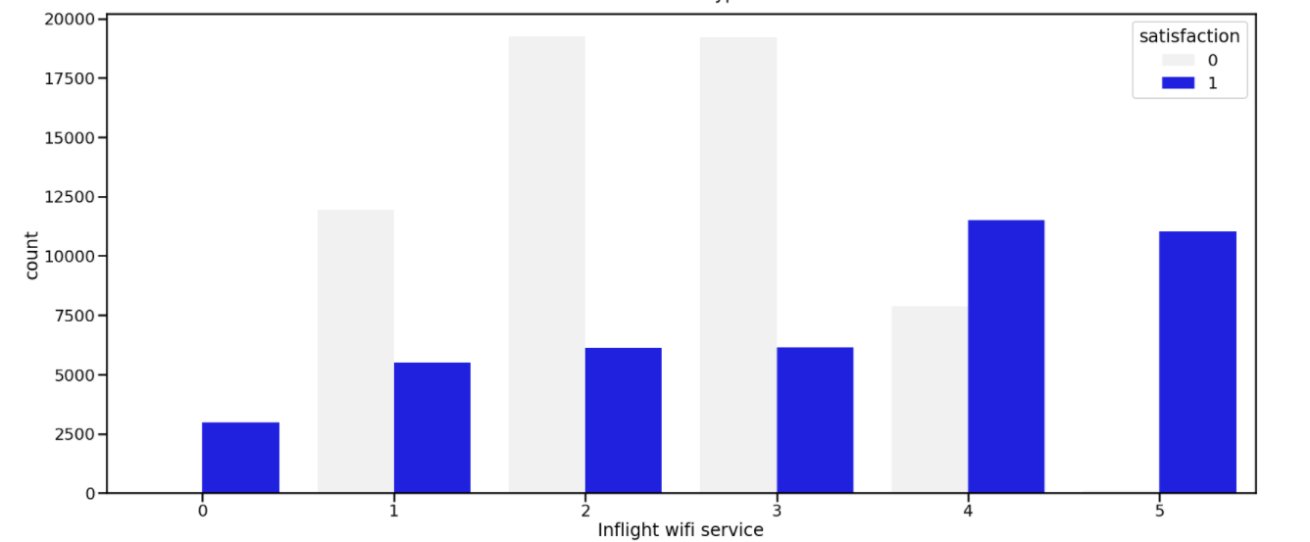
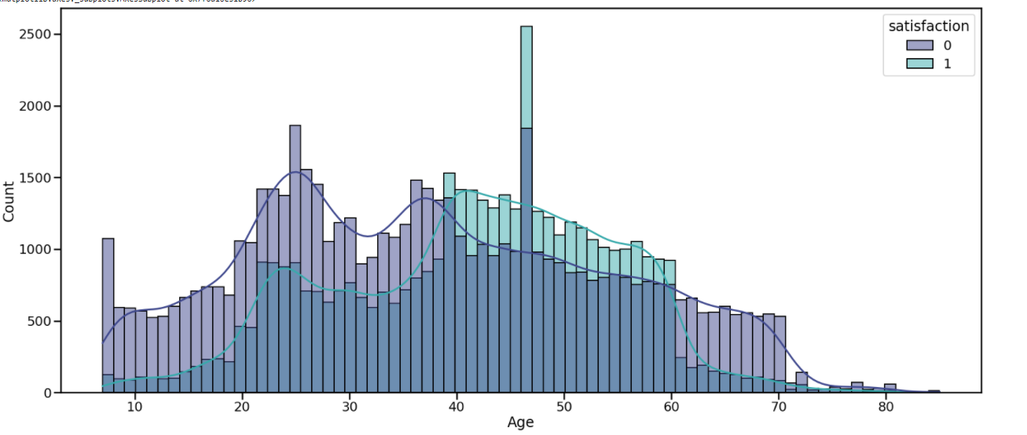
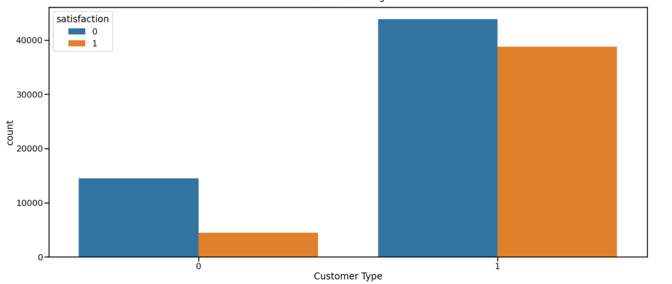
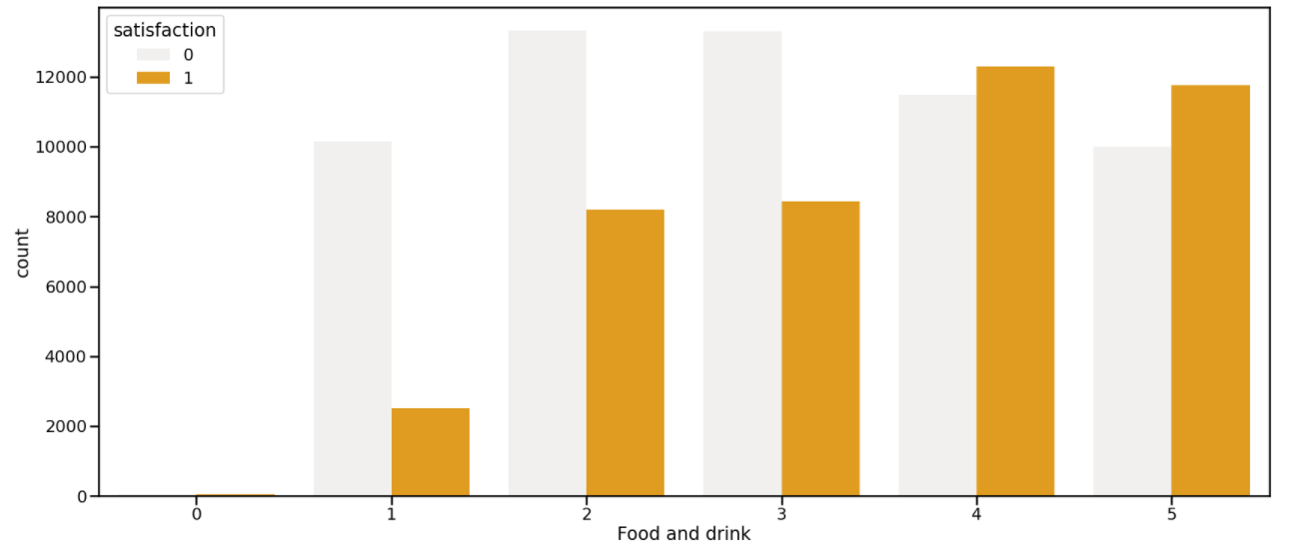
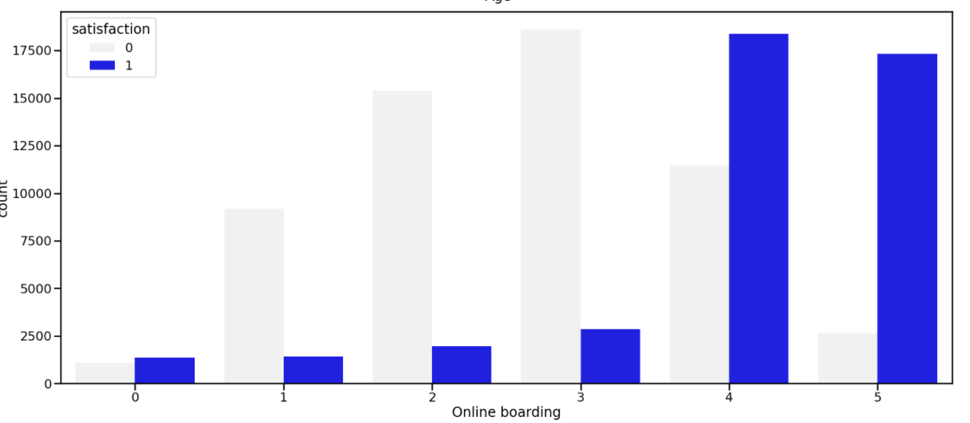
Satisfaction and other features

Slide 10
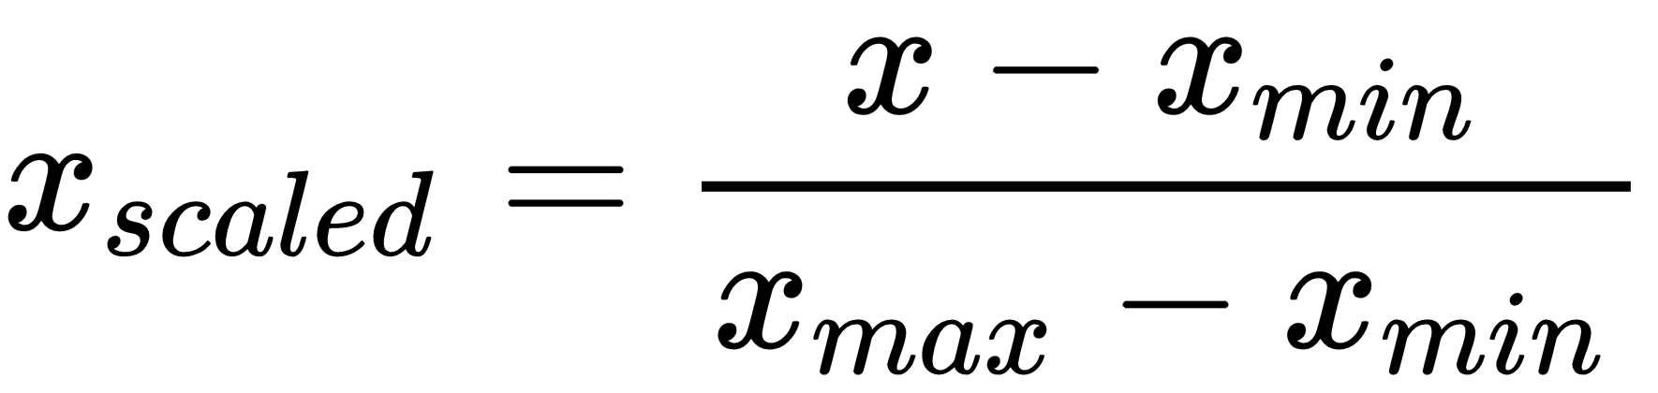
Normalization
The data was compressed to the minimum maximum range with the Standard Scaler.

Slide 11
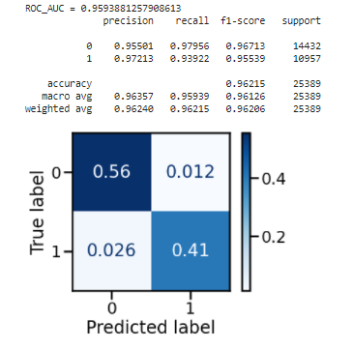
Random Forest

Slide 12
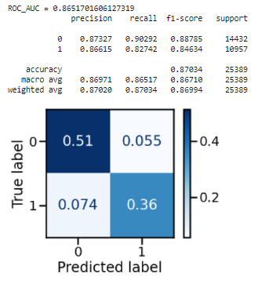
Logistic Regression

Slide 13
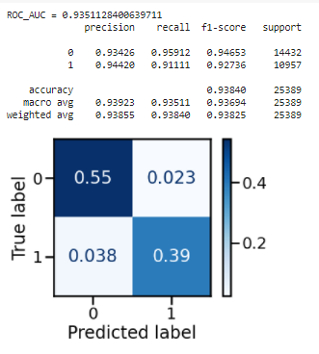
XGBoost

Slide 14
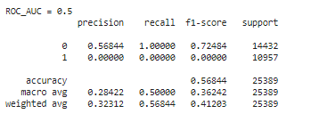
Gaussian Navie Bayes

Slide 15
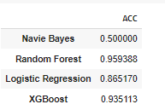
Classification
Random Forest (Library)
Logistic Regression(Library)
XGBoost(Library)
Gaussian Navie Bayes(Implementation)

