Slide 1
The EKF tracks six states; the rest of the system sees four
State vector of fusion/Ekf, with the sensor that drives or corrects each state
SENSORS
STATE
HOW EACH STATE IS DETERMINED
No sensor measures x, y yet: they follow from speed and heading (map updates come later).
x, y
position of the rear axle (m)
integrated speed and heading
dx/dt = v·cos ψ, dy/dt = v·sin ψ
Gyro
yaw rate ω · 100 Hz
predict
ψ yaw
heading (rad)
integrated gyro rate, minus the bias
dψ/dt = ω − b
Accelerometer
forward acceleration · 100 Hz
predict
v
speed along the car (m/s)
integrated accelerometer, corrected by wheel speed
dv/dt = a
Wheel encoders
ticks → speed over 0.2 s · 50 Hz
k odometry scale
wheel size error (1 = nominal)
wheel speed vs integrated accelerometer
z = k·v
update
Steering angle
front wheel angle δ · 50 Hz
update
b gyro bias
constant gyro offset (rad/s)
gyro vs steering angle
ω = b + v·tan δ / L
predict: gyro and accelerometer drive the motion model
update: wheel speed and steering angle correct the state
exposed as EstimatedState: x, y, ψ, v and their 4×4 covariance
internal: separate gyro bias and wheel error from the rest
Notes:
State vector of the EKF in fusion/ekf.hpp: x, y, yaw, v, gyro bias b, odometry scale k.
Predict (100 Hz): yaw' = gyro - b, v' = accelerometer; x and y integrate v and yaw.
Update (scalar, chi-square gated, Joseph form): wheel speed over 0.2 s windows, z = k*(v - a*W/2); steering angle, gyro = b + v*tan(delta)/L.
estimate() exposes x, y, yaw, v and the 4x4 covariance block; b and k stay inside the filter.

Slide 2
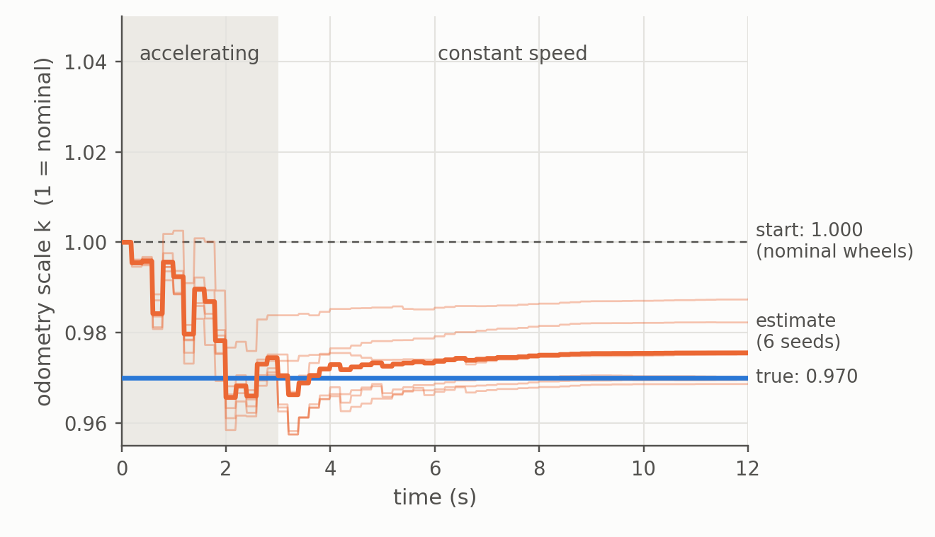
The odometry scale k is learned while the car accelerates
k = wheel speed computed from ticks ÷ true speed (1 = nominal 0.30 m wheels)
What it is
Estimated k, six noise seeds
Real wheels differ from the nominal 0.30 m radius, so the ticks give a wrong speed. 3% bigger wheels give 3% fewer ticks per meter: k ≈ 0.97.
k is constant during a run, but the ECU does not know it.
Why it matters
• 1% error in k is 1% of the distance driven.
• In a turn it looks like gyro bias: 0.02 m/s of speed error is about 0.002 rad/s of apparent bias, the size of a typical one. Without k the EKF blamed the gyro.
How it is estimated
1. Start parked: v = 0 is known.
2. While accelerating, integrate the accelerometer: v without using the wheels.
3. Compare with the wheel speed over 0.2 s: z = k·(v − ½·a·W).
4. The mismatch updates k.
Limit: at constant speed only the product k·v is measured, so k cannot be learned there.
Synthetic drive: wheels 3% larger, 3 s acceleration to 2 m/s, then constant speed. After 12 s the six estimates lie between 0.969 and 0.987 (slightly more scatter than the filter's σ, which fell from 3.0% to 0.6%).
0.42×
EKF position error vs dead reckoning, S1 circle, 6 seeds, default sensors
0.10×
same, with 3% wheel error and 0.01 rad/s gyro bias
Notes:
k = wheel speed computed from ticks / true speed. Real wheels differ from the nominal 0.30 m radius.
Why a state: on a constant-steering circle a 1% speed error looks like ~0.002 rad/s of gyro bias, so without k the steering update blamed the gyro (EKF worse than dead reckoning in some seeds, 3-sigma coverage as low as 44%). With k the covariance covered the real error in all 18 test runs.
Estimation: measurement z = k*(v - a*W/2), Jacobian [0 0 0 k 0 v_mean]. v comes from the integrated accelerometer starting from rest (prior 5 mm/s). At constant speed only k*v is measured, so k is not observable there.
Chart: synthetic drive, wheels 3% larger (true k = 0.970), prior sigma 3%, 3 s ramp to 2 m/s, six noise seeds. Mean 0.9705 at 3 s and 0.9755 at 12 s; individual seeds 0.969 to 0.987 at 12 s; reported sigma 0.6%, so the spread is a bit larger than the filter admits.
Tiles: scenario S1 (circle), mean over six seeds of the EKF position RMSE divided by dead reckoning's.

