Slide 1
BLG 561E Deep Learning
DETECTION OF AUTISM SPECTRUM DISORDER BASED ON DEEP FEATURES EXTRACTED FROM CONVOLUTIONAL NEURAL NETWORK MODEL
Ozan Güldali - 509191238
Cihat Kırankaya - 507192112
Notes:
Hi everyone. We want to present our study with my teammate Ozan which is related to DETECTION OF AUTISM SPECTRUM DISORDER BASED ON DEEP FEATURES EXTRACTED FROM CONVOLUTIONAL NEURAL NETWORK MODEL

Slide 2

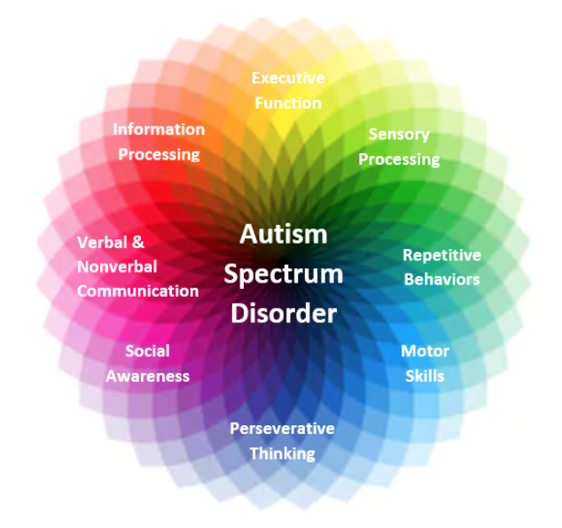
What is the problem to solve and why?
Accurate segmentation of the brain structure is extremely important for the correct diagnosis of diseases such as schizophrenia, Parkinson, and autism.
It has been evaluated that some abnormalities in the brain structure may be related to the diagnosis of various diseases and the emergence of possible behavioral disorders.
Notes:
1. Autism is known as a “spectrum” disorder because there is wide variation in the type and severity of symptoms people experience. ASD occurs in all ethnic, racial, and economic groups. Although ASD can be a lifelong disorder, treatments and services can improve a person’s symptoms and ability to function.
2. Therefore, it is extremely important to diagnose the disease early, without human errors, and in an automatic way. For all these reasons, it is determined crucial to include a study in which autism is diagnosed with a deep learning model based on MRI brain data to the literature.

Slide 3
Literature Review
Author | Year | Subject |  | Model | Accuracy(%)
 |  | ASD | Normal
Kong et al. [6] | 2019 | 78 | 104 | Autoencoder | 90.39
Saeed et al. [13] | 2019 | 505 | 530 | Autoencoder | 70.10
Anirudh et al. [10] | 2019 | 404 | 468 | Graph CNN | 70.8
Yao et al. [14] | 2019 | 438 | 544 | Graph CNN | 67.3
Li et al. [7] | 2018 | 82 | 48 | 3D CNN | 89.0
Heinsfeld et al. [15] | 2018 | 505 | 530 | Autoencoder | 70.0
Khosla et al. [8] | 2018 | 542 | 625 | 3D CNN | 73.30
Bi et al. [11] | 2018 | 50 | 42 | RNN | 84.7
Ktena et al. [18] | 2018 | 403 | 468 | Graph CNN | 62.90
Guo et al. [5] | 2017 | 55 | 55 | Autoencoder | 86.36
Choi et al. [16] | 2017 | 465 | 507 | Autoencoder | 60.00
Hazlett et al. [17] | 2017 | 106 | 42 | Autoencoder | 88.00
Parisot et al. [9] | 2017 | 403 | 468 | Graph CNN | 69.50
Notes:
Many studies have been conducted for ASD diagnosis. Studies mostly focused on CNN, RNN and Autoencoder based models. A few of these are summarized in the table. It can be said that most of the work has focused on CNN and autoencoder.

Slide 4
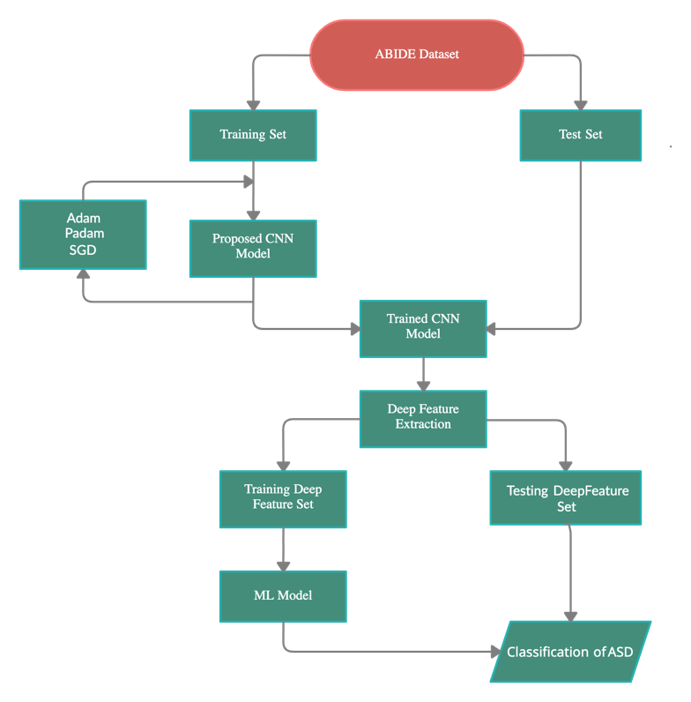
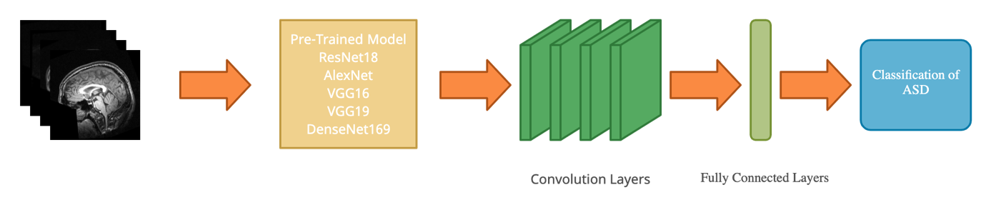
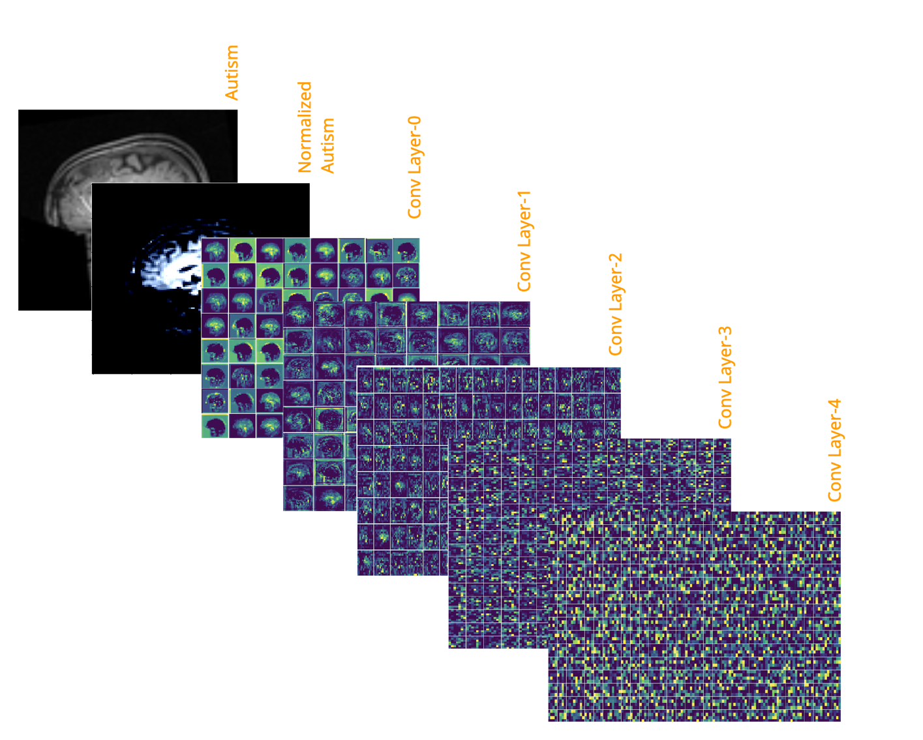
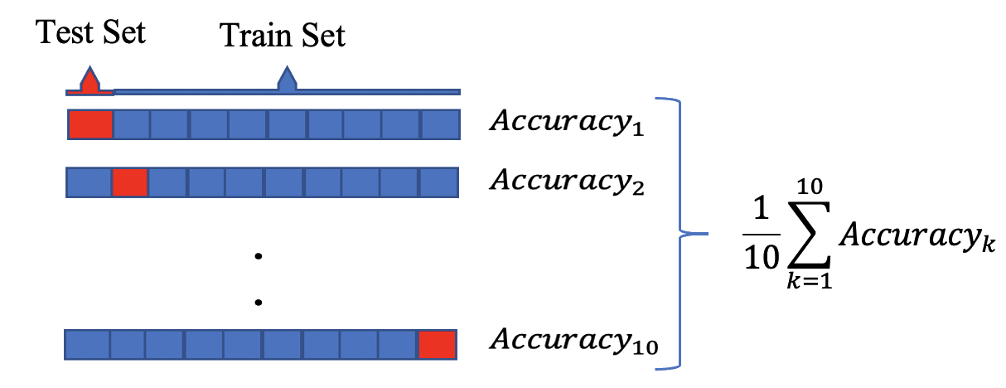

What is the solution and hypothesis?
Cross-Entropy Loss
Test
Train
$$\frac{1}{10}\sum_{k=1}^{10}{{Accuracy}_{k}}$$
10-Fold CV
Notes:
1. We have proposed classification of ASD by Machine Learning algorithms using deep features obtained from deep convolution neural network based on pre-trained models.
2.3 For this aim, we have used ResNet18, AlexNet, VGG16, VGG19 and DenseNet169 pre-trained models to obtain a higher prediction accuracy for dataset. Each data was resized to 112*112, center cropped, gray-scaled, and normalized. In final results, batch size as 32 was used. Each experiment was run on 200 epochs with validation using test data once in 10 epochs. Moreover, on each validation and the final test, the accuracy was compared with the previously stored results and saved as a new model weight *.pth file if it is better than the olders.
The model that gives the best result among the pre-train models has been used to extract deep features of dataset, then the features were inserted into ML algorithms to final classification. The results of SVM, kNN and Logistic Regression models with 10-Fold cross validation were analyzed comparatively.

Slide 5



Objective function
$$NLLLoss\left(x,y\right)=\sum_{n=1}^{N}{{l_{n}}/{\sum_{n=1}^{N}{w_{y_{n}}}}}$$
$$l_{n}= −w_{y_{n}}x_{n, y_{n}} ; w_{c}=weight\left[c\right]$$
$$\sum_{\left(x,y\right)}{\left(−log{(}\frac{\left.exp{(}x[class]\right)}{\sum_{j}{\left.exp{(}x[j]\right)}})\right)}$$
$$LogSoftmax(x_{i})=log(\frac{\left.exp(x_{i}​\right)}{\sum_{j}{\left.exp{(}x_{j}\right)}}​)$$
Take the average across observations for each minibatch to compute the final loss function
Notes:
1.2.3.4Cross-Entropy as the combination of Log SoftMax and Negative Log-Likelihood Loss was chosen to be the objective loss function on CNN models

Slide 6
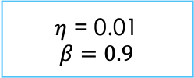

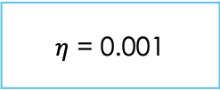



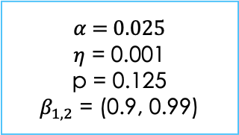
How to optimize the objective function?
f($θ$) = $\min_{θ}{\sum_{\left(x,y\right)}{\left(−log{(}\frac{\left.exp{(}x[class]\right)}{\sum_{j}{\left.exp{(}x[j]\right)}})\right)}}$
PADAM
ADAM
SGD Momentum
$$g_{t}=∇_{θ}f_{t}(θ_{t−1})$$
$$m_{t}=β_{1}m_{t−1}+(1−β_{1})g_{t}$$
$$υ_{t}=β_{2}υ_{t−1}+(1−β_{1})g_{t}^{2}$$
$${\hat{υ}}_{t}=max⁡({\hat{υ}}_{t−1}, v_{t})$$
$$θ_{t}=θ_{t−1}−η(\frac{m_{t}}{{{\hat{υ}}_{t}}^{p}}+{αw}_{t−1})$$
f : loss function
$α$: weight decay
$η$: initial learning rate
$p$: partially adaptive parameter
$$β_{1,2}:momentum parameters$$
$$g_{t}=∇_{θ}f_{t}(θ_{t−1})$$
$$m_{t}=β_{1}m_{t−1}+(1−β_{1})g_{t}$$
$$υ_{t}=β_{2}υ_{t−1}+(1−β_{1})g_{t}^{2}$$
$$θ_{t}=θ_{t−1}−η\frac{{m_{t}}/{\left(1 − β_{1}^{t}\right)}}{\sqrt{{v_{t}}/{\left(1 − β_{2}^{t}\right)}}+ε }$$
f : loss function
$$β_{1,2}:momentum parameters$$
$η$: initial learning rate
$g_{t}$: gradient at time t along w
$$g_{t}=∇_{θ}f_{t}(θ_{t−1})$$
$$υ_{t}=βυ_{t−1}+(1−β)g_{t}$$
$$θ_{t}=θ_{t−1}−ηυ_{t}$$
f : loss function
$η$: initial learning rate
$β$: momentum parameter
$η$ = 0.01
$$β=0.9$$
$η$ = 0.001
$α$ = 0.025
$η$ = 0.001
p = 0.125
$β_{1,2}$ = (0.9, 0.99)
Notes:
All pre-trained models were trained with Adam, Padam and SGD Momentum optimizers.
Final hyperparameter settings are as seen ! (learning rate as 0.01 and momentum as 0.9 for SGD Momentum, learning rate as 0.001 for Adam, learning rate as 0.001, partial as 0.125, weight decay as 0.025 and betas as (0.9, 0.99) for Padam.)
Moreover, for Adam and Padam, the learning rate was reduced by 0.1 for each quarter of total epoch size.

Slide 7
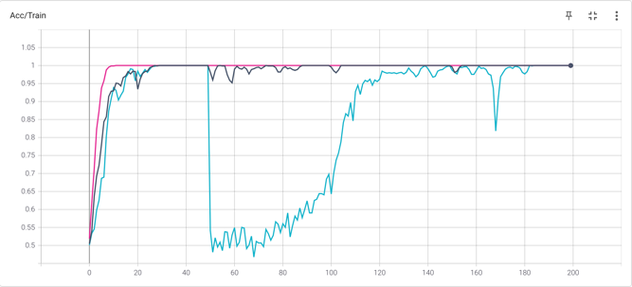
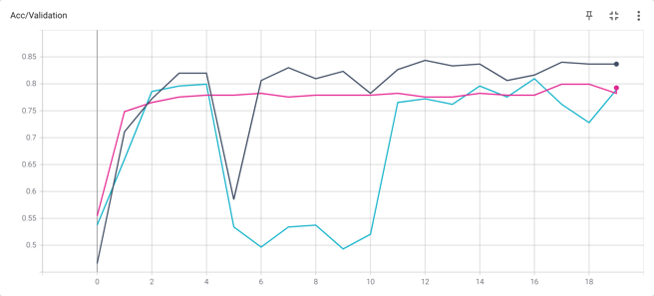
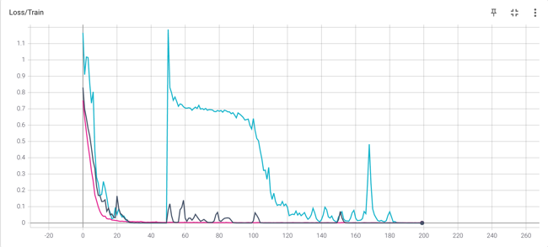
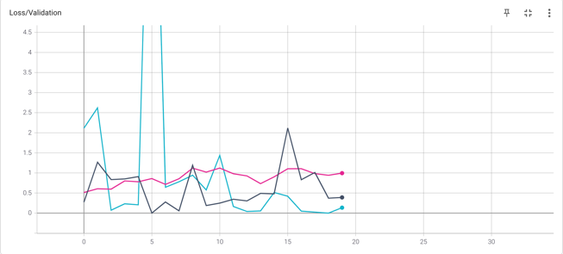
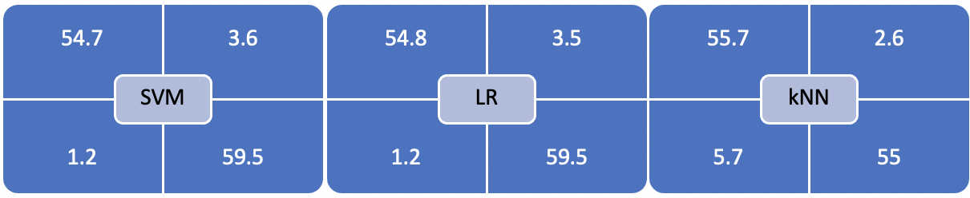
Result interpretation
 | Test Accuracy (%)
CNN Model | Adam | SGD Momentum | Padam
Resnet18 | *84.35(120 epoch) | 80.95 (160 epoch) | 79.93 (180 epoch)
AlexNet | 79.93 (60 epoch) | 78.57 (80 epoch) | 78.23 (180 epoch)
VGG16 | 80.61 (20 epoch) | 79.93 (80 epoch) | 81.63 (190 epoch)
VGG19 | *83.33 (30 epoch) | *82.65 (100 epoch) | 78.23 (60 epoch)
DenseNet169 | 81.97 (40 epoch) | 80.27 (50 epoch) | 79.59 (190 epoch)
Approach | Method | Accuracy (%) | Sensitivity (%) | Specificity (%)
Machine Learning (10-Fold CV) | Support Vector Machine | 62.26 | 63.67 | 61.28
 | *Logistic Regression | 63.94 | 63.23 | 64.63
 | k-Nearest Neighbors | 57.22 | 54.51 | 63.24
Convolutional Neural Networks | *Resnet18 (Adam) | 84.35 | 90.51 | 78.98
 | VGG19 (Adam) | 83.33 | 89.20 | 78.06
 | VGG19 (SGD+Momentum) | 82.65 | 86.01 | 79.47
ML Classifier with Deep Features Extracted from CNN | SVM with feature extraction of Resnet18 | 95.96 | 97.85 | 94.29
 | LR with feature extraction of Resnet18 | 96.05 | 97.85 | 94.44
 | kNN with feature extraction of Resnet18 | 93.02 | 90.71 | 95.48
Notes:
The most used pre-trained models on MRI datasets have been trained and tested.
It can be seen from the table that the best result was obtained by using Adam optimizer in ResNet18 model ! (with 84.35%)
Validation and loss curves for ResNet18 with experienced optimizers are as seen.
The deep features obtained from ResNet18 are used to train and test on ML algorithms.
The best results were obtained with Logistic Regression using deep features from ResNet18 pretrained model ! (as the accuracy of 96.05% and the AUC score of 0.9855.)
Confusion Matrix after cross validation are as seen

Slide 8
Recap
Autism spectrum disorder (ASD) is a common neuro developmental disorder, which has affected a lot of cases. Hence It has been evaluated that it is crucial to classify autism spectrum disorder quickly and effectively.
We have used ResNet18, AlexNet, VGG16, VGG19 and DenseNet169 pre-trained models to obtain a higher prediction accuracy for dataset.
The model that gives the best result among the pre-train models has been used to extract deep features of dataset, then the features were inserted into ML algorithms to final classification.
The best results were obtained with Logistic Regression using deep features from ResNet18 pre-trained model as the accuracy of 96.05%.
Notes:
Autism spectrum disorder (ASD) is a common neurol developmental disorder, which has affected a lot of cases. Hence It has been evaluated that it is crucial to classify ASD quickly and effectively.
The study consists of 2 main stages. In phase 1, The most used pre-trained models with cross entropy loss function have been trained with Adam, Padam and SGD Momentum optimizers and tested.
In phase 2, the deep features obtained from ResNet18 pre-trained model were used to train and test on ML algorithms with 10-Fold Cross Validation. It is considered that the results are better than other results in the literature and a significant contribution to the literature for the diagnosis of Autism.

Slide 9
THANK YOU!

