Slide 1
Coursera Capstone Project
Determining the best business places for the Restaurants,Cafes and Coffee Shops .

Slide 2
Project Description and Aims
This Project is combining the datas from the web , and finding the neighborhoods for the capital of Turkey, Ankara and its most crowded borough named as Çankaya.
When it comes to job or making business you need to determine the most valuable and most income purposes . To do this, you should determine your business as much as trending and prevent the overwhelming business areas .
This Project aims that finding not only the best places for the restaurants , coffee shops and cafes but also preventing the lower customer issues or high demanding , overwhelming places.

Slide 3
Technologies used in this Project
In this Project , in making process , used a lot of technology ;
Coding with Python 3.0
Foursquare Api ( for the finding places locations Nominator library)
BeautifulSoup ( for the web scrapping)
www.nufusune.com ( Ankara,Çankaya province’s neighborhoods)
Github
Ipython and Ibm Cloud .

Slide 4
Processings while Development
First when i get the data ;
Business Understanding ( Where is the best locations to build such restaurant,coffee shops and cafes )
Algorithms is ( more than 5 cafes and less than 20 ). For example if a place 500 metres around from the center has less than 5 restaurant , we could say there is not restaurant trend , by the way , if a place in 500 metres has more than 20 restaurant , you may face with the lack of customers .
Data collection process ( Web scrapping from the www.nufusune.com ) cont..

Slide 5
Processing while Development
Data Understanding ; Getting data from the web site and clean it use such Neighborhoods names and fit these the pandas DataFrame
Data Preperation : Adding Locations to the DataFrame and using one hot coding style for the Clustering algorithms .
Modeling : Data Clustering algorithms used as K-Means Clustering .

Slide 6
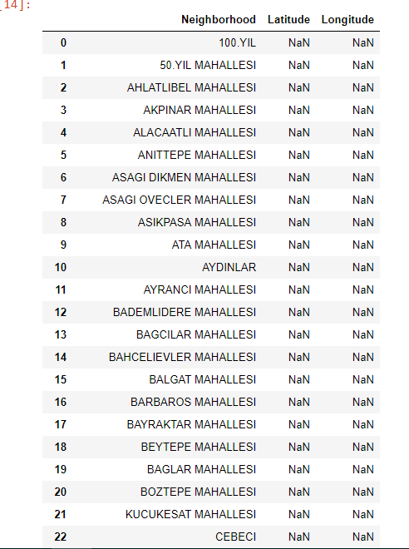
Project Elements
Data :

Slide 7
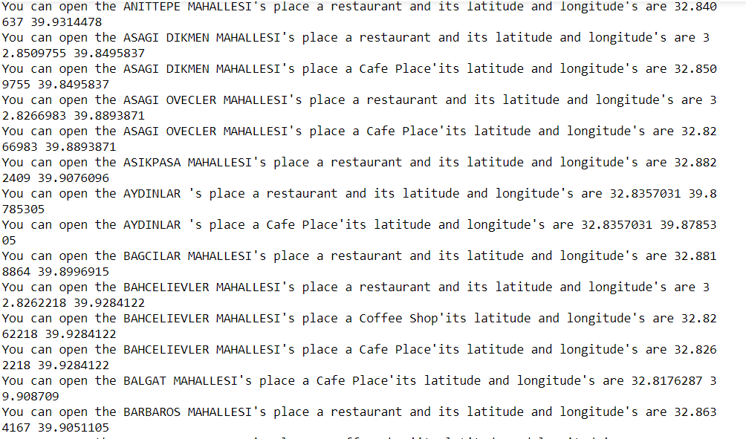
Report Section
Two report i have prepared for this Project First is algorithm used Report Second is Clustering used report for the best 10 Venue .

Slide 8
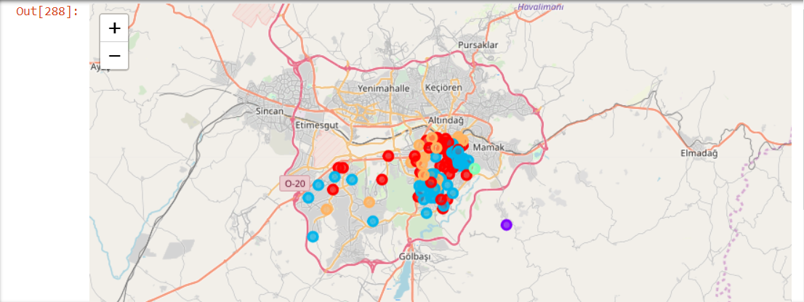
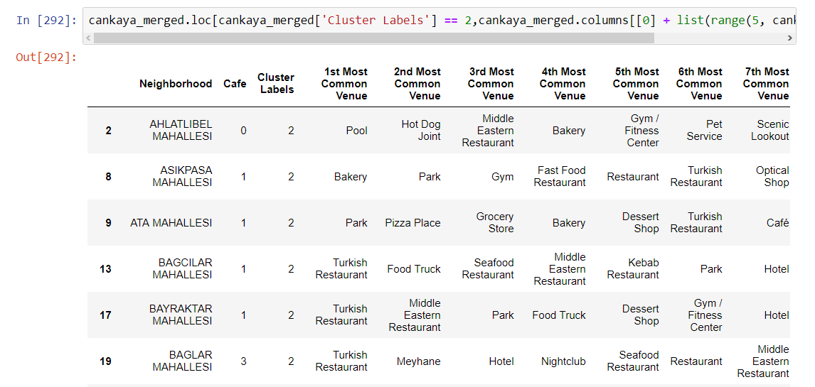
Report 2

Slide 9
Conclusion
This Project is in the iterating process , can be developed like compera first report analysis with second report analysis .Maybe in the future can be added extra features like neighborhoods price average , human population and universities . Because these features can increase the places choosing for the opening new venue .
Thank YOU IBM

