Slide 1

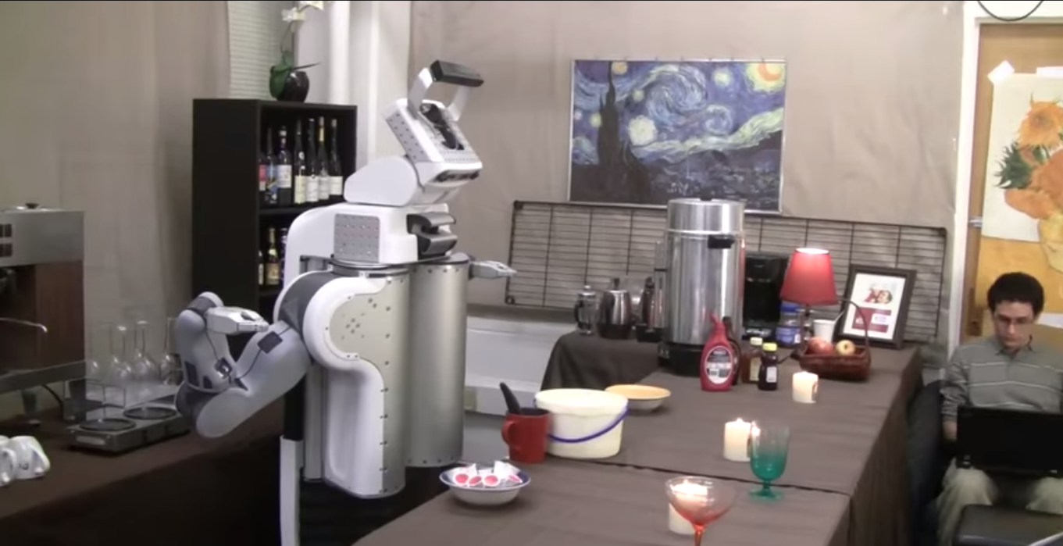

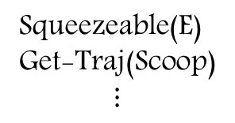
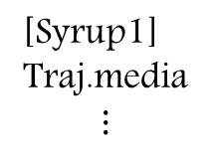
syrup1
pot1
Ice-cream1
Squeezeable(E)
Get-Traj(Scoop)
$$⋮$$
[Syrup1]
Traj.media
$$⋮$$
grasp(spoon1)
scoop(spoon1,ice-cream1)
place(ice-cream1,pot1)
place(spoon1,table1)
grasp(syrup1)
squeeze(syrup1,pot1)
“add ice-cream to cup and drizzle syrup over it”
$$argmax_{I} P(I|E,L)$$

Slide 2
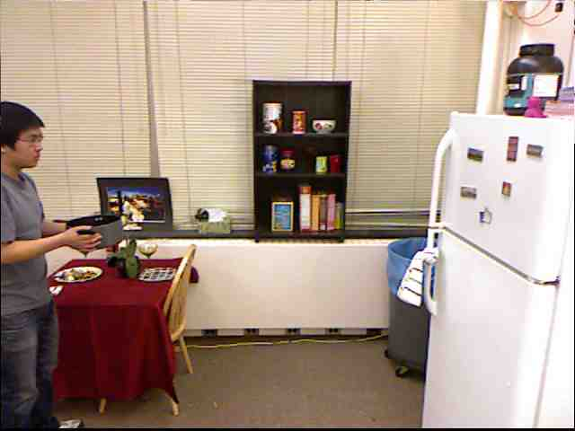
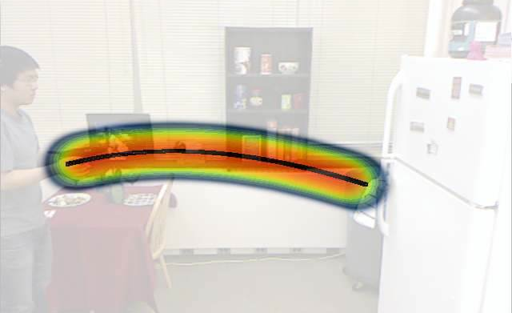
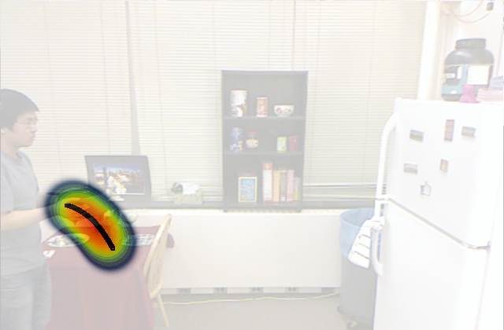
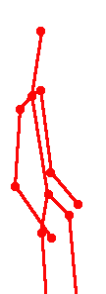
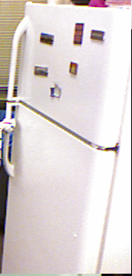
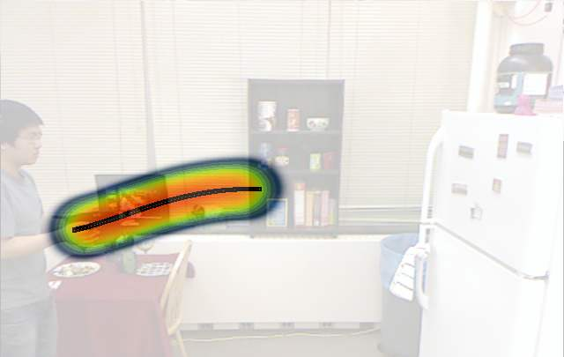

Top Anticipations
reaching
{reachable}
stationary
anticipation
moving
placing
moveable
{placeable , reachable}

