Slide 1
CE461- COMPUTER APPLICATIONS IN FOUNDATION ENGINEERING
Immediate Settlement of Foundations on Clay

Slide 2
Immediate settlement:
S_{i} = μ₀.μ₁.q.B/E
S_{i} : immediate settlement on clay (mm)
q : average applied vertical pressure (kPa)
B : width of the foundation (m)
E : modulus of elasticity of the soil (MPa)

Slide 3
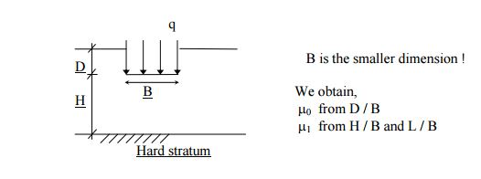
μ₀ and μ₁ are empirical factors dependent on foundation geometry and depth (dimensionless parameters).

Slide 4
D : depth of the foundation (m)
H : the vertical distance between hard stratum and the base of the
foundation (m)
L : length of the foundation (m)

Slide 5
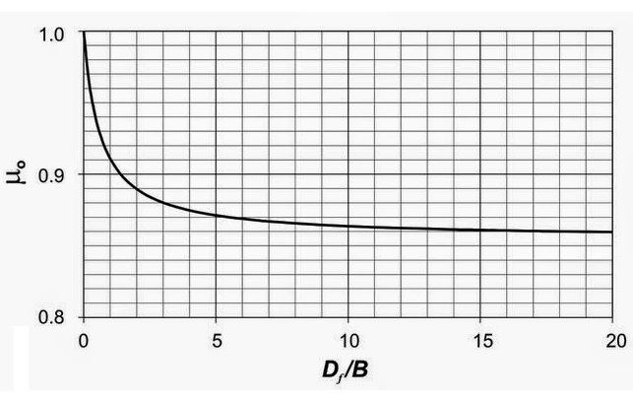
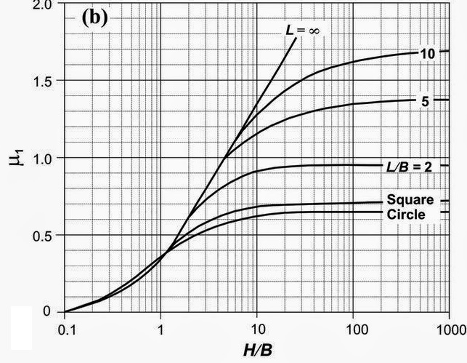
Janbu, Bjerrum and Kjaernsli (1956)

Slide 6
Janbu, Bjerrum and Kjaernsli (1956)
Excel drawing to obtain μ₀

Slide 7
Janbu, Bjerrum and Kjaernsli (1956)
Excel drawing to obtain μ₁

Slide 8
General Considerations
Clay layers
Water table at ground surface
In calculation of the shape factors (μ₀ and μ₁), curve are fitted in excel and equations of these curve are used in the code.
Foundation rigidity and depth factors are not applied to this calculation.
Principle of superposition
A guide for CE366 Foundation Engineering I students

Slide 9
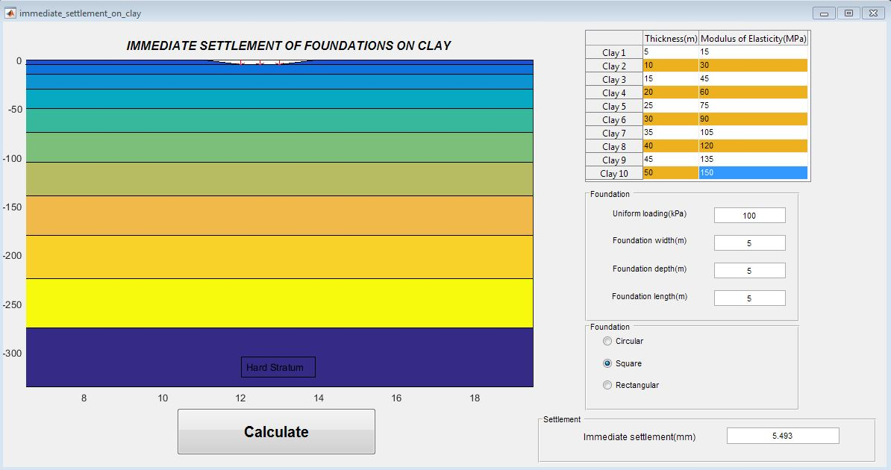

Slide 10
What I Did?
Immediate settlement were determined.
A simple hand design were done.
Different and found formulations were brought together in MATLAB GUI.
Algorithm was developed, and coded.

