Slide 1
from Department of Civil Engineering

Slide 2
Outline
Introduction
Body
-Membership cards/points
-"Happy Friday"
Closure

Slide 3
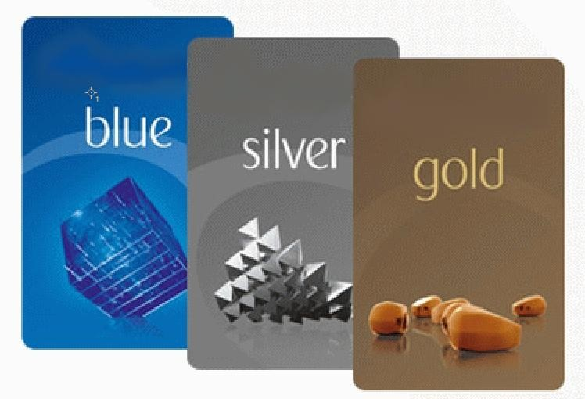
1)Membership cards/points

Slide 4
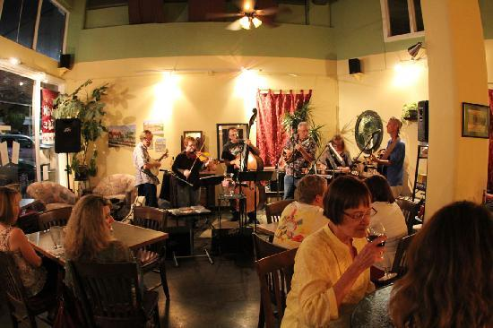
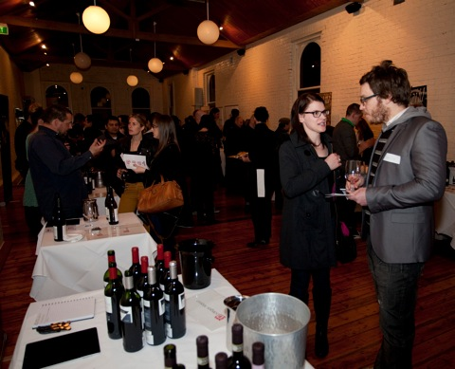
Classical music Wine session

Slide 5

2)"Happy Friday"

