Slide 1
From Department of Civil Engineering

Slide 2
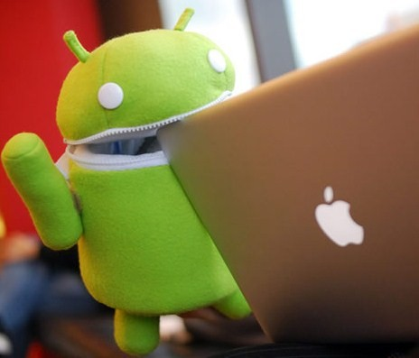
Differences between Iphone and Android?

Slide 3
Outline • Software • Hardware

Slide 4
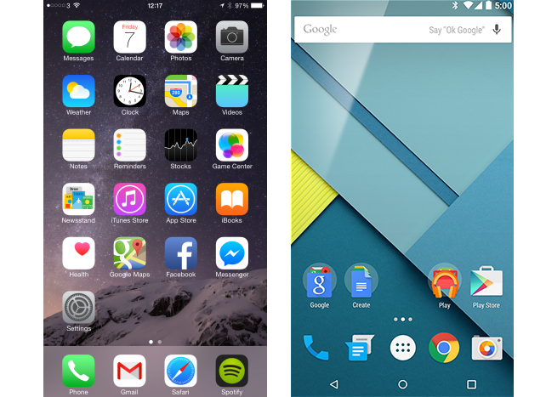
Software

Slide 5
Software
iOS
Android
Closed source
High security
Open source
Low security

Slide 6
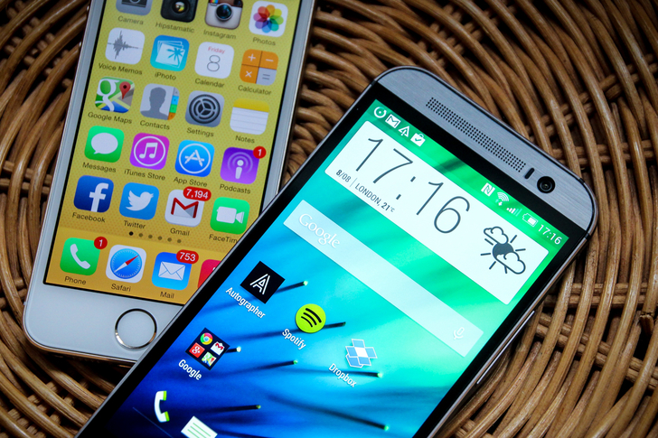
Hardware

Slide 7
Hardware
Iphone
Android
Only Apple Inc.
Short battery life
Many device manufacturer(LG,Samsung,HTC,Sony,Motorola,and many more)
Long battery life

Slide 8
" Apple offers users a single choice:what model of iPhone do you want(6 Plus,6,5S,5C),not what company's phone and then what model.Of course,some people may prefer the greater choice Android offers.Others,though,will appreciate the simplicity and quality offered by the iPhone." Sam Costello iPod/iPhone Expert

Slide 9
References
http://www.computerworld.com/article/2468474/mobile-apps/iphone-vs--android--five-points-of-difference.html4
http://ipod.about.com/od/iphonevscompetitors/tp/Iphone-Or-Android-which-to-buy.htm
http://www.emarketer.com/Article/Smartphone-Users-Worldwide-Will-Total-175-Billion-2014/1010536

