Slide 1
from Department of Civil Engineering

Slide 2
Outline
-Summarizing
-My reaction
-Conclusion

Slide 3
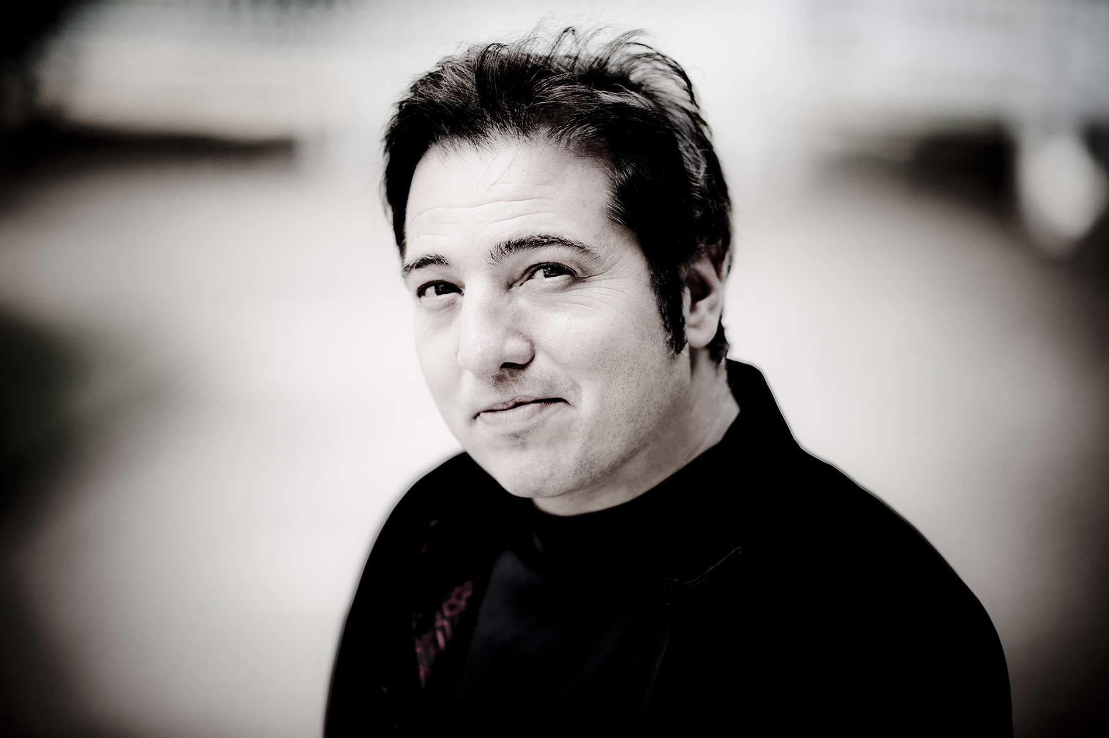
Is Fazıl Say really guilty ?

Slide 4
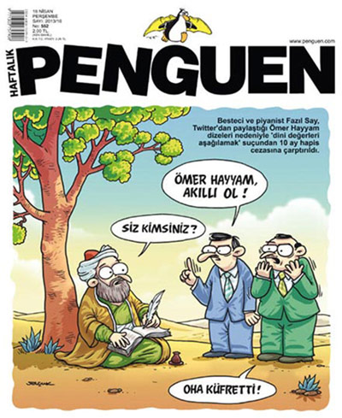
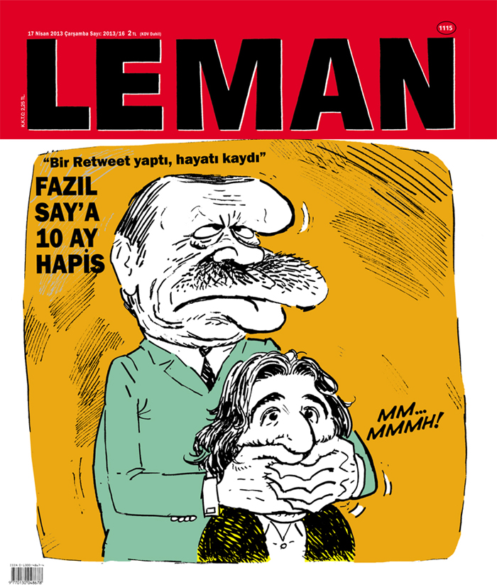
- He convicted of denigrating religion because of statements he made on Twitter.

Slide 5
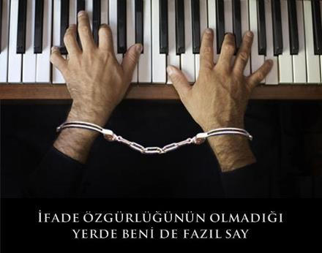
In a democratic country,freedoms of expression and religion should be guaranteed by government.

Slide 6
References: http://www.dailymail.co.uk/news/article-2309716/Fazil-Say-Turkish-composer-convicted-denigrating-religion-Twitter-jokes-Islam.html

