Slide 1
From Department of Civil Engineering

Slide 2
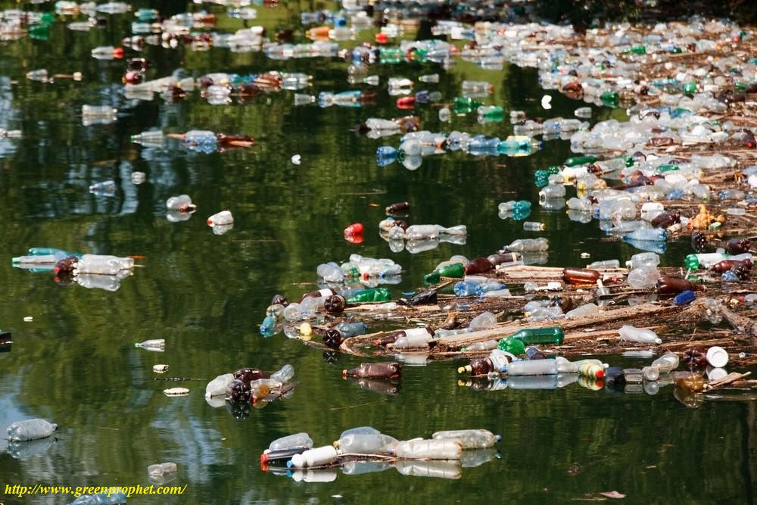

Slide 3
The Reasons of the Using Reusable Water Bottles
Environmental
Economical

Slide 4
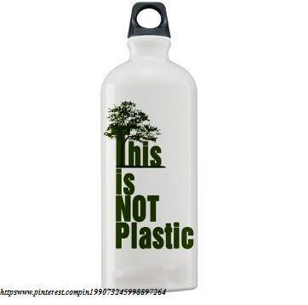

Slide 5
Enviromental
According to Ketcham;
The time of decomposition of plastic bottles is 700 years.

Slide 6
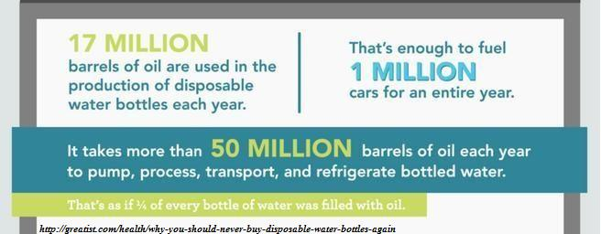
Enviromental

Slide 7
Economical
Tap water (in reusable water bottles)
Bottled water (in plastic water bottles)

Slide 8
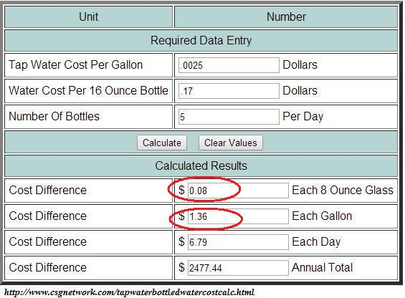
Economical

Slide 9
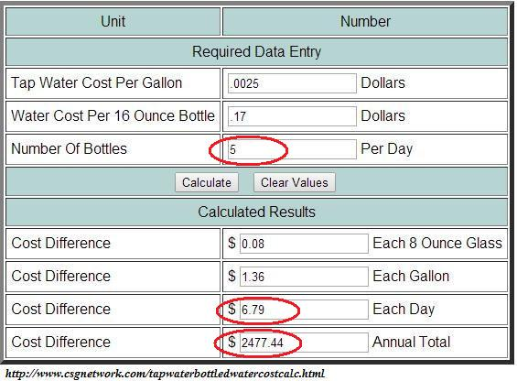
Economical

Slide 10
Reference List
Ketcham, S.(n.d.).Reusing Plastic Water Bottles.Retrieved June 4, 2015, from http://greenliving.lovetoknow.com/Reusing_Plastic_Water_Bottles
Speer,A.(2012,January 6).Reusable Water Bottles Help You Go Green and Stay Healthy.Retrieved June 4, 2015, fromhttp://www.isustainableearth.com/green-products/reusable-water-bottles-help-you-go-green-and-stay-healthy
Tap Water Bottled Water Cost Calculator(n.d.).Retrieved June 4, 2015, from http://www.csgnetwork.com/tapwaterbottledwatercostcalc.html
Why You Should Never Buy Disposable Water Bottles Again(2015, January 20). Retrieved June 4, 2015, from http://greatist.com/health/why-you-should-never-buy-disposable-water-bottles-again

