Slide 1
THE WATER SUPPLY SYSYTEM
BASTON CONSTRUCTION
Advısor :

Slide 2
OUTLINE
INTRODUCTION
POPULATION FORECASTING
GUIDELINES FOR FORECASTING AMOUNT OF DRINKING WATER
DETERMINATION OF WATER TANKS AND WATER RESOURCES
DETERMINATION OF PIPE SIZES
CONCLUSION

Slide 3
PART I INTRODUCTION

Slide 4
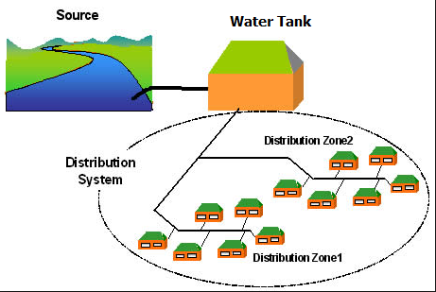
What is Water Supply System ?

Slide 5
Why water supply is important ?
Turkey has 112 billion m³ in total and 1500 m³ individual wastable water potential.
Water is a neccessity for life and our mission as an engineer is bringing that water to the people.

Slide 6
The Water Supply System will be designed in our project for following villages
Eskiköy
Dipsizgöl
İclaliye
İsaören
Karakadı
Kestanealan

Slide 7
PART II POPULATION FORECASTING
Methods Used:
İller Bankası Method
Arıthmetıc Increase Method

Slide 8
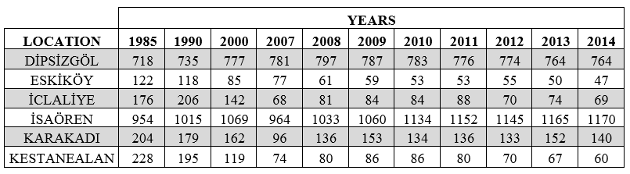
Table 1: Population Census Results of the Districts from 1985 to 2014

Slide 9

İller Bankası Method
In this method, increase coefficient (Ç) is calculated firstly by using the following formula:
$$Ç = [ {(N_{S} / N_{E})}^{(t_{S}−t_{E})} – 1 ] x 100$$
N_{S}: The last population census value
N_{E}: The firtst population census value
t_{S}: The year at the last population census
t_{E}: The year at the first population census

Slide 10
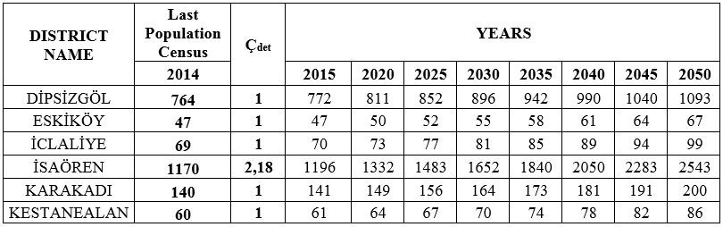
Table 2.2: Estimated Populations for Each District

Slide 11

Arithmetic Increase Method
In Arithmetic Increase Method, arithmetic increase coefficient (k_{a}) is calculated by using the following formula, for each time interval at that population census is taken.
$$k_{a} =\frac{N_{s}−N_{E}}{t_{S}−t_{E}}$$
N_{S}: The last population census value
N_{E}: The firtst population census value
t_{S}: The year at the last population census
t_{E}: The year at the first population census

Slide 12
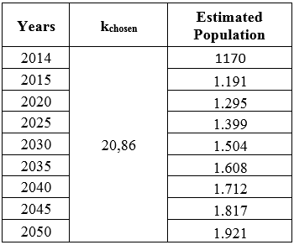
Table 2.3: Chosen Arithmetic Increase Coefficient and Estimated Populations for İsaören

Slide 13
Comparison of two methods on same graph for İsaören

Slide 14
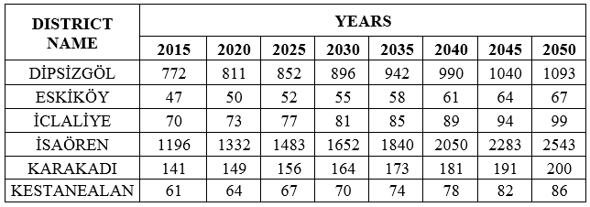
Table 2.4: Populations for Each District According to Preferred Method

Slide 15
PART III FORECASTING AMOUNT OF DRINKING WATER
StartIng forecastIng process
ObtaINIng water consumptIon
DSI specIfIcatIons

Slide 16
Daily Water Consumption for People and Animals
For our districts; each person 150 l/person-day
After 2045 → 170 l/person-day
For bovine animals; 50 l/head-day
For ovine animals; 15 l/head-day

Slide 17
Daily Water Consumption for Facilities
In boarding schools for each student 100 l/person/day
In non-boarding schools for each student 50 l/person/day
In military; for each soldier 100 l/person/day
Factories or big companies; customer and/or worker 50 l/person/day
Daily tourism, for each person 75 l/person/day

Slide 18
Unusual Situations
Peak Coefficient ( 1.5 & 2.0 )
→→ Q_{max},_{daily} = Q_{mean},_{daily} x Peak coefficient

Slide 19
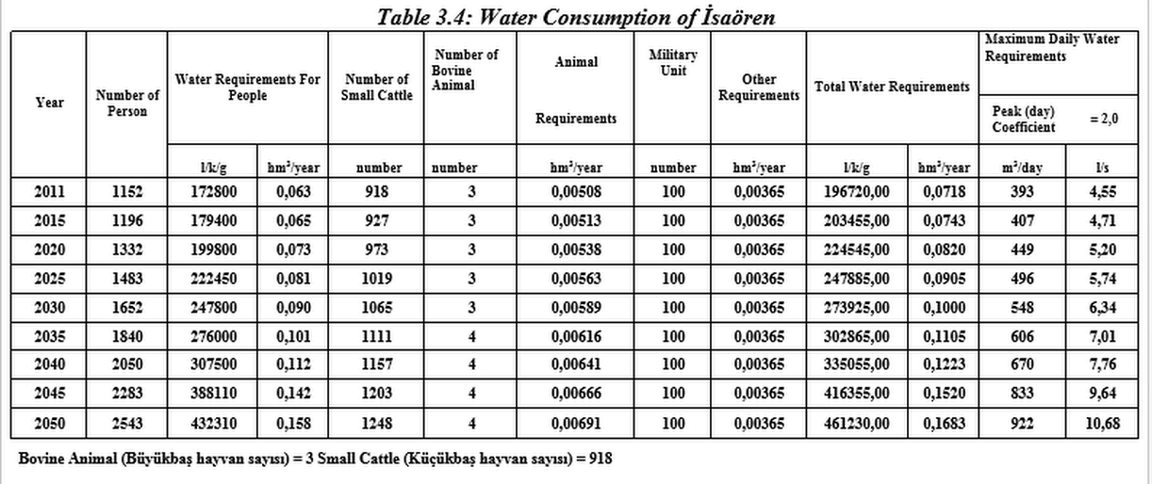
Most Crowded District İsaören

Slide 20
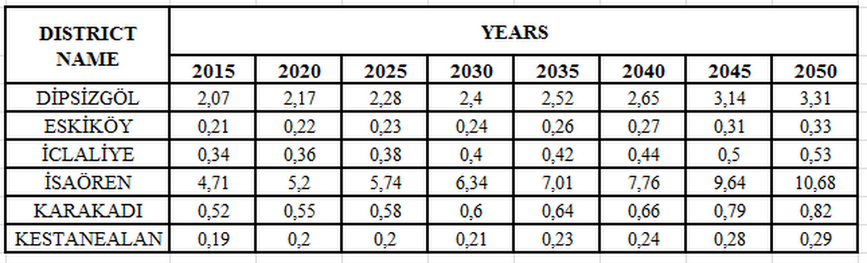
Table 3.7: General Daily Water Consumptions (l/s)

Slide 21
PART IV DETERMINATION of WATER TANK & WATER RESOURCE

Slide 22
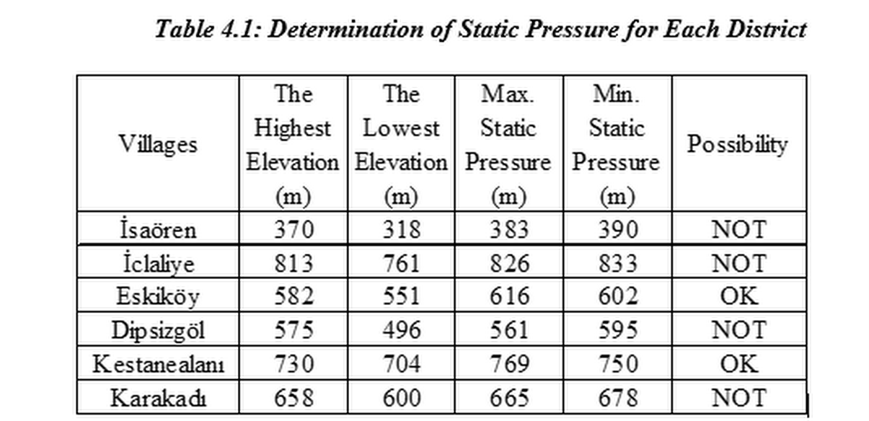
Determination of Static Pressure for Each District

Slide 23
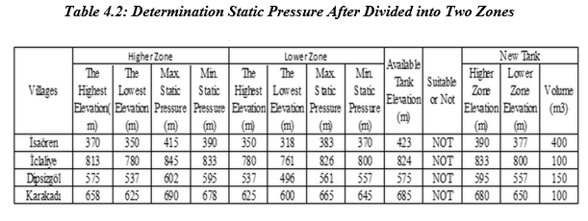
Determination Static Pressure After Divided into Two Zones

Slide 24
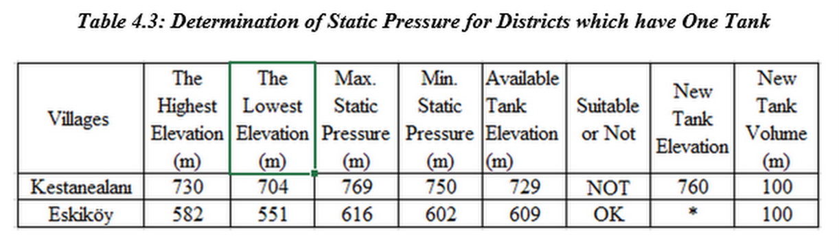
Determination of Static Pressure for Districts which have one tank

Slide 25
WE DECIDE ;
Two new tanks for İSAÖREN, DİPSİZGÖL, KARAKADI, İCLALİYE
One new water tank for KESTANEALANI
Available water tank can be used after fixing for ESKİKÖY

Slide 26
PART V DETERMINATION of PIPE SIZES AND LENGTHS

Slide 27
Q= V*A
Q= required discharge (m3/s)
V= calculated velocity (m/s)
A=Area of pipe (m2)

Slide 28
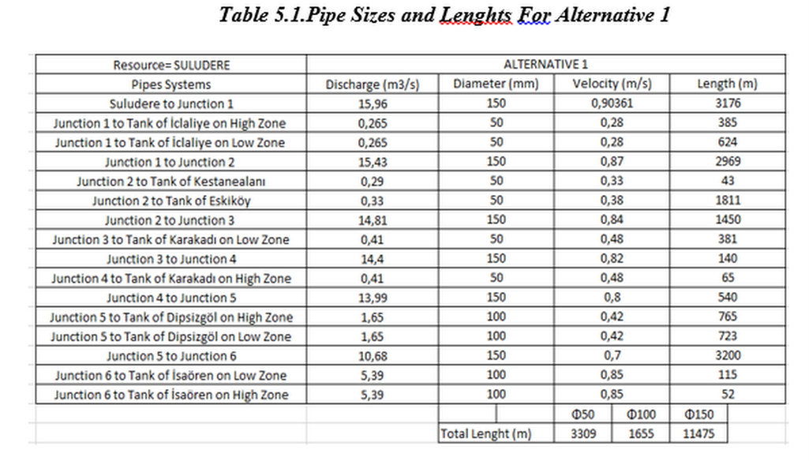
Pipe Sizes and Lengths for Alternative 1

Slide 29
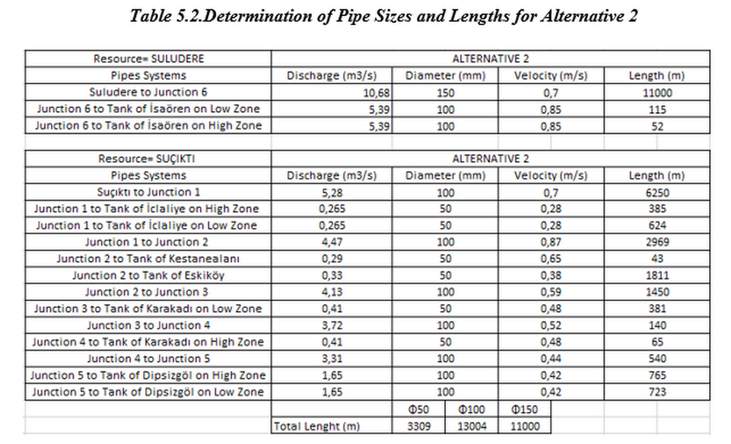
Determination of Pipe Sizes and Lengths for Alternative 2

Slide 30
LAST PART CONCLUSION AND DISCUSSION OF RESULTS

Slide 31
What was done?
Calculation of population
Calculation of daily drinking water demand

Slide 32
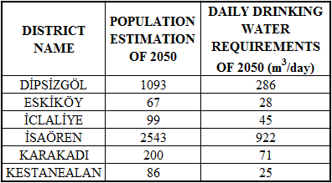
Table 6.1: Estimations of 2050 for each districts

Slide 33
What was done?
Determining location and volume of water tanks
Determining sources of the water tanks
Determining pipeline alternatives
Calculating the properties of pipes

Slide 34
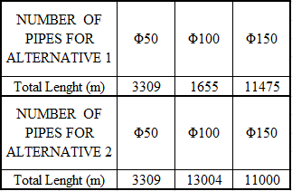
Table 6.2: Number of Pipes for Each Alternatives

Slide 35
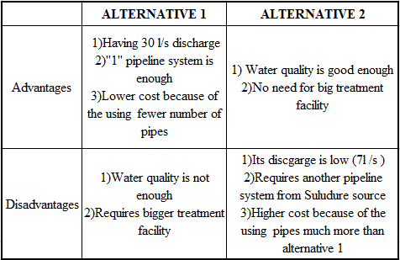
Table 6.3: Advantages and Disadvantages of Alternatives

Slide 36
Which alternative should be chosen?
Alternative 1
Alternative 2

Slide 37
REFERENCES
http://www.tuik.gov.tr
İÇMESUYU TESİSLERİ ETÜT, FİZİBİLİTE VE PROJELERİNİN HAZIRLANMASINA AİT TEKNİK ŞARTNAME prepared by İller Bankası in 2013
NÜFUS VE İÇMESUYU TAHMİN ESASLARI prepared by DSI
Inventories prepared by TEMELSU
https://www.google.com.tr/images/constructionofpipe
http://www.kalkinma.gov.tr

