Slide 1
Waste Water Project
CE410-Civil Engineering Design

Slide 2
OUTLINE
INTRODUCTION
POPULATION PLANNING
DESIGN OF PIPELINES
PUMP SELECTION
PUMP STATION

Slide 3
WASTEWATER / STORMWATER COLLECTİON SYSTEMS
Wastewater collection systems are used to collect and transmit liquid wastes to a central treatment plant.

Slide 4
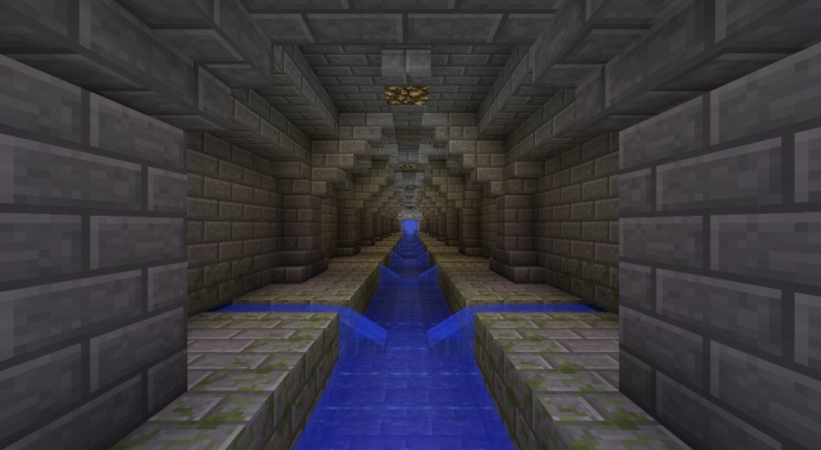
→sewers

Slide 5
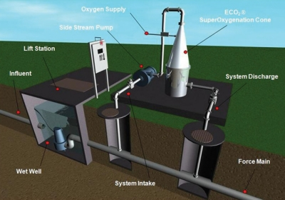
→force mains

Slide 6
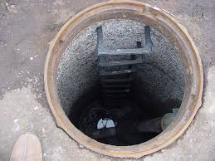
manholes

Slide 7
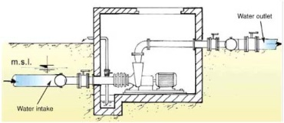
→ pump stations

Slide 8
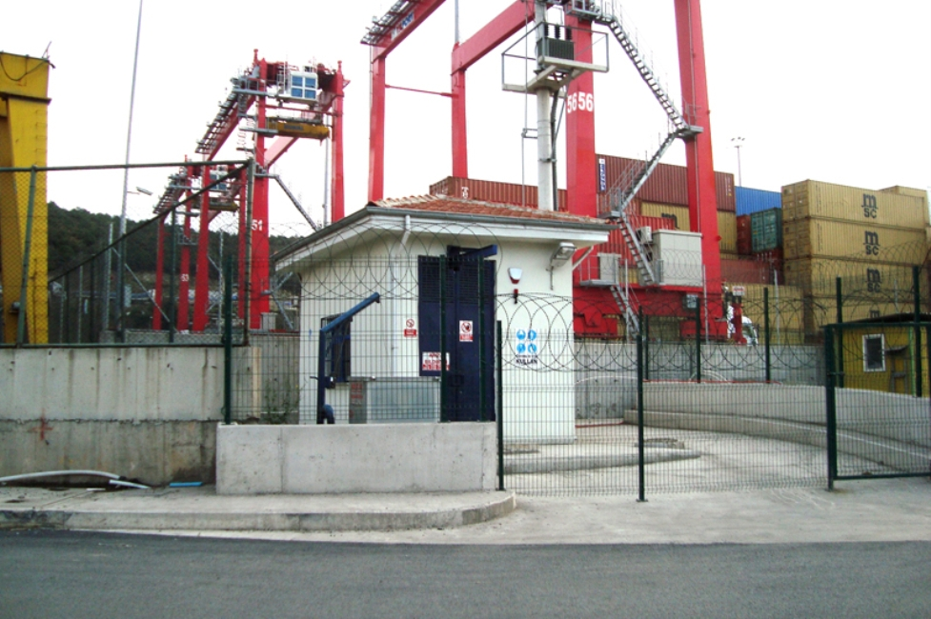

Slide 9
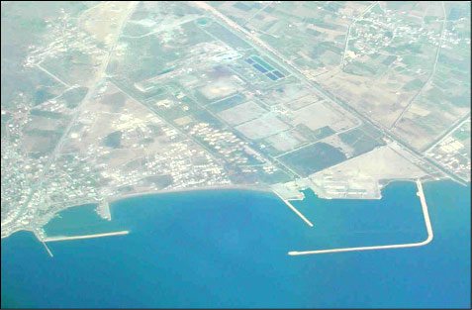
A view of Taşucu

Slide 10
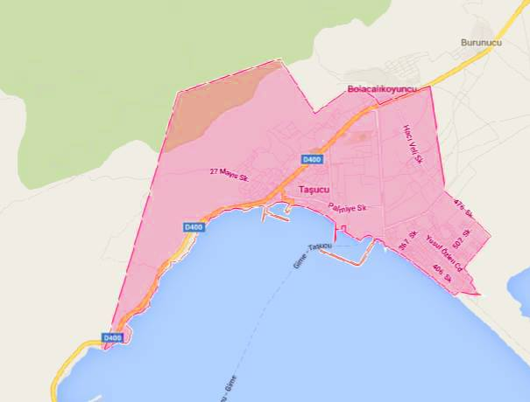

Slide 11
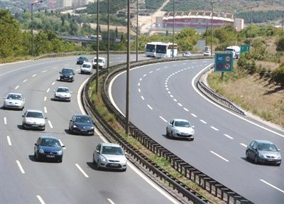
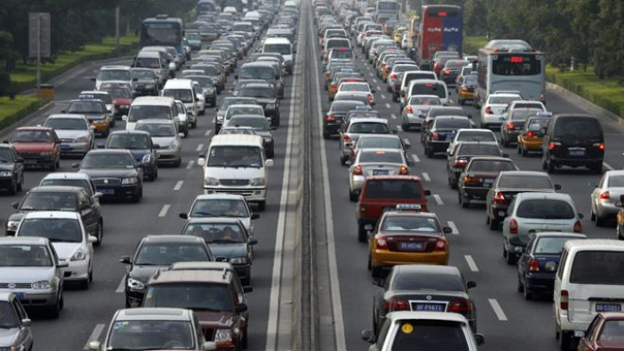
POPULATION PLANNING
Why is it important?
Demand > Supply
Demand < Supply

Slide 12
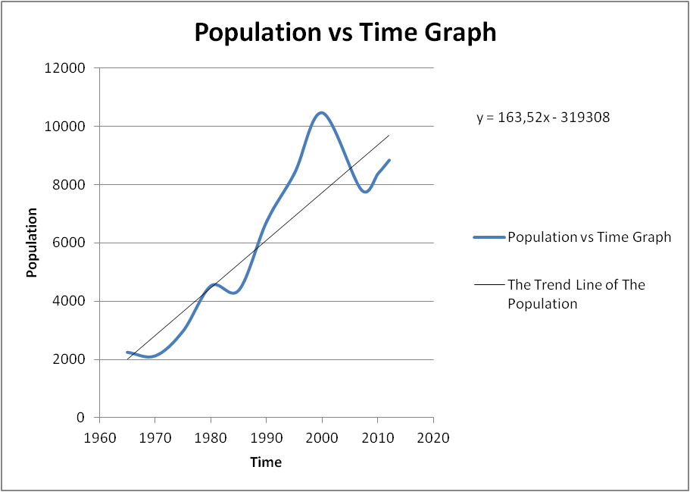
METHODS
Graphical Method
y = 163,52 * 2050 - 319308 = 16000

Slide 13
1) Graphical Method
2) Arithmetic Method
The Population= 140,21*2050- 273261 = 14200 people

Slide 14
3. Geometric Method
4. Bank of Provinces Method
In (Ng) = In (Ny) + kg * ( tg - ty ) = In (8847) + 0.0291 * (2050-2012)
Ng = 34000
y₂₀₅₀ = 73000

Slide 18
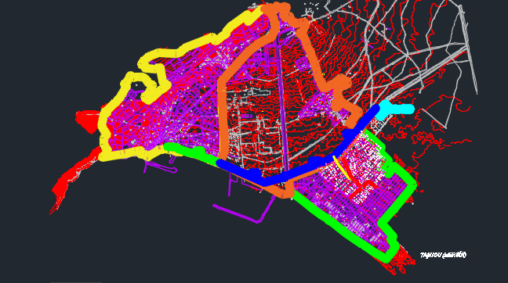
Interpretation of the Map
50 person/ha
430 ha
60 person/ha
340 ha
80 person/ha
210 ha
(Autocad file of Taşucu)

Slide 19
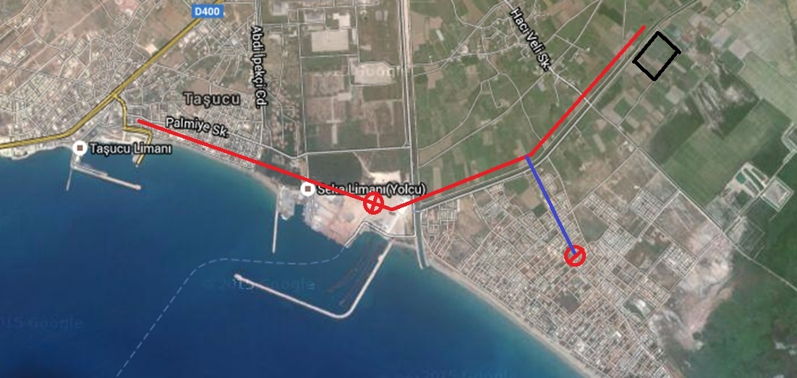
The Appropriate Place Selection for Tretmant Plant and Pipes
Tretmant plant
Elevation Center
Pumping station
Gravity pipes
(https://www.google.com.tr/maps/)
Pressurized pipes

Slide 20
Waste Water Amount Determination & Pipe Diameter Selection

Slide 21
Table 1: Potable water demand according to population (The Bank of Provincess)
population | Potable water demand (l/p/d)
3000 | 60
3000-5000 | 60-80
5000-10000 | 70-80
10000-30000 | 80-100
30000-50000 | 100-120
50000-100000 | 120-170
Population
60.000

Slide 22
The potable water per person = 140 l/d
According to TUIK data the rate of waste water formation from potable water is 84,3%. (TUİK BELEDİYE ATIKSU İSTATİSTİKLERİ, 2010)
140*0,843 = 120 l/d/p (for the parts of 1&2)

Slide 23
Table 2: The calculation of sewage amount
parts of the map | sewage(l/s/p) | areas(ha) | p/ha | total sewage(l/s)
1 | 120 | 340 | 50 | 23,61
2 | 120 | 430 | 60 | 35,83
3 | 170 | 210 | 80 | 33,05

Slide 24
Table 3: Grade standards for sewage works
diameter(mm) | minimum grade | maximum grade | fullness ratio | manhole distance(m)
φ200 | 300 | 7 | 40 | 50
φ300 | 500 | 7 | 50 | 60
φ400 | 600 | 25 | 60 | 70
φ500 | 800 | 25 | 60 | 70
φ600 | 1000 | 25 | 60 | 70
φ800 | 1200 | 50 | 60 | 80
φ1000 | 2000 | 75 | 70 | 100
φ1200 | 2050 | 75 | 70 | 125
φ1400 | 2100 | 75 | 80 | 150
φ1600 | 2150 | 75 | 80 | 150
φ2000 | 2250 | 75 | 80 | 150
φ3000 | 2500 | 75 | 80 | 150

Slide 25
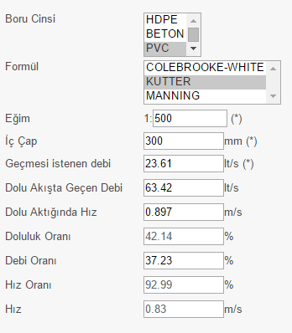
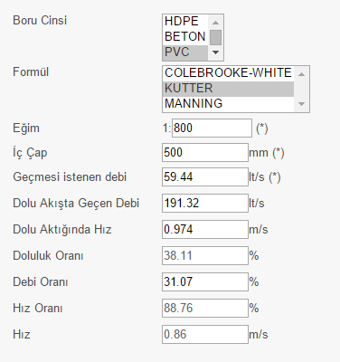
Part 1
Part 2
Figure 1 : Calculation of pipe diameter according to discharges(Dizayn grup)

Slide 26
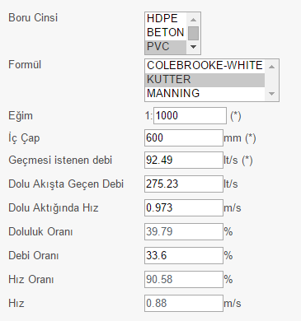
Part 3
Figure 2: Calculation of pipe diameter according to discharges(Dizayn grup)

Slide 27
Table 3 : Water demand for Kum neighborhood
facility | Water demand(l) | present unit | predicted unit | unit per facility | Water(l)
pension | 190 | 1 | 5 | 50 | 47500
hotel | 300 | 4 | 12 | 100 | 360000
swimming pool | 500l/m^2 | 3 | 9 | - | 450000*
*the area of the pool is assumed to be 100 m²

Slide 28
Waste water calculation of Kum neighboorhood
total demand | 2.870.000 liter
demand per person(l/p/d) | 170 l/p/d
170 l/p/d
For pump selection

Slide 29
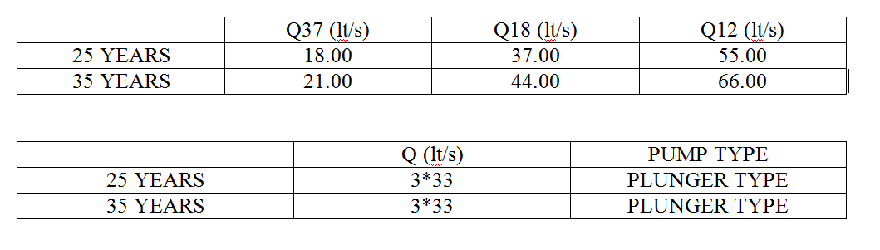
4. DISCHARGES & PUMP SELECTION :

Slide 30
3 pumps are used in the pumping station.
Plunger pumps are used as a pump type.
Circular caisons are used.
As a material type of the pipeline, polyethylene ( HDPE ) pipes are chosen.

Slide 31

Motor Power Calculation
Calculations of motor power are done according to the pump discharges for 25 years since economic life of pumps and air chambers is 25 years.
H_{g} = final elevation of pump line - pump axis elevation
H_{g} = (2.50) - (-9.10) = 11.60 m
Q_{p} = 55 lt/s

Slide 32
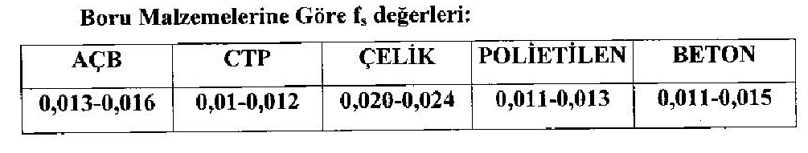

Slide 33
For polyethylene, f = 0.012
Q = v * A
55*10⁻³ = v * (π * (0.15)²) where D = 300 mm → v = 0.78 m/s
J = 0.012 * → J = 0.00123 m/m
L = 712 m → JL = 0.00123*712 = 0.88 m
H_{m} = H_{g} + JL + minor losses = 11.60 + 0.88 + 2.00 → H_{m} = 14.5 m
N_{e} = = → N_{e} = 15.6 kW
N_{e} = 15.6 kW → E.K. = 1.25
N_{m} = N_{e} * E.K. = 15.6*1.25 → N_{m} = 19.5 kW
N_{m} = 19.5 kW → n=8

Slide 34
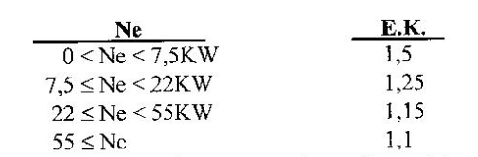
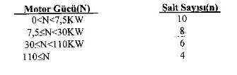

Slide 35
Calculation of the Volume of Collecting Chamber :
T_{min} = For n=8, T_{min} = 450 s
V₁ = = → V₁ = 7425 lt
V₂ = 0.392 * V₁ = 0.392*7425 → V₂ = 2911 lt
V₃ = 0.264 * V₁ = 0.264*7425 → V₃ = 1960 lt
V_{R} = 1704 lt is taken.
V_{T} = V₁ + V₂ + V₃ + V_{R} = 7425 + 2911 + 1960 + 1704 → V_{T} = 14000 lt = 14 m³

Slide 36
Base Area of Collecting Chamber :
F = π * r² = 3.14 * (2.50)² → F = 19.63 m² where diameter of caisson is taken as 5.00 m.
When concrete of bottom slope is considered, F_{net} = A = 15 m²
h₁ = = → h₁ = 0.50 m
h₂ = = → h₁ = 0.19 m
h₃ = = → h₁ = 0.13 m
h_{R} = = → h₁ = 0.11 m
h_{ö} is taken as 0.80 m.
H_{T} = h₁ + h₂ + h₃ + h_{R} + h_{ö} → H_{T} = 1.73 m

Slide 37
PUMP STATION
Valve House
Grille
Pump House

Slide 38
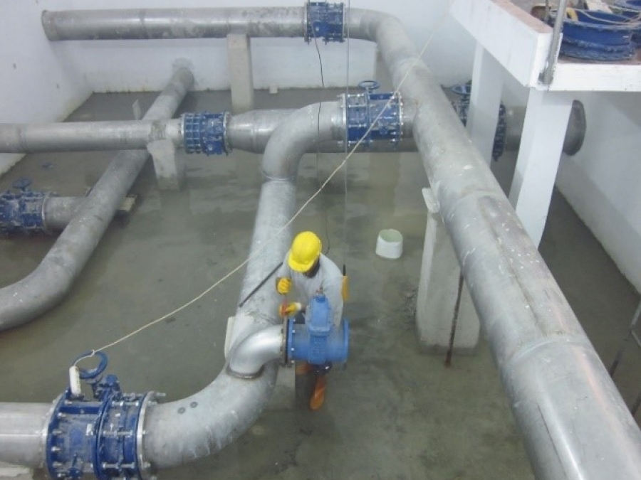

Slide 39
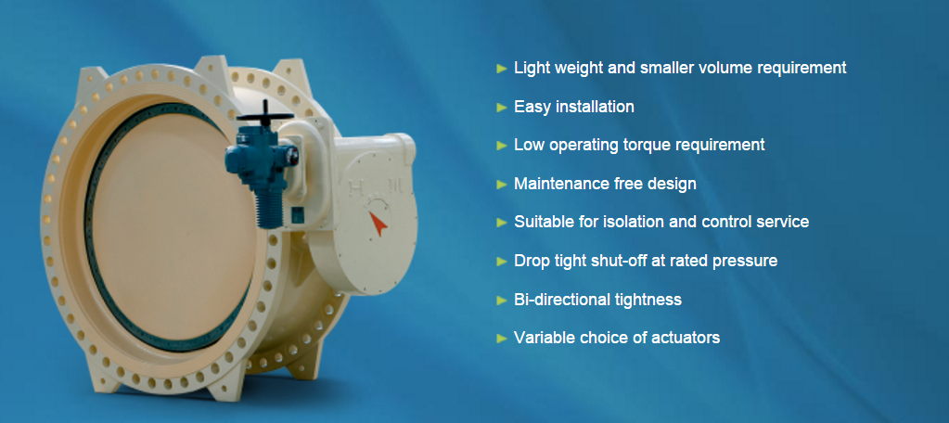

Slide 40
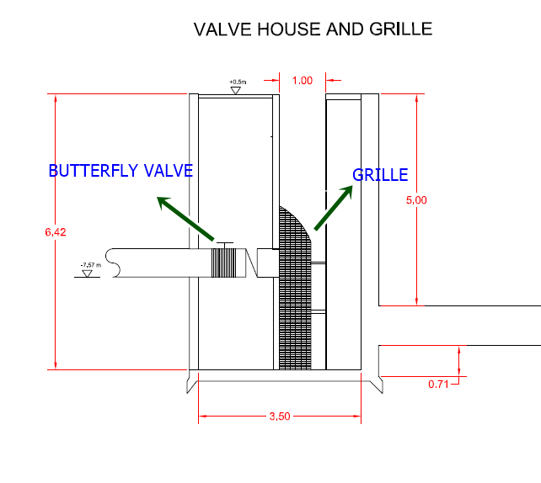

Slide 41
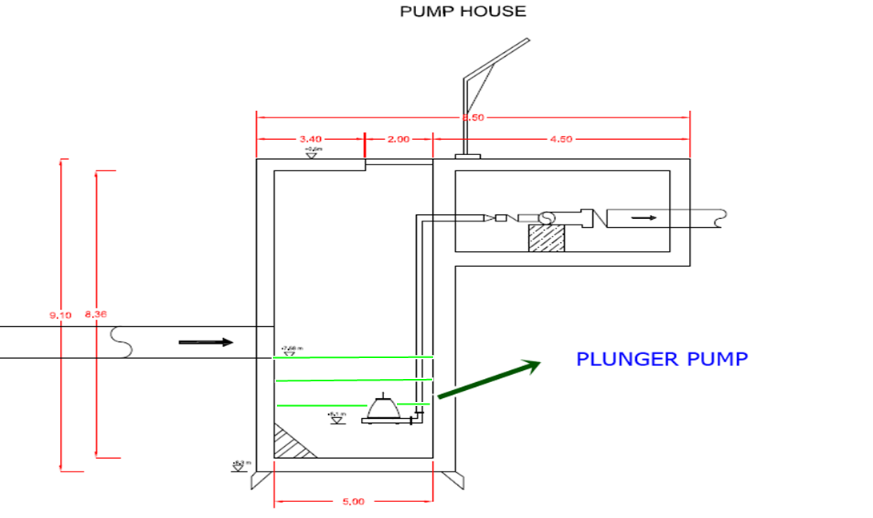

Slide 42
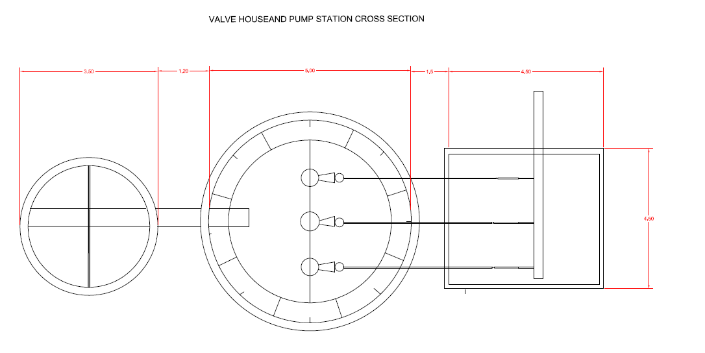

Slide 43
Storm Water
Rational Method
Q = C * I * A
Q = storm water discharge ( lt/s )
C = runoff coefficient depending on drainage area and type of rainfall
I = Rainfall intensity ( lt/s/ha )
A = Area ( ha )

Slide 44
COEFFICIENT C
COMMERCIAL ZONES ( 0.7- 0.95)
REZIDENTIAL ZONES (0.70- 0.25)
INDUSTRIAL ZONES ( 0.5 - 0.9)
ROADS (0.10-0.95)

Slide 45
(I) Rainfall Intensity
Collecting time, T = T_{g} + T_{a}( minutes )
T_{g} = Entrance time :
Slope Entrance Time (min.)
J > 1/20 5
1/20 > J > 1/50 10
1/50 > J 15

Slide 46
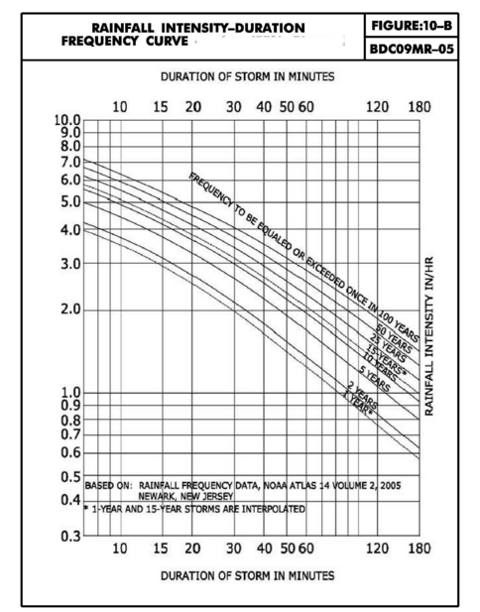

Slide 47
References
Mühendislik Hesaplamaları. (n.d.). Retrieved November 25, 2015, from http://www.dizayngrup.com/muhendislik-hesaplamalari.html
(n.d.). Retrieved November 25, 2015, from http://cevre.beun.edu.tr/zeydan/kanal/yagmur-kanal- 02.pdf
(n.d.). Retrieved November 25, 2015, from http://www.csb.gov.tr/dosyalar/images/file/MeltemMal atyali.ppt

Slide 48


