Slide 1

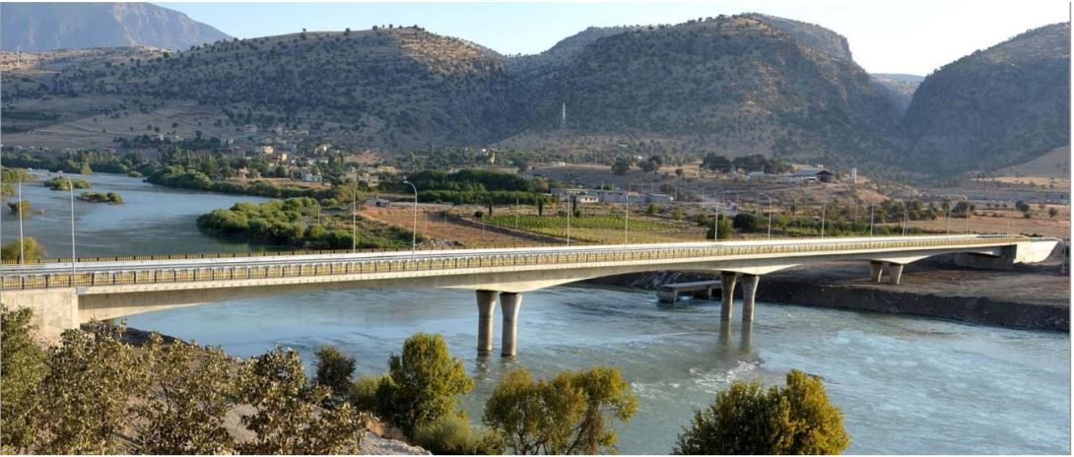
DesIgn of HIghway BrIdge

Slide 2
OutlIne
Introduction
Deck Design
Pier Design
Geotechnic Design
Cost Estimation

Slide 3
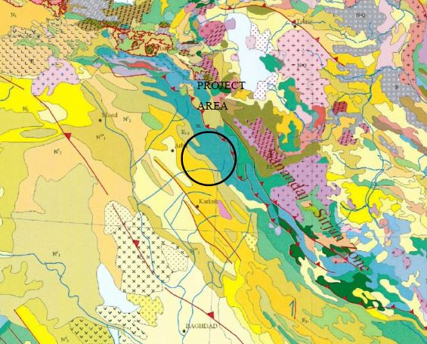
IntroductIon
LOCATION
Iraq
Mosul
Great Zab River

Slide 4
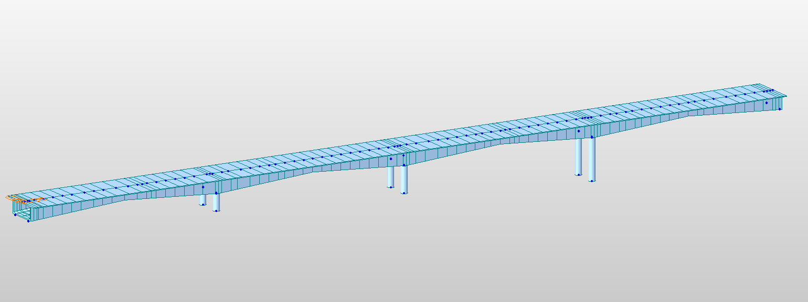
IntroductIon
L=240 m
W=15 m
2 lane highway

Slide 5
STRUCTURAL DesIgn OF DECK and analysıs
Arslan AGAMURADOV

Slide 6
DesIgn crIterIa and codes
AASHTO: The American Association of State Highway and Transportation Officials
SSHB: Standart Specifications for Seismic Design of Highway Bridges
ACI: American Concrete Institute
US system was changed to SI

Slide 7
External dead loads (DL)
Load coming from the aspahlt layer:
Asphalt area= 15*0.06=0.9m²
Asphalt density=21 kN/m³
0.9*21=18.9 kN/m
Loads coming from the guardrails:
Pedestrian guardrail =1 kN/m
Guardrail = 4 kN/m
4+1= 5 kN/m Total external dead loads= 23.9 kN/m

Slide 8
Total external vertIcal Loads
Truck loads, External live loads (LL):
W2= 300/20= 15 kN/m
Brake loads from Truck (AASHTO 3.9)
2.5 kN/m
Live loads :15+2.5=17.5 kN/m
Total External Loads:
15+2.5+23.9 = 41.4 kN/m

Slide 9
WInd loads (AASHTO 3.15)
Wind speed : 45km/hr
Wind load acting from the side, q_{w,T} : 2.4 kN/m²

Slide 10
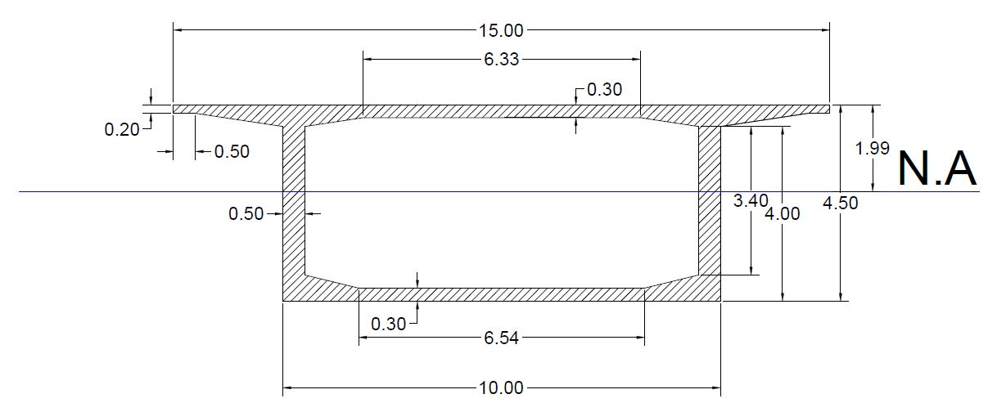
Cross-sectIon SelectIon: Support Section

Slide 11
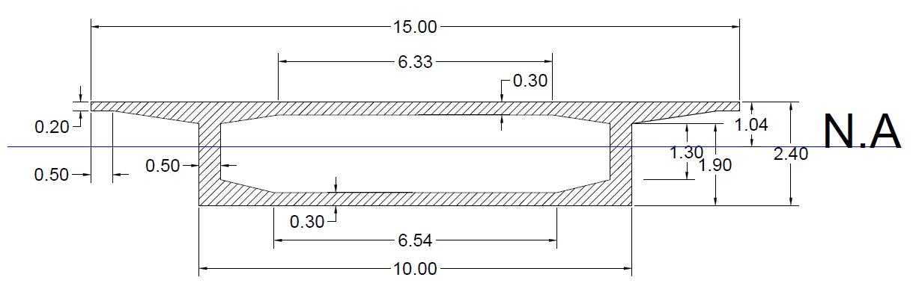
Cross-sectIon SelectIon: MId-span

Slide 12
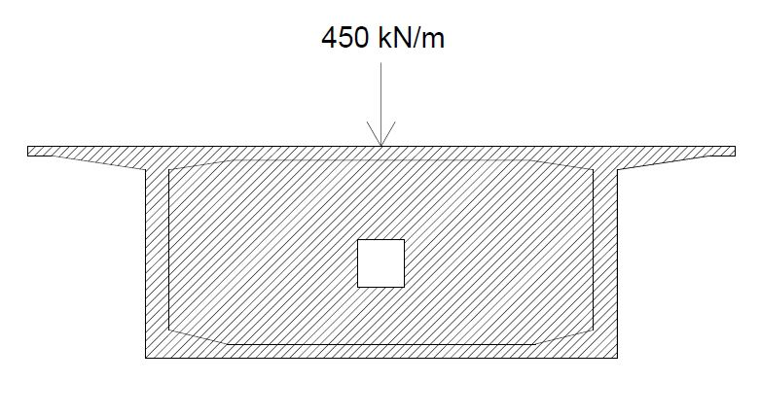
Diaphragms in support cross-section
Diaphragms are essential for resisting high shear stresses at supports.
Diaphragm load is taken as 450 kN/m to each side of the support for 2 meters.

Slide 13
Cross-sectional properties
 | Shape | Name | Area m2 | Ix m4 | Iy m4 | Iz m4 | Cyp m | Cym m | Czp | Czm
PSC | 1CEL | SUPPORT | 12.14 | 87.80 | 39.76 | 207.68 | 7.50 | 7.50 | 1.99 | 2.51
PSC | 1CEL | SPAN | 10.04 | 24.61 | 9.03 | 160.26 | 7.50 | 7.50 | 1.04 | 1.36
Tapered | 1CEL | ss | 12.14 | 87.80 | 39.76 | 207.68 | 7.50 | 7.50 | 1.99 | 2.51
Tapered | 1CEL | ss2 | 10.04 | 24.61 | 9.03 | 160.26 | 7.50 | 7.50 | 1.04 | 1.36
DB/User | SR | column | 3.14 | 1.57 | 0.79 | 0.79 | 1.00 | 1.00 | 1.00 | 1.00

Slide 14
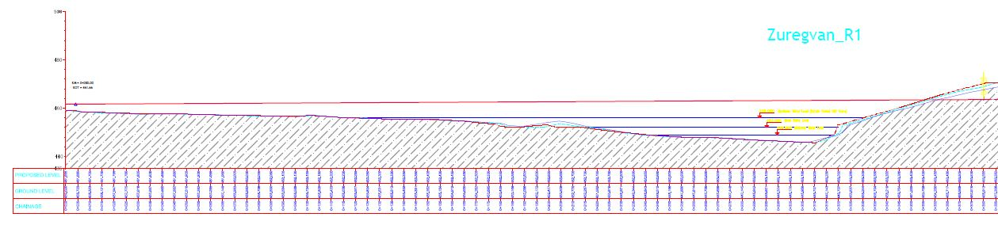
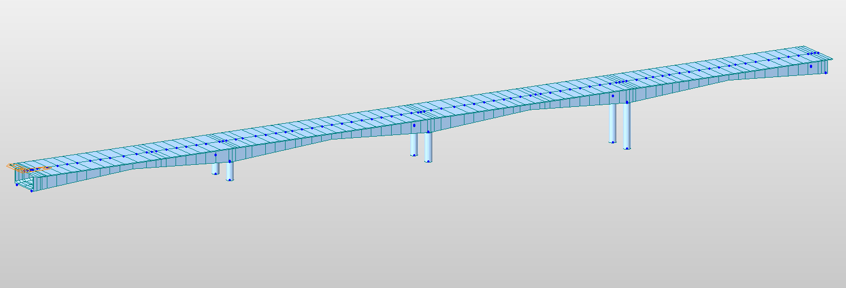
Finalized deck
Profile View of River bed
MIDAS modeled deck

Slide 15
Material Selection and deck load
Concrete: C50 γ_{c}= 25kN/m³
Steel Reinforcement: S420 γ_{s}= 78.5 kN/m³
Dead Load coming From the deck structure (uniform distribution)
P=64000 kN W= 64000/240 =267 kN/m
Load Combination AASHTO 3.22: 1.0(DL)+1.0(LL) + 1.0(D) + 1.0(W)
Total distributed load: 267+ 41.4 =308.4 kN/m

Slide 16
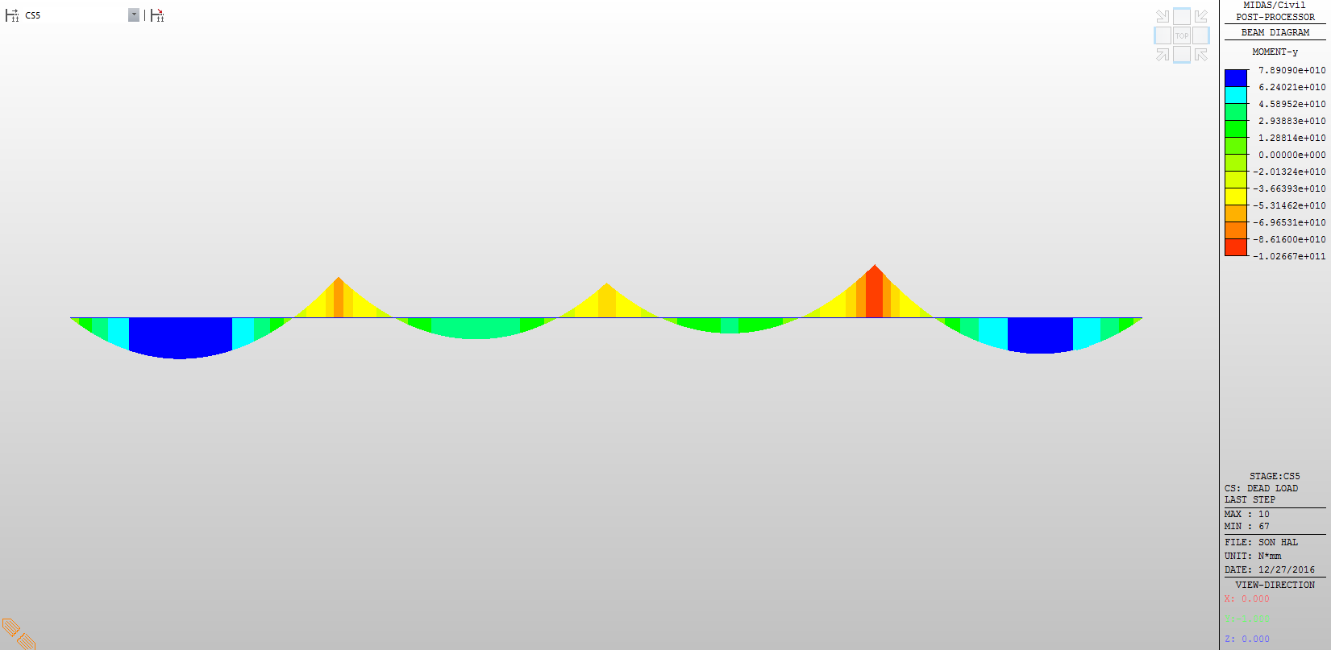
Moments From Loads

Slide 17
Moments From Loads
Moments at midspan:Moments at first and last spans:
M_{m1}=M_{m2}= 7.89e+4 kN.m
Moments acting on 2nd and 3rd spans:
M_{m2}=M_{m3}=4.59e+4 kN.m
Moments acting on supports:
M_{s1}= -8.62e+4 kN.m
M_{s2}= -6.96e+4 kN.m
M_{s3}= -1.03e+5 kN.m

Slide 18
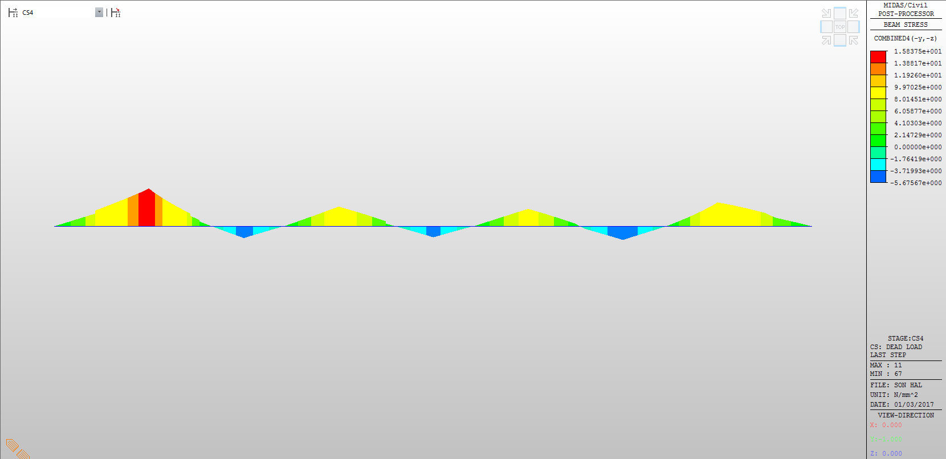
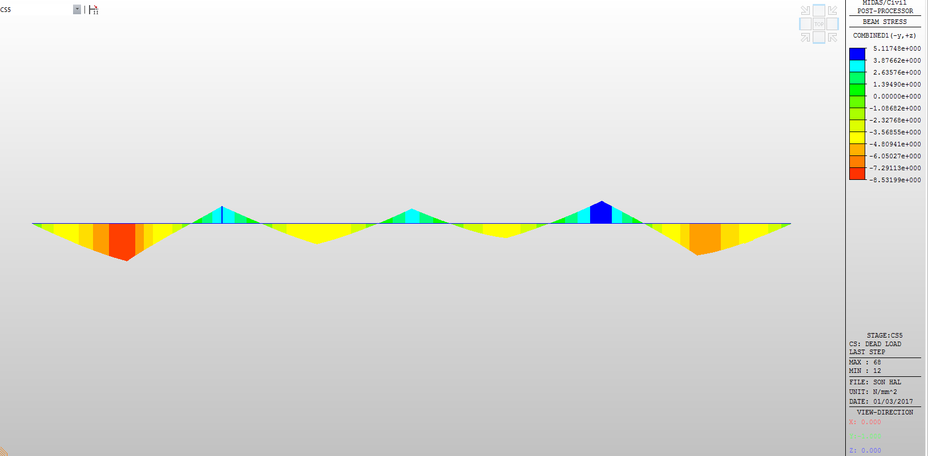
Stresses Acting on the Deck
Under NA
Above NA

Slide 19
Stresses Acting on the Deck
Name | Top Part (kN/m²) | Bottom part (kN/m²)
Span 1 | -8.53e+3 | 1.58e+4
Span 2 | -4.81e+3 | 9.97e+3
Span 3 | -4.81e+3 | 9.97e+3
Span 4 | -7.29e+3 | 9.97e+3
Support 1 | 5.12e+3 | -5.67e+3
Support 2 | 3.88e+3 | -5.67e+3
Support 3 | 5.12e+3 | -5.67e+3

Slide 20
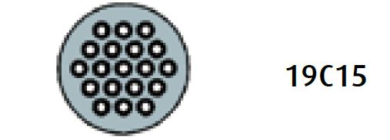
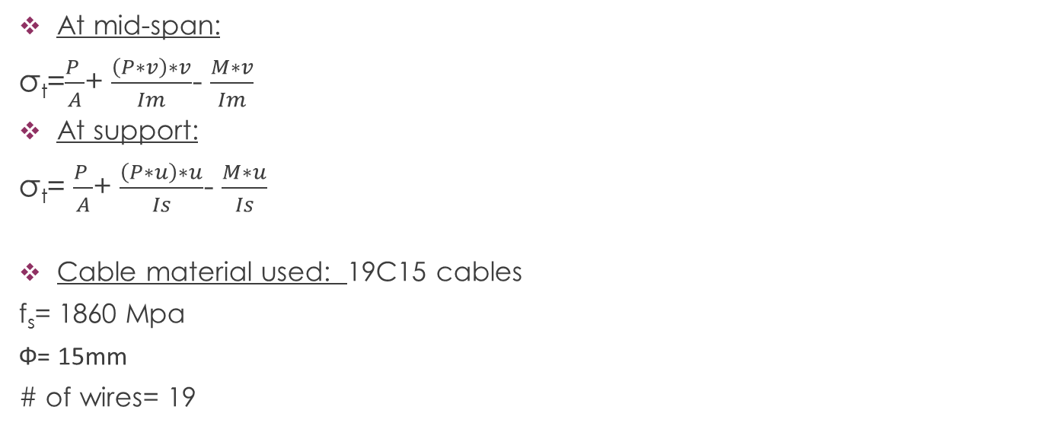
Tendon installation and Post-tensioning
At mid-span:
σ_{t}=$\frac{P }{A}$+ $\frac{\left(P∗v\right)∗v}{Im}$- $\frac{M∗v}{Im}$
At support:
σ_{t}= $\frac{P }{A}$+ $\frac{\left(P∗u\right)∗u}{Is}$- $\frac{M∗u}{Is}$
Cable material used: 19C15 cables
f_{s}= 1860 Mpa
Ф= 15mm
# of wires= 19

Slide 21
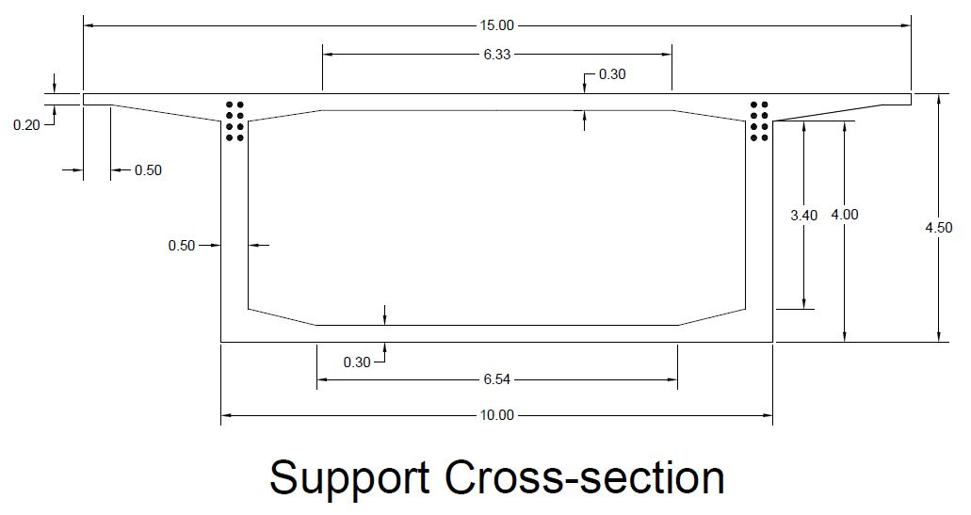

Slide 22
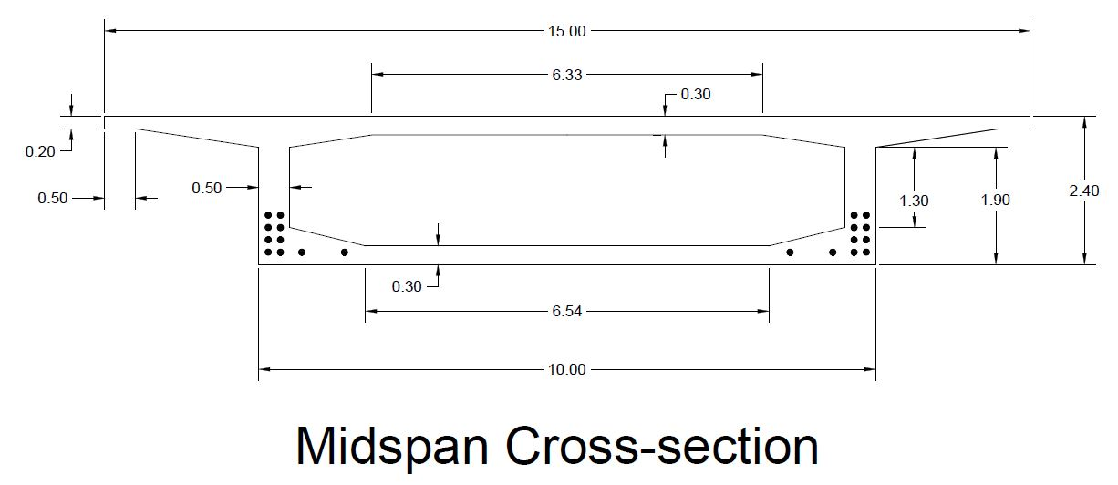

Slide 23
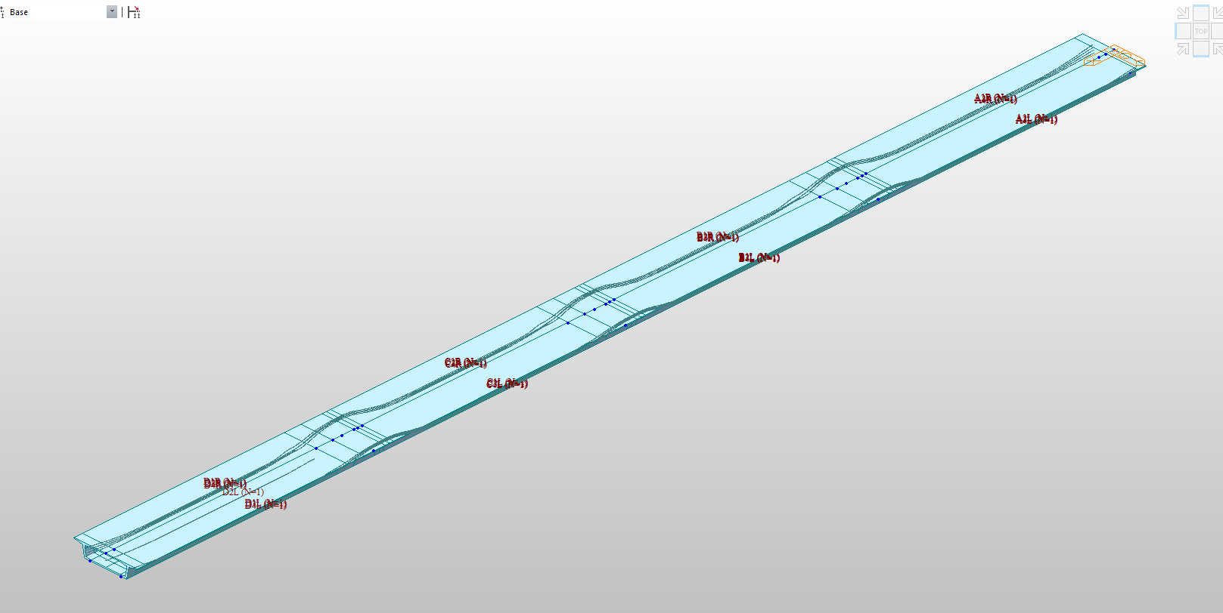
Cabling detail
In total 16*4+4*4= 80 cables
16 along each span
4 on each mid-span in blisters

Slide 24
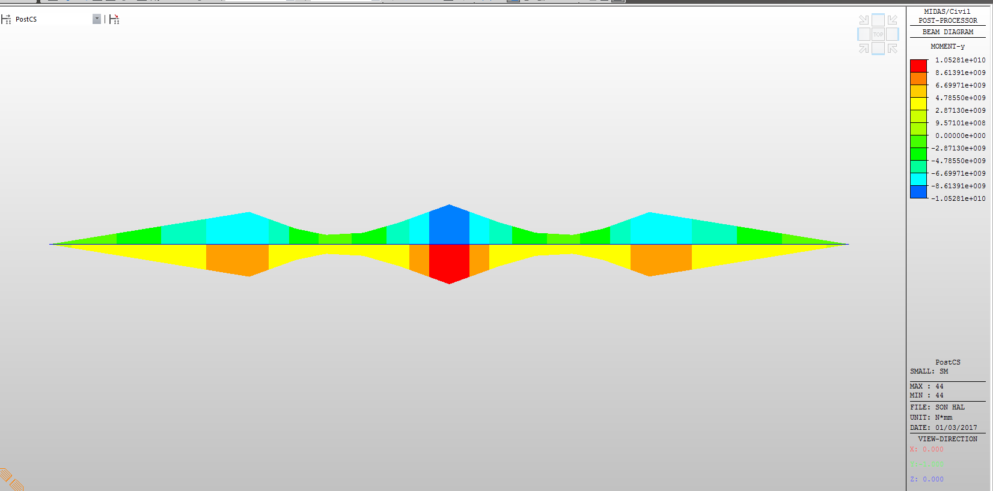
Tendon installation and Post-tensioning
Post-tensioning up to75% of yield strength of the cable

Slide 25
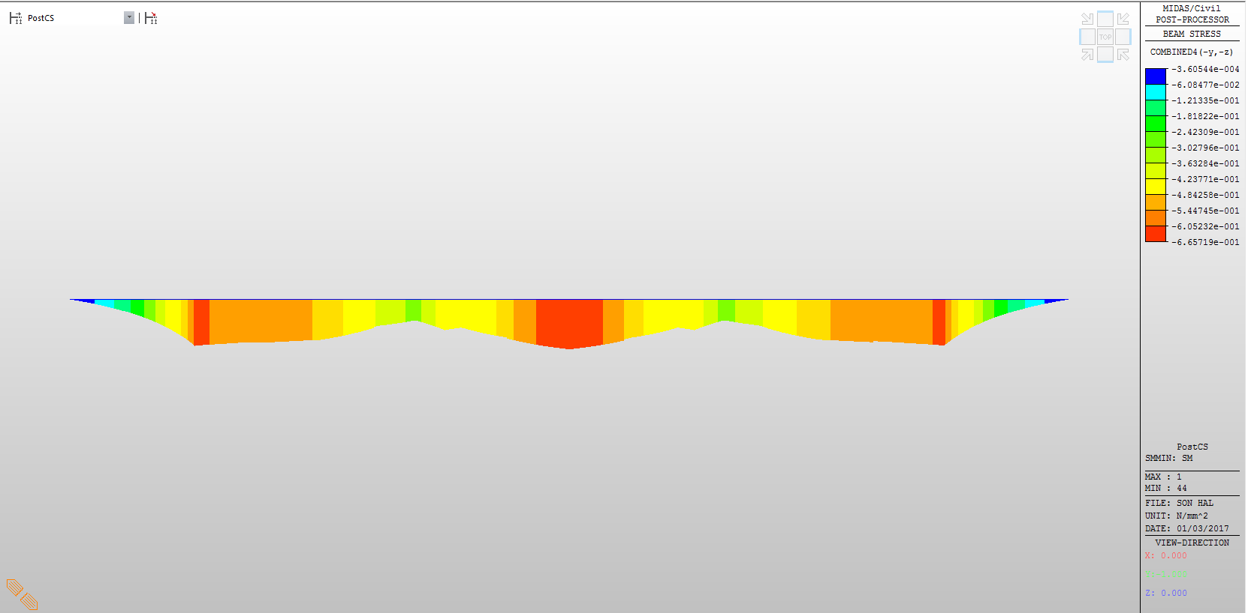
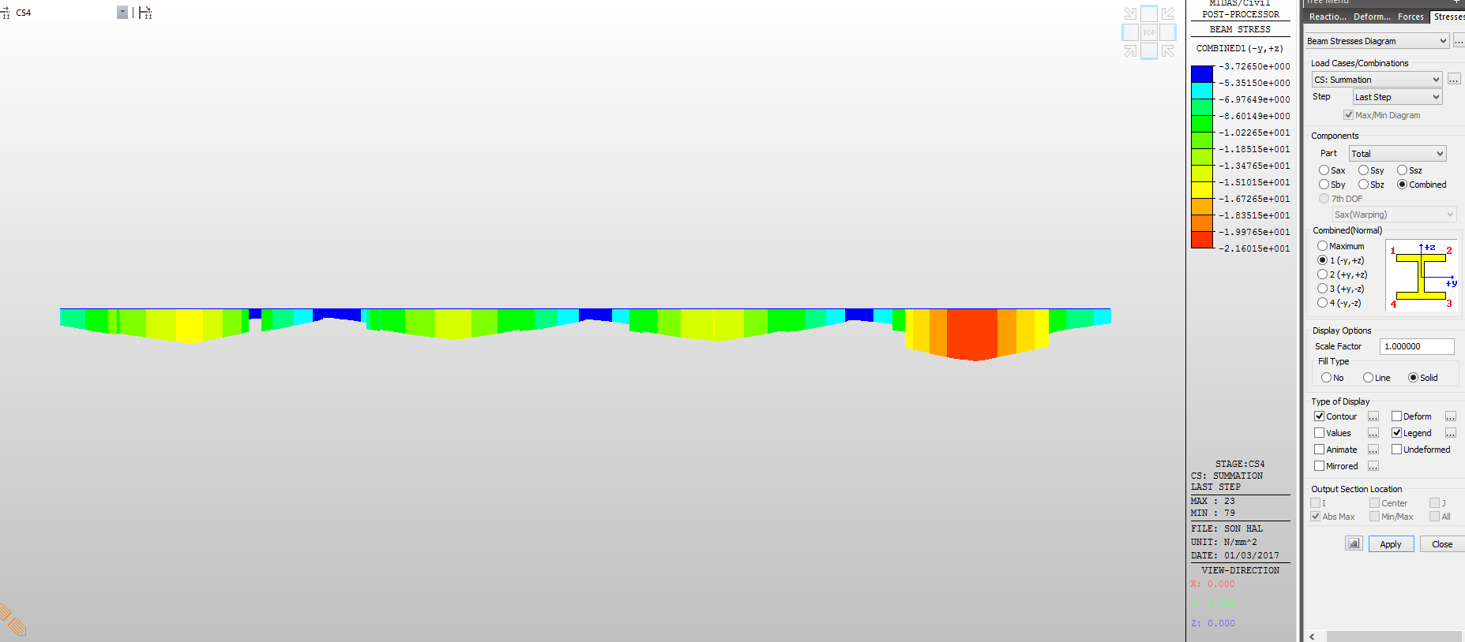
Stresses after post-tensioning
Under NA
Above NA

Slide 26
Stresses after post-tensioning
Name | Top Section (kN/m²) | Bottom Section (kN/m²)
Span 1 | -1.67e+4 | -6.05e+4
Span 2 | -1.51e+4 | -4.84e+4
Span 3 | -1.67e+4 | -4.84e+4
Span 4 | -2.16e+4 | -6.05e+4
Support 1 | -3.72e+3 | -5.44e+4
Support 2 | -3.72e+3 | -6.05e+4
Support 3 | -3.72e+3 | -5.44e+3

Slide 27
DesIgn and Construction of PIers
Can Özsoy

Slide 28
ConstructIon of PIers
2 piers’ foot naturally dried
Third pier artifically dried

Slide 29
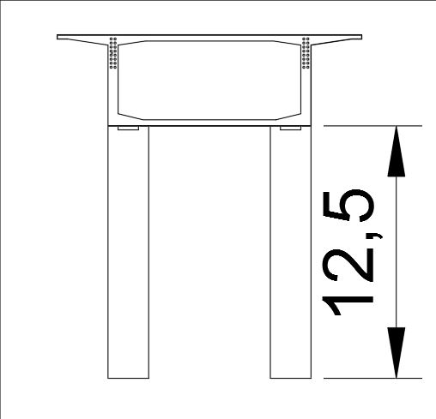
BearIng System

Slide 30
Earthquake
AASHTO LRFD Bridge Design
Deprem Bölgelerinde Yapılacak Binalar Hakkında Esaslar
A0=0.3
T=2.56
Soil Classification = S2
Total Weight=70000 kN
1G+1Q+1E

Slide 31

Earthquake
-Earthquake response coefficient=0.022
-Single Mode Analysis
-Uniform Load Method
-Fx=80.25 kN
-Fy=80.25 kN

Slide 32
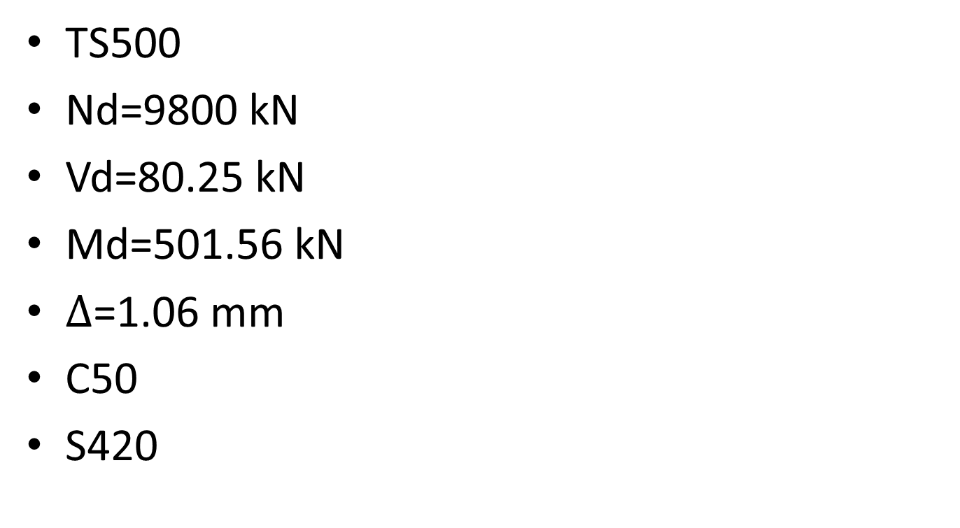
DesIgn of PIers
TS500
Nd=9800 kN
Vd=80.25 kN
Md=501.56 kN
$∆$=1.06 mm
C50
S420

Slide 33
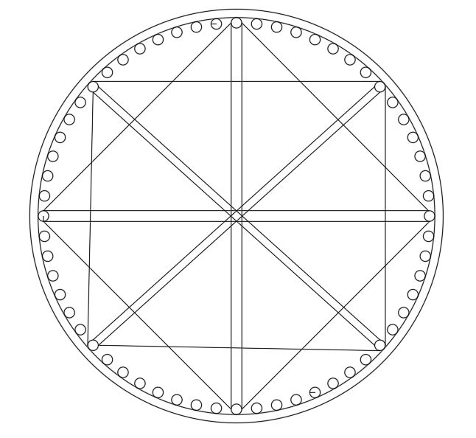
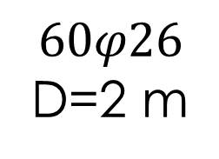
Cross-Section
$$60φ26$$
D=2 m

Slide 34
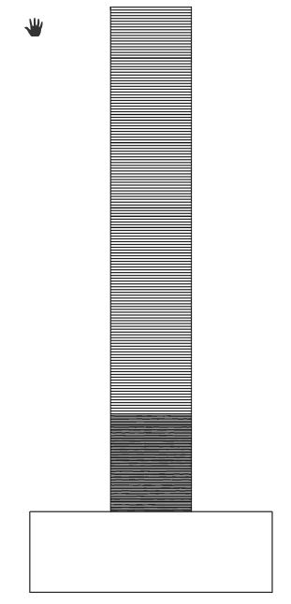
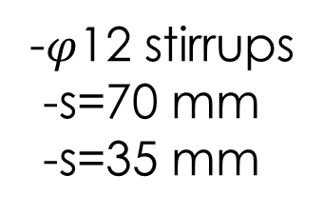
Cross-Section
-$φ$12 stirrups
-s=70 mm
-s=35 mm

Slide 35
GEOTECHNICAL DESIGN
Load combInatIons
FoundatIon system
Foundation pressures
SoIl profIlE
Settlements
B.C.
Pile design
Efkan Evkuran

Slide 36
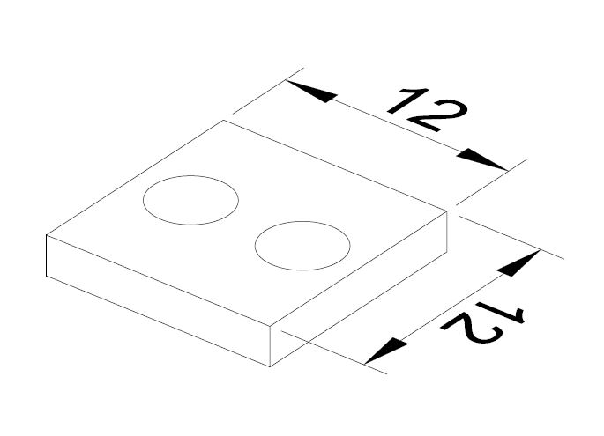
GEOTECHNICAL DESIGN
Load combination
(1.0) * D + (1.0) * L + (1.0) * E
2. Foundation system

Slide 37
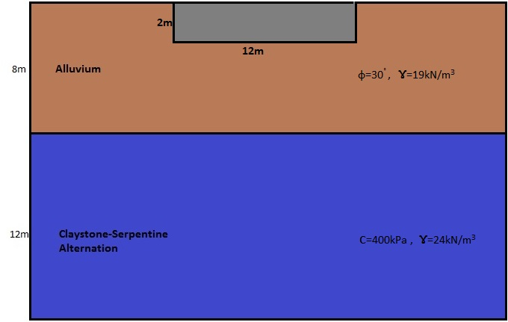
GEOTECHNICAL DESIGN
3. Total and Net Foundation Pressures
1280 tons from structure
Weight of the raft = 12 * 12 * 2 * 2.5 = 720 tons
Total weight that is transmitted to the soil = 1280+720= 2000 tons
4. Soil profile

Slide 38
GEOTECHNICAL DESIGN
Net foundation pressure
The weight of excavated soil = 12*12*2*19=5472 kN
q_{net} = (Total weight – excavated soil) / (B*L) = (20000-5472) / (12 * 12)
q_{net} = 101 kPa
5. Settlements
Immediate settlement
S_{i} = μ₀ * μ₁ * q * B / E

Slide 39
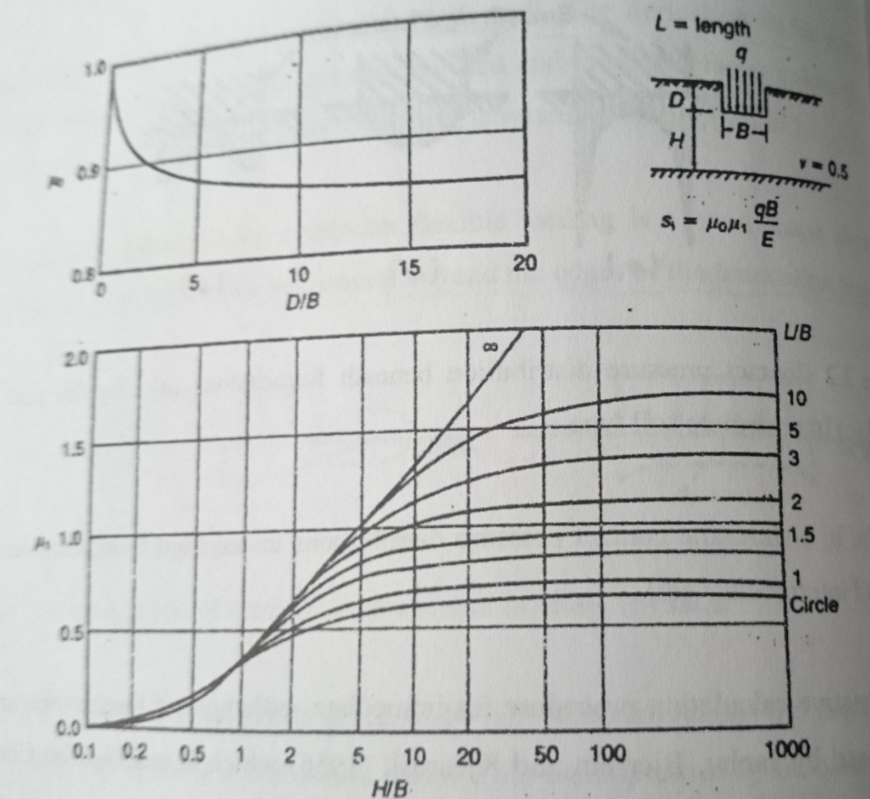
GEOTECHNICAL DESIGN
D/B = 2/12 = 0.17
μ₀ = 1.0
H/B = 10/12 = 0.83
L/B = 12/12 = 1
μ₁ = 0.25
S = 1.0 * 0.25 * 101 * 12 / 800
= 0.379 m = 38 cm

Slide 40
GEOTECHNICAL DESIGN
6. Ultimate capacity
q_{f} = (1 / 2) * s_{γ} * γ * B * N_{γ} + s_{c} * c * N_{c} + s_{q} * γ * D *N_{q}
q_{f} = ( 1 / 2 ) * 0,8 * 19 * 12 * 19 + 1 * (19) *2*19= 2455 kPa
2455 / (101) = 24 > 3,0

Slide 41
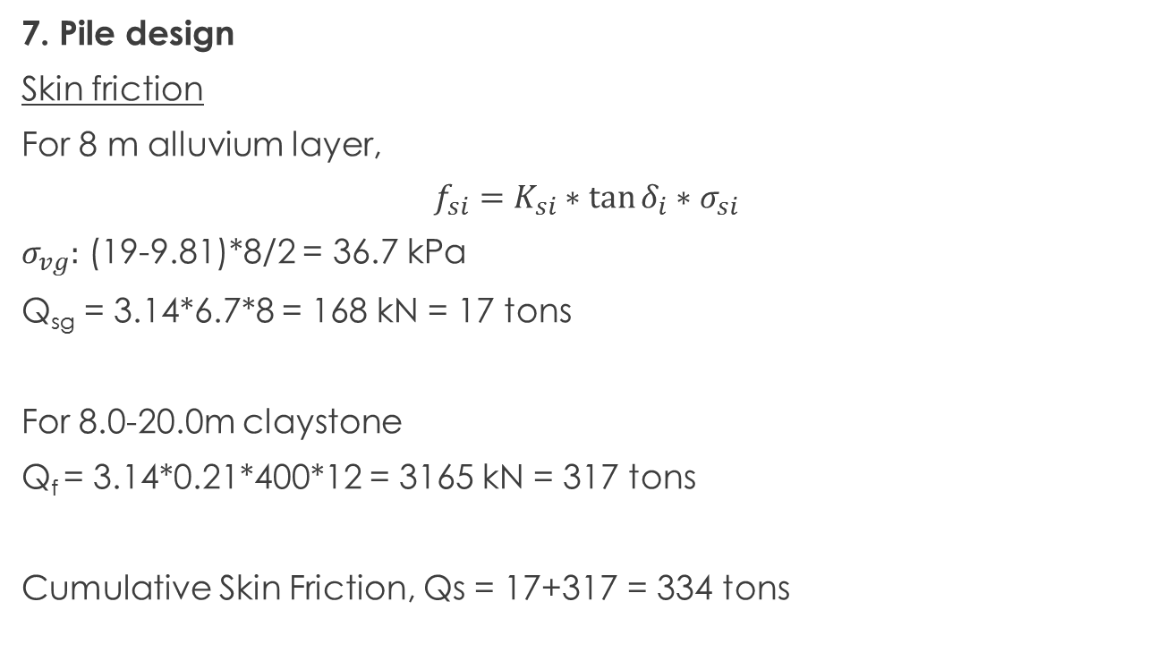
GEOTECHNICAL DESIGN
7. Pile design
Skin friction
For 8 m alluvium layer,
$$f_{si}=K_{si}∗\tan{δ_{i}∗σ_{si}}$$
$σ_{vg}:$ (19-9.81)*8/2 = 36.7 kPa
Q_{sg} = 3.14*6.7*8 = 168 kN = 17 tons
For 8.0-20.0m claystone
Q_{f} = 3.14*0.21*400*12 = 3165 kN = 317 tons
Cumulative Skin Friction, Qs = 17+317 = 334 tons

Slide 42
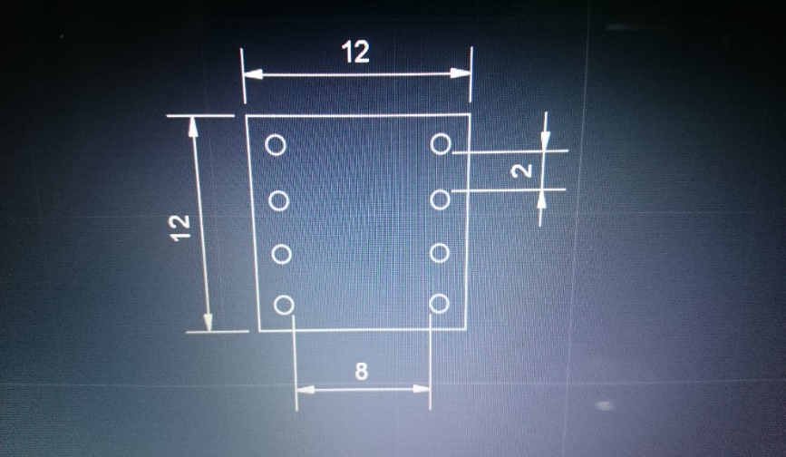
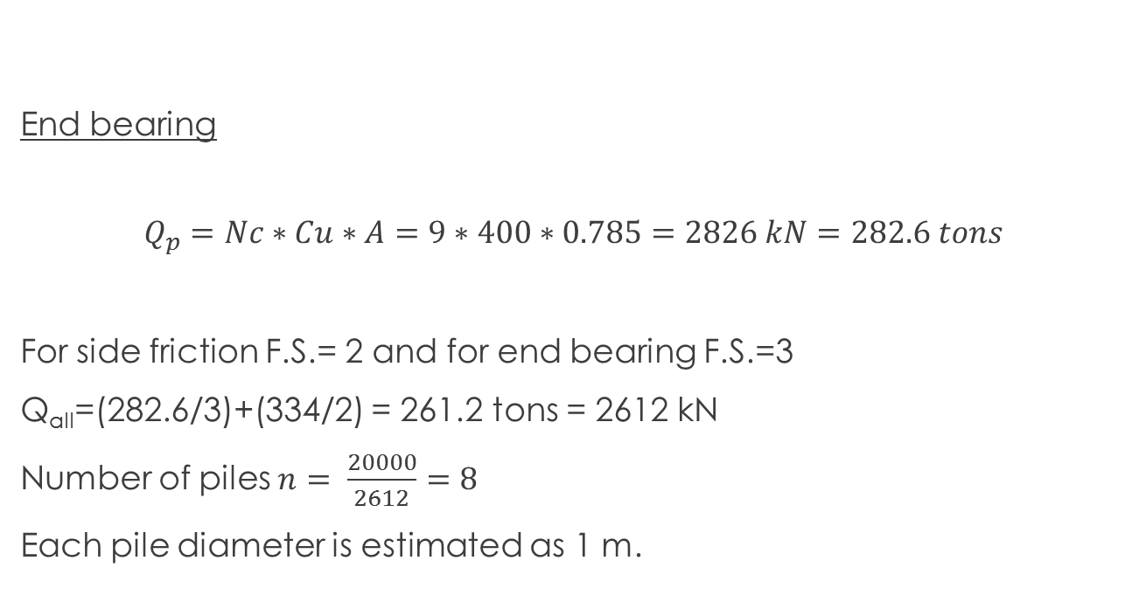
GEOTECHNICAL DESIGN
End bearing
$$Q_{p}=Nc∗Cu∗A=9∗400∗0.785=2826 kN=282.6 tons$$
For side friction F.S.= 2 and for end bearing F.S.=3
Q_{all}=(282.6/3)+(334/2) = 261.2 tons = 2612 kN
Number of piles $n= \frac{20000}{2612}=8$
Each pile diameter is estimated as 1 m.

Slide 43
GEOTECHNICAL DESIGN
Pile Group Capacity
Q_{ag} = N * Q_{all} * number of piles
Q_{ag} is allowable group capacity.
N, efficiency = 1 - arctan(D/s) * [ (m-1) * n + (n-1) * m ] / ( 90 * m * n )
m = 4 and n = 2
N = 0.63
Q_{ag} = 13164 kN

Slide 44
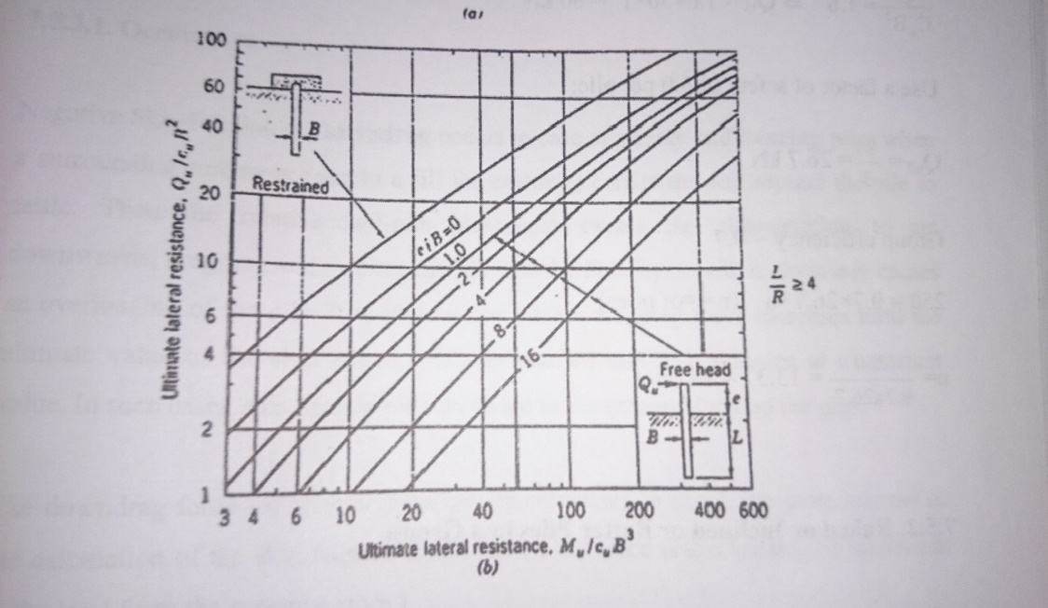
GEOTECHNICAL DESIGN
Lateral Force Capacity of the Pile Group
Lateral load for 1 group is 80.25 kN.
The highest column height is 12.5 m. Others are 5 and 8 m.
Highest moment is M = 1003 kN.m
We assume c_{u} is 200 kpa.
M/c_{u}B³ = 5
From the figure, Q_{u}/c_{u}B² = 5.5
Q_{u} = 1100 kN

Slide 45
GEOTECHNICAL DESIGN
Factor of safety per pile is 3.0.
Q_{all} = 1100/3 = 367 kN
Group efficiency = 0.63
Lateral force capacity of the group = 0.63*367*8 = 1850 kN
1850 kN > 80.25 kN so our system is safe.

Slide 46
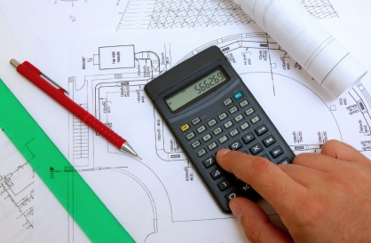
Cost EstImatIon
Gadim Tosoyev

Slide 47
Cost EstImatIon
240m
Total Cost = 56000 TL/m * 240 = 13.400.000 TL

Slide 48
Cost EstImatIon
Excavation
Pier Column
Bridge Decks
Rebars
Foundation
Pile Driving
Formwork
Tendons
Earthmoving
Scaffolding

Slide 49
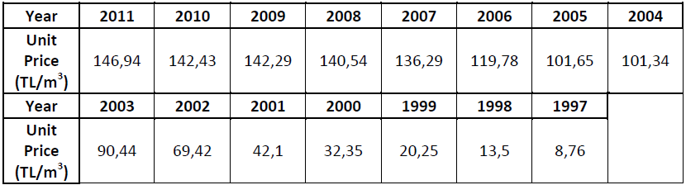
Cost EstImatIon
Unit Cost For Concrete C50
(Ministry of Environment and Urban Planning of Turkey)

Slide 50
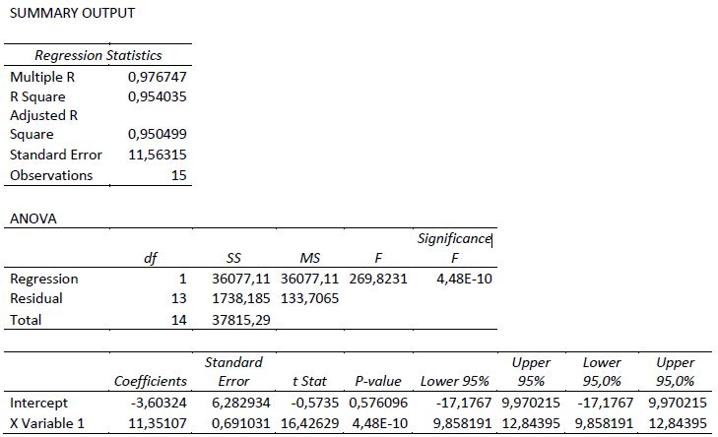
Cost EstImatIon
Regression Analysis
Unit Cost (Ministry of Environment and Urban Planning of Turkey)
Unit price for Concrete C50 = 250 Tl/m3

Slide 51
Cost EstImatIon
Quantity Take-off of Concrete Works

Slide 52
Cost EstImatIon
Final Cost=17.181.501 TL

Slide 53
THANKS FOR YOUR KIND ATTENTION
Post-Tensioning is Our Business
For further information please visit
www.ageaconstruction.io

