Slide 1

MIDDLE EAST TECHNICAL UNIVERSITY
DEPARTMENT OF CIVIL ENGINEERING
CE410-CIVIL ENGINEERING DESIGN
Onshore Thermal Power Plant

Slide 2
OUTLINE
Introduction
Construction Location
Working Principle of Thermal Power Plants
Water Supply and Drainage
Coal Supply
Bathymetry Studies
Wind and Wave Analysis
Pier Construction
Legislative Concerns
Cost Estimation
Conclusion

Slide 3
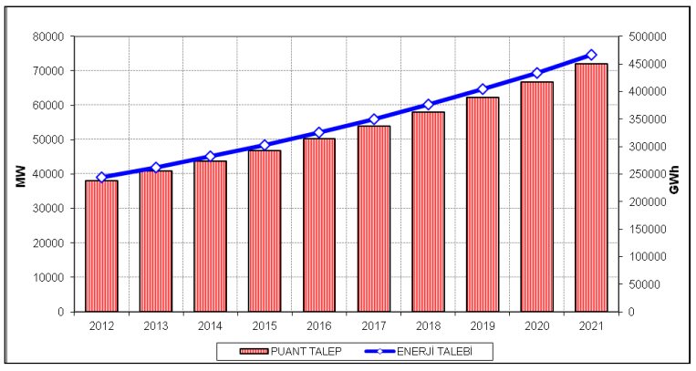
ENERGY DEMAND
Demand is increasing rapidly
Average electric power consumption 2,790 kWh/capita (The World Bank, 2011-2014)
Figure 1: Demand forecasting for Turkey (TEDC, 2012

Slide 4
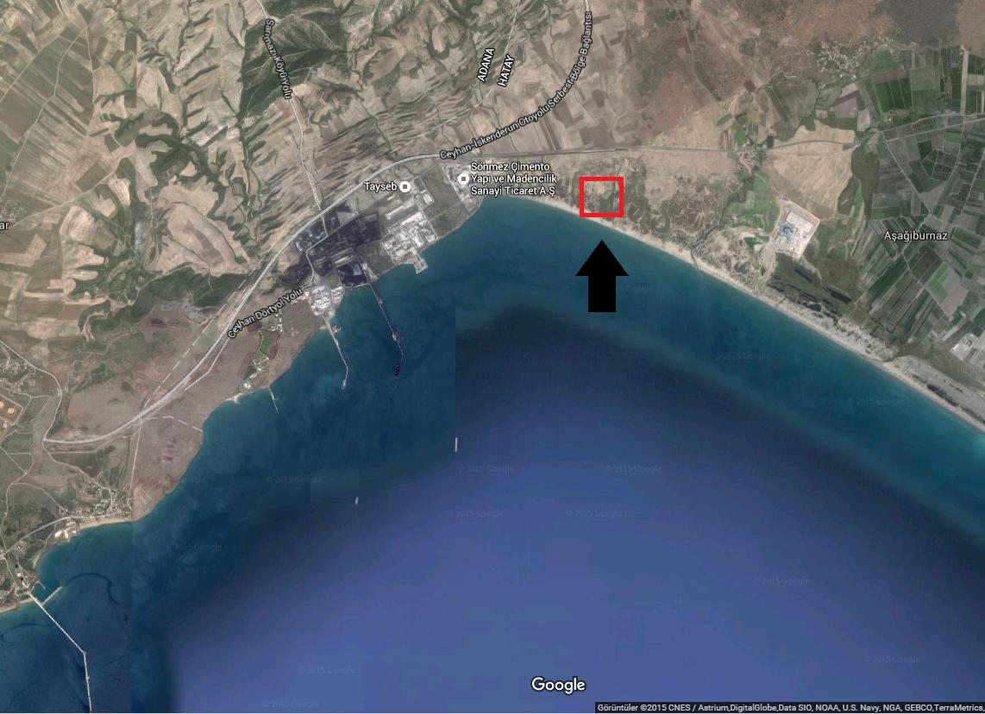
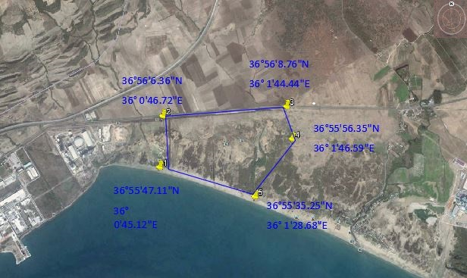
CONSTRUCTION LOCATION
The Gulf of İskenderun
Figure 2: Location of the TPP
Figure 3: Coordinates of the Project Area

Slide 6
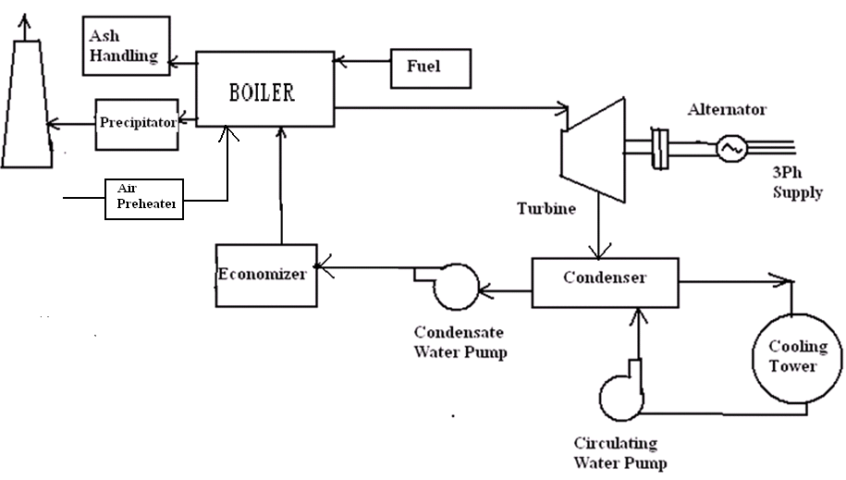
COMPONENTS

Slide 7
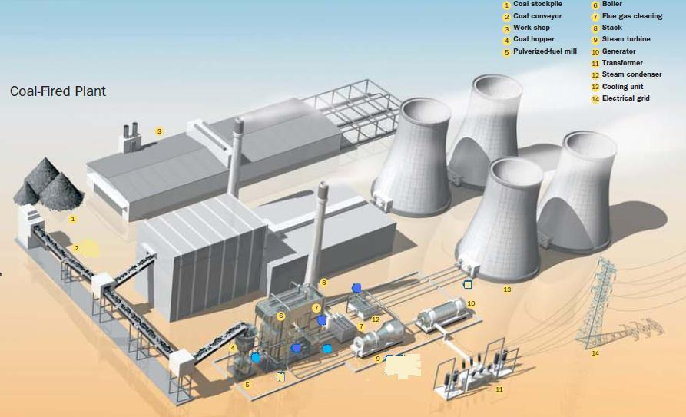
COMPONENTS
Figure 4: Basic Layout of a Coal-Fired TPP

Slide 8
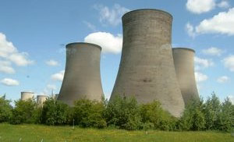
COMPONENTS
Cooling towers
Figure 5: Cooling towers

Slide 9
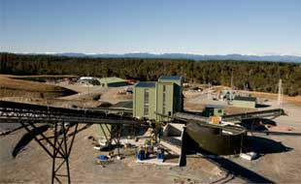
COMPONENTS
Coal handling plant
Figure 6: Coal Handling Plant

Slide 11
DRINKING AND POTABLE WATER SUPPLY
During Construction
During Operation

Slide 12
DRINKING AND POTABLE WATER SUPPLY
During Construction
Water requirement for drinking and potable purposes, concrete irrigation and firefighting
Sea water as a source
Reverse osmosis system

Slide 13
DRINKING AND POTABLE WATER SUPPLY
During Construction
1000 people working for constructions
Demand: 60 lt/day/capita
Q (ave) = 60*1000 = 60000 l/day = 60 m3/day

Slide 14
DRINKING AND POTABLE WATER SUPPLY
During Operation
Water requirement for cooling water
Demand is around 20-22 m3/sec for a 600MW Power Plant
Cooling water requirement (about 72000 to 80000 m3/ h), supplied from the Mediterranean Sea

Slide 15
COOLING WATER AND DISCHARGING
Large quantities in sea water
Ease of its use
Its high heating value
Ease in thermal discharge
The temperature of sea water is suitable for cooling purposes in all seasons

Slide 16
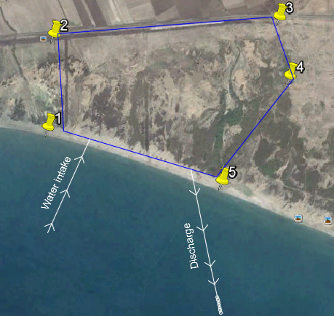
COOLING WATER AND DISCHARGING
Single Pass Sea Water Cooling System
Figure 7: Schematic Plan of Cooling Water System

Slide 18
COAL SUPPLY
Capacity is 600 MW >> 1500000 ton/year=125.000ton/month
1st option: 1 ship per month – 12 ships per year (big ships = depth limitations)
2nd option: 2 ships per month – 24 ships per year (most feasible)
3rd option: 3 ships per month – 36 ships per year (not economical)

Slide 19
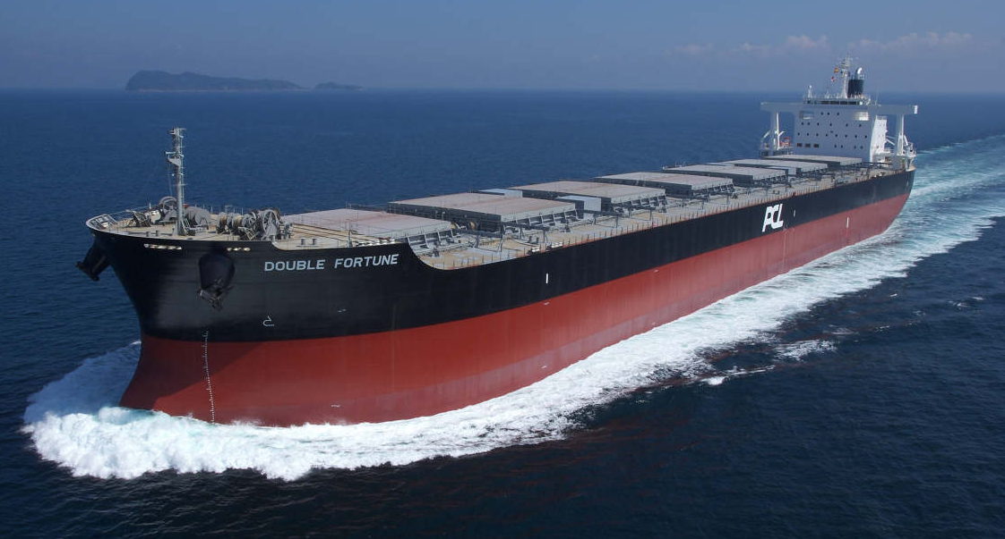
COAL SUPPLY
Panamax Bulk Carriers: 12.04m draft
60.000 – 80.000 DWT
Figure 8: An example of Panamax Bulk Carriers

Slide 20
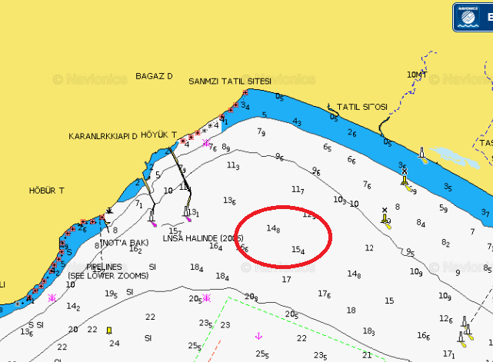
BATHYMETRY STUDIES
For ships of 65.000 tons
15 m depth is needed
2000m further from shoreline
Figure 9: Bathymetry map of the İskenderun Bay

Slide 22
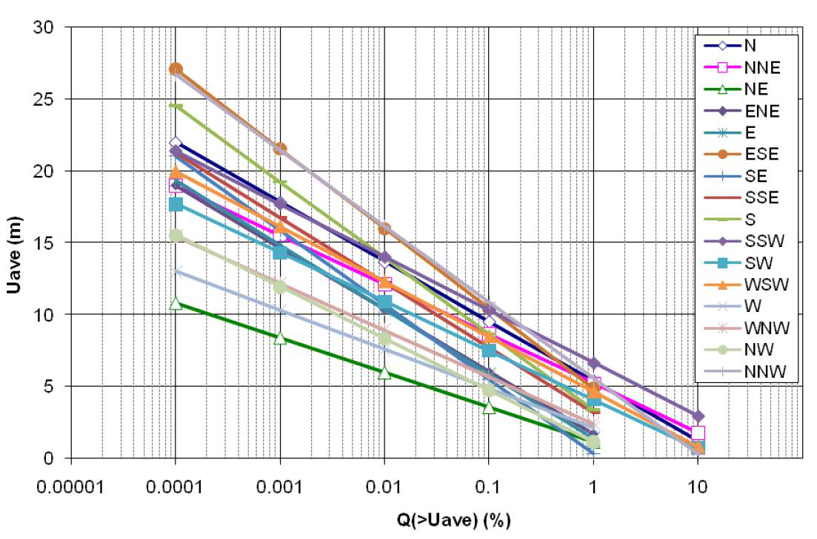
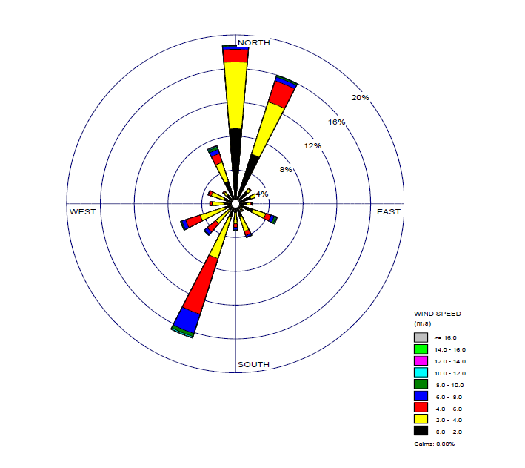
WIND & WAVE ANALYSIS
Data obtained from General Directorate of State Meteorological Works Yumurtalık Meteorological Station
Graph 1: Long Term Wind Statistics
Graph 2: Wind Rose of the Region (Annual)

Slide 23
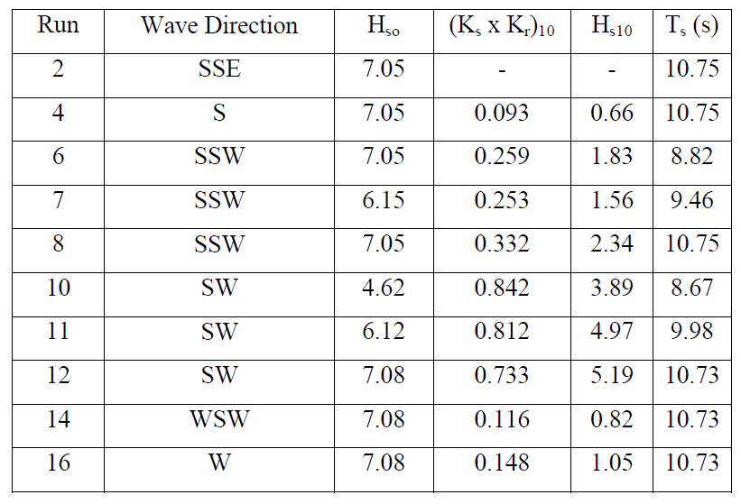
WIND & WAVE ANALYSIS
Extreme and average wave velocities were examined.
Most critical direction is SW
Significant wave height is 5.19m
Graph 3: Table of wave heights at 10 meter water depth (from extreme value distribution)

Slide 24
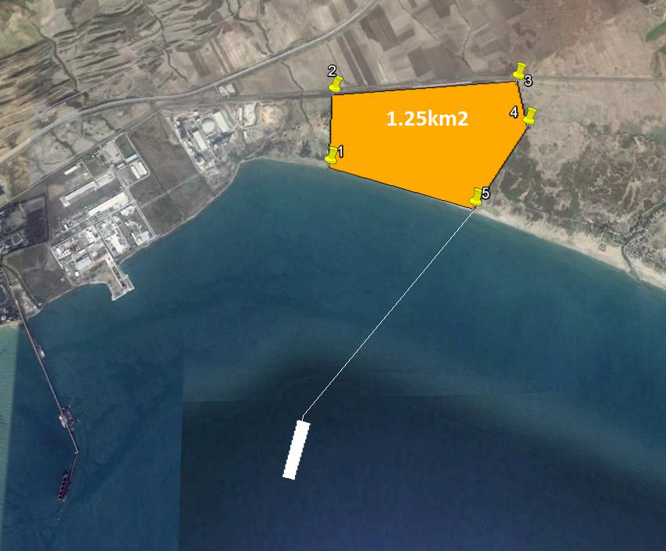
PIER CONSTRUCTION
Pier Length = 2km
Foundation = Driven Steel Piles
Orientation = // SSW
Corrosion Protection= Cathodic
Figure 10: Positioning of the Pier and Dock

Slide 26
REGULATIONS
Water Pollution Control Regulation
Regulation for Protection Against Sabotages
Hazardous Waste Control Regulation
Industry Based Air Pollution Control Regulation

Slide 27
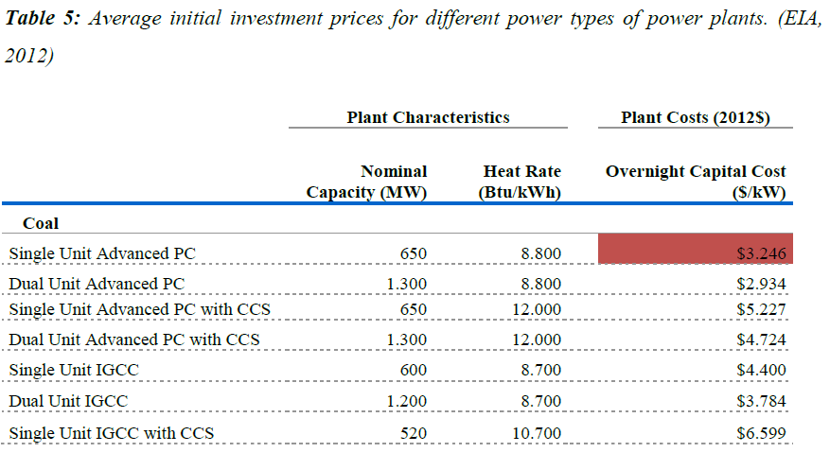
COST ESTIMATION
10% Inflation, for 600MW ➔ $2.392 billion

Slide 28
CONCLUSION
Planned capacity = 600MW
Required Coal= 125.000 tons/month
Transportation of Coal = via Panamax Ships twice a month
Depth for Dock = 15 m
Lenght of the Pier= 2000m
Plant Area= 1.25km²
Chimney Height = 175m
Water consumption= 80000 m³/h
*Number of piles and dimensions will be calculated accordingly.

Slide 29
REFERENCES
Armada Planning and Consulting Company. (2009). Erzin Natural Gas Power Plant Environmental Impact Analysis Final Report. Ankara: EGEMER ELEKTRİK ÜRETİM A.Ş.
General Directorate of State Meteorology Affairs. (1980-2014, December). Yearly Precipitation Data of Hatay. November 12, 2015 Turkish State Meteorological Service, retrieved from: http://www.mgm.gov.tr/veridegerlendirme/yillik-toplam-yagis- verileri.aspx?m=HATAY#sfB
International Energy Agency. (2010). Energy Policies of IEA Countries Turkey Review. Paris: IEA.
Ministry of Environment and Urbanisation. (2004, December 31). Water Pollution Control Regulation. Ankara, Turkey.
Official Gazette. (2005, March 14). Hazardous Waste Control Regulation. Ankara, Turkey: Ministry of Envirronment and Urbanization.
Official Gazette. (2009, July 3). Industry Based Air Pollution Control Regulation. Ankara , Turkey: Ministry of Environment and Urbanization.
Official Gazette. (1988, December 28). Regulation for Protection Against Sabotages. Ankara, Turkey: The Grand National Assembly of Turkey.
Sylvain Quoilina, M. V. (2013, June 22). Techno-economic survey of Organic Rankine Cycle (ORC) systems. Renewable and Sustainable Energy Reviews , s. 168-186.
Turkey Electricity Distribution Corporation . (2012). Demand Forecasting. Ankara: TEDC.
World Bank. (2013). Electric power consumption (kWh per capita). November 10, 2015 The World Bank, retrieved from: http://data.worldbank.org/indicator/EG.USE.ELEC.KH.PC/countries?display=graph
World Coal Association. (2015). Coal. November 10, 2015 retrieved from World Coal: http://www.worldcoal.org/coal

