Slide 1

Immersed Tube Tunnel Project in IZMIR

Slide 2
Members
We are VOLTRAN

Slide 3
Content
General Overview
Ground Profile
Bridge
Artificial Island
Immersed Tube Tunnel

Slide 4
General Overview
1

Slide 5
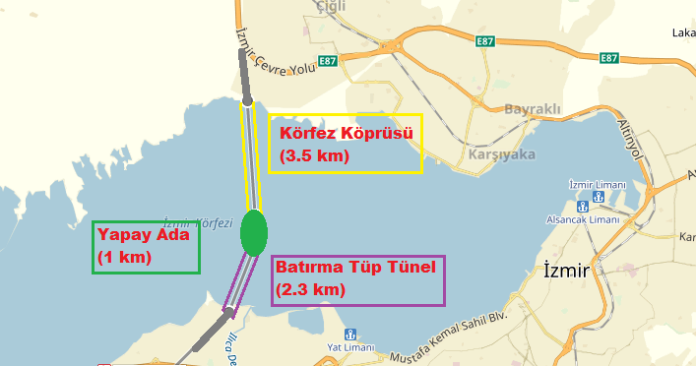
About Project

Slide 6
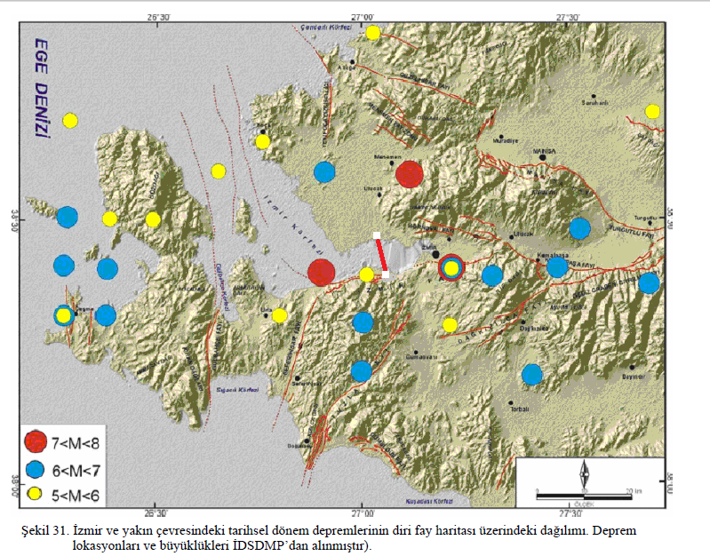
Location of Project Relative to Fault Line
Retrieved from http://www.tmmmb.org.tr/images/Etkinlikler/9_TMK/ozgur_ugurlu.pdf

Slide 7
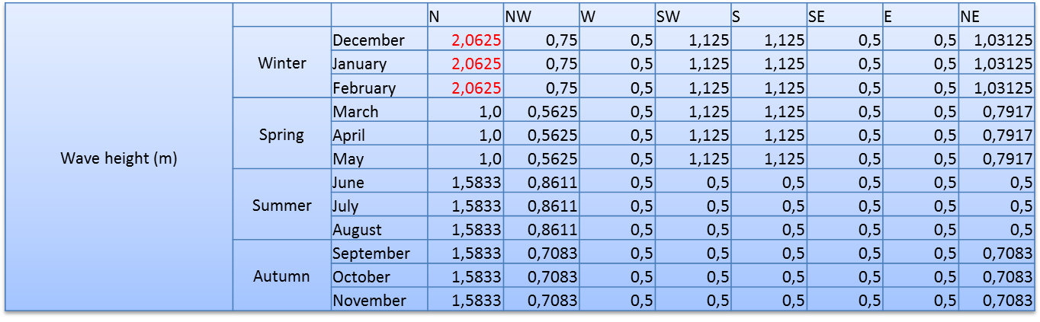
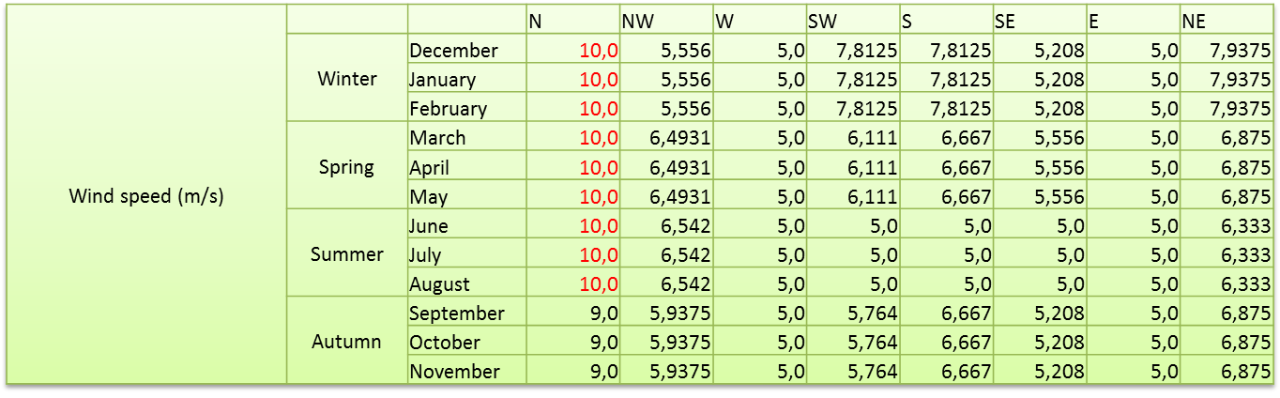
Design Parameters

Slide 8
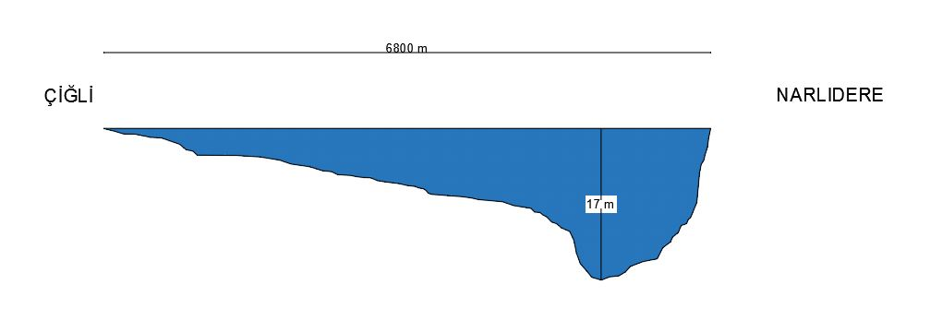
Bathymetry

Slide 9
Ground Profile
2

Slide 10
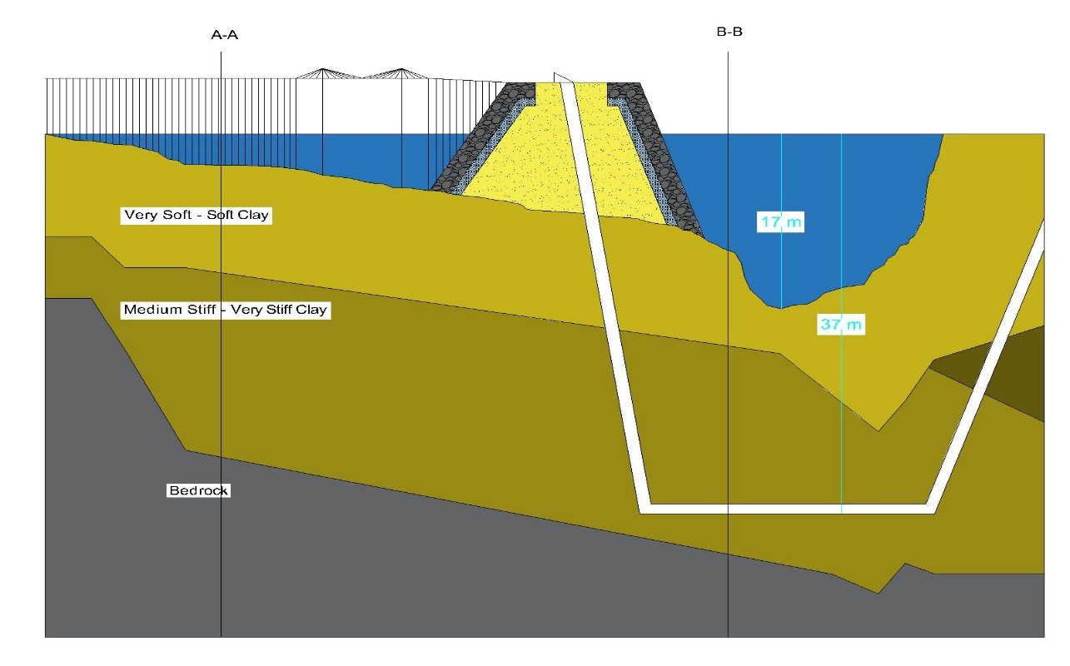
Soil Profile

Slide 11
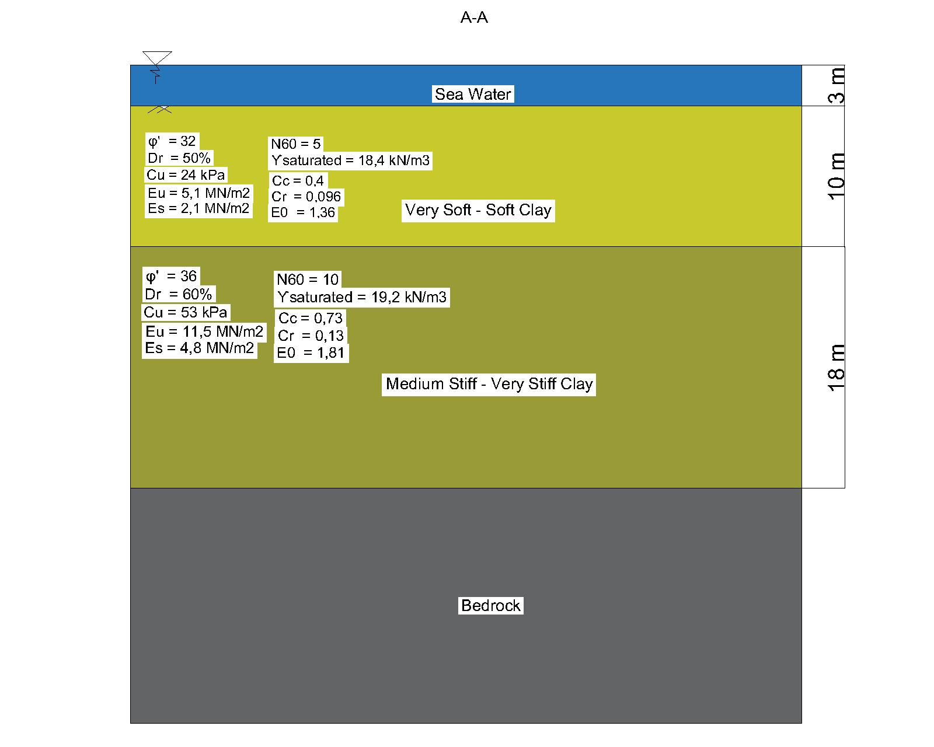
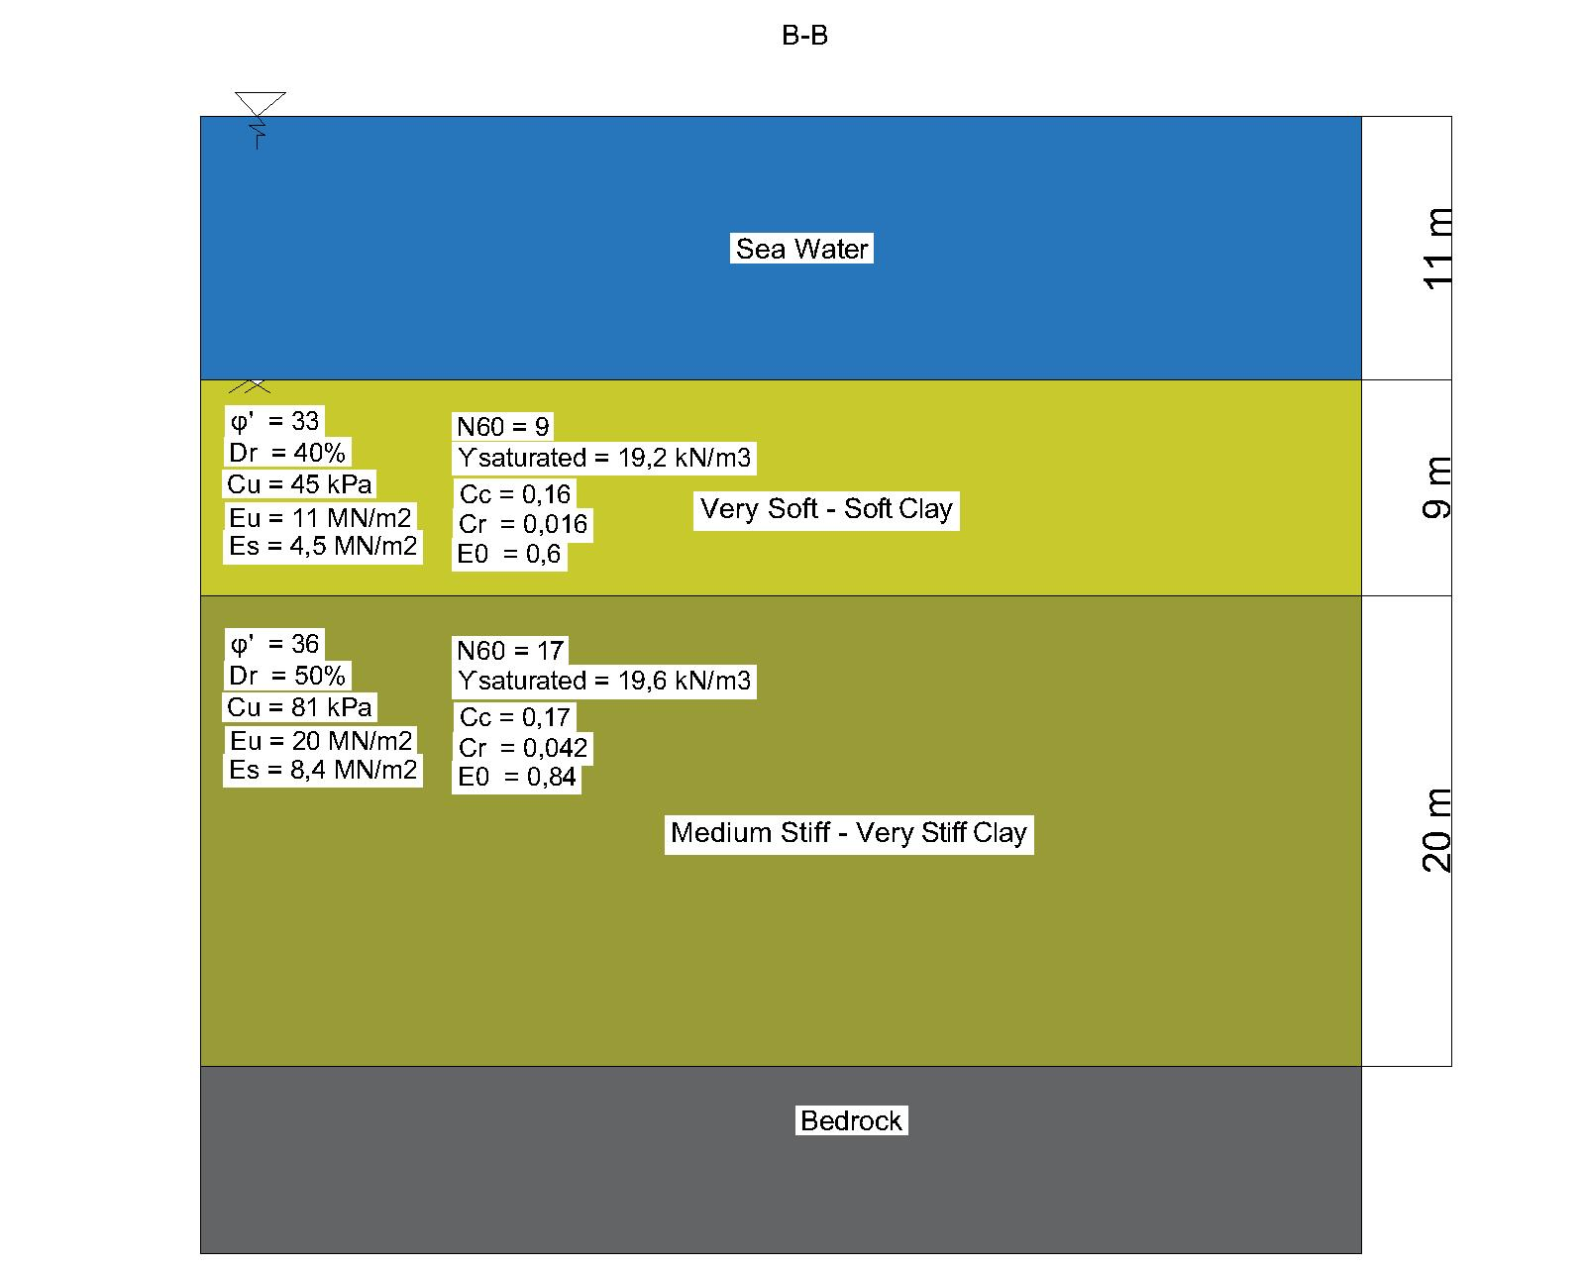
Soil Parameters

Slide 12
Soil Parameters
A-A
B-B

Slide 13
2,639,389 m³
1,656,000 m³
Volume of Dredged Soil
Volume of Fill Dirt

Slide 14
Bridge
3

Slide 15
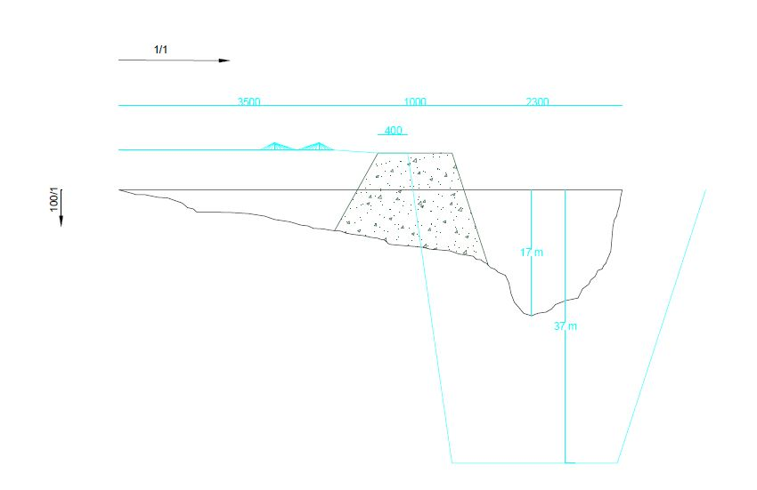
The Route

Slide 16
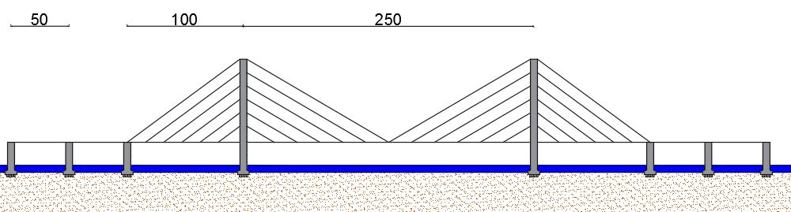
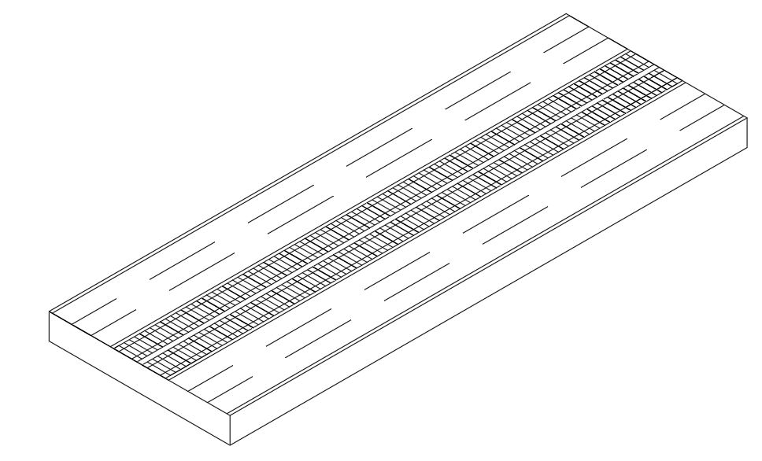
Leg Spans & Highway

Slide 17
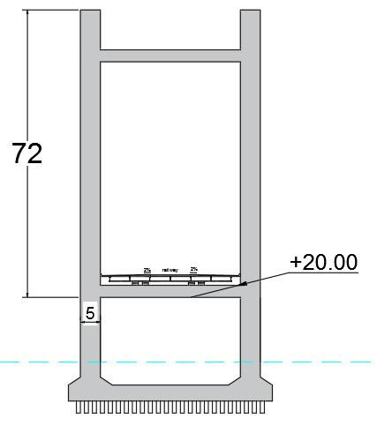
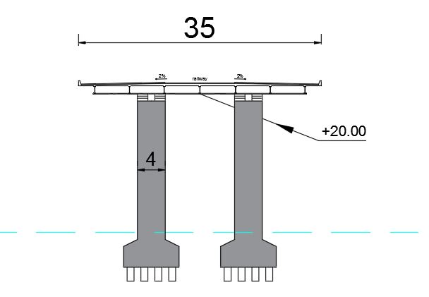
Pier Sections

Slide 18
Artifical Island
4

Slide 19
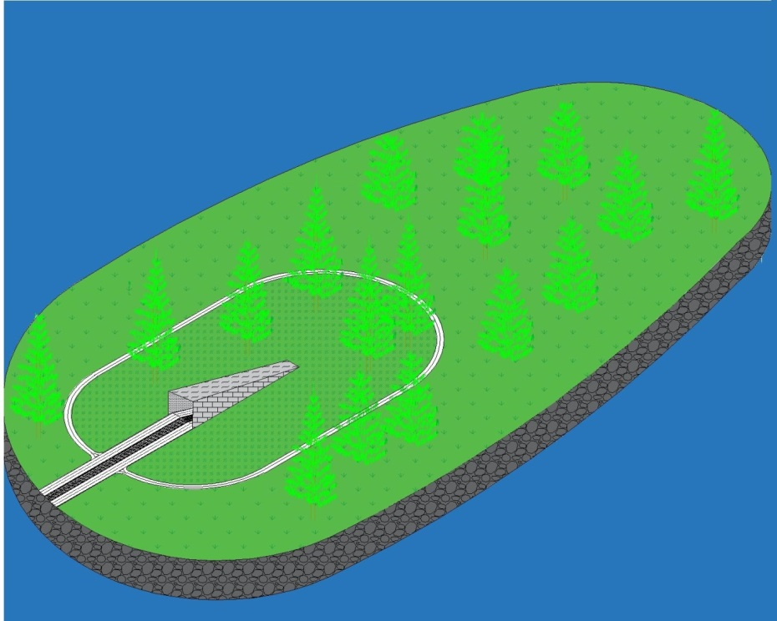
Design of Artificial Island

Slide 20
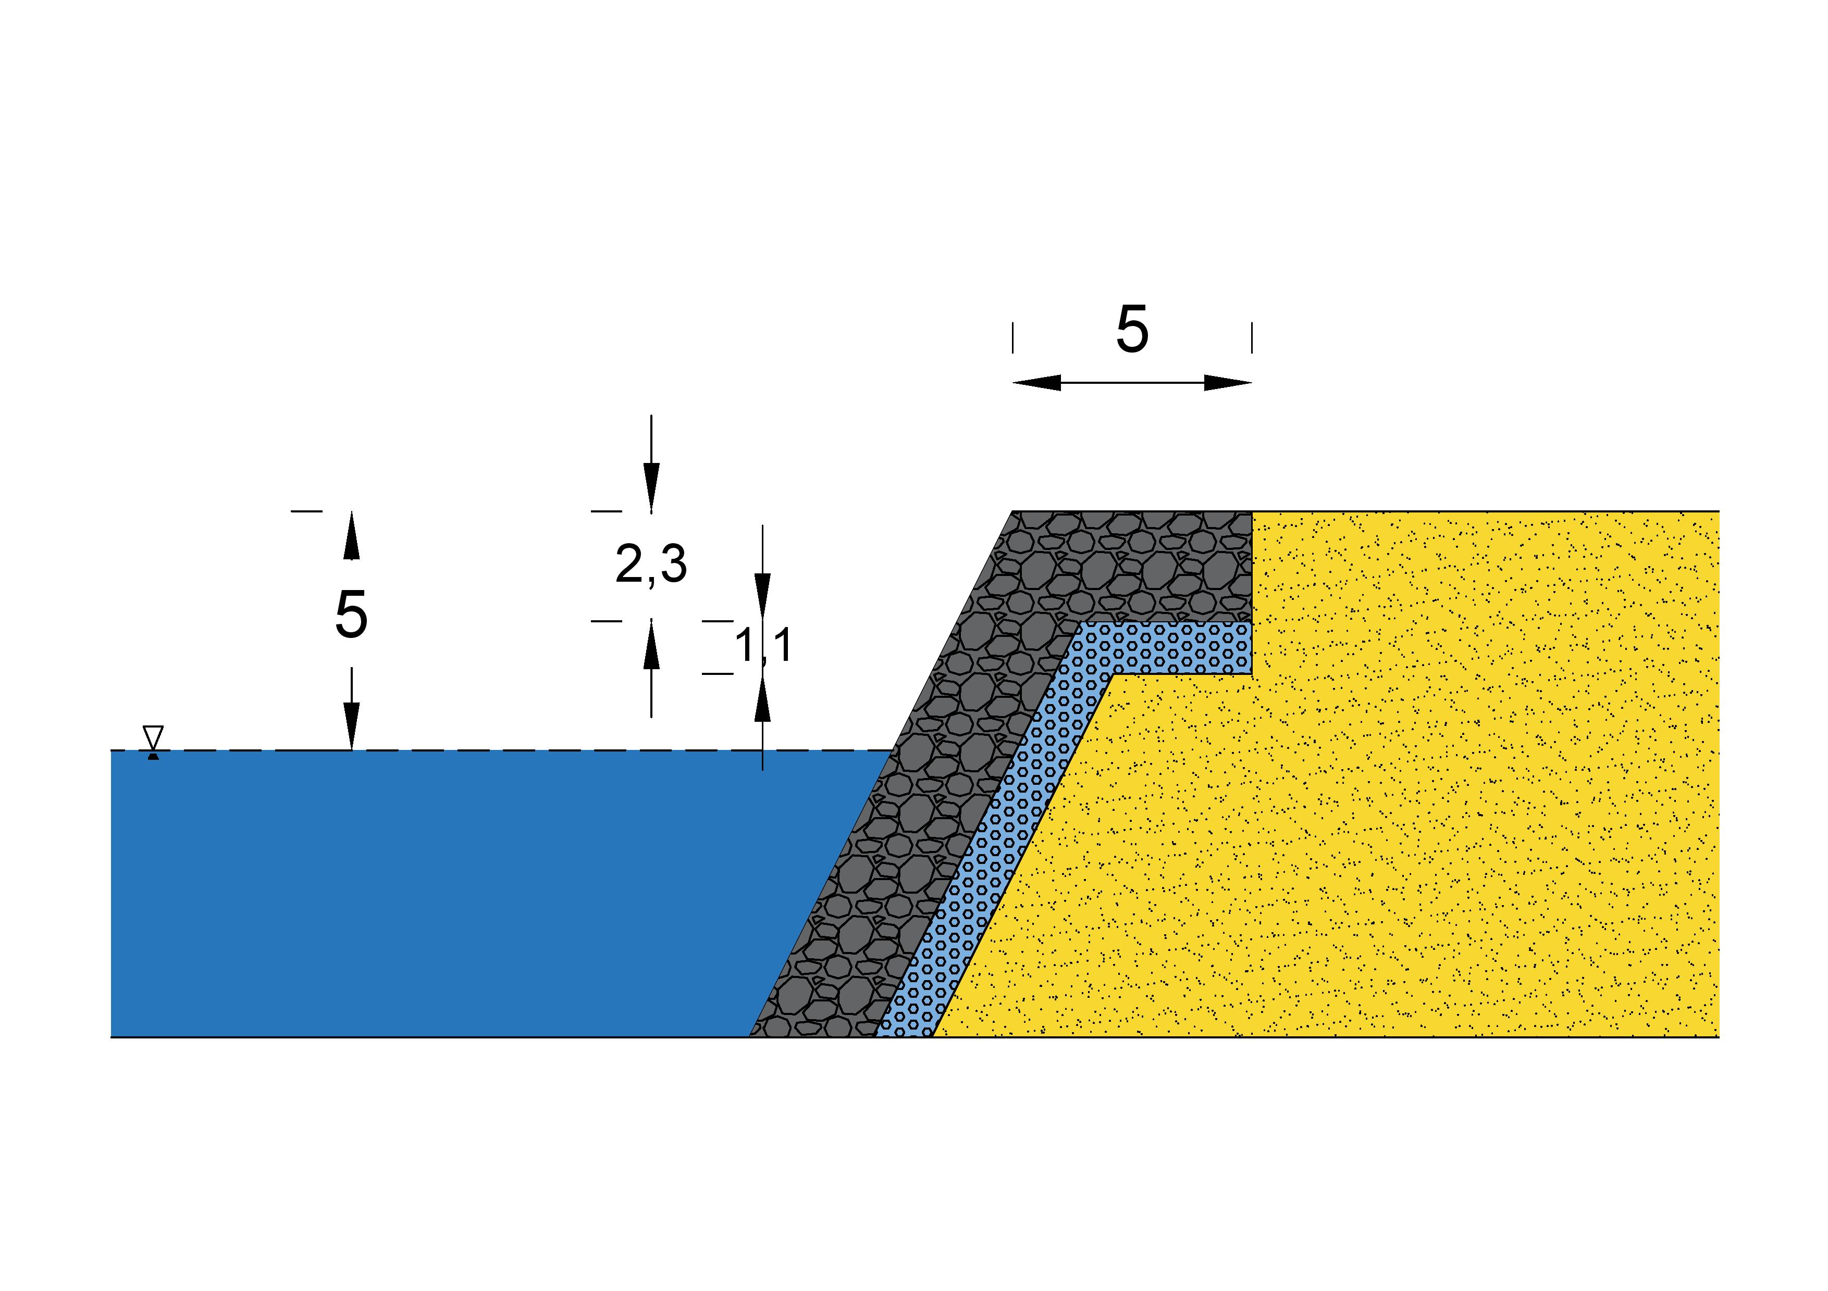
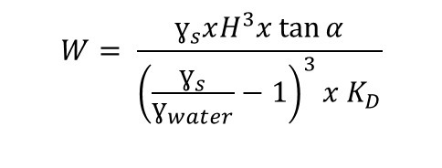
Layers of Artificial Island
According to Hudson Formula;
$$W= \frac{ɣ_{s}xH^{3}x\tan{α}}{{\left(\frac{ɣ_{s}}{ɣ_{water}}−1\right)}^{3}x K_{D}}$$
Armour Layer : 3,6 Tons
Under Layer : 0,36 Tons

Slide 21
11,443,000 m³
133,750 m³
Volume of Core
Volume of Armour Layer
44,600 m³
Volume of Under Layer

Slide 22
Immersed Tube Tunnel
5

Slide 23
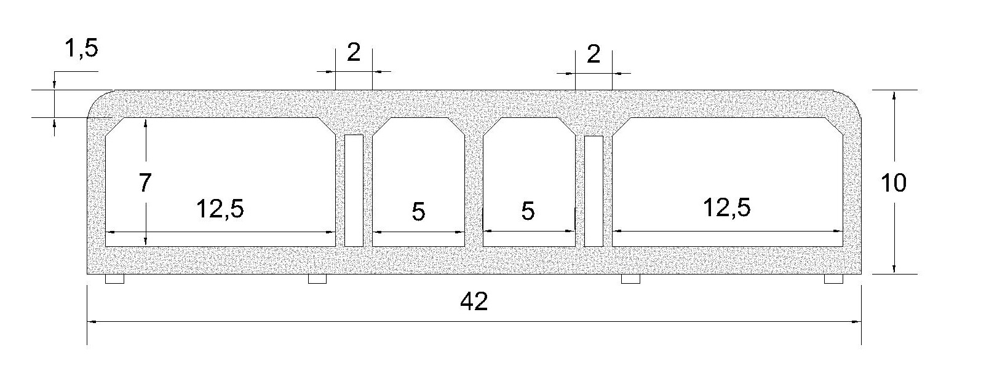
Properties of Tube Tunnel
Rectangular
Reinforced Concrete

Slide 24
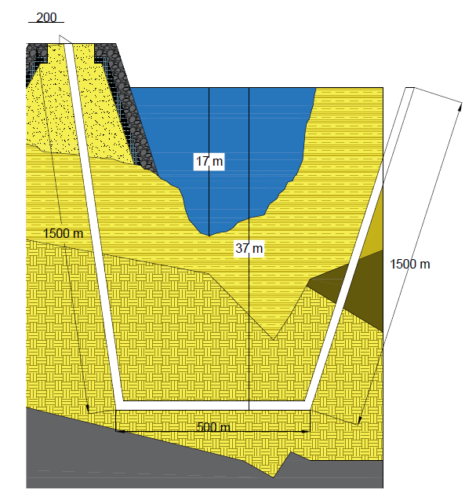
Design Process
Planned Location
A
A

Slide 25
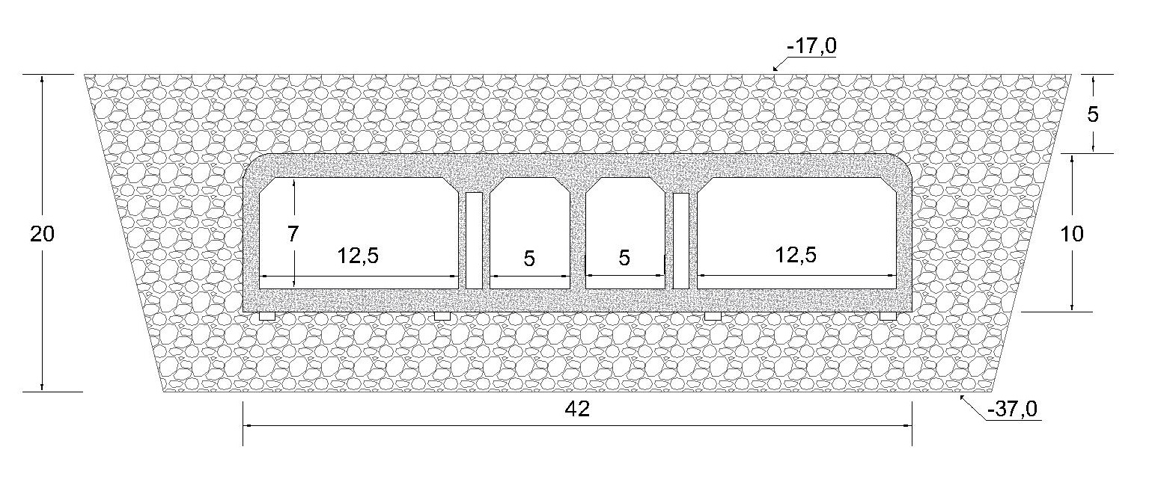
A-A Section
Bedding Layer,
Backfilled and Armor Layer,
Tectonic Motion.

Slide 26
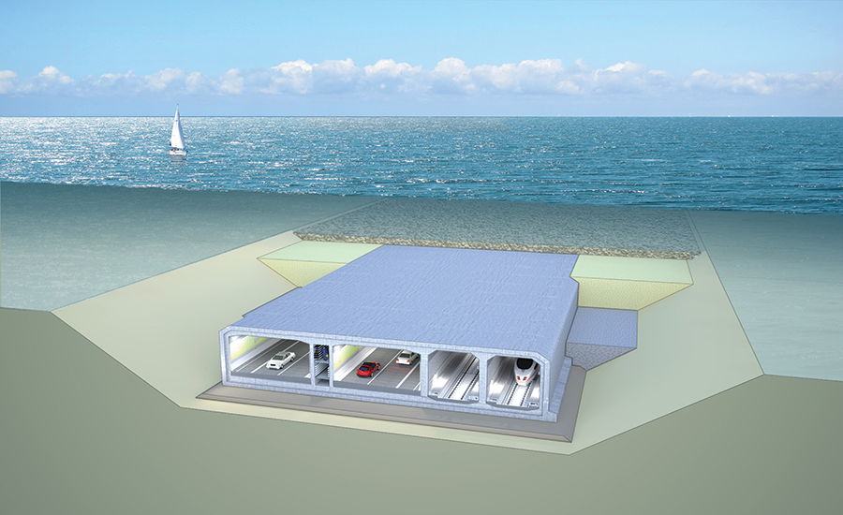
Construction Procedures
Prefabrication
Immersion Operation,
Seated on the Foundation
Retrieved from http://www.railsystem.net/immersed-tube-tunnel/

Slide 27
References
Erol, O., & Çekinmez, Z. (2014). “Geoteknik Mühendisliğinde Saha Deneyleri”. Retrieved March 20, 2017
İzmir Körfezi ve Limanı Rehabilitasyon Projesi (İzmir İli, Konak İlçesi) Çevresel Etki Değerlendirmesi Raporu. (2016). Retrieved March 21, 2017
İzmir Körfezi ve Limanı Rehabilitasyon Projesi Liman Yaklaşım Kanalı, Manevra Dairesi, Liman Baseni,II. Kısım Konteynır Sahası ve Sirkülasyon Alanı Jeoteknik Raporu. (2013). 1-2. Retrieved March 20, 2017.
Körfez Yeniden Hayat Buluyor. (n.d.). Retrieved March 21, 2017, from http://www.izsu.gov.tr/Pages/standartPage.aspx?id=208
M.J. Tomlinson, Foundation Design and Construction, Pitman Books Ltd, London,1980,p.659 (Deniz Yapılarında Beton Üretim Teknikleri,Prof.Dr M.Süheyl AKMAN,, İTÜ İnş. Fak.)
N.Kartaltepe (2008).Preliminary Design anf Analysis For an Immersed Tube Tunnel Across The Izmir Bay. Retrieved from http://library.iyte.edu.tr/tezler/master/insaatmuh/T000768.pdf

Slide 28
References
Non-Conventional Rubble Mound Breakwater with Core made of Geotextile Sand Containers (Geocore Breakwater). (n.d.). Retrieved March 21, 2017, from https://www.tu- braunschweig.de/lwi/hyku/forschung/abgeschlosseneprojekte/geocore
Yılmaz, M. (2017, March 06). Bürokrasi, İzmir'e milyarları kaybettirdi | Mustafa Yılmaz. Retrieved March 21, 2017, from http://www.milliyet.com.tr/burokrasi-izmir-e-milyarlari-/mustafa- yilmaz/ege/yazardetay/06.03.2017/2408106/default.htm
http://www.kgm.gov.tr/
https://www.tmmob.org.tr/

Slide 29
Thank you for your attention!
Is there any question?

