Slide 1
CE 410 GROUP VOLTRAN-IZMIR IMMERSED TUBE TUNNEL PROJECT

Slide 2
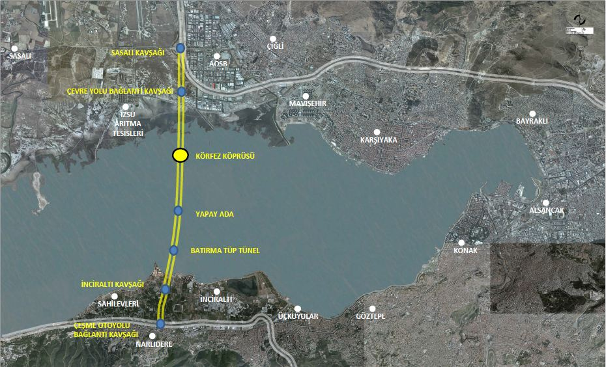
IZMIR IMMERSED TUBE TUNNEL

Slide 3
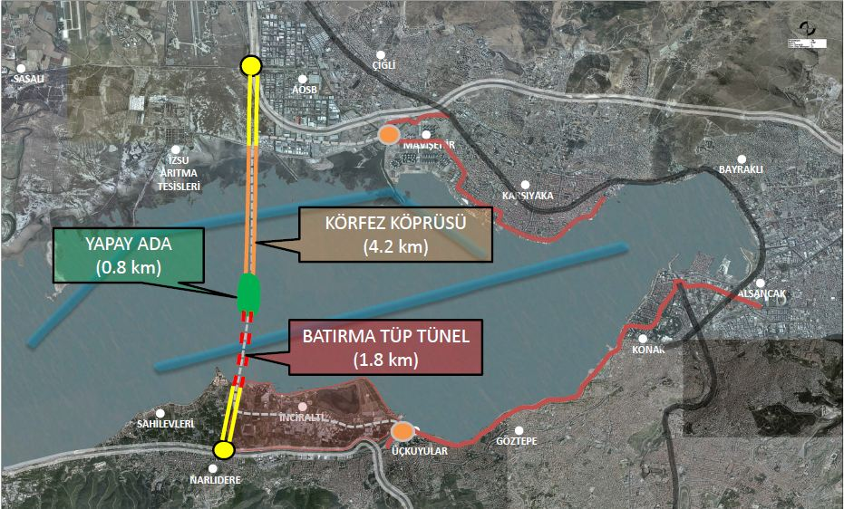

Slide 4
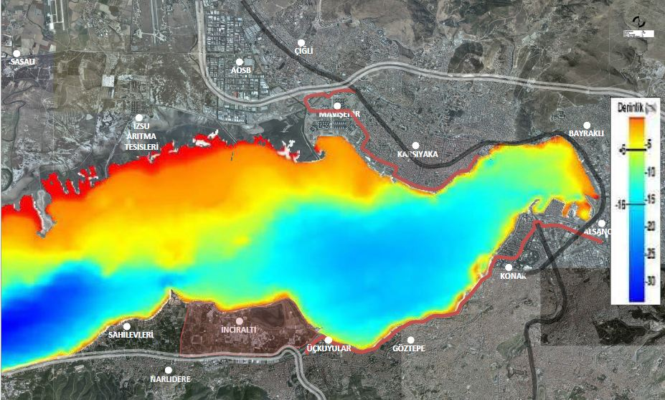

Slide 5
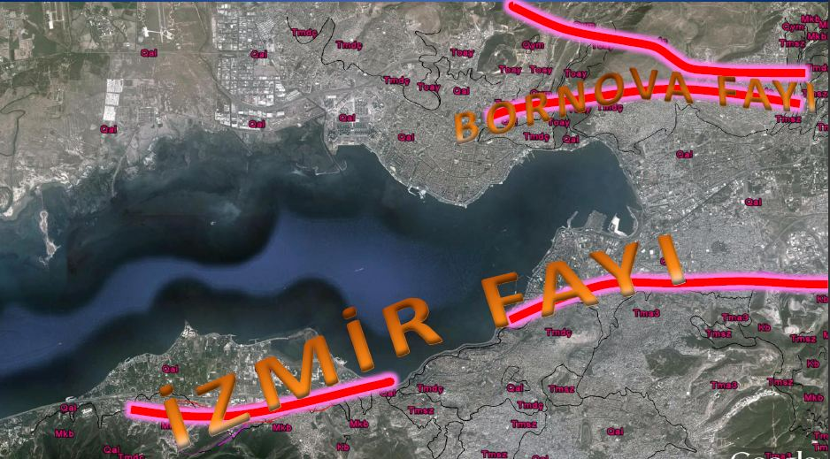

Slide 6

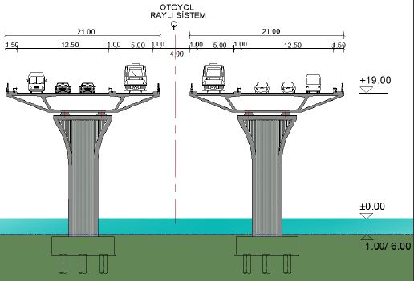

Slide 7
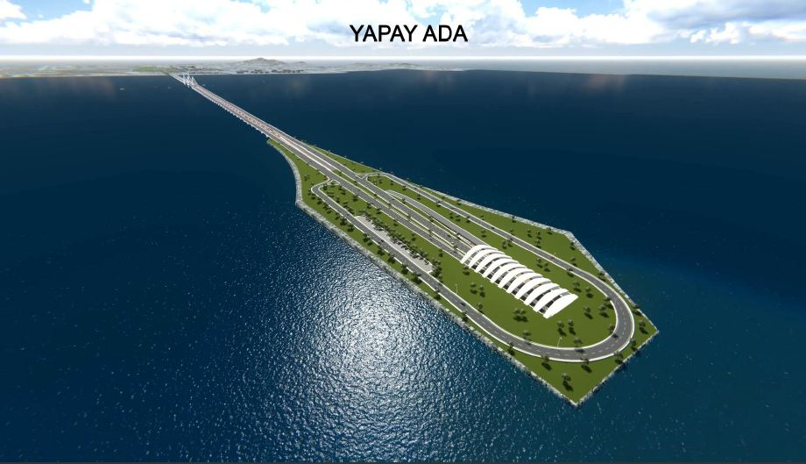

Slide 8
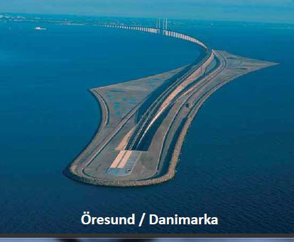
OTHER ARTIFICIAL ISLANDS

Slide 9
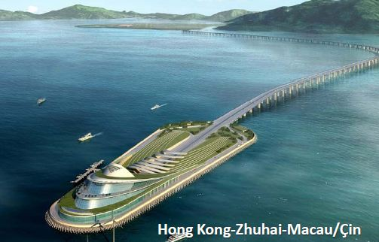
OTHER ARTIFICIAL ISLANDS

Slide 10
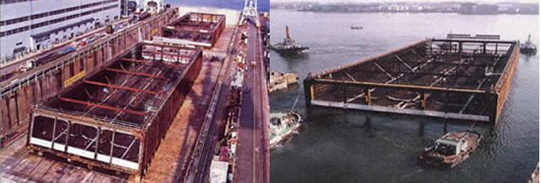
Other Immersed Tube Tunnels
Tama River - JAPAN

Slide 11
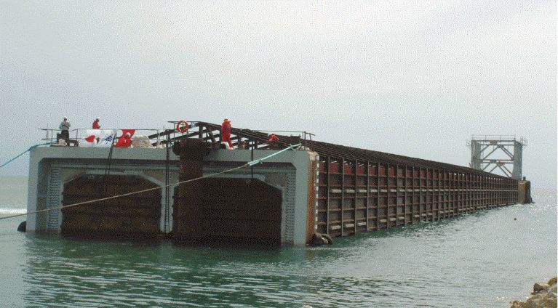
Other Immersed Tube Tunnels
Marmaray-TURKEY

Slide 12
References
Marmaray. (n.d.). Retrieved March 07, 2017, from http://www.marmaray.gov.tr/
TürkMMMB. (n.d.). Retrieved March 07, 2017, from http://www.tmmmb.org.tr/

