Slide 1
WASTEWATER / STORMWATER COLLECTİON SYSTEMS
Wastewater collection systems are used to collect and transmit liquid wastes to a central treatment plant.

Slide 2
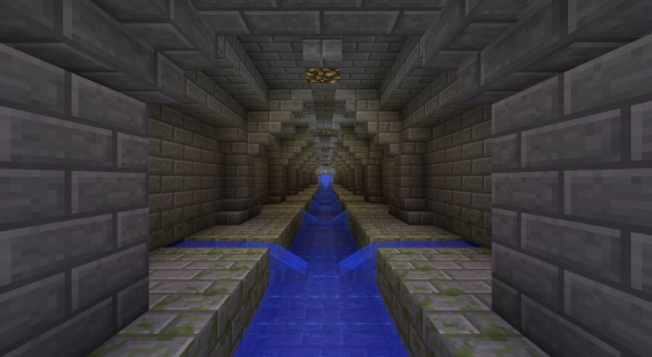
→sewers

Slide 3
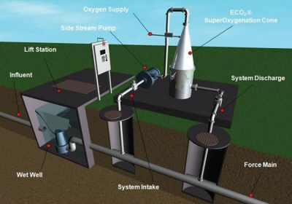
→force mains

Slide 4
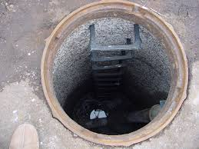
manholes

Slide 5
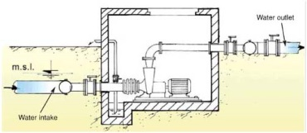
→ pump stations

Slide 6
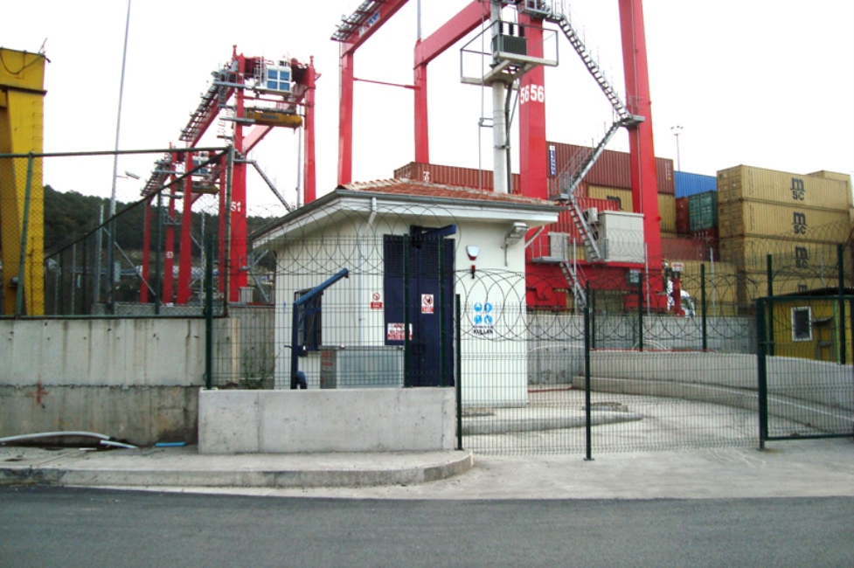

Slide 7
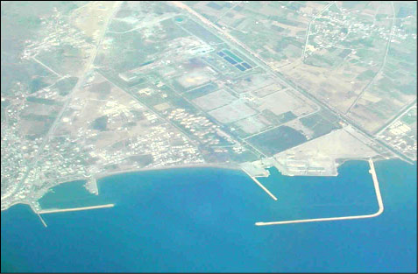
A view of Taşucu

Slide 8
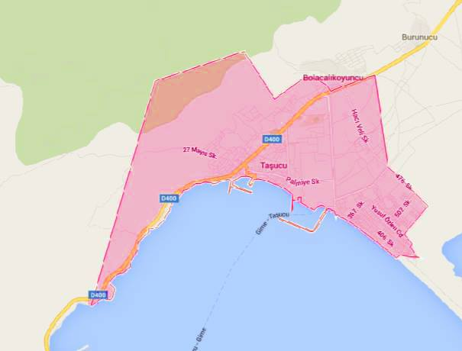

Slide 9
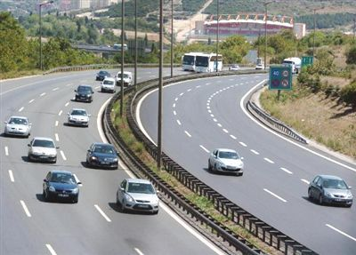
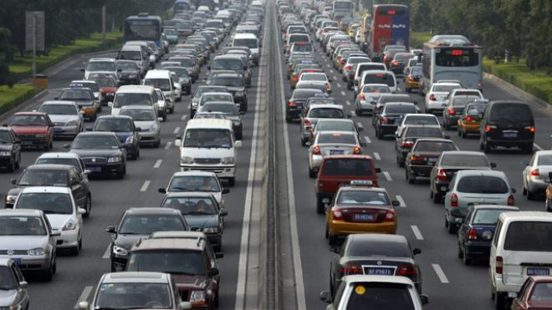
POPULATION PLANNING
Why is it important?
Demand > Supply
Demand < Supply

Slide 10
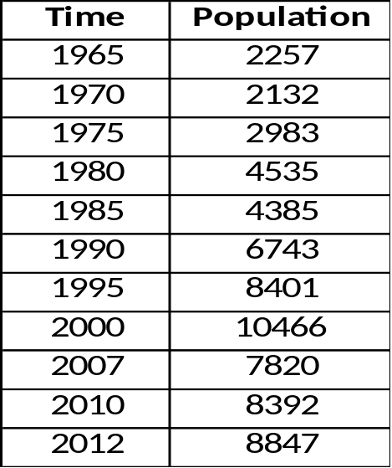
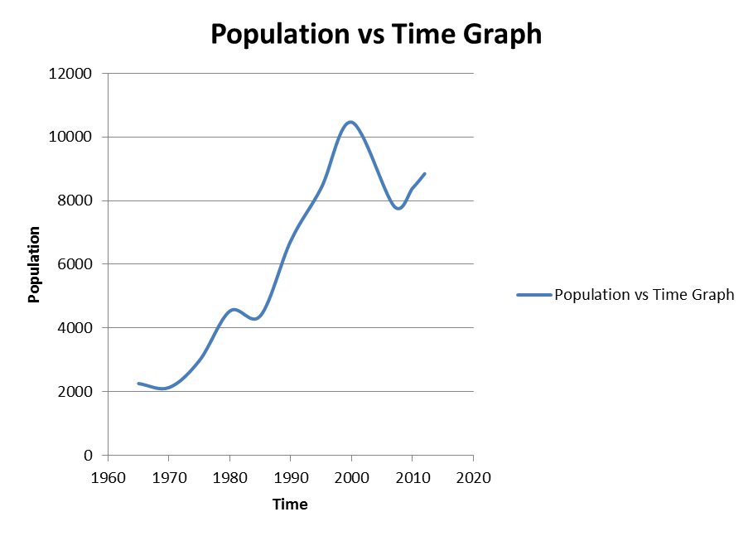
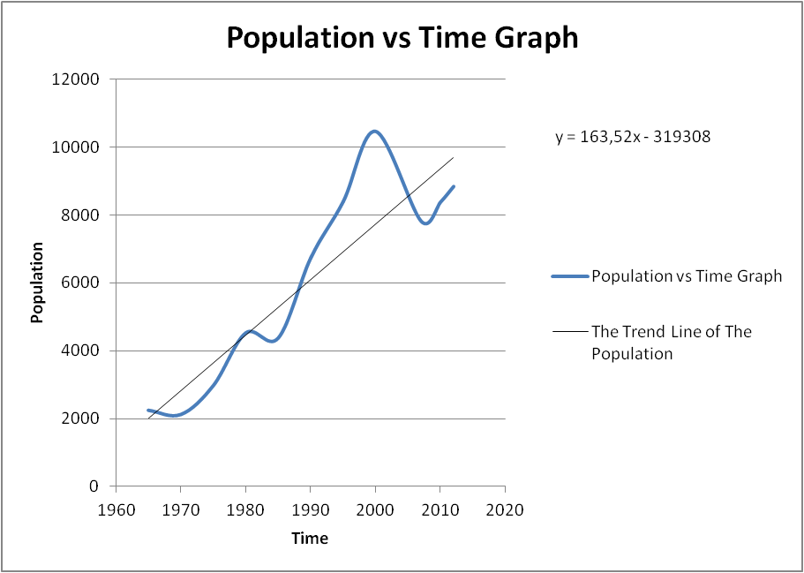
METHODS
Graphical Method
y = 163,52 * 2050 - 319308 = 16000

Slide 11
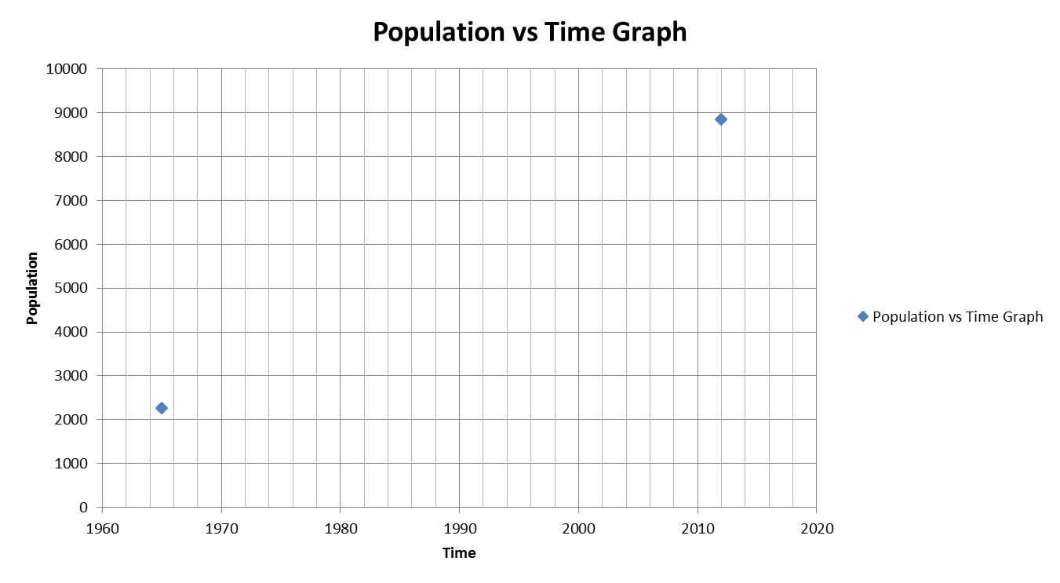
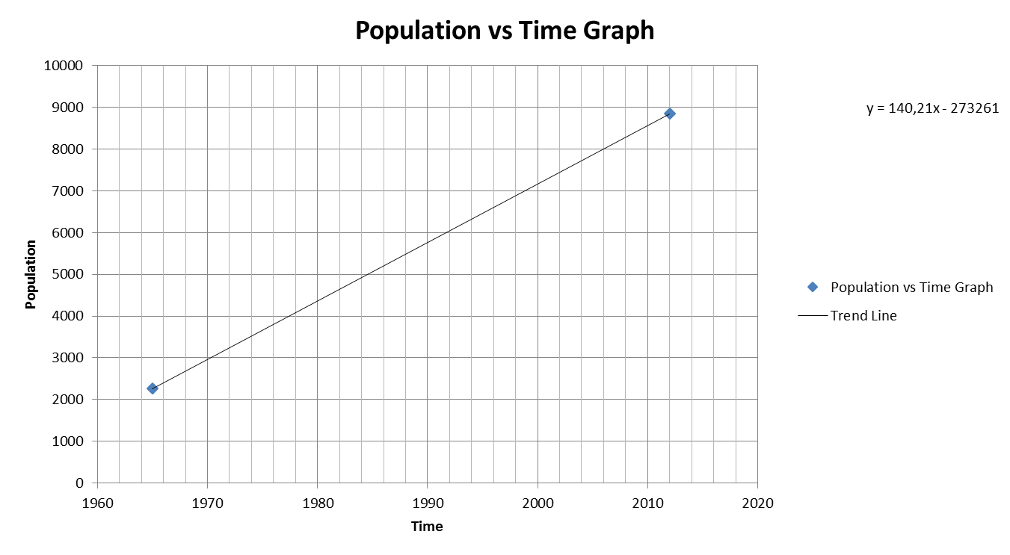
1) Graphical Method
2) Arithmetic Method
The Population= 140,21*2050- 273261 = 14200 people

Slide 12
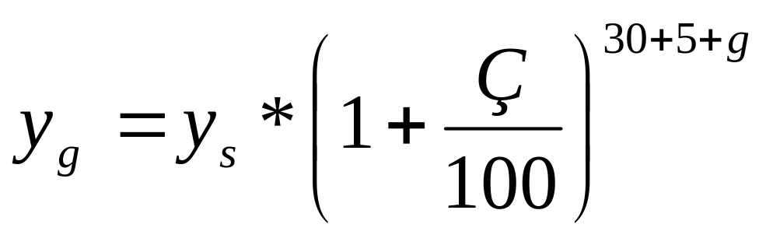
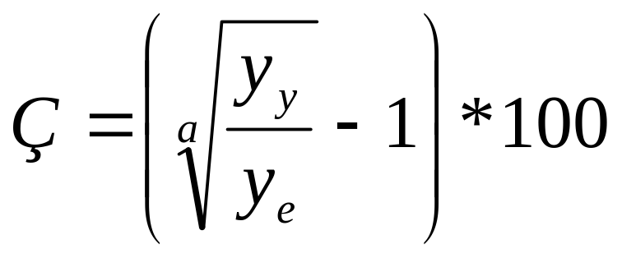
3. Geometric Method
4. Bank of Provinces Method
In (Ng) = In (Ny) + kg * ( tg - ty ) = In (8847) + 0.0291 * (2050-2012)
Ng = 34000
y₂₀₅₀ = 73000

Slide 13
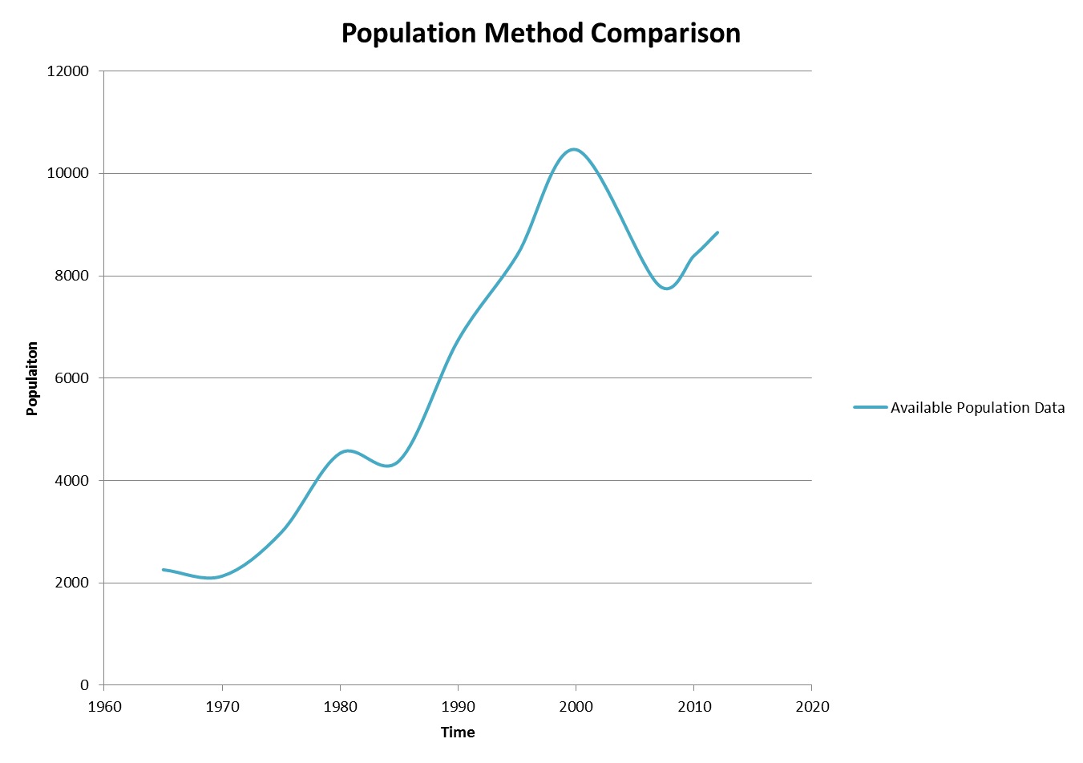
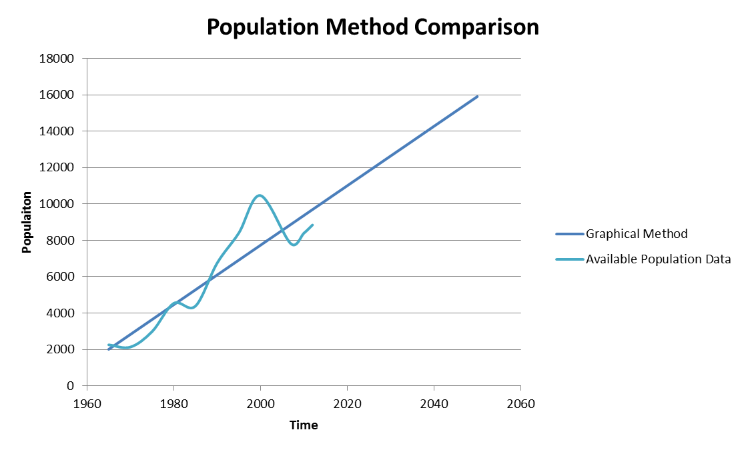

Slide 14
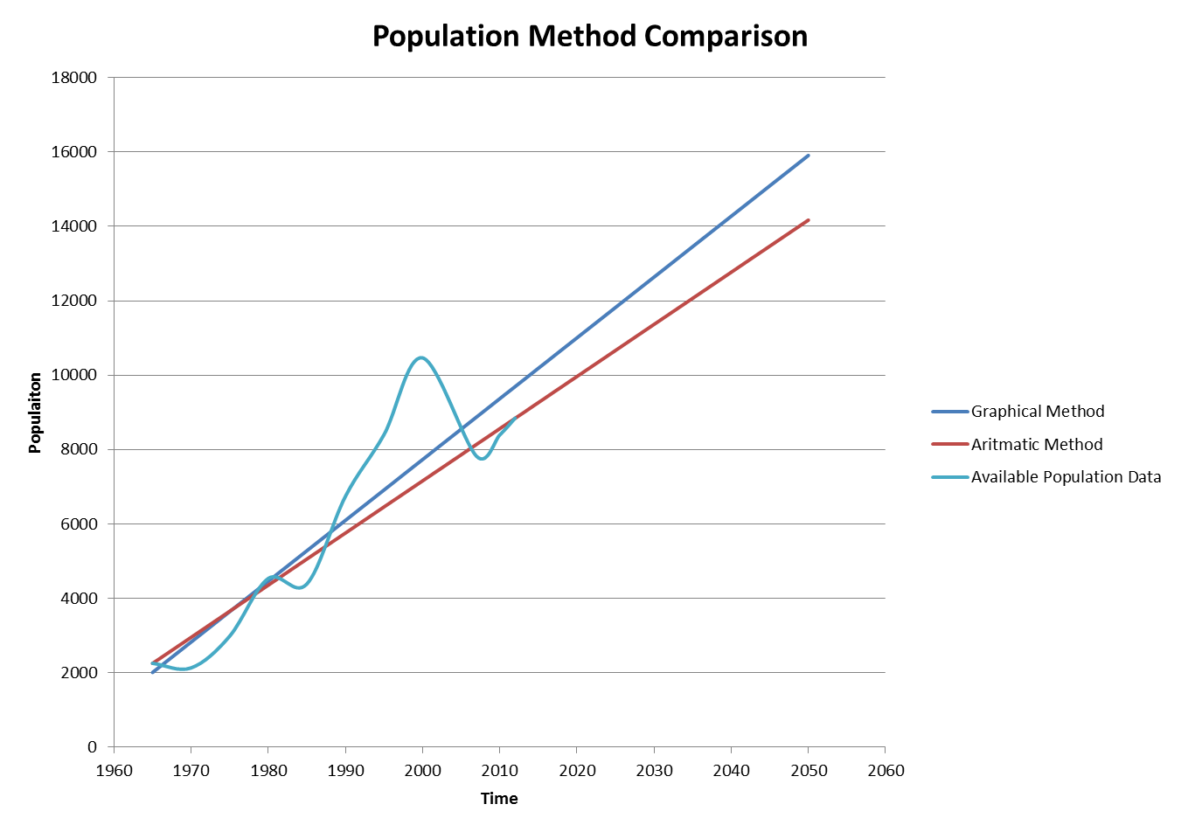
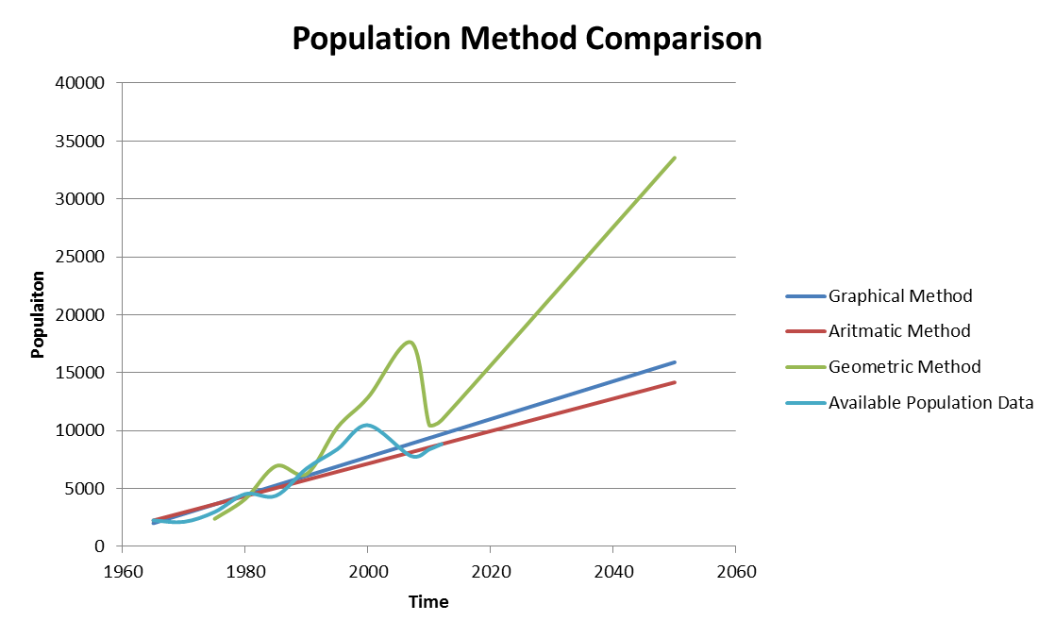

Slide 15
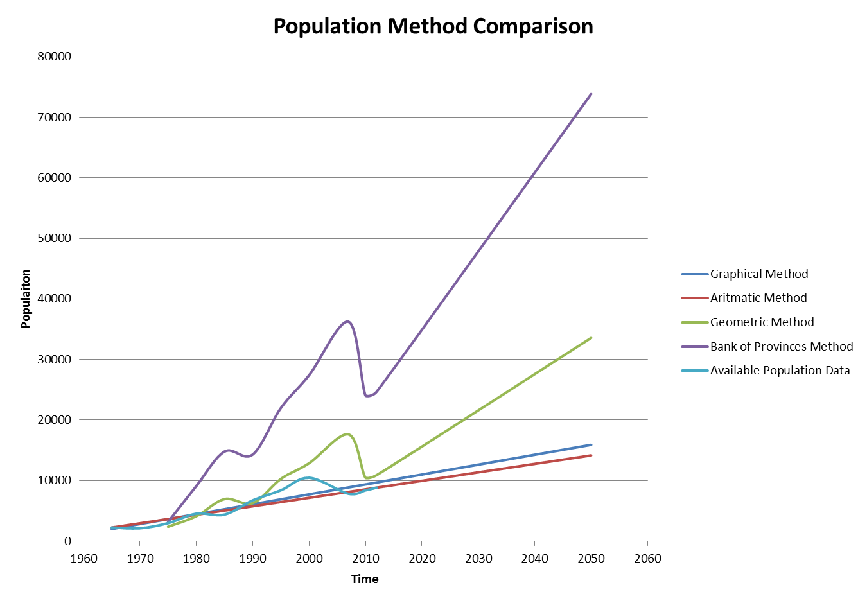

Slide 16
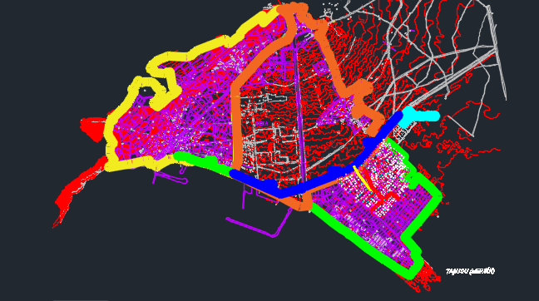
Interpretation of the Map
50 person/ha
430 ha
60 person/ha
340 ha
80 person/ha
210 ha
(Autocad file of Taşucu)

Slide 17
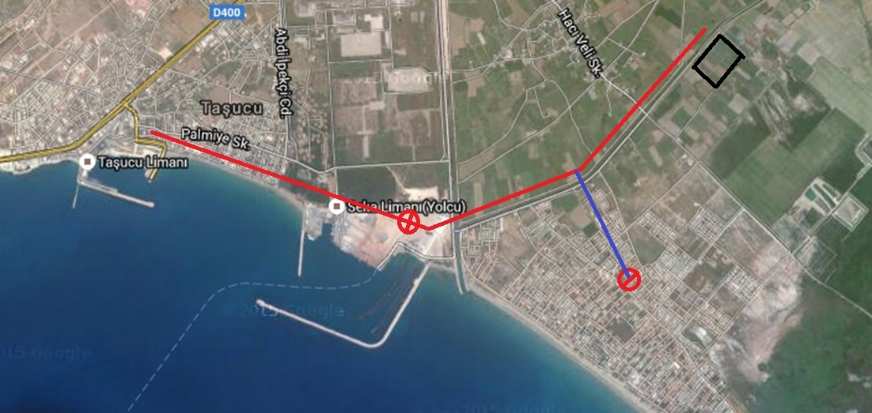
The Appropriate Place Selection for Tretmant Plant and Pipes
Tretmant plant
Elevation Center
Pumping station
(https://www.google.com.tr/maps/)

Slide 18
Waste Water Amount Determination & Pipe Diameter Selection

Slide 19
Table : Potable water demand according to population (The Bank of Provincess)
population | Potable water demand (l/p/d)
3000 | 60
3000-5000 | 60-80
5000-10000 | 70-80
10000-30000 | 80-100
30000-50000 | 100-120
50000-100000 | 120-170
Population
60.000

Slide 20
The potable water per person = 140 l/d
According to TUIK data the rate of waste water formation from potable water is 84,3%. (TUİK BELEDİYE ATIKSU İSTATİSTİKLERİ, 2010)
140*0,843 = 120 l/d/p (for the parts of 1&2)

Slide 21
Table : The calculation of sewage amount
parts of the map | sewage(l/s/p) | areas(ha) | p/ha | total sewage(l/s)
1 | 120 | 340 | 50 | 23,61
2 | 120 | 430 | 60 | 35,83
3 | 170 | 210 | 80 | 33,05

Slide 22
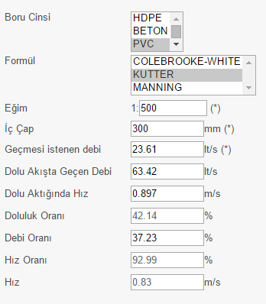
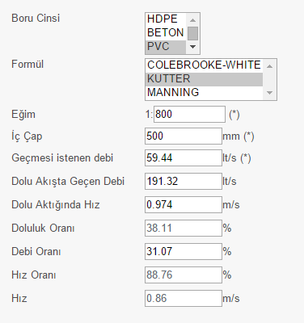
Part 1
Part 2
Figure : Calculation of pipe diameter according to discharges(Dizayn grup)

Slide 23
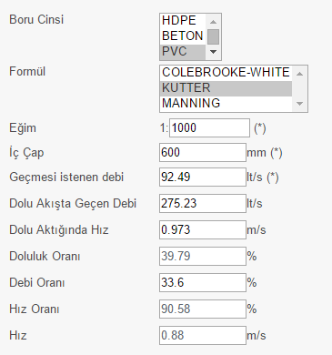
Part 3
Figure : Calculation of pipe diameter according to discharges(Dizayn grup)

Slide 24
Table? : Water demand for Kum neighborhood
facility | Water demand(l) | present unit | predicted unit | unit per facility | Water(l)
pension | 190 | 1 | 5 | 50 | 47500
hotel | 300 | 4 | 12 | 100 | 360000
swimming pool | 500l/m^2 | 3 | 9 | - | 450000*
*the area of the pool is assumed to be 100 m²

Slide 25
Waste water calculation of Kum neighboorhood
total demand | 2.870.000 liter
demand per person(l/p/d) | 170 l/p/d
170 l/p/d
For pump selection

Slide 26
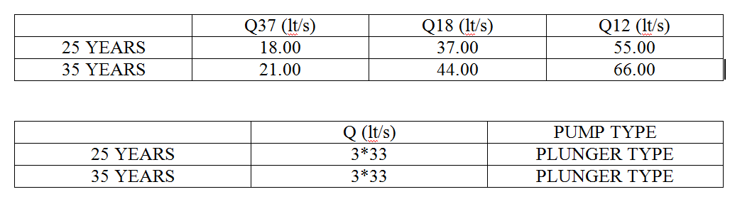
4. DISCHARGES & PUMP SELECTION :

Slide 27
3 pumps are used in the pumping station.
Plunger pumps are used as a pump type.
Circular caisons are used.
As a material type of the pipeline, polyethylene ( HDPE ) pipes are chosen.

Slide 28

Motor Power Calculation
Calculations of motor power are done according to the pump discharges for 25 years since economic life of pumps and air chambers is 25 years.
H_{g} = final elevation of pump line - pump axis elevation
H_{g} = (2.50) - (-9.10) = 11.60 m
Q_{p} = 55 lt/s

Slide 29
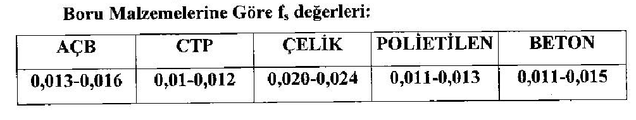

Slide 30
For polyethylene, f = 0.012
Q = v * A
55*10⁻³ = v * (π * (0.15)²) where D = 300 mm → v = 0.78 m/s
J = 0.012 * → J = 0.00123 m/m
L = 712 m → JL = 0.00123*712 = 0.88 m
H_{m} = H_{g} + JL + minor losses = 11.60 + 0.88 + 2.00 → H_{m} = 14.5 m
N_{e} = = → N_{e} = 15.6 kW
N_{e} = 15.6 kW → E.K. = 1.25
N_{m} = N_{e} * E.K. = 15.6*1.25 → N_{m} = 19.5 kW
N_{m} = 19.5 kW → n=8

Slide 31
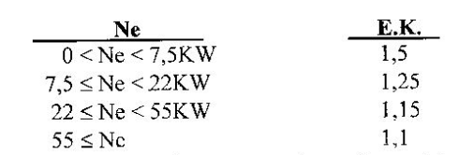
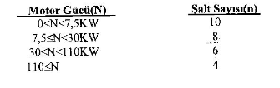

Slide 32
Calculation of the Volume of Collecting Chamber :
T_{min} = For n=8, T_{min} = 450 s
V₁ = = → V₁ = 7425 lt
V₂ = 0.392 * V₁ = 0.392*7425 → V₂ = 2911 lt
V₃ = 0.264 * V₁ = 0.264*7425 → V₃ = 1960 lt
V_{R} = 1704 lt is taken.
V_{T} = V₁ + V₂ + V₃ + V_{R} = 7425 + 2911 + 1960 + 1704 → V_{T} = 14000 lt = 14 m³

Slide 33
Base Area of Collecting Chamber :
F = π * r² = 3.14 * (2.50)² → F = 19.63 m² where diameter of caisson is taken as 5.00 m.
When concrete of bottom slope is considered, F_{net} = A = 15 m²
h₁ = = → h₁ = 0.50 m
h₂ = = → h₁ = 0.19 m
h₃ = = → h₁ = 0.13 m
h_{R} = = → h₁ = 0.11 m
h_{ö} is taken as 0.80 m.
H_{T} = h₁ + h₂ + h₃ + h_{R} + h_{ö} → H_{T} = 1.73 m

