Slide 1

TRIDENT

Slide 2
DISTRICTS OF İNEGÖL
Boğazköy
Çavuşköy
Halhalca
Karagölet
Sungurpaşa
Şehitler

Slide 3
DESIGN PROCESS
Population Projection Analysis
Water Demand Estimation
Water Tanks
Routes
Quantity Take-Off

Slide 4
Population Projection Analysis
Merve YAVUZ

Slide 5

Population Projection Analysis

Slide 6
Table 1: Census data for all districts
 | Census Data
Years | Boğazköy | Çavuşköy | Halhalca | Karagölet | Sungurpaşa | Şehitler
1980 | 678 | 565 | 573 | 353 | 800 | 784
1985 | 711 | 592 | 510 | 377 | 746 | 811
1990 | 690 | 596 | 529 | 337 | 747 | 820
2000 | 602 | 623 | 406 | 263 | 647 | 753
2007 | 464 | 541 | 333 | 190 | 575 | 641
2008 | 541 | 528 | 331 | 184 | 569 | 638
2009 | 483 | 501 | 309 | 183 | 475 | 639
2010 | 505 | 490 | 294 | 167 | 442 | 628
2011 | 499 | 476 | 285 | 173 | 430 | 619
2012 | 517 | 453 | 279 | 167 | 404 | 610
2013 | 494 | 444 | 285 | 163 | 398 | 610
2014 | 490 | 428 | 280 | 170 | 388 | 592

Slide 7
Gathering the past records of census results,
Investigating the socio-economic developments.

Slide 8
Population Projection Analysis Methods
The Arithmetic Extrapolation Method
The Geometric Extrapolation Method
The Turkish Bank of Provinces Method
Logistic S-curve method
Declining growth rate method

Slide 9
According to the Turkish Bank of Provinces Specification, at least 3 methods should be used.
The Arithmetic Extrapolation Method,
The Geometric Extrapolation Method,
The Turkish Bank of Provinces Method.

Slide 10
Figure 1: The Projected Population values of Çavuşköy between 2014-2050

Slide 11
Table 2: The Projected Population values by Turkish Bank of Provinces Method
 |  | The Projected Population values by Turkish Bank of Provinces Method
The Projected Years | Ç_{chs} | Boğazköy | Çavuşköy | Halhalca | Karagölet | Sungurpaşa | Şehitler
2014 | 1 | 490 | 428 | 280 | 170 | 388 | 592
2015 | 1 | 495 | 432 | 283 | 172 | 392 | 598
2020 | 1 | 520 | 454 | 297 | 180 | 412 | 628
2025 | 1 | 547 | 478 | 312 | 190 | 433 | 660
2030 | 1 | 575 | 502 | 328 | 199 | 455 | 694
2035 | 1 | 604 | 527 | 345 | 210 | 478 | 730
2040 | 1 | 635 | 554 | 363 | 220 | 503 | 767
2045 | 1 | 667 | 583 | 381 | 231 | 528 | 806
2050 | 1 | 701 | 612 | 401 | 243 | 555 | 847

Slide 12
Estimation of Water Demand Quantity
Mustafa YILMAZ

Slide 13
Factors that Effect Water Demand
Population values
Socio – Economic development
Water quality
Climate
Unit price of water

Slide 14
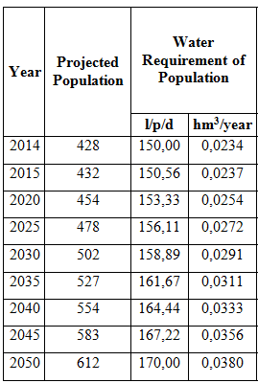
Water Demand Quantity based on Population values
Table 3: The water demand quantity of Çavuşköy

Slide 15
Water Requirement of Livestock
According to the General Directorate of State Hydraulic Works;
Table 4: The water requirement of livestock
Animal Species | Quantity (l/day)
Bovine | 50
Ovine | 15
Chicken-Duck | 0,25

Slide 16
Water Requirement of Other
Regional Boarding School: 100 liter/p/day
School that gives mobile education: 50 liter/p/day
Military Buildings: 100 liter/p/day
Factory and big offices: 50 liter/p/day
Hotel, Motel, Summer houses: 200 liter/p/day

Slide 17
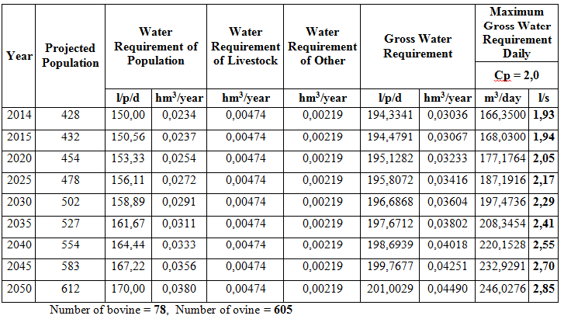
Selection of Peak Coefficient
Table 5: The water demand quantity of Çavuşköy

Slide 18
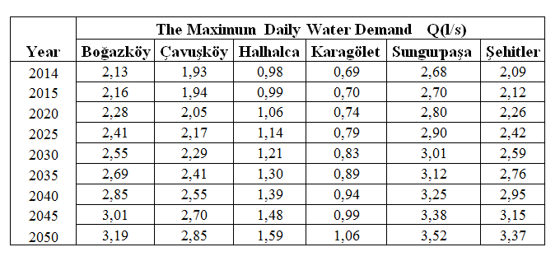
The Maximum Daily Water Demand of each District
Table 6: The maximum daily water demand of each district

Slide 19
Water Tanks
Gökberk SIĞINIR

Slide 20
Water Tank Placement Criteria
Being near to District
Direction of the Water Resources
Topography & Master Plan
Hydrology
Economic conditions

Slide 21
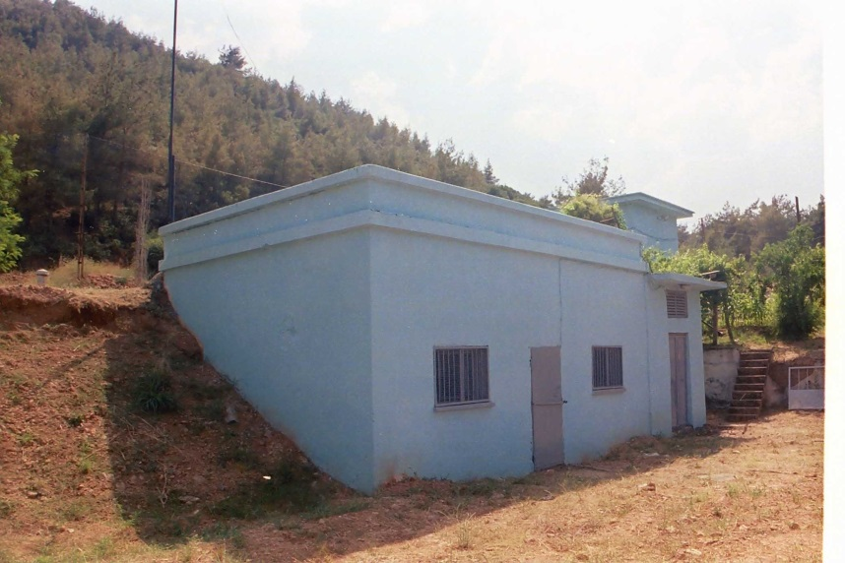
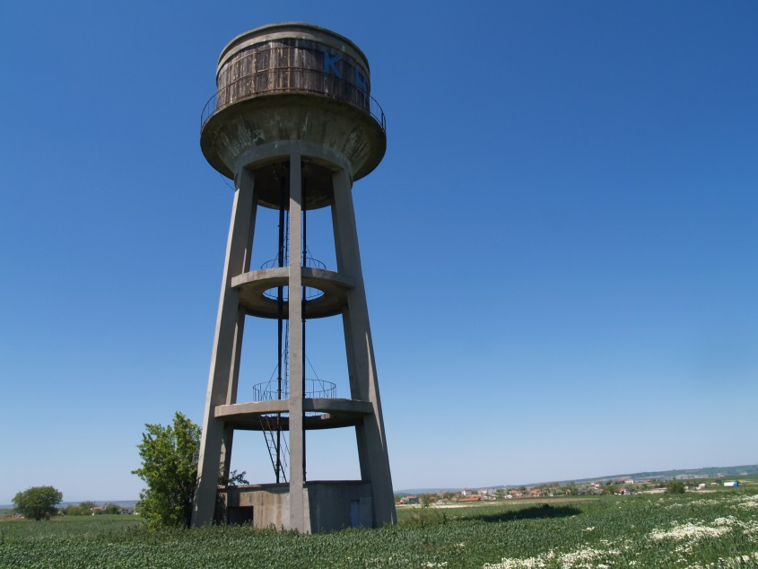
Water Tank Types
Prismatic Tank
Tower Tank

Slide 22
Elevation of the Water Tanks
Minimum dynamic pressure
Highest point +20 m
Maximum maximum static pressure
Lowest point + 60-65 m
Difference > 45 m
Upper & Lower Pressure Zones

Slide 23
Calculation Example : Şehitler
The maximum settled elevation: 518 m
The minimum settled elevation: 440 m
Diffrence =78m > 45m 2 pressure zones
20
20
505
485
440
65
65
538
518
473

Slide 24
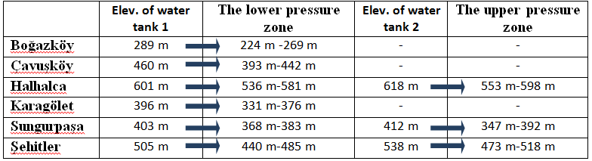
Table 7: The lower and upper pressure zones for each district

Slide 25
Volume of the Water Tanks
Hourly & Daily Water Consumption
Qwater (in case of Fire)
Emergency Need
Balancing the Efficiency Variance in Water Resources

Slide 26
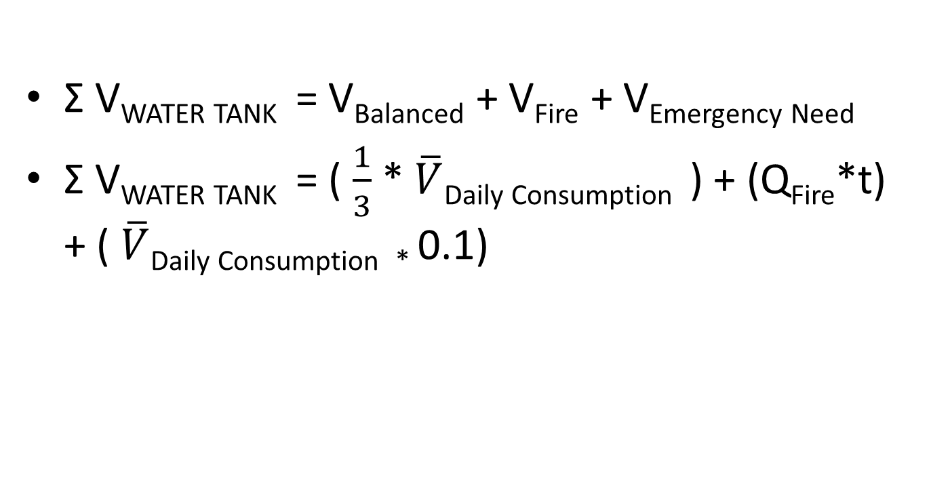
Calculation of the Volume of the Water Tanks
Ʃ V_{WATER TANK} = V_{Balanced} + V_{Fire} + V_{Emergency Need}
Ʃ V_{WATER TANK} = ( $\frac{1}{3}$ * $\overline{V}$_{Daily Consumption} ) + (Q_{Fire}*t) + ( $\overline{V}$_{Daily Consumption *} 0.1)

Slide 27
The Calculated Volumes for the Water Tanks
Table 8: The volumes of the water tanks
Districts | Volume of daily consumption(m³) | Total volume of water tanks (V_{t})
Boğazköy | 137,8 | 95,7
Çavuşköy | 123,0 | 89,3
Halhalca | 68,5 | 65,7
Karagölet | 45,6 | 55,8
Sungurpaşa | 152,0 | 101,9
Şehitler | 145,4 | 99,0

Slide 28
Water Supply System Route and Diameter Selection
Ferhat ÜNAL

Slide 29
Water Supply System Route Selection
Technical and economic aspect
Considered conditions:
Shortest route
Easiness of route construction
Easiness of maintenance and operating

Slide 30
Route Types
Pumped Discharged Lines
Pumps
160m maximum head
Pump station
Gravity Pipelines
Gravity and self weight
80m maximum head
Trough

Slide 31
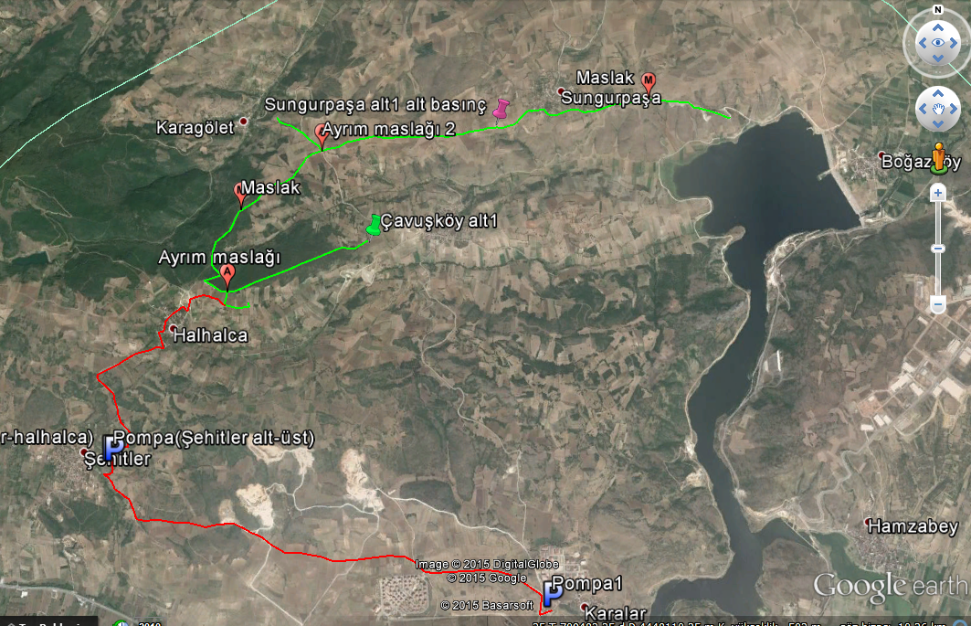
Alternative Route 1

Slide 32
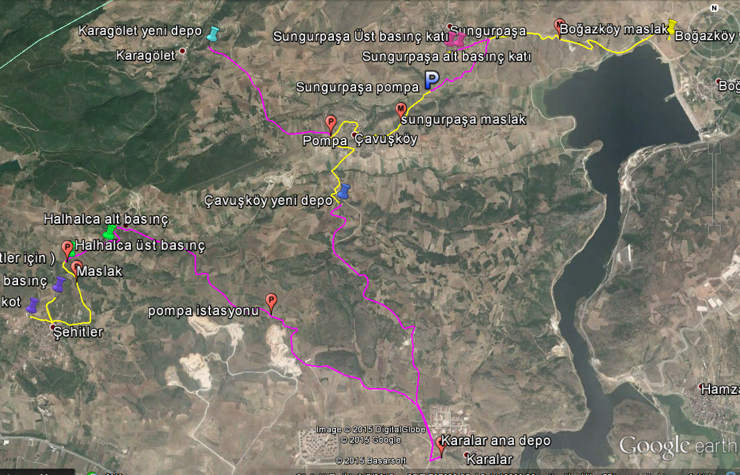
Alternative Route 2

Slide 33
Water Supply System Diameter Selection
Pumped Discharge Lines
Initial investment cost
Coefficient of friction
Efficiency of pumps
Water hammer
Operating cost
Bigger diameter Lower head losses and energy
consumption
Bigger diameter Higher investment and operating
cost

Slide 34
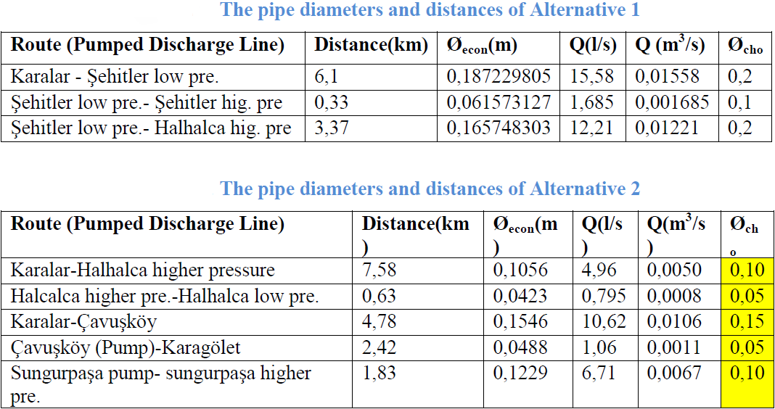
Calculation of Pumped Discharge Lines
De = 1.5 √Qe
Table 9:
Table 10:

Slide 35
Water Supply System Diameter Selection
Gravity Pipelines
Velocity
Minimum 0,3 m/s
Maximum 3,0 m/s
Average 1,0 - 1,5 m/s
Q = V * A
Trial diameters

Slide 36
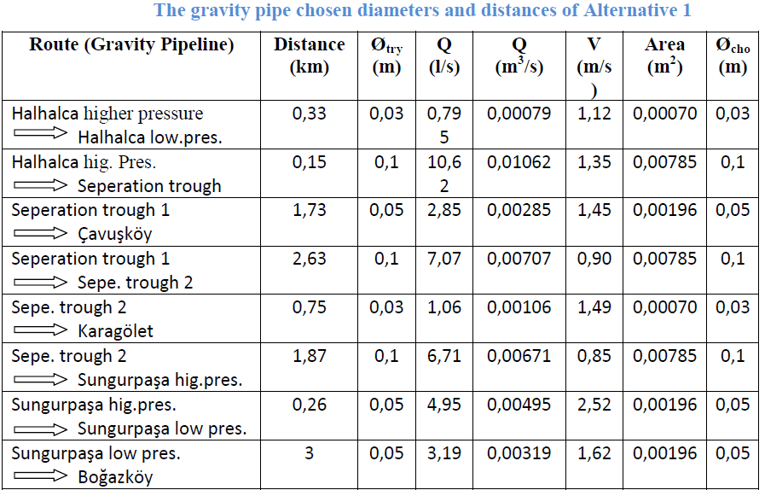
Table 11:

Slide 37
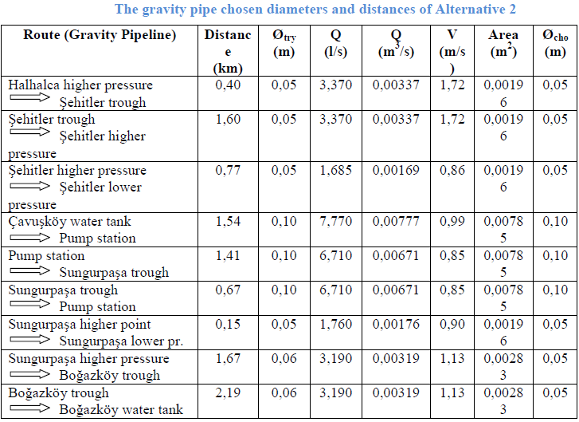
Table 12:

Slide 38
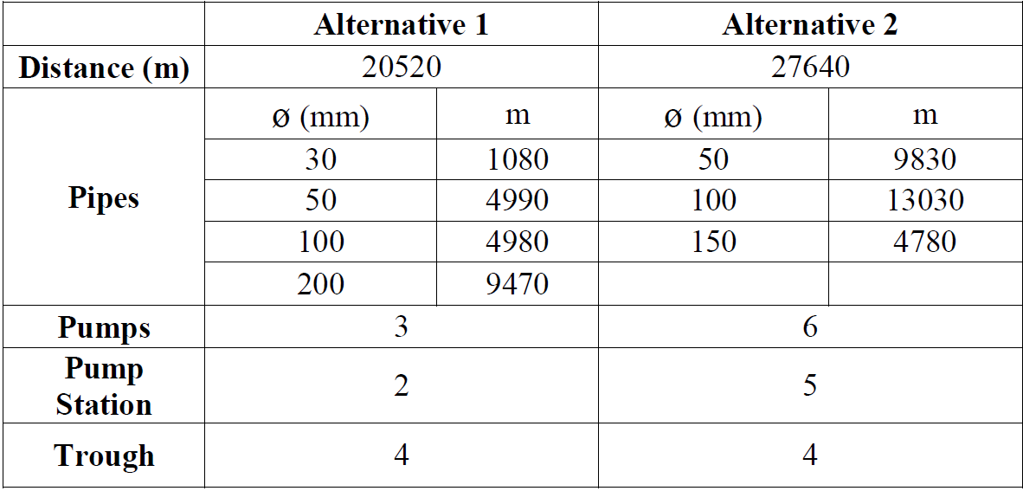
Table 13:Quantity Take-Off

Slide 39
References
İller Bankası – İçme suyu Tesisleri Etüt, Fizibilite Projelerinin Hazırlanmasına ait Teknik Şartname
Devlet Su İşler- Nüfus ve İçme suyu Tahmin Esasları
YANMAZ, M. (16). Applied Water Resources Engineering (pp. 286-287). Ankara, TURKEY: METU Press.
http://orig13.deviantart.net/69ff/f/2013/125/f/1/poseidon_s_trident_tattoo_by_pumpkinsoup-d3fm4v1.png
http://www.google.com.trsearchq=population&espv=2&biw=1366&bih=677&source=lnms&tbm=isch&sa=X&ved=0ahUKEwjY1sjq0qfJAhXJ6CwKHShhCh4Q_AUIBigB&dpr=1#tbm=isch&tbs=rimg%3ACQuUNX-LPIgMIji7tefgePOtXy1hCWCvjOdEn6cybtC5Kz4UqrTBwjq26CiUCB5pruh
http://www.denizlihaber.com/medya/2012/09/b%C3%B6yle+ola...jpg
http://www.uzunkopru.gov.tr/ortak_icerik/uzunkopru/galeri//76/P4287123.JPG
http://www.audiotech.com/trends-magazine/wp-content/themes/Trends

Slide 40
Thank You

