Slide 1


INTRODUCTION TO MATLAB
MIDDLE EAST TECHNICAL UNIVERSITY
Civil Engineering Department
Ocean Engineering Research Center
Lecture 3 – Loops, Surface Plot and Postprocessing
Hasan Gökhan Güler-Çağıl Kirezci

Slide 2
Outline
Preprocessing
Control Flow: Loops
Surface Plot
Postprocessing
Summary

Slide 3
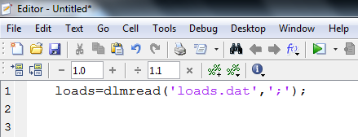
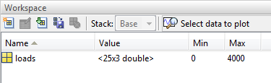
Getting Data
DLMREAD: Gets data from ASCII-delimited file of numerical data (.dat) files.
Syntax:
variable=dlmread(‘filename.dat’, ‘delimiter’)
Delimiters: ‘,’ ‘;’ , etc.
Example:
loads=dlmread(‘loads.dat’, ‘;’)

Slide 4
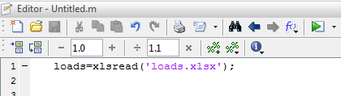
Getting Data
XLSREAD: Gets data from MS Excel sheets.
Syntax:
variable=xlsread(‘filename.extension’)
Extensions: .xls or .xlsx
Example:
loads=xlsread(‘loads.xlsx’)

Slide 5
For Loop
A loop is a sequence of statements which is specified once but which may be carried out several times in succession. (Wikipedia)
For executes a group of statements a fixed number of times.
Counter = Initial Value such as 1
Counter <= N
increase Counter
YES
NO
Statements
end

Slide 6
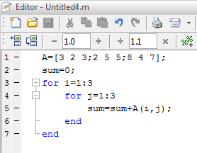

For Loop
for i=1:N Number of repetition
statements
end
Example: Find the summation of the elements of matrix A$=\left[\begin{matrix}3 & 2 & 3 \\ 2 & 5 & 5 \\ 8 & 4 & 7\end{matrix}\right]$.
variable(i,j)
i: Row
j: Column

Slide 7
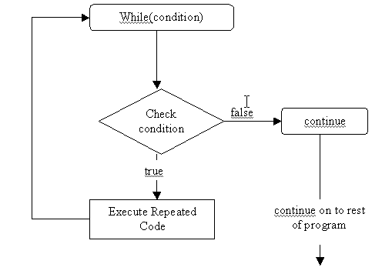
While Loop
A while loop is a control flow statement that allows code to be executed repeatedly based on a given condition.

Slide 8
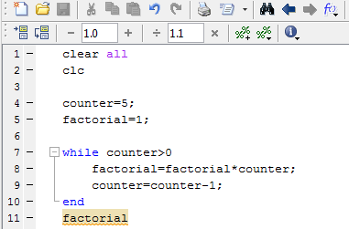
While Loop
while condition Controls the repetition
statements
end
Example: Use while loop to find 5!, i.e., factorial of 5.

Slide 9
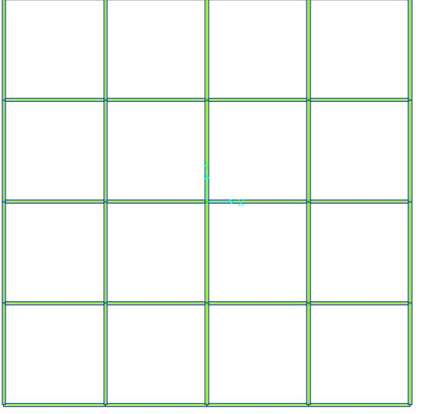
Task 1
The design for the High Tower building you previously made in the class will be checked by Ministry of Construction. The control engineer requested the total load of the columns to compare with the calculations.
Your job is to write a code that finds total load
acting on the floor.
The data provided consists of x and y coordinates
of the columns, and the compressive loads (kN)
applied to these columns.
y
10m
10m
10m
10m
10m
10m
10m
10m
x
(0,0)

Slide 10
Task 2
The control engineer found that some columns are not safe under the compressive loads. Write a code that investigates the safety of each column and gives a warning message if that column is not safe.
You are given that the compressive strength is 30MPa and the cross sections are 400x600 (in mm) for all columns.
Hint: To display a statement in the command window containing a variable you may use ‘fprintf’ function. The syntax is as follows:
>> fprintf(‘…… %i ……’, variable_name)
the place where you want to display the variable which is an integer

Slide 11
Task 3
The control engineer requested the list of moments corresponding to each load with respect to x and y axes. Write a code that calculates total moment acting on the structure with respect to both axes
y
10m
10m
10m
10m
10m
10m
10m
10m
x
(0,0)

Slide 12
Surface Plot
SCATTER3: 3-D Scatter Plot
Syntax:
scatter3(X,Y,Z)
Example:
x_coordinate = loads(:,1);
y_coordinate = loads(:,2);
force=loads(:,3);
scatter3(x_coordinate,y_coordinate,force)
loads(:,1) → All of the rows, first column in the variable loads.

Slide 13

Surface Plot
BAR3: Plots 3-D bar chart
Syntax:
bar3(variable)
$$\text{variable}\text{=}{\left[\begin{matrix}{\text{value}}_{\text{11}} & ... & {\text{value}}_{\text{1}\text{n}} \\ ... & ... & ... \\ {\text{value}}_{\text{m}\text{1}} & ... & {\text{value}}_{\text{mn}}\end{matrix}\right]}_{\text{mxn}}$$

Slide 14
Task 4
The control engineer requested a 3-D bar chart to visualize the forces. Your job is to plot forces at points (X1,Y1), (X1,Y2),…, (X5,Y5).
Y5
Y4
Y3
Y2
Y1
X1
X2
X3
X4
X5

Slide 15
Resulting Graph for Task 4

Slide 16
Prepare Report
DLMWRITE: Stores numeric or cell array in ASCII delimited file.
Syntax:
dlmwrite(‘filename.extension’, variable_name)
Example:
dlmwrite(‘axialforce.dat’, axial_force)

Slide 17
Prepare Report
XLSWRITE: Stores numeric or cell array in MS Excel sheet.
Syntax:
xlswrite(‘filename.extension’, variable_name)
Example:
xlswrite(‘axialforce.xlsx’, axial_force)

Slide 18
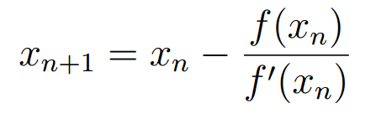


Class Exercise
Write a script that finds the root of the folllowing equation using Newton-Raphson formula. Consider absolute error, and an error tolerance of . Use initial guess as x=0.
$${10}^{−8}$$
$$x^{2}=1+x+sin⁡(x)$$
Newton Raphson Method:

