Slide 1
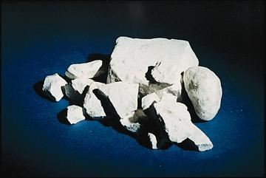
GYPSUM

Slide 2
GYPSUM
In nature : Gypsum Rock
Pure gypsum rock : CaSO₄.2H₂O
Impurities : MgO, Al₂O₃, Fe₂O₃, SiO₂, CaCO₃, MgCO₃...

Slide 3
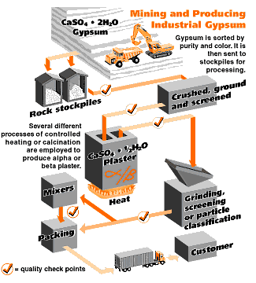
PRODUCTION STEPS
Excavating
Crushing (~25 mm diameter)
Grinding
Heating (calcining)
Cooling and Pulverizing
Marketing in Bags

Slide 4
CALCINATION
Gypsum rock wahen heated to 100-190°C looses ¾ of its water.
CaSO₄.2H₂O → CaSO₄.½H₂O + 3/2 H₂O
Plaster of Paris
This is low burning process and named as INCOMPLETE CALCINATION.
When calcination is carried out at temperatures above 190°C all water is removed.
CaSO₄.2H₂O → CaSO₄ + 2H₂O
gypsum anhydrite
This is high-burning process & COMPLETE CALCINATION.

Slide 5
Both of these products form gypsum rock by recombining with water.
CaSO₄.½H₂O + 3/2H₂O → CaSO₄.2H₂O
CaSO₄ + 2H₂O → CaSO₄.2H₂O
Calcination process is carried out in two types of kilns.
Kettle Kilns
Rotary Kilns

Slide 6

KETTLE KILN
MIXER
FIRE BRICK
~ 2-3 ^{m}
GYPSUM ROCK
DISCHARGE
HEAT
~ 2.5-3 ^{cm}

Slide 7
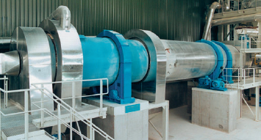
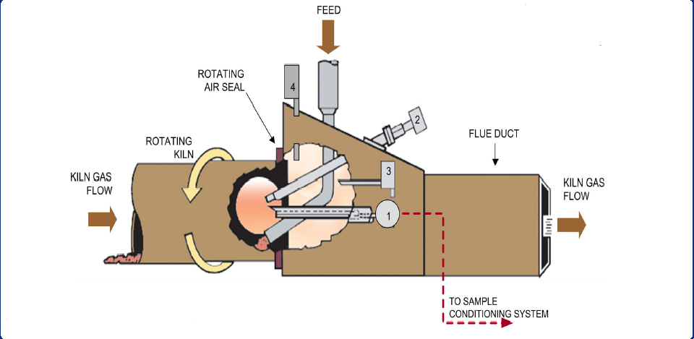
ROTARY KILN

Slide 8
GYPSUM PLASTERS
Obtained by Incomplete Calcination (CaSO₄.½H₂O)
Plaster of Paris : is formed by incomplete calcination at 100-190°C. No admixtures are found.
Hard Wall Plaster
Plaster of Paris + Admixtures (Glue, Sand...)

Slide 9
Obtained by Complete Calcination (CaSO₄)
Flooring Plaster (CaSO₄ with no impurities)
Hard Finish Plaster (CaSO₄ + Al₂(SO₄)₃)
(CaSO₄ + Na₂B₄O₇)

Slide 10
PROPERTIES & USES OF GYPSUM PLASTERS
Plaster of Paris
  Setting time ~5-20 min.
  Used for sculpturing, ornamental work, small repair work

Slide 11
PROPERTIES & USES OF GYPSUM PLASTERS
Hard Wall Plaster
  Setting time ~1 hr
  Compressive strength ~7 MPa
  Admixtures result in increased plasticity & setting time & reduced shrinkage
  Can be used for plastering walls
  Production of prefabricated structural units
  Masonry bricks & blocks

Slide 12
PROPERTIES & USES OF GYPSUM PLASTERS
Flooring, Hard Finish Plaster
  Setting time ~1-16 hrs
  Compressive strength > 7 MPa
  Can be used for producing prefabricated units, masonry bricks & blocks & flooring & pavement bricks & tiles.

Slide 13
PROPERTIES & USES OF GYPSUM PLASTERS
Gypsum often serves as a fire proofing material even though its strength is destroyed by long continuous heat. It forms a powder covering the surface which acts as an effective insulator.
Gypsum products tend to disintegrate when exposed to moisture. Therefore, they should not be used for exterior work & for moist interiors.
(NON-HYDRAULIC)

Slide 14
BY-PRODUCT GYPSUM
Phospogypsum – Major by-product of phosporic acid production
phosphate + sulfuric acid --> fertilizer + gypsum
Desulfogypsum – Obtained from the desulfurization of combustion gases in coal burning power plants (Harmful SO₂ gas is turned into CaSO₄.2H₂O

