Slide 1
CE 244
MATERIALS OF CONSTRUCTION

Slide 2
Course Objectives
• To develop a basic understanding of key material properties, requirements, and related behavior characteristics of typical construction materials.

Slide 3
Course Content
Types
Production methods
Uses in construction
Properties and related tests of the following materials of construction:
Building Stones
Metals
Clay Products
Gypsum
Lime
Cements
Mineral Aggregates
Concrete

Slide 4
Course Content
These materials are used in all civil engineering structures such as;
  buildings
  bridges
  highways
  railways
  tunnels
  dams
  harbor structures
  towers
  etc.

Slide 5
CLASSIFICATION OF CIVIL ENGINEERING MATERIALS
According to their phases
According to their internal structure & chemical composition

Slide 6
Phase Classification
Gases : Air, oxygen, CO₂
Liquids : Water, chemical admixtures
Semi-solids : Fresh pastes, mortars, asphalt
Solids : Metals, hardened concrete

Slide 7
Internal Structure & Chemical Composition Classification
Metals : (formed by metallic bonds)
  Ferrous (iron, cast iron, steel)
  Non-ferrous (aluminum, copper, zinc, lead)
Polymers : (long chains having molecules of C, H, O, N which are formed by covalent bonding. The chains are bound to each other either by covalent bonds or Van der Waals forces.)
  Natural (rubber, asphalt, resins, wood)
  Artificial (plastics)

Slide 8
Internal Structure & Chemical Composition Classification
Ceramics : (mainly aluminosilicates formed by mixed bonding, covalent and ionic)
  Structural clay products (bricks, tiles, pipes)
  Porcelains
Composite Materials :
  Natural (agglomerates)
  Artificial (Portland cement, concrete)

Slide 9
Internal Structure & Chemical Composition Classification
Reinforced Composite Materials : (reinforced concrete, reinforced plastics)
One of the most important tasks of an engineer is to select the most suitable material for a given civil engineering structure.

Slide 10
Factors Determining the Choice of Proper Material for a Structure
Strength, rigidity & durability Requirements
  Permanent loading → Creep Strength
  Repeated loading → Fatique Strength
  Impact loading → Toughness & Resilience
  Surface loading → Hardness & Resistance to abrasion
Environmental Requirements
  Temperature change → coefficient of thermal expansion
  Moisture movement → permeability
  Chemical effects → chemical composition

Slide 11
Factors Determining the Choice of Proper Material for a Structure
Economy. Choose the cheaper & available materials considering
  Initial cost
  Useful life
  Frequency of maintenance
  Cost of maintenance
  Salvage value
  etc.

Slide 12
Example: Comparison of concrete pavement vs. asphalt pavement for economy.
 | Concrete | Asphalt
Initial Cost | – | +
Useful Life | + | –
Frequency of Repair | + | –
Cost of Repair | – | +
Salvage Value | + | +

Slide 13
General Properties of Civil Engineering Materials
Physical **
Mechanical **
Chemical
Other
  Thermal, Acoustical, Optical, Electrical
** Most CE Applications focus on physical & mechanical properties

Slide 14
Physical Properties
Properties of physical structure
  density
  specific gravity
  porosity
  permeability
  surface energy
  texture (micro, macro)
  other (color, thermal expansion, shape)

Slide 15
Mechanical Properties
Resistance to applied loads (stress) initially & over time
  stiffness
  strength
  fracture / yielding
  (brittle / ductile)
  tension
  compression
  flexure (bending)
  torsion
  direct shear
  multiaxial

Slide 16
Chemical Properties
Chemical composition, potential reaction with environment
  oxide content
  carbonate content
  acidity, alkalinity
  resistance to corrosion

Slide 17
Determining the Properties of Civil Engineering Materials
Properties of materials are determined by
  Laboratory testing
  Field testing
To avoid inconsistencies in test results STANDARDS are devised which describe the test apparatus and the procedure.

Slide 18
Items that are usually standardized in a test are:
Obtaining test specimens and number of specimens
Size and shape of the specimen
Preparation of specimens for testing
Temperature & moisture during preparation & testing
Type of machinery
Rate of loading
Interpretation of test results
Writing a report

Slide 19
Standardization Institutes
Turkey - Turkish Standards Institute (TSE)
England - British Standards Institute (BSI)
Germany - Deutsche Institute Norm (DIN)
U.S. - American Society for Testing and Materials (ASTM)
Europe - European Committee for Standardization (CEN)

Slide 20
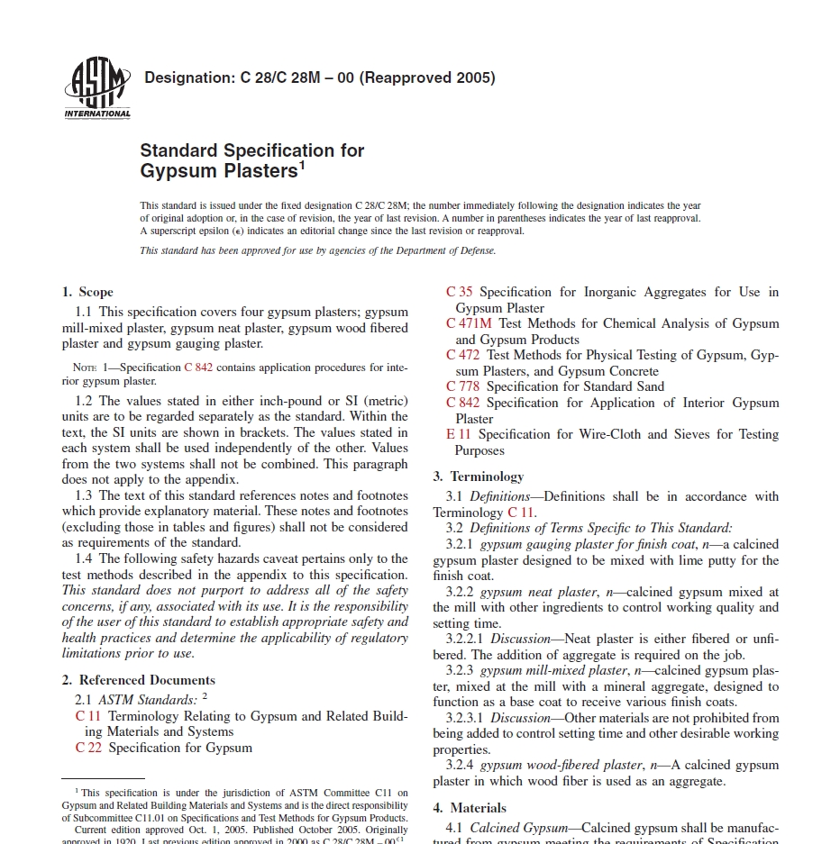

Slide 21
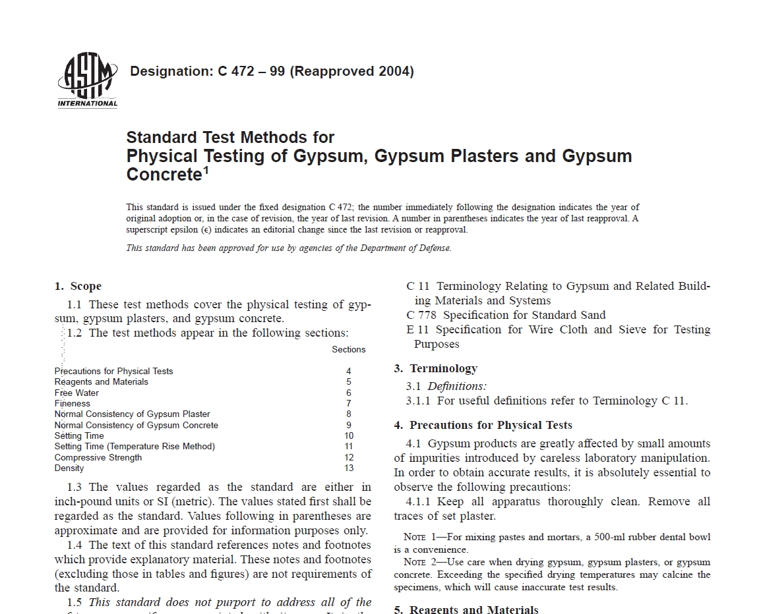

Slide 22
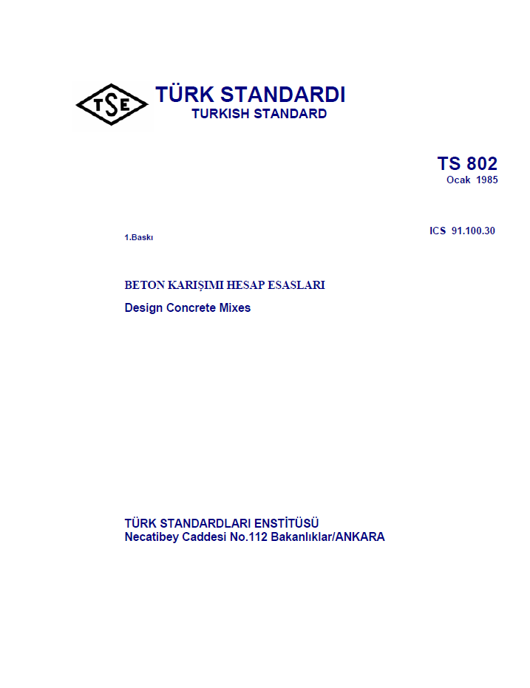

Slide 23
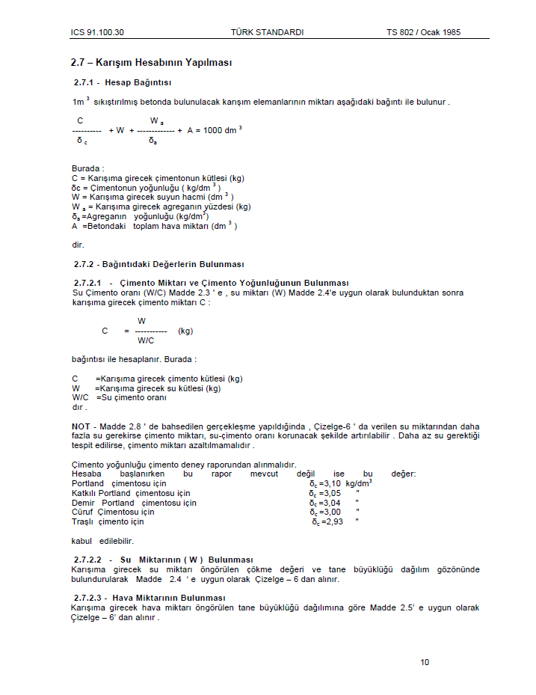

Slide 24


Slide 25
CEMENTITIOUS MATERIALS
Although there are several different materials which have adhesive properties, three types are of particular interest to civil engineers.
Glues : materials of gelatinous nature derived from vegetable or animal sources.
Bituminous Materials : complex hydrocarbon
Various Compounds of Calcium : gypsum, lime, cements

Slide 26
CEMENTITIOUS MATERIALS
Cementitious materials are substances which, upon certain chemical reactions attain binding properties
  Non-hydraulic cements (gypsum and lime)
  Hydraulic cements (portland cement)
Hydraulicity is that property of gaining binding value when mixed with water and remaining stable when exposed to water.

Slide 27
SPECIAL PROPERTIES OF CEMENTITIOUS MATERIALS
Fineness : Particle size.
Normal Consistency : A standard amount of water which gives a certain fluidity to the paste.
Time of Setting : Beginning of complete loss of plasticity.
Sand Carrying Capacity : Amount of sand that can be added without harming plasticity
Hardening : Formation of solid phase; complete loss of plasticity.
Yield : Volume of final product obtained in comparison with volumes of constituent materials.

