Slide 1
LIME

Slide 2


Lime
Naturally occurs as: Limestone

Slide 3
Lime
marine animals
Chemistry for pure rock:
CaCO3 (calcium carbonate)
but, impurities are always present:
MgCO3,Al2O3, Fe2O3, SiO2

Slide 4
Production
Excavation
Crushing Limestone
Grinding
Calcination → Quicklime
Pulverize quicklime
Mix with water under pressure → Slaked Lime
Drying of Slaked Lime
Pulverizing
Marketing in bags.

Slide 5

Calcination
CaCO3 CaO + CO2 ( > 900°C)
“quick lime”
Calcination is carried out in kilns:
- Intermittent
- Continuous
- Rotary
- Reactor

Slide 6
Intermittent Kiln
1
crushed limestone
1. Load kiln
2. Calcine
4
3. Cool
4. Unload kiln
1. Load kiln
.
.
.
quick lime
heat
2
3

Slide 7
Continuous Kiln
crushed limestone
heat
heat
air
ash + quick lime

Slide 8
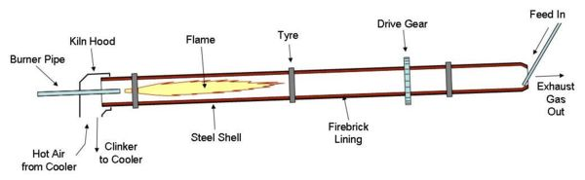
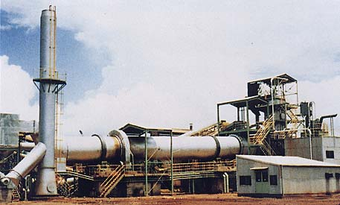
Rotary Kiln
Finely crushed
limestone

Slide 9
Reactor Kiln
ground limestone
Hot pressurized air
Cooling compartment

Slide 10
Classification of Quicklime
According to Particle Size
Lump Lime (10-30 cm lumps)
Pebble Lime (2-5 cm)
Granular Lime (~0.5 cm)
Crushed Lime (~5-8 mm)
Ground Lime (passes #10 sieve, by grinding crushed lime)
Pulverized Lime (passes #100 sieve)

Slide 11
Classification of Quicklime
According to Chemical Composition
High-Calcium Quicklimes (~90% CaO)
Calcium Quicklime (75% CaO)
Magnesian Quicklime ( > 20% of MgO)
Dolomitic Quicklime ( > 25% of MgO)
According to Intended Use
Mortar Lime
Plaster Lime

Slide 12
Slaking of Lime (Hydration)
CaO + H₂O → Ca(OH)₂ + Heat (i.e. exothermic)
CaO is mixed with water in a slaking box until a “putty” has been formed.
The putty is then covered with sand to protect it from the action of the air & left for seasoning.
Time of seasoning →1 week for mortar use
6 weeks for plaster use

Slide 13
If CaO is not slaked well, it will absorb moisture from air & since the volume expands up to 2.5-3 times popouts will occur.
Slaked lime can also be bought from a factory. It is more homogeneous & economical but less plastic.
Seasoning provides a homogeneous mass & completion of chemical reactions
During slaking heat evolves & volume expands.

Slide 14
Factors affecting heat evolution and rate of slaking
Quicklime particle size
Chemical composition
Burning temperature

Slide 15
Hardening of Slaked Lime
air
Ca (OH)₂ + CO₂ → CaCO₃ + H₂O
Air-Slaked Lime
At surface of uncovered quicklime (CaO) → it picks up moisture and CO₂ from air → becomes partly CaCO₃.
CaO + H₂O → Ca(OH)₂
Ca(OH)₂ + CO₂ → CaCO₃ + H₂O
Expansion observed

Slide 16
Lime Pops
If quicklime is not mixed completely with water → some CaO will be carried to construction stage.
In its final stage it will absorb water & CO₂ from air and will expand upto 2.5-3 times.
This will cause cracking & pop-outs in the structure.

Slide 17
Properties of Lime Mortars
Lime + sand lime mortar
Adding sand:
- Adjusts plasticity – otherwise too sticky
- Provides economy
- Decreases shrinkage effects

Slide 18
Strength of Lime Mortars
Chemical composition of lime
Magnesian Limes > Calcium Limes
Sand amount & properties
Adding sand decreases strength
Amount of water
Voids are formed after evaporation
Setting conditions
Lower humidity & higher CO₂ → higher strength

Slide 19
Properties of High-Calcium Limes
Slakes faster
Hardens faster
Have greater sand carrying capacity

Slide 20
Durability of Limes
Not resistant to moving water
Not for use outside
hydraulic binder ???

Slide 21
Uses of Lime
In producing masonry mortars
Plaster mortars – sets slower than gypsum
White-wash
In production of masonry blocks – slaked lime + sand under pressure

Slide 22
Hydraulic Lime
Obtained by calcination of siliceous or clayey limestone at higher temperature
It differs from quicklime:
- Burned at higher temperature
- It contains lime silicates
- It can set & harden under water

