Slide 1
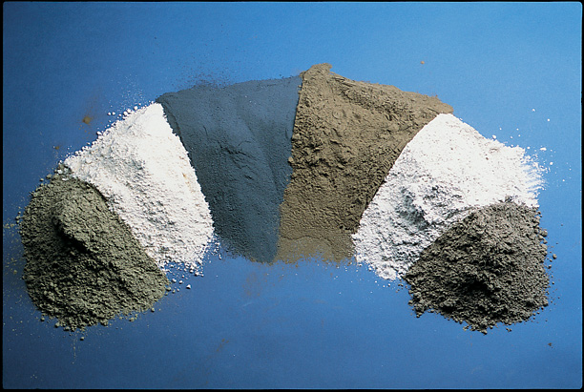
POZZOLANS
(Supplementary Cementitious Materials)

Slide 2
Pozzolan
The name Pozzolan comes from the town Pozzuoli, Italy.
Ancient Romans (~100 B.C.) produced a hydraulic binder by mixing hydrated lime with soil (predominantly volcanic ash)
Horasan mortar, mixing lime with finely divided burned clay, is extensively used by Ottomans
Nowadays, the word pozzolan covers a broad range of natural and artificial materials.

Slide 3
Pozzolan
a material that, when used in conjunction with portland cement, contributes to the properties of the hardened concrete through hydraulic or pozzolanic activity, or both.
  Natural (Volcanic ash, volcanic tuff, pumicite)
  Artificial (fly ash, silica-fume, granulated blast furnace slag)

Slide 4
Pozzolan
Siliceous or aluminous material, which in itself possesses little or no cementitious value but will, in finely divided form and in the presence of moisture, chemically react with calcium hydroxide Ca(OH)₂ to form compounds possessing hydraulic cementitious properties.

Slide 5
POZZOLANS
Silica&Alumina
(higher amounts)
Iron oxide, calcium oxide,
magnesium oxide,
alkalies
(lesser amounts)
POZZOLANIC REACTIONS
Calcium Hydroxide+Silica+Water → “Calcium-Silicate-Hydrate”
(C-S-H)
C-S-H provides the hydraulic binding property of the material.
Pozzolanic Activity: Capacity of pozzolan to form alumino-silicates with lime to form cementitious products. (How good how effective the pozzolan is!)

Slide 6
FACTORS THAT AFFECT THE ACTIVITY OF POZZOLANS
1) SiO₂ + Al₂O₃ + Fe₂O₃ content
2) The degree of amourpheness of its structure
3) Fineness of its particles

Slide 7
1) SiO₂ + Al₂O₃ + Fe₂O₃
The greater amount of these, the greater its activity.
ASTM C 618 & TS 25 → min “SiO₂+Al₂O₃+Fe₂O₃” for natural pozzolans > 70%
Fly Ash - ASTM
Class C→ from lignitide or subbituminous coals (SiO₂+Al₂O₃+Fe₂O₃>50%)
Class F→ from bituminous coals and SiO₂+Al₂O₃+Fe₂O₃>70%
Silica fume → SiO₂ ≈ 85-98%
Blast Furnace Slag→ SiO₂ ~ 30-40%
Al₂O₃ ~ 7-19%
CaO ~ 30-50%

Slide 8
2) Amorphousness
For chemical reaction → pozzolans must be amorphous
Volcanic ash, volcanic tuff, fly ash, silica fume are all amorphous by nature.
Clays → contain high amounts of silica & alumina but have a crystallic structure! (Do not possess pozzolanic activity)
  However, by heat treatment, such as calcining ~700-900°C crystallic structure is destroyed & a quasi-amorphous structure is obtained.

Slide 9
2) Amorphousness
  Clay → does not possess pozzolanic property
  Burned clay → possess pozzolanic property
Blast furnace slag → contain high amounts of silica, alumina & lime.
  However, if molten slag is allowed to cool in air, it gains a crystal structure. * do not possess pozzolanic property.
  However, if it is cooled very rapidly by pouring it into water, it becomes a granular material & gains amorpousness. * possess pozzolanic property.

Slide 10
3) Fineness
Pozzolanic activity increases as fineness increases.
Volcanic ash, rice husk ash, fly ash, condensed silica fume are obtained in finely divided form.
Volcanic tuff, granulated blast furnace slag & burned clay must be ground.

Slide 11
DETERMINATION OF POZZOLANIC ACTIVITY
Pozzolanic activity is determined by “strength activity indexes”
Six mortar cubes are prepared (ASTM)
→”Control Mixture” 500 g portland cement+1375 g sand+242 ml water
→”Test Mixture” 400g of portland cement+100g of pozzolan+1375g of sand+some water for the same consistency

Slide 12
Compressive testing at 7 or 28 days
Strength Activity Index (SAI) =A/B*100
A=f’_{c} of test mixture
B=f’_{c} of control mixture
ASTM C 618 → SAI ≥ 75%

Slide 13
CHEMICAL COMPOSITION OF POZZOLANS
Silica Fume is mostly SiO₂
G. G. Blast Furnace Slag→ high amounts of CaO (self-cementitious)
Class C Fly Ash has CaO (self-cementitious)

Slide 14
Chemical Analysis of Typical Fly Ash, Slag, Silica Fume, Calcined Clay, Calcined Shale, and Metakaolin
 | Class F fly ash | Class C fly ash | Groundslag | Silica fume | Calcined clay | Calcined shale | Meta-kaolin
SiO₂, % | 52 | 35 | 35 | 90 | 58 | 50 | 53
Al₂O₃, % | 23 | 18 | 12 | 0.4 | 29 | 20 | 43
Fe₂O₃, % | 11 | 6 | 1 | 0.4 | 4 | 8 | 0.5
CaO, % | 5 | 21 | 40 | 1.6 | 1 | 8 | 0.1
SO₃, % | 0.8 | 4.1 | 9 | 0.4 | 0.5 | 0.4 | 0.1
Na₂O, % | 1.0 | 5.8 | 0.3 | 0.5 | 0.2 | — | 0.05
K₂O, % | 2.0 | 0.7 | 0.4 | 2.2 | 2 | — | 0.4
Total Na eq. alk, % | 2.2 | 6.3 | 0.6 | 1.9 | 1.5 | — | 0.3
Artificial Pozzolans
Natural Pozzolans
Notes:
Table 3-2. Chemical Analysis and Selected Properties of Typical Fly Ash, Slag,
Silica Fume, Calcined Clay, Calcined Shale, and Metakaolin

Slide 15
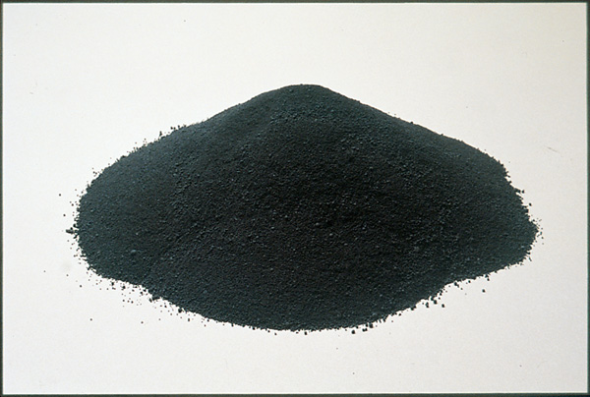
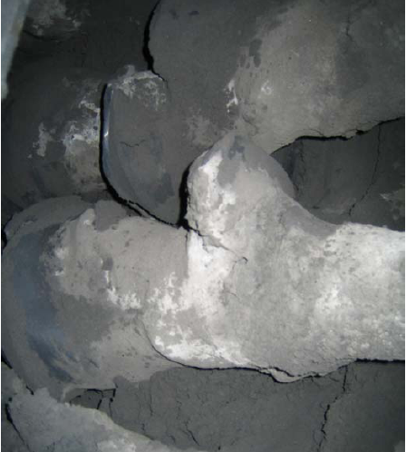
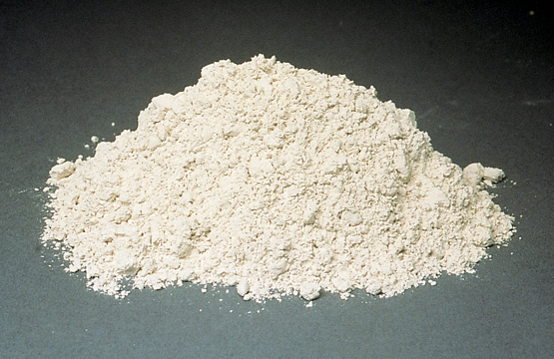
SILICA FUME
FLY ASH
GRANULATED BLAST FURNACE SLAG

Slide 16
Selected Properties of Typical Fly Ash, Slag, Silica Fume, Calcined Clay, Calcined Shale, and Metakaolin
 | Class F fly ash | Class C fly ash | Groundslag | Silica fume | Calcined clay | Calcined shale | Meta-kaolin
Loss on ignition, % | 2.8 | 0.5 | 1.0 | 3.0 | 1.5 | 3.0 | 0.7
Blaine fineness, m²/kg | 420 | 420 | 400 | 20,000 | 990 | 730 | 19,000
Relative density | 2.38 | 2.65 | 2.94 | 2.40 | 2.50 | 2.63 | 2.50
Notes:
Table 3-2. Chemical Analysis and Selected Properties of Typical Fly Ash, Slag,
Silica Fume, Calcined Clay, Calcined Shale, and Metakaolin

Slide 17
Typical Amounts of Pozzolans in Concrete by Mass of Cementing Materials
Fly ash
  Class C 15% to 40%
  Class F 15% to 20%
Slag 30% to 45%
Silica fume 5% to 10%
Calcined clay 15% to 35%
  Metakaolin 10%
Calcined shale 15% to 35%

Slide 18
REQUIREMENTS FOR AN ACCEPTABLE QUALITY OF POZZOLAN
TS 25 → Natural Pozzolans
TS 639 → Fly Ash
ASTM C 618 → For Natural Pozzolan & Fly Ash
 | Natural | Class F | Class C
Fineness (max. % retained when wet sieved on 45 μm sieve) | 34% | 34% | 34%
Strength Activity Index | 75 | 75 | 75
min "SiO2+Al2O3+Fe2O3" | 70 | 70 | 50

Slide 19
USES OF POZZOLANS
1) Direct use of Pozzolan by Mixing it with Calcium Hydroxide
Extensively used in ancient times but not very common now.
2) Use of Pozzolan in Producing Blended Cements
Grinding “Clinker+Pozzolan+Gypsum”→ Portland Pozzolan Cements Extensively used
3) Use of Pozzolan as an Admixture
“Cement+Pozzolan+Aggregate+Water”→ Concrete

