Slide 1
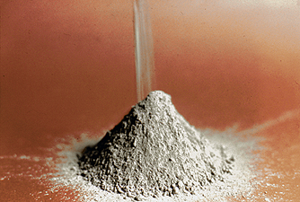
PORTLAND CEMENT

Slide 2
Portland Cement → Gypsum+Portland Cement Clinker (pulverizing)
Portland Cement Clinker → Calcareous & Clayey Materials (burning)
Paste → P.C. + Water
Mortar → P.C. + Water + Sand
Concrete → P.C. + Water + Sand + Gravel

Slide 3
RAW MATERIALS OF P.C.
Calcareous Rocks (CaCO₃ > 75%)
Limestone
Marl
Chalk
Marine shell deposits
Argillocalcareous Rocks (40%<CaCO₃<75%)
Cement rock
Clayey limestone
Clayey marl
Clayey chalk

Slide 4
Argillaceous Rocks (CaCO₃ < 40%)
Clays
Shales
Slates
Portland cement is made by mixing substances containing CaCO₃ with substances containing SiO₂, Al₂O₃, Fe₂O₃ and heating them to a clinker which is subsequently ground to powder and mixed with 2-6 % gypsum.

Slide 5
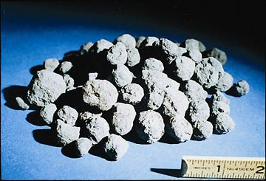
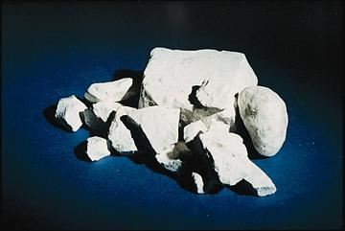
CLINKER
GYPSUM

Slide 6
PRODUCTION STEPS
Raw materials are crushed, screemed & stockpiled.
Raw materials are mixed with definite proportions to obtain “raw mix”. They are mixed either dry (dry mixing) or by water (wet mixing).
Prepared raw mix is fed into the rotary kiln.
As the materials pass through the kiln their temperature is rised upto 1300-1600 °C. The process of heating is named as “burning”. The output is known as “clinker” which is 0.15-5 cm in diameter.

Slide 7
Clinker is cooled & stored.
Clinker is ground with gypsum (3-6%) to adjust setting time.
Packing & marketting.

Slide 8
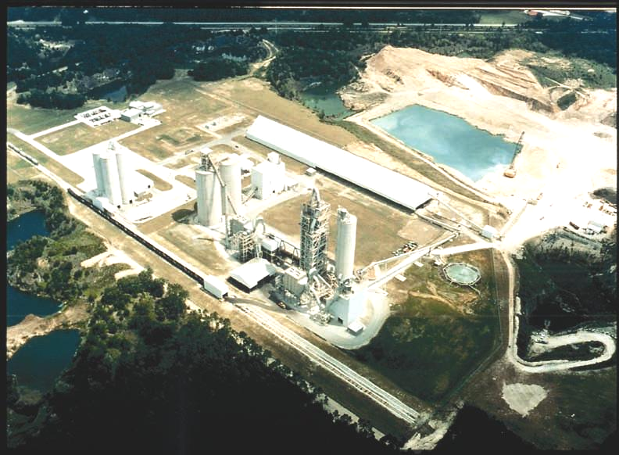

Slide 9
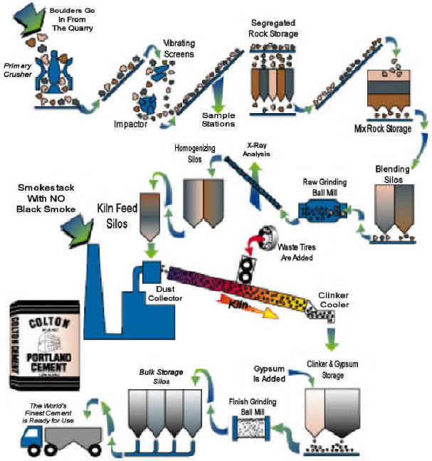

Slide 10
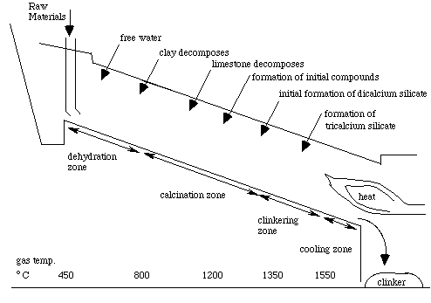

Slide 11
REACTIONS IN THE KILN
~100°C→ free water evaporates.
~150-350C°→ loosely bound water is lost from clay.
~350-650°C→decomposition of clay→SiO₂&Al₂O₃
~600°C→decomposition of MgCO₃→MgO&CO₂ (evaporates)
~900°C→decomposition of CaCO₃→CaO&CO₂ (evaporates)

Slide 12
~1250-1280°C→liquid formation & start of compound formation.
~1280°C→clinkering begins.
~1400-1500°C→clinkering
~100°C→clinker leaves the kiln & falls into a cooler.
Sometimes the burning process of raw materials is performed in two stages: preheating upto 900°C & rotary kiln

Slide 13
CHEMICAL COMPOSITION OF P.C.
Portland cement is composed of four major oxides (CaO, SiO₂, Al₂O₃, Fe₂O₃ ≥90%) & some minor oxides. Minor refers to the quantity not importance.

Slide 14

Oxide | Common Name | Abbreviation | Approx. Amount (%)
CaO | Lime | C | 60-67
SiO₂ | Silica | S | 17-25
Al₂O₃ | Alumina | A | 3-8
Fe₂O₃ | Iron-oxide | F | 0.5-6
MgO | Magnesia | M | 0.1-4
Na₂O | Soda | N | 0.2-1.3
K₂O | Potassa | K
SO₃ | Sulfuric Anhydride | Ś | 1-3
CaO→limestone
SiO₂-Al₂O₃→Clay
Fe₂O₃→Impurity in Clays
SO₃→from gypsum→not from the clinker

Slide 15
The amount of oxides in a P.C. Depend on the proportioning of the raw materials and how well the burning is done in the kiln. The chemical composition is found by chemical analysis.
A typical analysis of O.P.C.
C | 63.6
S | 20.7
A | 6
F | 2.4
Ś | 2.1
M | 2.6
N | 0.1
K | 0.9
Free C | 1.4
Total | 99.8
Insoluble residue=0.2
Loss on ignition=1.4

Slide 16
CaO (C), SiO₂ (S), Al₂O₃ (A) & Fe₂O₃ are the major oxides that interact in the kiln & form the major compounds.
The proportions of these oxides determine the proportions of the compounds which affect the performance of the cement.
SO₃→comes largely from gypsum
P.C. alone sets quickly so some gypsum is ground with clinker to retard the setting time.

Slide 17
If too much gypsum is included it leads to distruptive expansions of the hardened paste or concrete.
ASTM C 150 → SO₃ ≤ 3% in O.P.C.
MgO+H₂O→MH
C+H→CH volume expansion & cause cracking.
ASTM C 150 → M<6%
free C < 3%

Slide 18
Alkalies (Na₂O & K₂O) may cause some dificulties if the cement is used with certain types of reactive aggregates in making concrete. The alkalies in the form of alkaline hydroxides can react with the reactive silica of the aggregate & resulting in volume expansion after hardening. This process may take years.
Na₂O & K₂O ≤ 0.6%

Slide 19
Insoluble Residue: is that fraction of cement which is insoluble in HCl. It comes mainly from the silica which has not reacted to form compounds during the burning process in the kiln. All compounds of P.C. is soluble in HCl except the silica.
The amount of I.R., determined by chemical analysis, serves to indicate the completeness of the reactions in the kiln.
ASTM C 150 → I.R. ≤ 0.75%

Slide 20
Loss on Ignition (L.O.I.): is the loss in weight of cement after being heated to 1000°C. It indicates the prehydration or carbonation due to prolonged or improper storage of cement & clinker.
If cement is exposed to air, water & CO₂ are absorbed & by heating the cement upto 1000°C loose these two substances.
ASTM C 150 → L.O.I. ≤ 3% for O.P.C.

Slide 21
COMPOUND COMPOSITION OF P.C. (OR CLINKER)
Oxides interact with eachother in the kiln to form more complex products (compounds). Basically, the major compounds of P.C. can be listed as:
Name | Chemical Formula | Abbreviations
Tri Calcium Silicate | 3CaO.SiO₂ | C₃S
Di Calcium Silicate | 2CaO.SiO₂ | C₂S
Tri Calcium Aluminate | 3CaO.Al₂O₃ | C₃A
Tetra Calcium Alumino Ferrite | 4CaO.Al₂O₃.Fe₂O₃ | C₄AF

Slide 22
The degree to which the potential reactions can proceed to “equilibrium” depends on:
Fineness of raw materials & their intermixing.
The temperature & time that mix is held in the critical zone of the kiln.
The grade of cooling of clinker may also be effective on the internal structure of major compounds.

Slide 23
There are also some minor compounds which constitute few %, so they are usually negligible. Moreover, portland cement compounds are rarely pure.
For example in C₃S, MgO & Al₂O₃ replaces CaO randomly.
C₃S→ALITE & C₂S→BELITE
Ferrite Phase: C₄AF is not a true compound. The ferrite phase ranges from C₂AF to C₆AF. *C₄AF represents an average.

Slide 24
Methods of Determining Compound Composition
Each grain of cement consists of an intimate mixture of these compounds.
They can be determined by:
Microscopy
X-Ray Diffraction
But due to the variabilities involved the compound composition is usually calculated using the oxide proportions.
Calculations (Bouge’s Equations)

Slide 25
Assumptions
The chemical reactions in the kiln proceeded to equilibrium.
Compounds are in pure form such as C₃S & C₂S
Presence of minor compounds are ignored.
Ferrite phase can be calculated as C₄AF
All oxides in the kiln have taken part in forming the compounds.

Slide 26
%C₃S=4.071(%C)-7.6(%S)-6.718(%A)-1.43(%F)-2.852(%Ś)
%C₂S=2.867(%S)-0.7544(%C₃S)
%C₃A=2.650(%A)-1.692(%F)
%C₄AF=3.043(%F)

Slide 27
Ex:Given the following oxide composition of a portland cement clinker.
CaO=64.9% SiO₂=22.2%
Al₂O₃=5.8% Fe₂O₃=3.1% MgO=4%
Using Bogue’s eqn’s calculate the compound composition of the P.C. clinker?
C₃S=4.071*64.9-7.6*22.2-6.718*5.8-1.43*3.1=52.1%
C₂S=2.876*22.2-0.7544*52.1=24.5%
C₃A=2.65*5.8-1.692*3.1=10.1%

Slide 28
C₄AF=3.043*3.1=9.4%
To see the effect of change in oxide composition on the change in compound composition, assume that CaO is 63.9% & SiO₂ is 23.2% and others are the same.
C₃S=40.4% , C₂S=36.2% , C₃A=10% , C₄AF=9.4%
C₃S changed from 52.1%→40.4%
C₂S changed from 24.5%→36.2%
1% change in CaO & SiO₂ resulted in more than 10% change in C₃S & C₂S content.

Slide 29
Influence of Compound Composition on Characteristics of P.C.
P.C.+water→the compounds in the cement undergo chemical reactions with the water independently, and different products result from these reactions.
 | C₃S | C₂S | C₃A | C₄AF
Rate of Reaction | Moderate | Slow | Fast | Moderate
Heat Liberation | High | Low | Very High | Moderate
Early Cementitious Value | Good | Poor | Good | Poor
Ultimate Cementitious Value | Good | Good | Poor | Poor

Slide 30
ASTM Type & Name of P.C. | Average Compound Composition
 | C₃S | C₂S | C₃A | C₄AF
Type I - O.P.C. | 49 | 25 | 12 | 8 | General Purpose
Type II - Modified | 46 | 29 | 6 | 12 | For Moderate Heat of Hydration
Type III - High Early Strength | 56 | 15 | 12 | 8 | C₃S&C₃A increased, C₂S decreased
Type IV - Low Heat P.C. | 30 | 46 | 5 | 13 | C₂S increased
Type V - Sulfate Resistant P.C. | 43 | 36 | 4 | 12 | Limit on C₃A≤5%, 2C₃A+C₄AF≤25%

Slide 31
Hydration of P.C.
Hydration: Chemical reactions with water.
As water comes into contact with cement particles, hydration reactions immediately starts at the surface of the particles. Although simple hydrates such as C-H are formed, process of hydration is a complex one and results in reorganization of the constituents of original compounds to form new hydrated compounds.

Slide 32
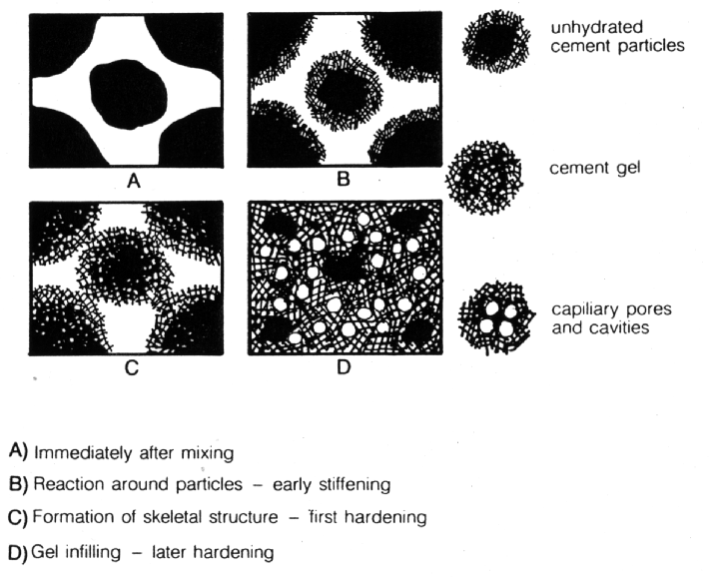

Slide 33
At any stage of hydration the hardened cement paste (hcp) consists of:
Hydrates of various compounds referred to collectively as GEL.
Crystals of calcium hydroxide (CH).
Some minor compound hydrates.
Unhydrated cement
The residual of water filled spaces – pores.

Slide 34
As the hydration proceeds the deposits of hydrated products on the original cement grains makes the diffusion of water to unhydrated nucleus more & more difficult. Thus, the rate of hydration decreases with time & as a result hydration may take several years.
Major compounds start to produce:
Calcium-silicate-hydrate gels
Calcium hydroxide cement
Calcium-alumino-sulfohydrates gel

Slide 35
At the beginning of mixing, the paste has a structure which consists of cement particles with water-filled space between them. As hydration proceeds, the gels are formed & they occupy some of this space.
1cc of cement → 2.1cc of gel
Gel Pores: 28% of the total gel volume have diameter of 0.015-0.020 μm. (very small-loss or gain of water is difficult)

Slide 36
Capillary Pores: 12.5 μm diameter, with varying sizes, shapes & randomly distributed in the paste.
Volume of capillary pores decreases as hydration takes place. Water in capillary pores is mobile, can not be lost by evaporation or water can get into the pores. They are mainly responsible for permeability.
- w/c ratio
capillary porosity
- degree of hydration

Slide 37
C₂S & C₃S: 70-80% of cement is composed of these two compounds & most of the strength giving properties of cement is controlled by these compounds.
Upon hydration both calcium-silicates result in the same products.
2C₃S+6H → C₃S₂H₃ + 3CH
2C₂S+4H → C₃S₂H₃ + CH
Calcium-Silicate-Hydrate (C-S-H gel) is similar to a mineral called “TOBERMORITE”. As a result it is named as “TOBERMORITE GEL”

Slide 38
Upon hydration C₃S & C₂S, CH also forms which becomes an integral part of hydration products. CH does not contribute very much to the strength of portland cement.
C₃S having a faster rate of reaction accompanied by greater heat generation developes early strength of the paste. On the other hand, C₂S hydrates & hardens slowly so results in less heat generation & developes most of the ultimate strength.

Slide 39
Higher C₃S→higher early strength-higher heat generation (roads, cold environments)
Higher C₂S→lower early strength-lower heat generation (dams)
C₃A: is characteristically fast reacting with water & may lead to a rapid stiffening of the paste with a large amount of the heat generation (Flash-Set)-(Quick-Set). In order to prevent this rapid reaction gypsum is added to the clinker. Gypsum, C₃A&water react to form relatively insoluble Calcium-Sulfo-Aluminates.

Slide 40
C₃A+CŚH₂+10H→C₄AŚH₁₂ (calcium- alumino-monosulfohydrate)
C₃A+3CŚH₂+26H→C₆AŚ₃H₃₂ (calcium-alumino-trisulfohydrate “ettringite”)
When there is enough gypsum “ettringite” forms with great expansion
If there is no gypsum→flash-set
more gypsum→ettringite
formation increases
which will cause cracking

Slide 41
Also Calcium-Sulfo Aluminates are prone (less resistant) to sulfate attack & does not contribute much for strength. The cement to be used in making concretes that are going to be exposed to soils or waters that contain sulfates should not contain more than 5% C₃A.
C₄AF: The hydration of ferrite phase is not well understand. Ferrite phase has lesser role in development of strength. The hydration products are similar to C₃A. Alumina & iron oxide occur interchangebly in the hydration products.
C₄AŚH₁₂ or C₄FŚH₁₂
C₆AŚ₃H₃₂ or C₆FŚ₃H₃₂

Slide 42
HEAT OF HYDRATION
Hydration process of cement is accompanied by heat generation (exothermic).
As concrete is a fair insulator, the generated heat in mass concrete may result in expansion & cracking. This could be overcome by using suitable cement type.
It could also be advantages for cold wheather concreting.
The heat of hydration of OPC is on the order of 85-100 cal/gr.
About 50% of this heat is liberatedwithin 1-3 days & 75% within 7 days.
By limiting C₃S&C₃A content heat of hydration can be reduced.

Slide 43
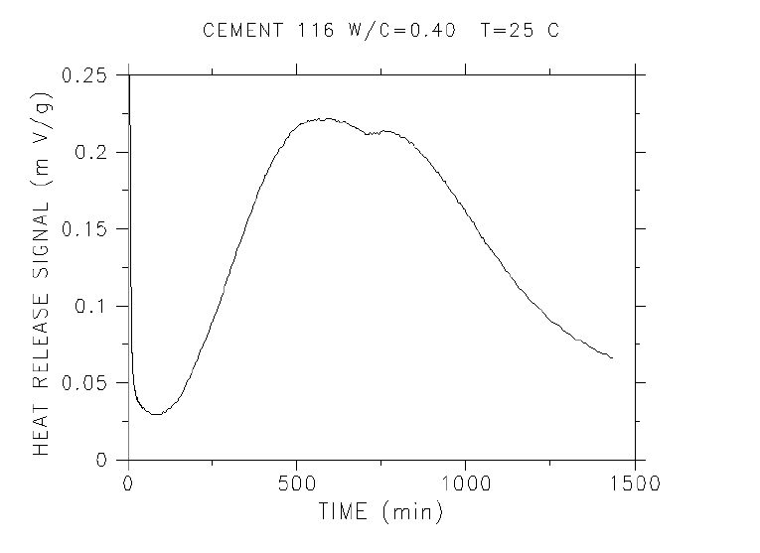

Slide 44
Heat of Hydration of Pure Compounds
 | Heat of Hydration (cal/gr)
C₃S | 120
C₂S | 62
C₃A | 207
C₄AF | 100
The amount of heat liberated is affected by the fractions of the compounds of the cement.
Heat of Hydration(cal/gr)=120*(%C₃S)+62*(%C₂S)+207*(%C₃A)+100*(C₄AF)

Slide 45
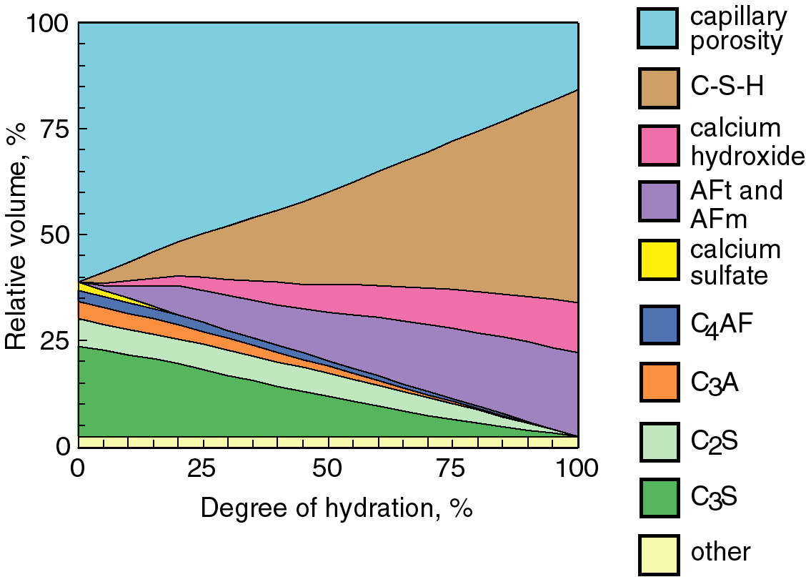

Slide 46
FINENESS OF CEMENT
As hydration takes place at the surface of the cement particles, it is the surface area of cement particles which provide the material available for hydration. The rate of hydration is controlled by fineness of cement. For a rapid rate of hydration a higher fineness is necessary.

Slide 47
However,
Higher fineness requires higher grinding (cost )
Finer cements deteriorate faster upon exposure to atmosphere.
Finer cements are very sensitive to alkali-aggregate reaction.
Finer cements require more gypsum for proper hydration.
Finer cements require more water.

Slide 48
Fineness of cement is determined by air permeability methods. For example, in the Blaine air permeability method a known volume of air is passed through cement. The time is recorded and the specific surface is calculated by a formula.
Fineness is expressed in terms of specific surface of the cement (cm²/gr). For OPC specific surface is 2600-3000 cm²/gr.

Slide 49
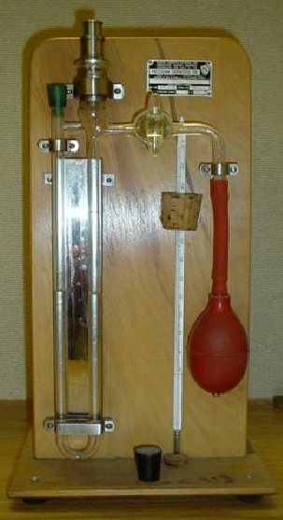
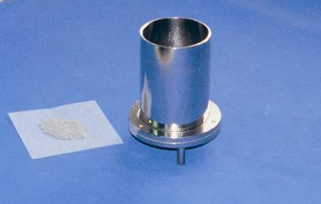
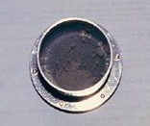
Sieving
Blaine Apparatus

Slide 50
SETTING
Setting refers to a change from liquid state to solid state. Although, during setting cement paste acquires some strength, setting is different from hardening.
The water content has a marked effect on the time of setting. In acceptance tests for cement, the water content is regulated by bringing the paste to a standard condition of wetness. This is called “normal consistency”.

Slide 51
Normal consistency of O.P.C. Ranges from 20-30% by weight of cement.
Vicat apparatus is used to determine normal consistency. Normal consistency is that condition for which the penetration of a standard weighed plunger into the paste is 10mm in 30sec. By trial & error determine the w/c ratio.
In practice, the terms initial set&final set are used to describe arbitrary chosen time of setting. Initial set indicates the beginning of a noticeable stiffening & final set may be regarded as the start of hardening (or complete loss of plasticity).

Slide 52
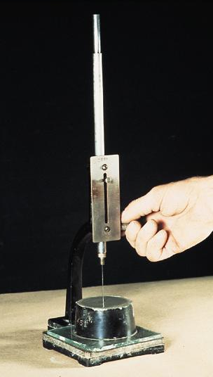
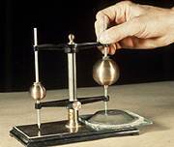
Gillmore Needle
Vicat Needle

Slide 53
Setting can be obtained by using the vicat apparatus.
Initial setting time>45min
ASTM C150
Final setting time<375min
Initial > 1hr (60min)
TS 19
Final < 8hr (480min)

Slide 54
Factors Affecting Setting Time
Temperature & Humidity
Amount of Water
Chemical Composition of Cement
Fineness of Cement (finer cement, faster setting)
Flash-set
Abnormal Settings
False-set

Slide 55
Flash-Set: is the immediate stiffening of cement paste in a few minutes after mixing with water. It is accompanied by large amount of heat generation upon reaction of C3A with water.
Gypsum is placed in cement to prevent flash-set. The rigidity can not be overcome & plasticity may not be regained without addition of water.
Amount of gypsum must be such that it will be used upto almost hardening. Because expansion caused by ettringite can be distributed to the paste before hardening. More gypsum will cause undesirable expansion after hardening.

Slide 56
False-Set: is a rapid development of rigidity of cement paste without generation of much heat. This rigidity can be overcome & plasticity can be regained by further mixing without addition of water. In this way cement paste restores its plasticity & sets in a normal manner without any loss of strength.
Probable Causes of False-Set:
When gypsum is ground by too hot of a clinker, gypsum may be dehydrated into hemihydrate (CaSO₄.1/2H₂O) or anhydrate (CaSO₄). These materials when react with water gypsum is formed, which results in stiffening of the paste.

Slide 57
Alkali oxides in cement may carbonate during storage. Upon mixing such a cement with water, these alkali carbonates will react with Ca(OH₂) (CH-Calcium Hydroxide) liberated by hydrolysis of C₃S resulting in CaCO₃. CaCO₃ precipates in the mix & results in false-set.

Slide 58
SOUNDNESS OF CEMENT
Soundness is defined as the volume stability of cement paste.
The cement paste should not undergo large changes in volume after it has set. Free CaO&MgO may result in unsound cement. Upon hydration C&M will form CH&MH with volume increase thus cracking.
Since unsoundness is not apparent until several months or years, it is necessary to provide an accelerated method for its determination.
Lechatelier Method: Only free CaO can be determined.
Autoclave Method: Both free CaO&MgO can be determined.

Slide 59
STRENGTH OF CEMENT
Strength tests are not carried out on neat cement pastes, because it is very difficult to form these pastes due to cohesive property of cement.
Strength tests are carried out on cement mortar prepared by standard gradation (1 part cement+3 parts sand+1/2 part water)

Slide 60
Direct Tension (Tensile Strength):
P
P
1”
1”
σ_{t}=P/1in²
^{Difficult test procedure}

Slide 61
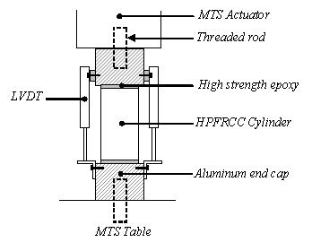

Slide 62
Flexural Strength (tensile strength in bending):
P
4^{cm}
4^{cm}
L
C
σf=(M*C)/I
M:maximum moment
I:moment of inertia
C:distance to bottom fiber from C.G.

Slide 63
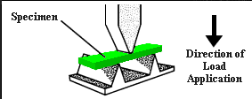


Slide 64
Compression Test:
i) Cubic Sample ii)Flexural Sample after it is broken
P
4^{cm}
4^{cm}
4^{cm}
P
σ_{c}=P/A
A=4x4
σ_{c}=P/A

Slide 65
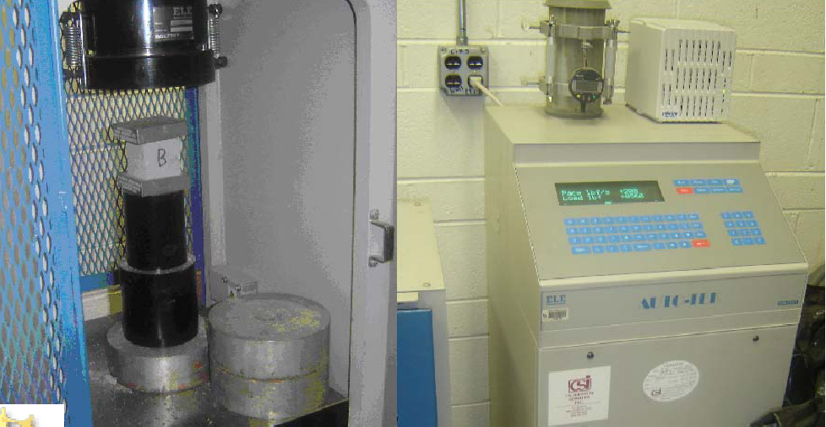

Slide 66
TYPES OF PORTLAND CEMENT
Cements of different chemical composition & physical characteristics may exhibit different properties when hydrated. It should thus be possible to select mixtures of raw materials for the production of cements with various properties.
In fact several cement types are available and most of them have been developed to ensure durability and strength properties to concrete.

Slide 67
It should also be mentioned that obtaining some special properties of cement may lead to undesirable properties in another respect. For this reason a balance of requirements may be necessary and economic aspects should be considered.
Standard Types: these cements comply with the definition of P.C., and are produced by adjusting the proportions of four major compounds.
Special Types: these do not necessarily couply with the definiton of P.C. & are produced by using additional raw materials.

Slide 68
Standard Cements (ASTM)
Type I: Ordinary Portland Cement
Suitable to be used in general concrete construction when special properties are not required.
Type II: Modified Portland Cement
Suitable to be used in general concrete construction. Main difference between Type I&II is the moderate sulfate resistance of Type II cement due to relatively low C3A content (≤%8). Since C₃A is limited rate of reactions is slower and as a result heat of hydration at early ages is less. *It is suitable to be used in small scale mass concrete like retaining walls.

Slide 69
Type III: High Early Strength P.C.
Strength development is rapid.
3 days f’_{c}=7 days f’_{c} of Type I
It is useful for repair works, cold weather & for early demolding.
Its early strength is due to higher C₃S & C₃A content.
Type IV: Low Heat P.C.
Generates less heat during hydration & therefore gain of strengthis slower.
In standards a maximum value of C₃S&C₃A& a minimum value for C₂S are placed.
It is used in mass-concrete and hot-weather concreting.

Slide 70
Type V: Sulfate Resistant P.C.
Used in construction where concrete will be subjected to external sulfate attack – chemical plants, marine & harbor structures.
During hydration C₃A reacts with gypsum & water to form ettringite. In hardened cement paste calcium-alumino-hydrate can react with calcium&alumino sulfates, from external sources, to form ettringite which causes expansion & cracking.
C-H and sulfates can react & form gypsum which again causes expansion & cracking.
* In Type V C₃A is limited to 5%.

Slide 71
Type IA, IIA, IIIA: Air Entrained Portland Cement
Only difference is adding an air-entraining agent to the cement during manufacturing to increase freeze-thaw resistance by providing small sized air bubbles in concrete.

Slide 72
SPECIAL CEMENTS
Portland Pozzolan Cement (P.P.C.)
By grinding & blending P.C. Clinker+Pozzolan+Gypsum
P.P.C. Produces less heat of hydration & offers higher sulfate resistance so it can be used in marine structures & mass concrete.
However, most pozzolans do not contribute to strength at early ages.
The early strength of PPC is less.

Slide 73
Portland Blast Furnace Slag Cement (P.B.F.S.C.)
By intergrinding B.F.S.+P.C. Clinker+Gypsum
This cement is less reactive (rate of gain of strength & early strength is less but ultimate strength is same)
High sulfate resistance
Suitable to use in mass concrete construction
Unsuitable for cold weather concreting
Both P.P.C.&P.B.F.S.C. Are called blended cements. Their heat of hydration & strength development are low in early days. Because upon adding water C₃S compounds start to produce C-S-Hgels & CH. The Ch & the pozzolanic material react together to produce new C-S-H gels. That’s why the early strength is low but the ultimate strength is the same when compared to O.P.C.

Slide 74
White Portland Cement
W.P.C. İs made from materials containing a little iron oxide & manganese oxide.
Fe₂O₃ + MnO ≤ 0.8%
To avoid contamination by coal ash, oil is used as fuel.
To avoid contamination by iron during grinding, instead of steel balls nickel-molybdenum alloys are used.

Slide 75
High Alumina Cement
The raw materials for H.A.C. İs limestone and Bauxite (Al₂O₃ & Fe₂O₃)
These raw materials are interground & introduced in the kiln clinkered at 1600°C. Then the obtained material is ground to a fineness of 2500-3000 cm2/gr.
The oxide composition is quite different
Al₂O₃ → 40-45%
CaO → 35-42%
Fe₂O₃ → 5-15%
SiO₂ → 4-10%

Slide 76
Major compounds are CA & C2S
It is basically different from O.P.C. & the concrete made from this cement has very different properties.
It has high sulfate resistance.
Very high early strength (emergency repairs)
About 80% of ultimate strength is obtained within 24 hours. But the strength is adversely affected by temperature. The setting time is not as rapid as gain of strength.
Initial setting time is 4 hrs & final setting time is 5 hrs.

Slide 77
STANDARD TURKISH CEMENTS
(TS 19) – Cancelled
TS 19 groups them into 3
P.Ç. 32.5 → min. Compressive strength is 32.5 MPa in 28 days.
P.Ç. 42.5
P.Ç. 52.5
Special Cements are:
TS 20 –Blast Furnace Slag Cement
CÇ 32.5 – Cüruflu Çimento
CÇ 42.5
TS 21 – White Portland Cement BPÇ 32.5-42.5
TS22 – Masonry Cement, HÇ 16 (Harç Çimentosu)
TS 26 – Trass Cement, TÇ 32.5 (Traslı Çimento)
TS 640 – Fly Ash Cement, UKÇ 32.5 (Uçucu Küllü Çimento)

Slide 78
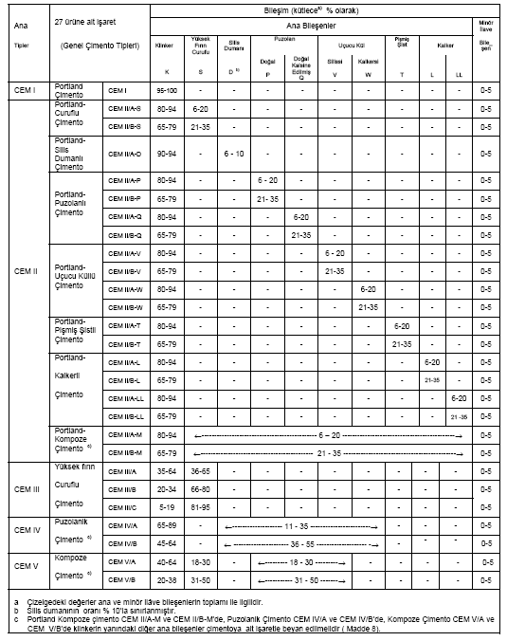
TS EN 197-1
NEW
CEM cements
CEM I – Portland Cement
CEM II – Portland Composite Cement
CEM III – Portland Blast Furnace Slag Cement
CEM IV – Pozzolanic Cement
CEM V – Composite Cement
27 different cements

Slide 79
TS EN 197-1
CEM cements :
  Binding property is mainly due to hydration of calcium-silicates
  Reactive C + Reactive S > 50%
Clinker, major and minor mineral admixtures
  Clinker + Major + Minor = 100% (mass) + Gypsum
  Major > 5% by mass
  Minor ≤ 5% by mass

Slide 80
TS EN 197-1
Mineral Admixtures
K : Clinker
D : Silica Fume
P : Natural Pozzolan
Q : Calcined Natural Pozzolan
T : Calcined Shale
W : Class – C Fly Ash
V : Class – F Fly Ash
L : Limestone (Organic compound < 0.5%)
LL : Limestone (Organic compound < 0.2%)
S : Granulated Blast Furnace Slag

Slide 81
TS EN 197-1
Composition
A : Lowest amount of mineral admixture
B : Mineral admixture amount is > A
C : Mineral admixture amount is > B

Slide 82
TS EN 197-1
Composition
CEM I : Portland Cement
95-100% K + 0-5% Minor

Slide 83
TS EN 197-1
Composition
CEM II : Portland Composite Cement
CEM II/A-S : Portland Slag Cement
80-94% K + 6-20% S + 0-5% Minor
CEM II/B-S : Portland Slag Cement
65-79% K + 21-35% S + 0-5% Minor
CEM II/B-P : Portland Pozzolanic Cement
65-79% K + 21-35% P + 0-5% Minor
CEM II/A-V : Portland Fly Ash Cement
80-94% K + 6-20% V + 0-5% Minor

Slide 84
TS EN 197-1
Composition
CEM III : Portland Blast Furnace Slag Cement
CEM III/A : Portland Blast Furnace Slag Cement
35-64% K + 36-65% S + 0-5% Minor
CEM III/B : Portland Blast Furnace Slag Cement
20-34% K + 66-80% S + 0-5% Minor
CEM III/C : Portland Blast Furnace Slag Cement
5-19% K + 81-95% S + 0-5% Minor

Slide 85
TS EN 197-1
Composition
CEM IV : Pozzolanic Cement
CEM IV/A : Pozzolanic Cement
65-89% K + 11-35% (D,P,Q,V,W) + 0-5% Minor
CEM IV/B : Pozzolanic Cement
45-64% K + 36-55% (D,P,Q,V,W) + 0-5% Minor

Slide 86
TS EN 197-1
Composition
CEM V : Composite Cement
CEM V/A : Composite Cement
40-64% K + 18-30% S + 18-30% (P,Q,V) + 0-5% Minor
CEM V/B : Composite Cement
20-38% K + 31-50% S + 31-50% (P,Q,V) + 0-5% Minor

Slide 87
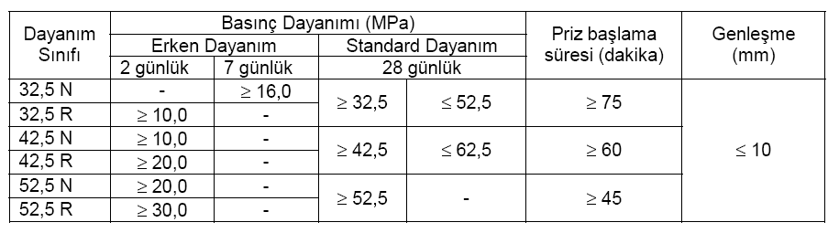
Strength Classes

Slide 88
Name - Example
CEM II / A – P 42.5 N
CEM II / A – P 42.5 R

