Slide 1
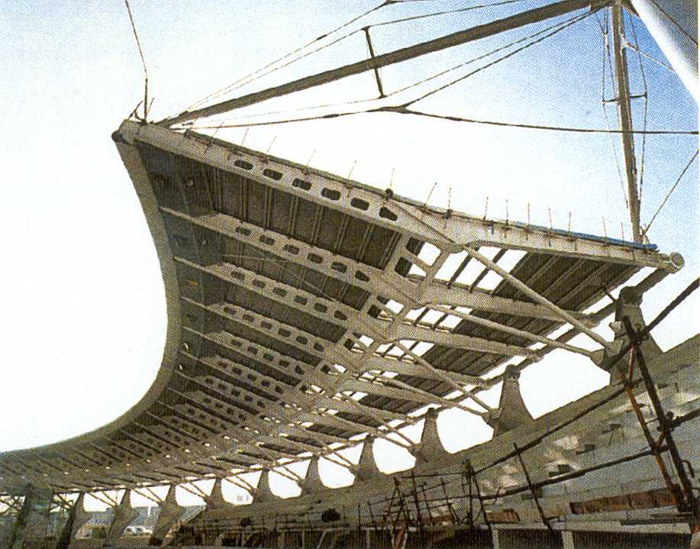
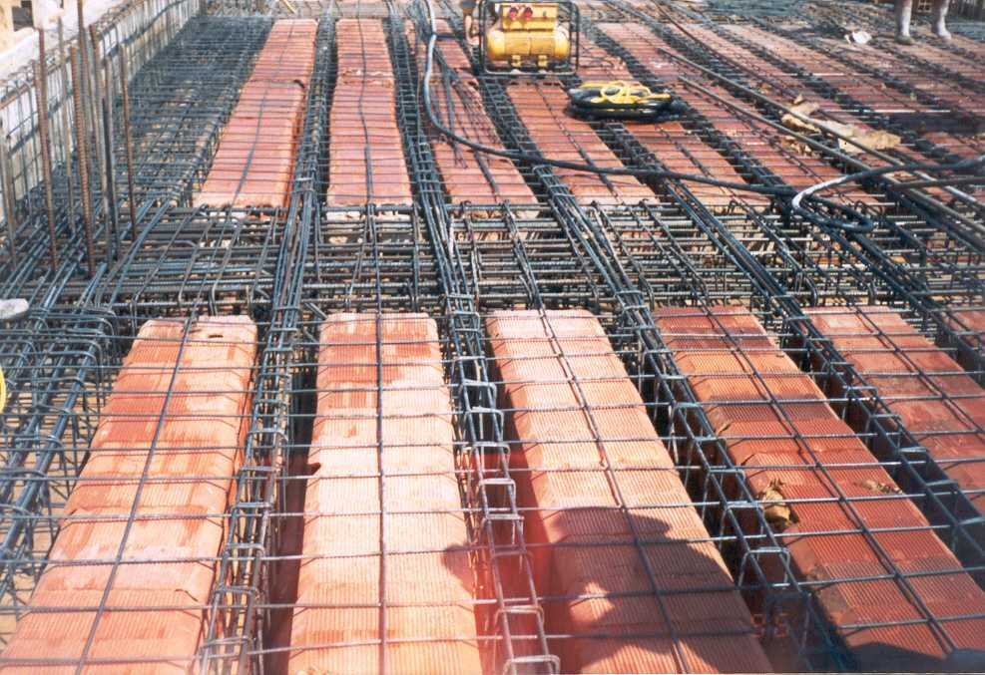
FERROUS METALS

Slide 2
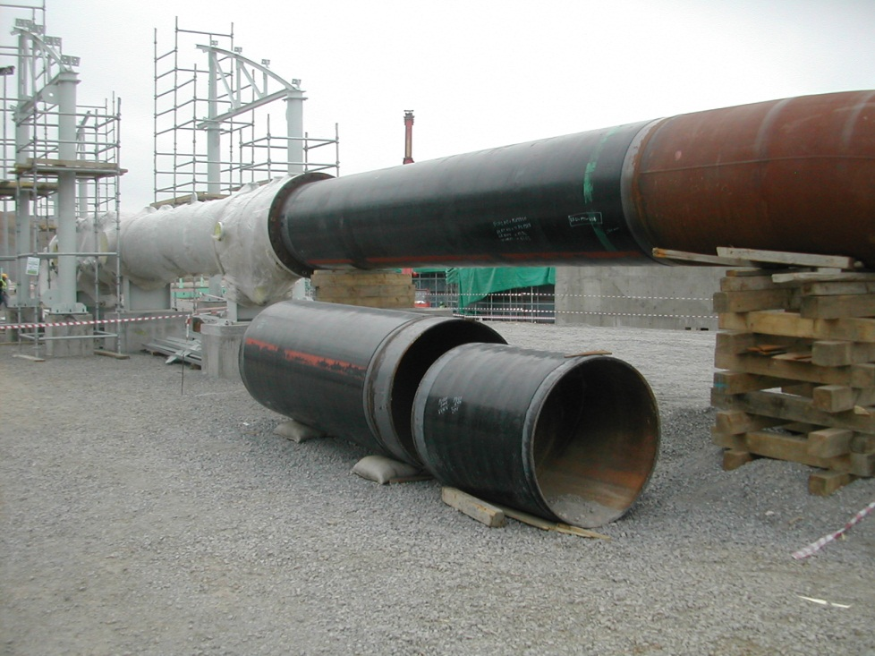
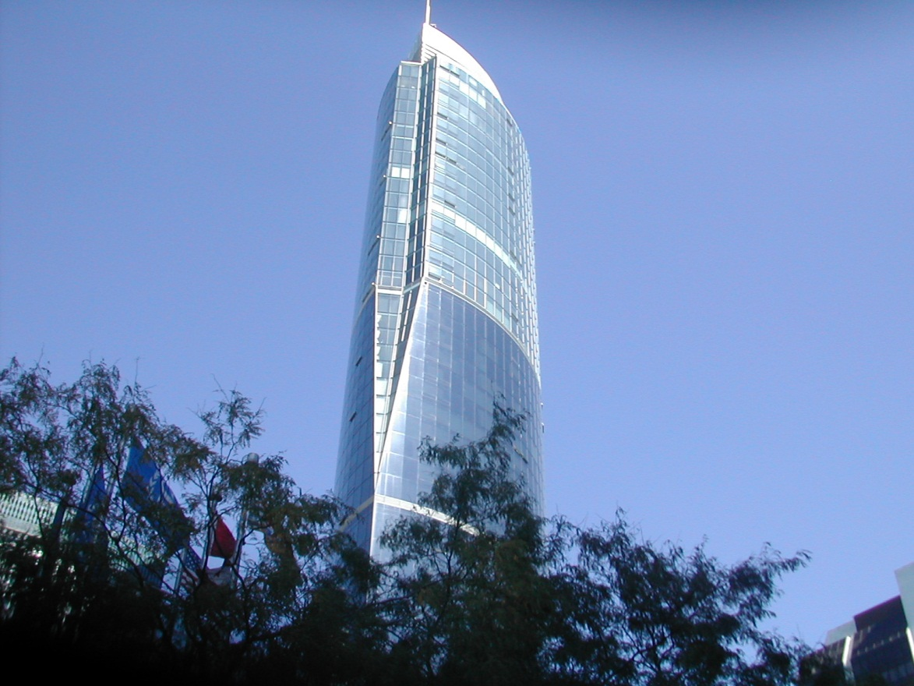
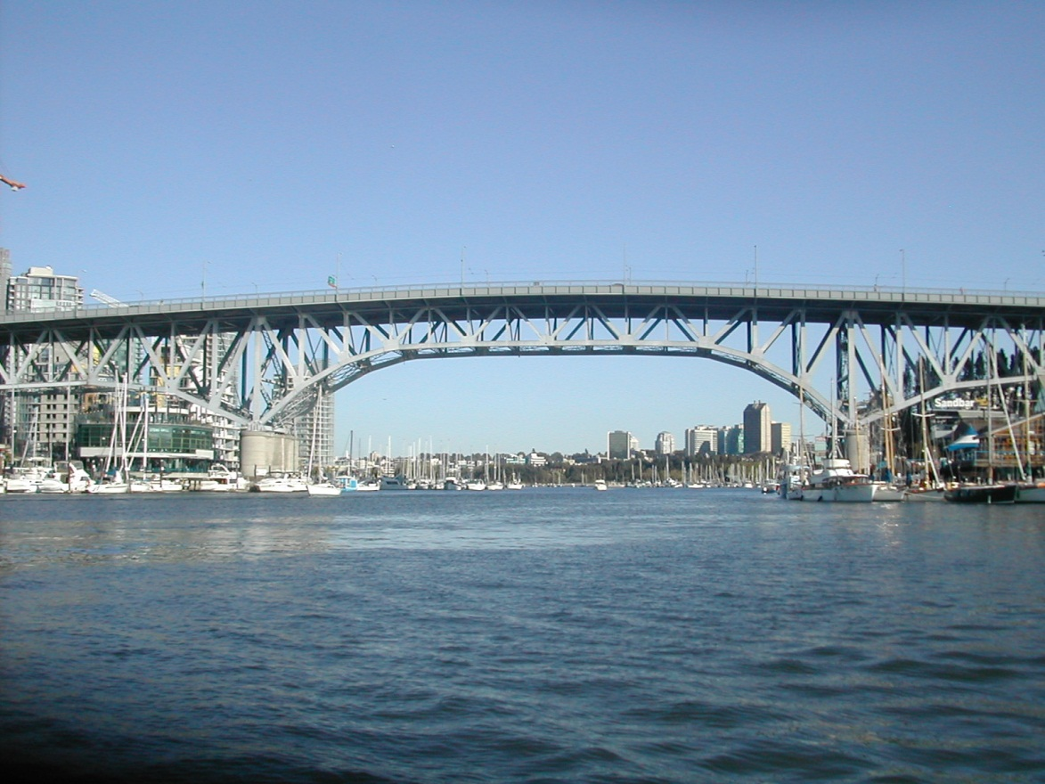
Steel Structures

Slide 3
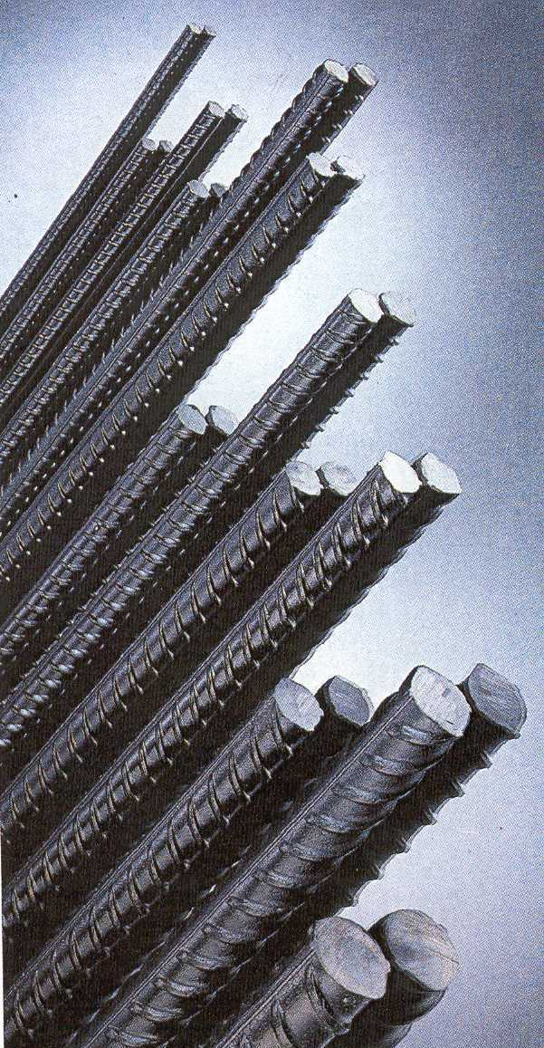
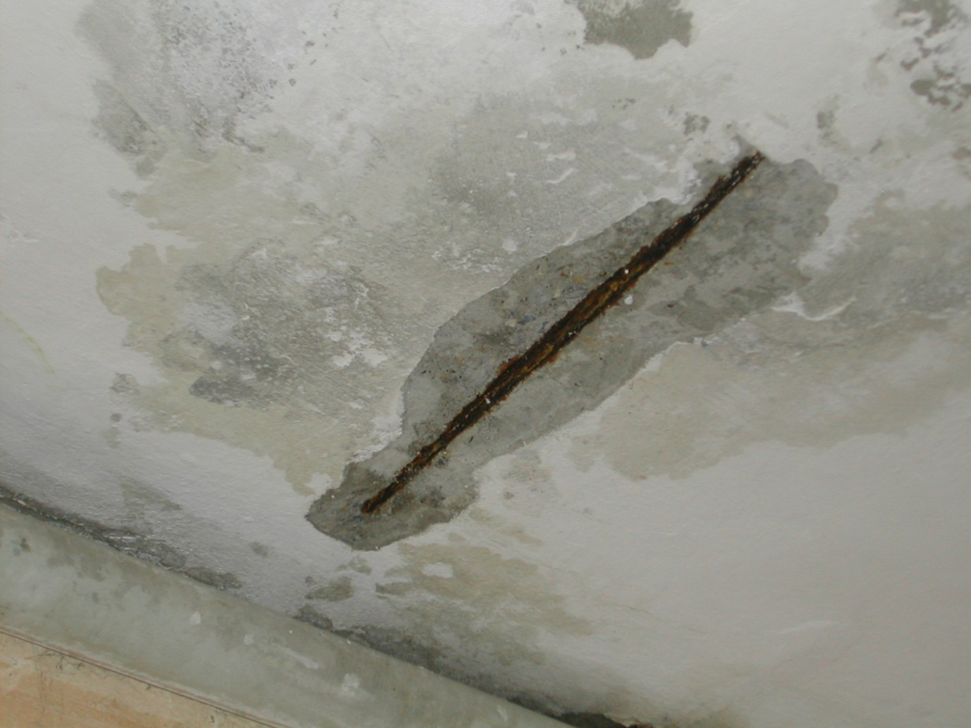
Steel in Structures

Slide 4
Steel Production
Ferrous metals are those metals that contain Iron.
The steel production process might be divided into three phases:
  Reduction of iron to pig iron
  Refining pig iron to steel
  Forming the steel into products

Slide 5
Iron
Iron is extracted from iron ores such as Hematite (Fe₂O₃) and Magnetite (Fe₃O₄)
The iron ores contain 25% to 70% metallic iron. Sulfur, phosphorous, silica and clay are the principal impurities.
Materials used to produce pig iron are coke, limestone and iron ore.
Iron ore, coke and limestone are heated together at high temperatures in blast furnaces for the extraction process of iron.

Slide 6
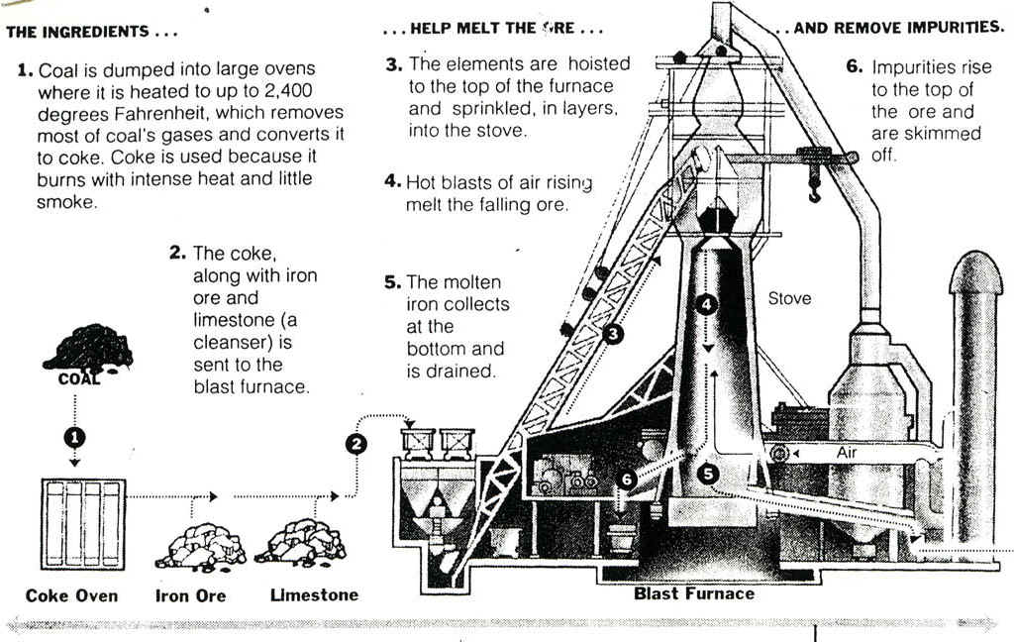

Slide 7
Pig Iron (Raw Iron)
Pure iron is a soft metal having a structure of iron crystals. In metallurgy, pure iron is called “Ferrite”
Coke → provides the heat & supplies carbon (C) to extract iron
C + O₂ → CO₂
CO₂ + C → 2CO
3CO + Fe₂O₃ → 2Fe + 3CO₂
Limestone is used to reduce the impurities.
Ordinary pig iron as produced by blast furnaces contains iron, about 92 percent; carbon, 3 or 4 percent; silicon, 0.5 to 3 percent; manganese, 0.25 to 2.5 percent; phosphorus, 0.04 to 2 percent; and a trace of sulfur.

Slide 8
CAST IRON
When pig iron is further processed by remelting to eliminate some of the carbon, cast iron (having a carbon content of about 1.5 to 4%) is produced.
The remelting process is usually performed in a cupola (a smaller version of blast furnace).
During the remelting operation in the cupola, no particular chemical change in the iron is ecpected. Some of the impurities may be eliminated and a more uniform product is obtained.

Slide 9
CAST IRON
After the treatment in the cupola the molten iron is cast into forms of desired shape. Depending on the rate of cooling the final product is called as:
  1. Gray Cast Iron
  2. White Cast Iron

Slide 10
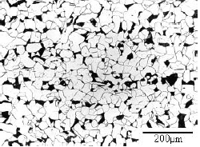
GRAY CAST IRON
When cast iron is allowed to cool slowly, most of the free carbon solidifies in large crystals known as graphite.
A small part of the carbon combines with iron to form cementite (Fe₃C).
  Iron and Carbon unit to form Iron Carbide (Fe₃C) “Cementite” with the ratio of 1 Carbon : 14 Iron.
  Cementite: is very hard and brittle substance so the more cementite the iron contains the more it gets harder.
Dark spots in this microscopic view of steel are cementite

Slide 11
WHITE CAST IRON
When cast iron is not allowed to cool slowly, the amount of cementite increases and the amount of graphite decreases.
Most carbon is reacted with Fe to get cementite (Fe₃C).
Therefore, white cast iron is strong and hard but brittle.
Moreover, since it is rapidly cooled it has high initial stresses.

Slide 12
MALLEABLE CAST IRON
Malleable Cast Iron: is obtained by annealing the white cast iron.
Annealing is the process of heating and cooling to induce softening, which will eliminate the initial stresses.
Moreover, this type of cast iron is also shaped by a hammer or by the pressure of rollers.
It has some ductility.

Slide 13
CAST IRON
All cast irons, in general, are brittle materials.
They are easy to form shapes, by casting into molds.
They are cheaper than forming steel shapes.

Slide 14
STEEL
Steel is also produced from pig iron by removing the impurities and by decreasing the carbon content.
Pig iron is again heated and the excess carbon is removed as CO₂ gas and the oxides of other impurities form a slag on top of the molten steel.

Slide 15
Composition of Steel
The essential difference between cast iron and steel is in the amount of carbon contained in the constituency of the metal.
Steel is fundamentally an alloy of iron and carbon with carbon content less than 1.5% while cast iron is an alloy of iron and carbon with carbon content ranging between 1.5 to 4% .

Slide 16
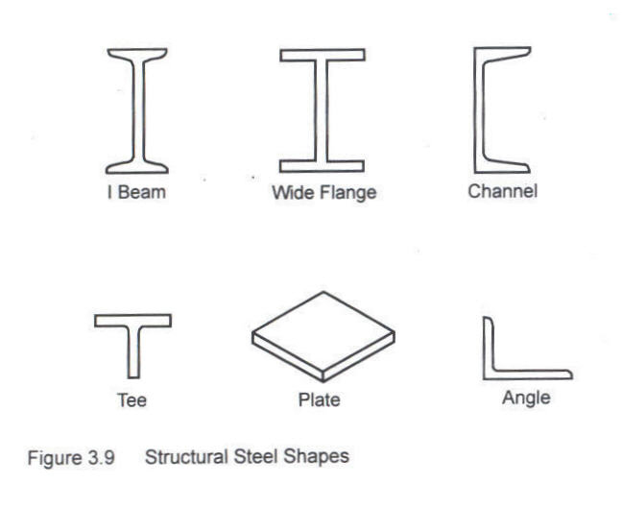
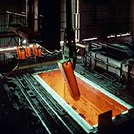
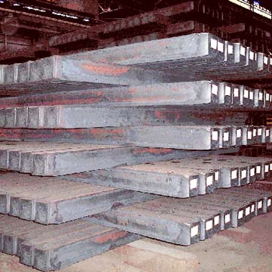
Shaping Structural Steel
They are first cast into simple shapes, “ingot”
Later ingots are given a preliminary shaping by being rolled or forged into “billets”.
Finally, desired shapes are obtained from billets by:
  Forging
  Rolling
  Extrusion
  Drawing

Slide 17
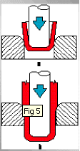
FORGING
Place a billet in a die and apply pressure with a suitably shaped punch.
As the metal is forced into position, it is stressed above the proportional limit and refinement in grain boundaries or goes into strain hardening.
Thick plates, sheetings and objects of irregular shape are produced by forging.

Slide 18
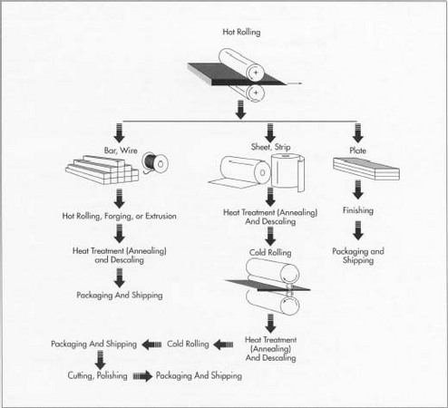
ROLLING

Slide 19
Hot Rolling: If the temperature of the metal is above its critical temperature which causes recrystallization of the crystallic structure. Properties will not be affected greatly.
Cold Rolling: If the temperature is below the critical temperature the initial crystallic structure will be maintained but the properties will change. The strength is increased but the ductility is decreased.

Slide 20
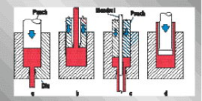
EXTRUSION
Applying sufficient pressure to the material by forcing it through a die which has the required constant cross-section (I-beams, channel section)

Slide 21
DRAWING
A rolled “rod” is pulled through a die having an opening smaller than the original cross-section of the rod. Wires and some rods are prepared by this method.

Slide 22
FACTORS THAT AFFECT
PROPERTIES OF STEELS
Carbon content
Heat treatment and shaping method
Presence of harmful elements
Presence of alloying materials.

Slide 23
Carbon Content
For steel C → ~0.05-2% usually <1.5%
It affects both strength & ductility. As it increases, strength increases but ductility decreases.
If C < 0.5% → well defined yield point
E is the same : 2.1x106 kgf/cm²
Low Carbon Steels: (C<0.2%) : soft & very ductile “commercial steels” → used for construction.
Medium Carbon Steels: (C<0.5%) : used in machine parts & reinforcing bars
High Carbon Steels: (C>0.5%) : used in production of tools such as drills, saw blades. They are very hard.

Slide 24
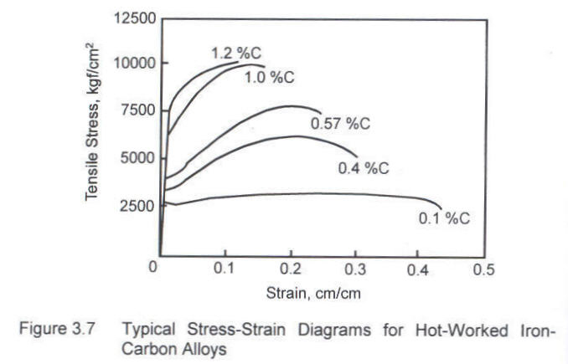
Carbon Content

Slide 25
Heat Treatment and
Shaping Methods
Cold Drawn & Cold Rolled → No microstructural changes. Changes are plastic deformations in the form of elongation of grains.
Hot Rolled → Microstructural changes
Drawn & Annealed → Initial stresses are releaved.

Slide 26
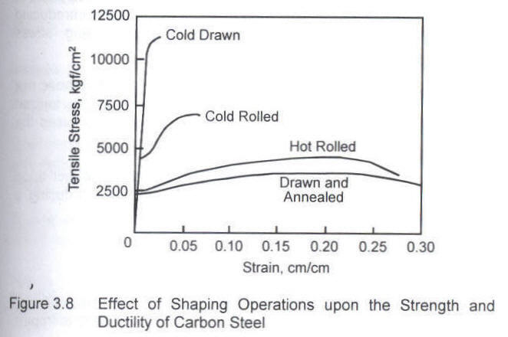
Heat Treatment and
Shaping Methods

Slide 27
Harmful Elements
Sulfur: makes steel brittle at high temperature (limited to → <0.05%). May become important in hot-rolling.
Phosphorous: makes steel brittle at low temperature (limited to → <0.05%). May become important in cold-rolling.
Oxygen, Hydrogen & Nitrogen

Slide 28
Alloying Elements
Alloying elements are added to steel:
  Higher strength with ductility
  Higher resistance to corrosion
  Higher resistance to heat
Chromium & Nickel are the most important alloying elements. “Stainless Steel” has ~20% Chromium & 8% Nickel.

Slide 29
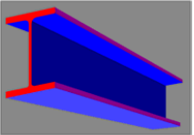
GENERAL USES OF STEEL
FOR CONSTRUCTION
Rolled Steel Sections: (I-beams, Wide Flange I-beams, Channel sections...) are used for beams, columns and in trusses.
Round Steel Bars: are used extensively in R/C structures as reinforcement and ties.

Slide 30
STEEL BARS FOR
CONCRETE REINFORCEMENT
Concrete → for compression
Steel Bar → for tension therefore used in tension zones.
→ Plain Bars: smooth surfaces
→ Deformed Bars: to increase the bond characteristics they have some deformation on the surfaces
→ Wire Mesh: Welded at joints & used in slabs.

Slide 31
They are produced usually by a hot rolling operation, although some steel bars are cold rolled. Small diameter bars are usually cold drawn.
A cold rolled or cold drawn steel has higher strengths but less ductility (Because of strain hardening!). Therefore, not desired.
Nominal diameter of plain bars → can be measured.
Nominal diameter of deformed bars →
W
D = 12.74
L

Slide 32
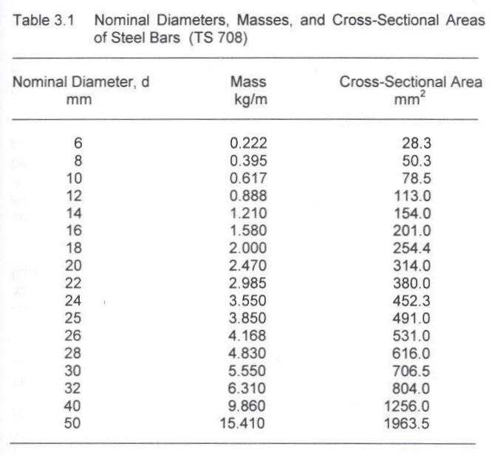

Slide 33
For reinforcing bars → yield strength, ultimate strength & ductility are important.
TS 708 → C should be <0.25% →plain
<0.4% → def.
In TS 500 & TS 708 → S220a, S420a, S420b, S500a
S:steel a: hot rolled b: cold worked 220: minimum yield point (MPa)

Slide 34
