Slide 1
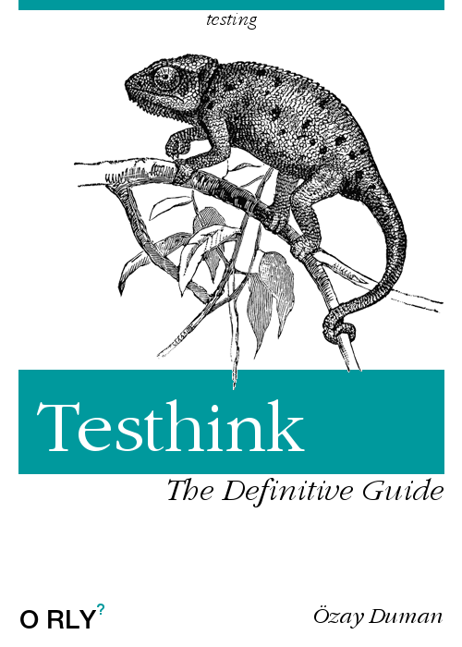
TESTHINK
UNIT & INTEGRATION REFACTORING TDD
TESTING STRATEGIES
Özay Duman

Slide 2

Outline
Software Testing Concepts
Unit & Integration Testing
How to write hard to test code
TDD (DEMO)
Spring Boot Testing

Slide 3
Why Automate Testing
-Achieves stakeholders goals -Meets functional requirements -Correctly handles corner cases
-Manually is time-consuming, repetitive
-Remove Fear of Change
-Enables Large Scale Refactoring -Performance -Usability
Software Testing

Slide 4
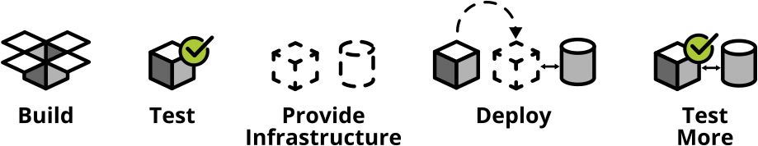
Why Automate Testing
CI/CD
Use build software pipelines to automatically and reliably get you into production

Slide 5
A suite of tests is a powerful bug detector that decapitates the time it takes to find bugs (Martin Fowler)

Slide 6
Unit tests are like the second pair of eyes of a pair programmer. (Kent Beck)

Slide 7
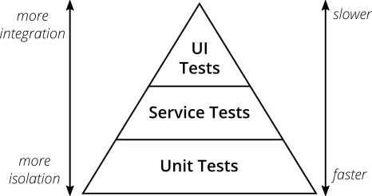
The Test Pyramid
Test the whole system (Configuration). End2End
Test interaction/contracts between classes (Wiring)
Test individual classes/ methods in isolation
Notes:
Write lots of small and fast unit tests. Write some more coarse-grained tests and very few high-level tests that test your application from end to end.
-Debugging maintain cost
-Test Engineers

Slide 8
What’s a Unit?
-in a functional language a unit will most likely be a single function
-In an object-oriented language a unit can range from a single method to an entire class.
Unit ?
Test Driver
Class Under Test
Notes:
Your unit tests will call a function with different parameters and ensure that it returns the expected values.
What’s the problem with this?

Slide 9
Test Doubles
Long Runnging Class
Other Class
Test Driver
Class Under Test
Other Class
CPU Intensive Class
Notes:
A unit test typically replaces external collaborators with test doubles

Slide 10
Test Doubles
Object Graph Construction
& Lookup
Business Logic
Notes:
You mix object creation code with business logic. This will assure that a test can never construct a graph of objects different from production. Hence nothing can be tested in isolation.

Slide 11
Test Doubles
Object Graph Construction
& Lookup
Business Logic
Notes:
A unit test typically replaces external collaborators with test doubles

Slide 12
Test Doubles (Seams)
Long Runnging Class
Friendly
Test Driver
Class Under Test
Seam
Friendly
CPU Intensive Class
Notes:
Object Instantiated Object Passed In Global Object

Slide 13
Test Doubles (Seams)
Friendly
Test Driver
Class Under Test
Seam
Friendly
Object Life Time & Calling
Object Instantiation
Object Passed In
Notes:
Object Instantiated Object Passed In Global Object
You mix object creation code with business logic. This will assure that a test can never construct a graph of objects different from production. Hence nothing can be tested in isolation.

Slide 14

Mocking and Stubbing
-replace a real thing with a fake version
-fake version acts like real version
-unit tests run very fast ☺
avoid hitting db, filesystem, http etc.
-test in isolation

Slide 15
TestDouble Dummy objects are passed around but never actually used. Usually they are just used to fill parameter lists. Fake objects actually have working implementations, but usually take some shortcut which makes them not suitable for production (an InMemoryTestDatabase is a good example). Stubs provide canned answers to calls made during the test, usually not responding at all to anything outside what's programmed in for the test. Spies are stubs that also record some information based on how they were called. One form of this might be an email service that records how many messages it was sent. Mocks are pre-programmed with expectations which form a specification of the calls they are expected to receive. They can throw an exception if they receive a call they don't expect and are checked during verification to ensure they got all the calls they were expecting.

Slide 16
What to Test?
-One test class per production class
-Test the public interface of the class
happy path and edge cases
-Don't reflect your internal code structure within your unit tests -Test for observable behaviour -Do not test trivial code getter/setter etc.
Software Testing
Notes:
Private methods should generally be considered an implementation detail. That's why you shouldn't even have the urge to test them.

Slide 17
Test Structure
Set up the test data
Call your method under test
Assert that the expected results are returned
Software Testing
given | when | then
Notes:
Private methods should generally be considered an implementation detail. That's why you shouldn't even have the urge to test them.

Slide 18
Exceptions, Failures & Errors
@Test(expected = IllegalArgumentException.class)
given | when | then
Notes:
Private methods should generally be considered an implementation detail. That's why you shouldn't even have the urge to test them.

Slide 19
Treat Tests like code!
Well Named
Behavior not Implementation
DRY
Software Testing
Executable documents | Maintence | Readability
https://martinfowler.com/articles/practical-test-pyramid.html
Notes:
Use domain terminology
Natural language
Exposing private state results in brittle and hard to maintain tests
Assert about the result of an operation You can change the implementation and the test still passes
Annotations @Before // Before each test method runs @After // After each test method runs @BeforeClass // Before all tests in the class @AfterClass // After all tests in the class

Slide 20
Integration Tests
Outside part of your application
-Calls to your services' REST API
-Reading from and writing to databases
-Calling other application's APIs
-Reading from and writing to queues
-Writing to the filesystem
Software Testing
H2 | WireMock | InMemory or Embeded DBs
Notes:
Use domain terminology
Natural language
Exposing private state results in brittle and hard to maintain tests
Assert about the result of an operation You can change the implementation and the test still passes
Annotations @Before // Before each test method runs @After // After each test method runs @BeforeClass // Before all tests in the class @AfterClass // After all tests in the class

Slide 21
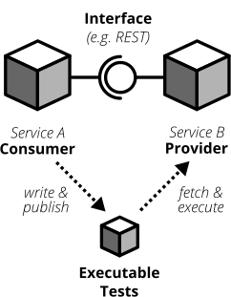
Consumer-Driven Contract Testing
Microservice Testing
Notes:
The consuming team writes automated tests with all consumer expectations
They publish the tests for the providing team
The providing team runs the CDC tests continuously and keeps them green
Both teams talk to each other once the CDC tests break

Slide 22

TDD
Always implement things when you actually need them, never when you foresee that you need them. (Ron Jeffries)

Slide 23
What’s TDD
Failing Test
Refactor
Approach to Design From Requirements
Passing Implementation
Notes:
The consuming team writes automated tests with all consumer expectations
They publish the tests for the providing team
The providing team runs the CDC tests continuously and keeps them green
Both teams talk to each other once the CDC tests break

Slide 24
Refactoring
to restructure software by applying a series of refactorings without changing the observable behavior of the software. . (Wikipedia)
Code Smells

Slide 25

Two Hats
martinfowler.com/articles/preparatory-refactoring-example.htm
Notes:
Private methods should generally be considered an implementation detail. That's why you shouldn't even have the urge to test them.

Slide 26
JUnit 4
-JUnit 4 is the most popular testing framework in the java community
Originally written by Erich Gamma and Kent Beck (creator of extreme programming)
-JUnit 5
Software Testing
Notes:
Private methods should generally be considered an implementation detail. That's why you shouldn't even have the urge to test them.

Slide 27
JUnit 4 Basics
@Test
@Before
@After
@Ignore
@Test(expected = Exception.class)
@Test(timeout = 10)
Software Testing
Notes:
Private methods should generally be considered an implementation detail. That's why you shouldn't even have the urge to test them.

Slide 28
Mockito Basics
var mockList = mock(List.class); mockList.size(); verify(mockList).size(); verify(mockList,times(1)).size(); verify(mockList, never()).clear(); verify(mockList, atLeast(1)).clear(); verify(mockList, atMost(10)).clear(); verifyZeroInteractions(mockList); verifyNoMoreInteractions(mockList);
Notes:
Private methods should generally be considered an implementation detail. That's why you shouldn't even have the urge to test them.

Slide 29
Mockito Basics
mockList.add("test"); verify(mockList).add("test"); mockList.add("Özay"); ArgumentCaptor<String> stringArgumentCaptor = ArgumentCaptor.forClass(String.class); verify(mockList).add(stringArgumentCaptor.capture()); Assert.assertEquals("Özay",stringArgumentCaptor.getValue());
Notes:
Private methods should generally be considered an implementation detail. That's why you shouldn't even have the urge to test them.

Slide 30
Mockito Annotation Based
@RunWith(MockitoJUnitRunner.class) public class PersonControllerTest { @Mock private PersonService personService; @InjectMocks private PersonControllerImpl controller;
OR
@Before public void init() { MockitoAnnotations.initMocks(this); }
@Mock private PersonService personService; @InjectMocks private PersonControllerImpl controller;
Notes:
Private methods should generally be considered an implementation detail. That's why you shouldn't even have the urge to test them.

Slide 31
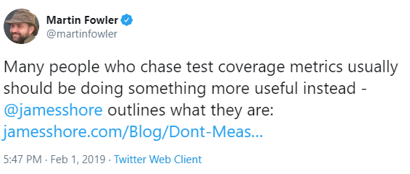
Code Coverage
• Percentage of lines of code tested is code coverage • Ideal coverage is in the 70-80% range
Notes:
Private methods should generally be considered an implementation detail. That's why you shouldn't even have the urge to test them.

Slide 32
Unit Testing
• Bringing up the Spring Context makes your tests exponentially slower • Try to test specific business logic in unit tests • Use Integration Tests to test interactions • Think of a pyramid. Base is unit tests, middle is integration tests, top is functional tests
Software Testing
Notes:
Private methods should generally be considered an implementation detail. That's why you shouldn't even have the urge to test them.

Slide 33
Spring Boot Annotations
@RunWith(SpringRunner.class): Run test with Spring Context
@SpringBootTest: Search for Spring Boot Application for configuration
@TestConfiguraiton: Specify a Spring configuration for your test
@MockBean: Injects Mockito Mock
@SpyBean: Injects Mockito Spy
@JsonTest: Creates a Jackson or Gson object mapper via Spring Boot
Notes:
Private methods should generally be considered an implementation detail. That's why you shouldn't even have the urge to test them.

Slide 34
Spring Boot Annotations
@WebMvcTest: Used to test web context without a full http server
@DataJpaTest: Used to test data layer with embedded database
@ContextConfiguration Used to direct Spring how to configure the context for the test.
@ActiveProfiles Set which Spring Profiles are active for the test
@DirtiesContext Resets the Spring Context after the test (expensive to do)
Notes:
Private methods should generally be considered an implementation detail. That's why you shouldn't even have the urge to test them.

Slide 35
DEMO

