Slide 1

EXPLORATORY DATA ANALYSIS
Electric Vehicles (EV)
Technical and commercial performance data of EV models · 2020 – 2026
2,000
24
20
6
Observations
Columns
Brands
Countries of Origin
Created by: Süha Çağrı Özbakışlar

Slide 2

DATASET
Dataset Overview & Data Quality
2,000
24
20
0
Observations
Columns
Brands
Missing Values / Duplicates
Countries of Origin of the Brands
Germany
Audi, BMW, Mercedes, Porsche, Volkswagen
Each row represents one brand’s model for a given year and variant (base, standard, long range, premium, performance).
13 numerical and 7 categorical variables cover technical features (battery, range, power) and commercial metrics (price, sales, rating).
No missing values and no duplicates across all 24 columns — a complete, consistent dataset.
A solid foundation for the exploratory analysis of the global EV market.
USA
Fisker, Ford, GM/Chevrolet, Lucid, Rivian, Tesla
Japan
Honda, Toyota
South Korea
Hyundai, Kia
China
BYD, NIO, Xiaomi
Sweden
Polestar, Volvo
Süha Çağrı Özbakışlar · Electric Vehicle Market Analysis (EDA)
2

Slide 3

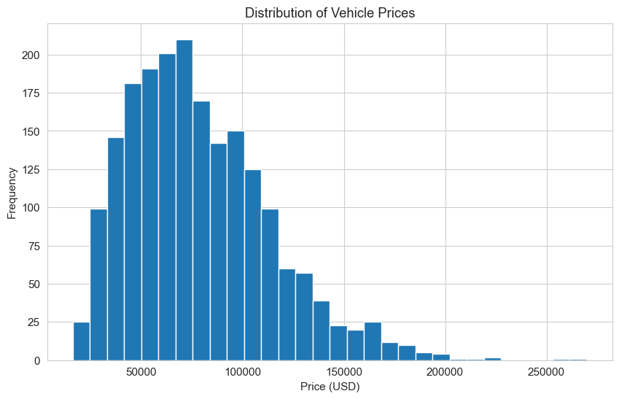
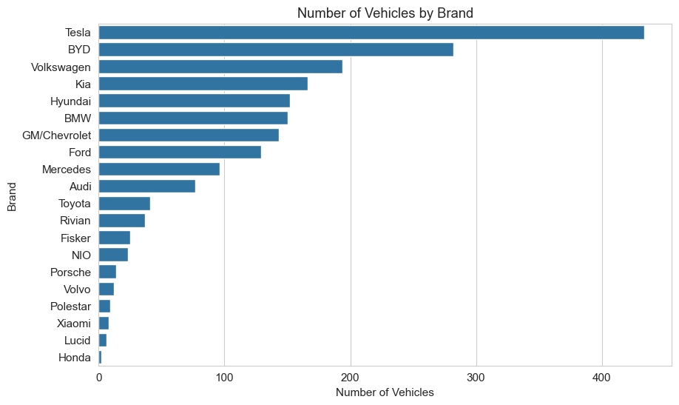
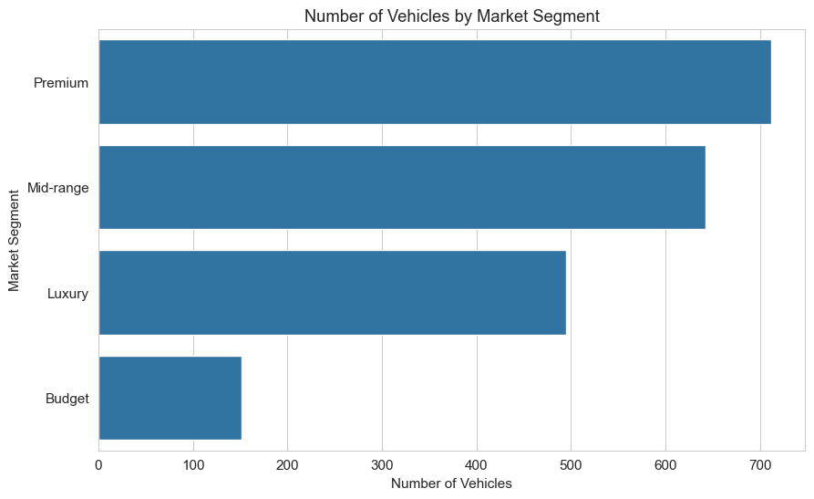
NUMERICAL & CATEGORICAL VARIABLES
Key Distributions
Vehicle Price (price_usd)
Brand (brand)
Market Segment (market_segment)
Vehicle prices are right-skewed (avg. $78,874, median $73,013) and concentrated in the $50,000–100,000 range.
Tesla dominates with 434 vehicles, followed by BYD (282) and Volkswagen (194) — 20 brands in total.
The dataset is concentrated in the Premium (712) and Mid-range (642) segments; Budget is the smallest with 151.
Süha Çağrı Özbakışlar · Electric Vehicle Market Analysis (EDA)
3

Slide 4

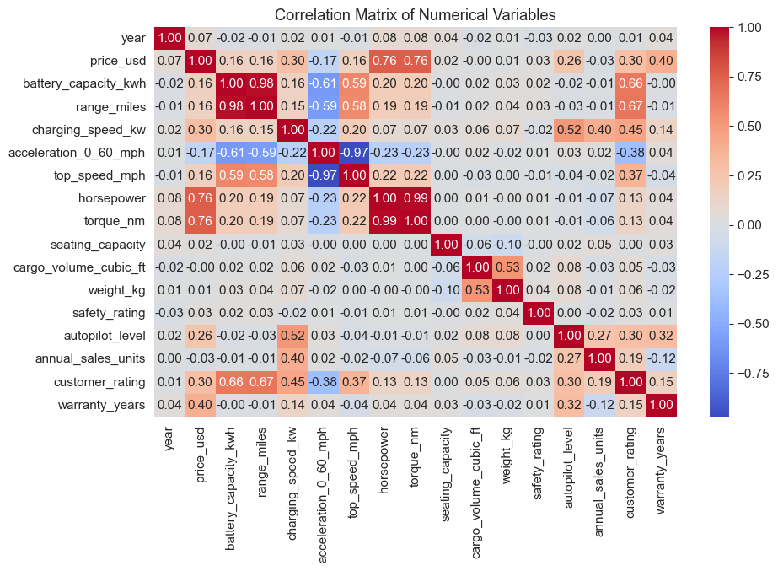
BIVARIATE ANALYSIS
Relationships & Correlations
r = 0.978
Battery capacity ↔ range (very strong) — bigger battery, more range.
r = 0.765
Horsepower ↔ price (strong) — price is not explained by power alone.
r = 0.668
Range ↔ customer rating (moderate) — more range, higher satisfaction.
Süha Çağrı Özbakışlar · Electric Vehicle Market Analysis (EDA)
4

Slide 5



Business Insights & Conclusion
Battery Capacity as the Strongest Range Driver
Very strong relationship (r = 0.978) — bigger battery packs mean significantly more range.
Power Shapes Price More Than the Battery
Price ↔ power (r = 0.765) is much stronger than price ↔ battery capacity (r = 0.164).
A High Price Does Not Automatically Mean High Sales
Lucid leads on price, but VW, Tesla and the Budget segment lead on sales.
Multiple Factors Work Together
Price, satisfaction and sales can only be explained by the interplay of brand, segment and technology.
Conclusion: The dataset is complete, consistent and forms a solid foundation for predictive modeling and business intelligence applications.
Created by: Süha Çağrı Özbakışlar

