Slide 1

Anja Abramovič
Ožbej Kresal
Matej Rupnik
Urban Vesel
-
Simulation of zebrafish group behaviour using a
stochastic vision-based model
based on work by Collignon et al.
January 2026

Slide 2
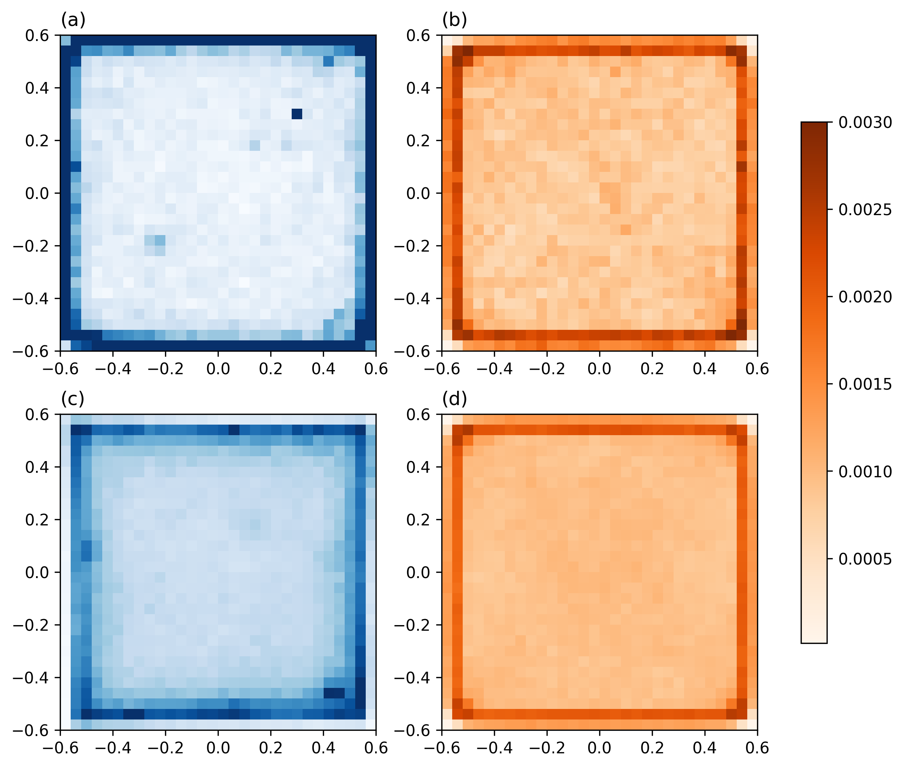
Verifying the model – Homogeneous environments

Slide 3
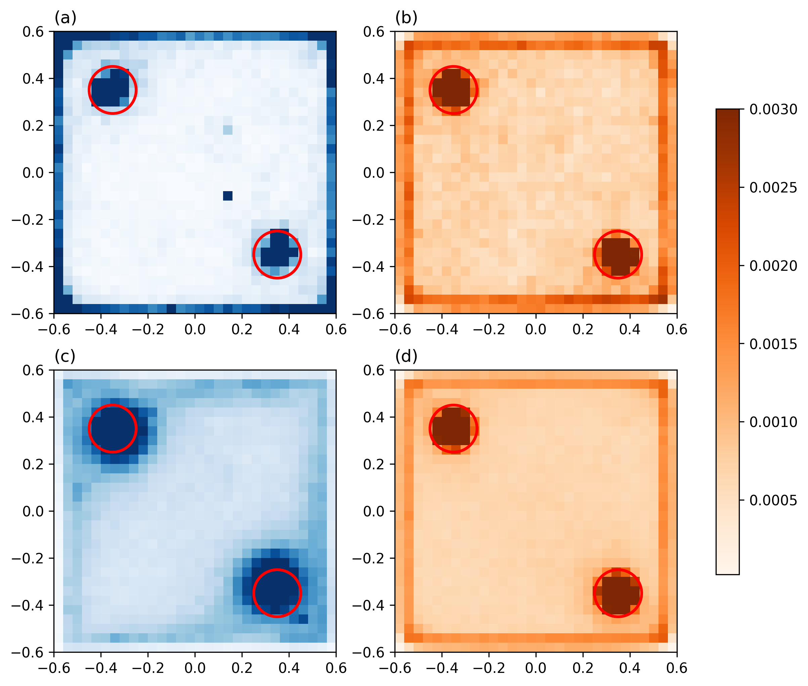
Verifying the model – Heterogeneous environments

Slide 4
Model improvement: Irregular environments

Slide 5
Interactive simulation

