Slide 1
Data Science with Python Project
Text analysıs ın e-commerce revıews
Ali ozcan kures
Notes:
Hello everyone , i will be talking about a e-commerce review dataset and hopefully be able to use text data and categorical data to classify products whether they are recommended or not

Slide 2
CONTENTS
Problem Definition
Data Exploration
Text Preprocessing
Methodology
Classification Algorithms
Best Model
Conclusion

Slide 3
PROBLEM DEFINITION
In the realm of women's clothing e-commerce, the task at hand is to develop a predictive model that can accurately determine whether a given product is recommended or not based on textual data associated with the products.
The objective is to leverage text processing and classification techniques to analyze product descriptions, reviews, or other relevant textual features, and predict the likelihood of a product being recommended by customers.
The primary challenge lies in extracting meaningful information from the textual content associated with each product and training a robust classification model that generalizes well to unseen data.
The model should be capable of discerning the nuances in language, sentiment, and product characteristics that contribute to customers' recommendations or lack thereof.
Notes:
This dataset is about reviews of women clothing for a e commerce website. The dataset is collected from Kaggle.It can be said that data is imbalanced, Recommended reviews are almost 6 time higher than not recommended reviews.

Slide 4
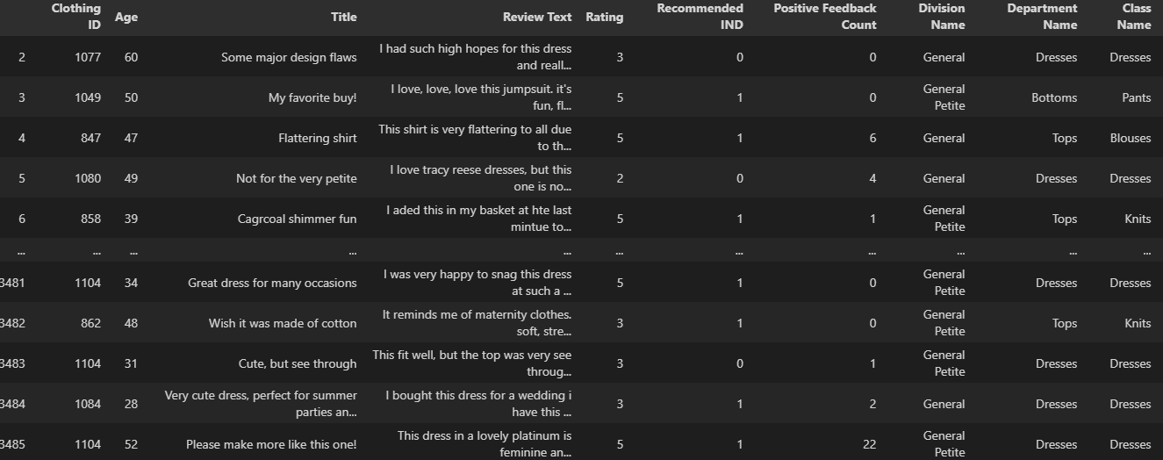
DATA EXPLORATION
10 features and 19662 observations.
Notes:
This dataset is about reviews of women clothing for a e commerce website. The dataset is collected from Kaggle.It can be said that data is imbalanced, Recommended reviews are almost 6 time higher than not recommended reviews. There were some missing rows so I basically just droped them because it is hard to impute text data.

Slide 5
DATA EXPLORATION
Feature Name | Explanation
Clothing ID | Integer Categorical variable that refers to the specific piece being reviewed.
Age | Positive Integer variable of the reviewers age
Title Text | String variable for the title of the review.
Review Text | String variable for the review body.
Rating | Positive Ordinal Integer variable for the product score granted by the customer from 1 Worst, to 5 Best.
Recommend IND (target variable) | Binary variable stating where the customer recommends the product where 1 is recommended, 0 is not recommended.
Positive Feedback Count | Positive Integer documenting the number of other customers who found this review positive.
Division Name | Categorical name of the product high level division.
Department Name | Categorical name of the product department name.
Class | Categorical name of the product class name.
Notes:
There are almost twenty thousand observations and 10 features in our dataset. I will be focusing on the title text , review text , positive feedback count and recommend IND as my target value. Normally I tried to use the rating aswell but it is very highly correlated with target variable so I just didnt use it and try to see the performance of text data. So I will be focusing on title text and review text , which are obviously text data. I will also use positive feedback count and try to predict recommend ınd.

Slide 6
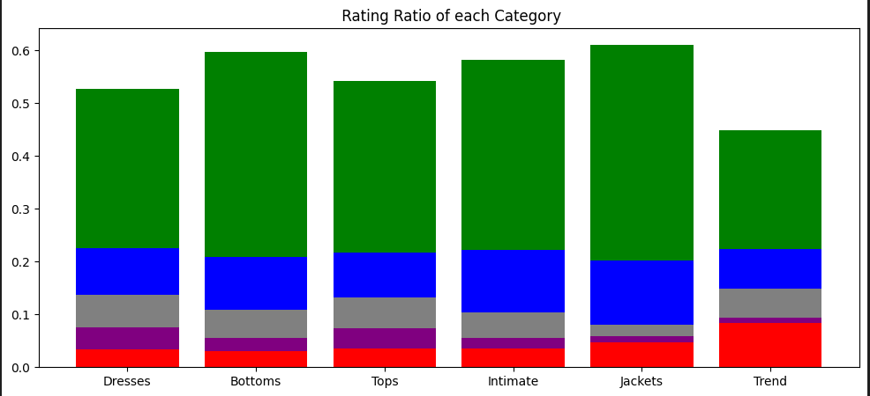
DATA EXPLORATION
Top 5 Positive ngrams(2x2) | Top 5 Negative ngrams(2x2)
«love love»(188) | «wanted love» (88)
«super cute»(152) | «poor quality»(61)
«beautiful dress»(145) | «runs small»(45)
«great dress»(140) | «runs large»(29)
«love dress»(140) | «didn work»(26)
Notes:
The table on the right shows the most frequent bigrams. We can define a bigram as consecutive words in our context. The graph on the left shows us the most recommended category is bottoms and tops on the other hand trend category has the highest ratio of negative rating.

Slide 7
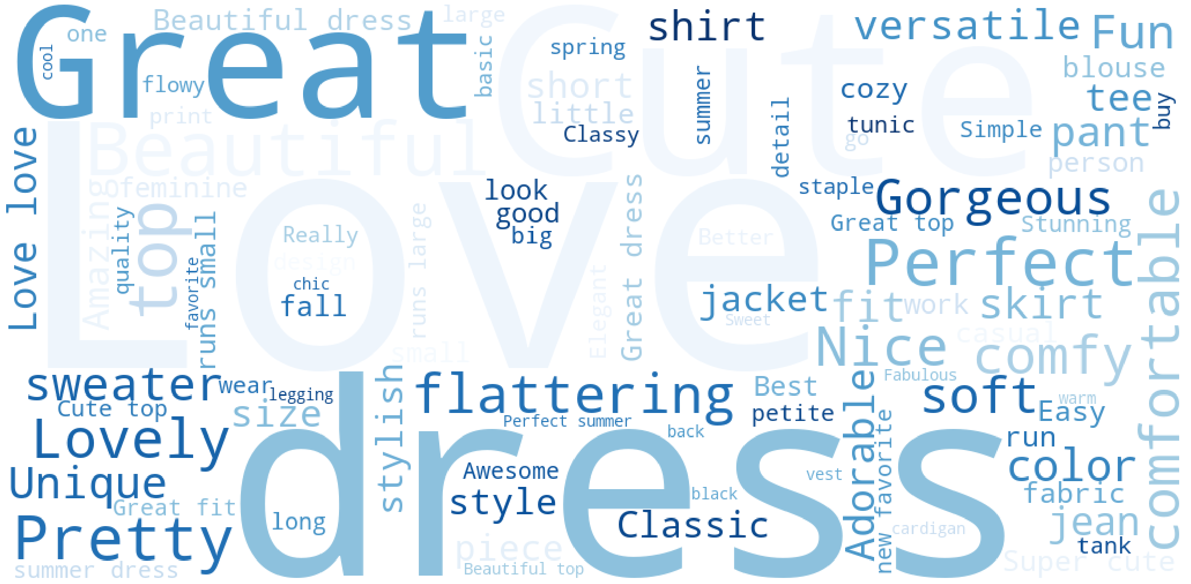
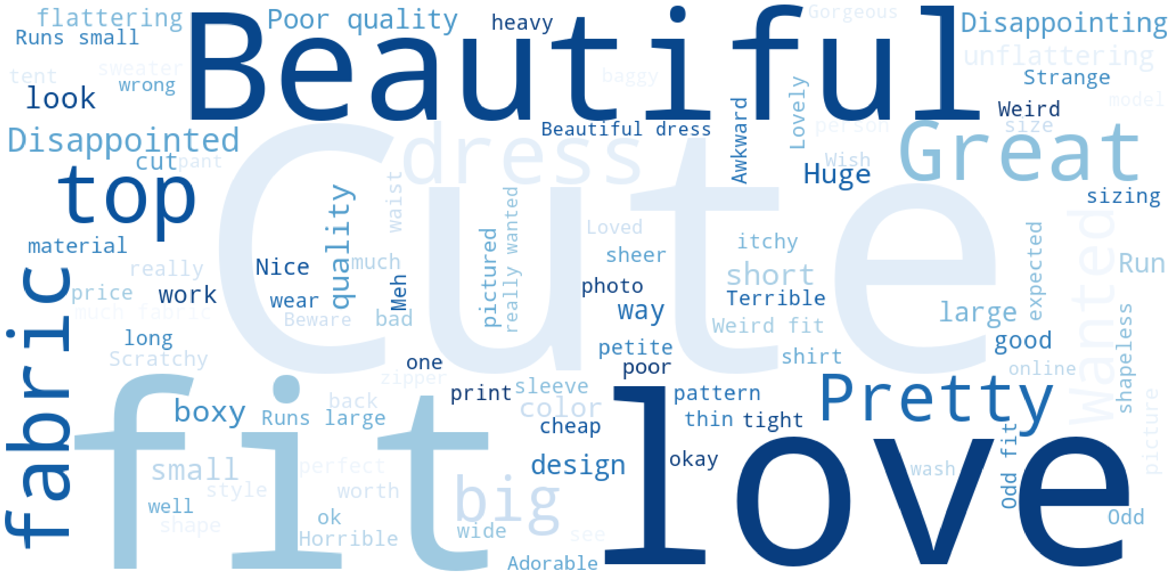
WORD CLOUD
Recommended
Not Recommended
Notes:
I used word cloud library for that. The size of each word is related to their frequency in the data

Slide 8
Text Preprocessing
Clean & Normalize
Remove special characters,emoji,space
Lowercase & split the words
Stop Words
Common used words
Stemmer/Lemmatizer
Producing variants of a root/base word
A, an, in , the, these etc.
Normalize
Ali went back to university
Tokenize
«ali», «went»,»back»,»to»,»university»
Remove Stop Words
«ali»,«went»,»university»
Stem / Lemmatize
«ali»,»go»,»univers»
Notes:
So I used some libraries like WordNetLemmatizer , corpus , feature_extraction and regular expression libraries to preprocess the text data. After I remove emojis , spaces , numbers and special characters I removed stop words. Stop words are basically the most common words in English. Finally I try to reduce words to their roots by stemming. This helps to reduce sparsity and reduce dimensionality of the data.

Slide 9
Methodology
TFIDF VECTORIZATION
TF-IDF stands for Term Frequency Inverse Document Frequency of records. It can be defined as the calculation of how relevant a word in a series or corpus is to a text. The meaning increases proportionally to the number of times in the text a word appears but is compensated by the word frequency in the corpus (data-set).These values are stored in «sparse matrix «.
COLUMN TRANSFORMATION
This estimator allows different columns or column subsets of the input to be transformed separately and the features generated by each transformer will be concatenated to form a single feature space.
That is how I apply tf-idf vectorization on text data and also used categorical data for classification.
GrID sEARCH
Grid search is a hyperparameter tuning technique in machine learning that systematically evaluates a predefined set of hyperparameter combinations to identify the optimal configuration for a given model.
Text Preprocessing
Tfidf Vectorization
Column Transformation
Grid Search &Cross Validation
Performance Evaluation
Notes:
term frequency inverse document frequency
Tf-idf : calculates how relaevant a Word in whole dataset. These values are stored in a different format which is a sparse matrix .
Higher tf-idf score = Frequent in the document and relatively rare accross the corpus
Column-transformation : this helped me to concatanete categorical and the text data.
Grid Search : Similar what we do in so assignments, tries each hyperparameter.

Slide 10
Performance of Classifiers
Classifier | TPR | TNR | Accuracy | AUC | Hyperparameters
Logistic Regression | 0.97 | 0.61 | 0.90 | 0.79 | C : 1 , Penalty = L2 , Solver = Liblinear
AdaBoost | 0.90 | 0.52 | 0.83 | 0.71 | Learning Rate = 0.01, n_estimator = 50
Random Forest | 0.99 | 0.31 | 0.87 | 0.65 | Max_features = sqrt , n_estimators = 100
XGBoost | 0.89 | 0.81 | 0.87 | 0.85 | Learning rate = 0.2 , n_estimators = 300,subsample = 1, scale_pos_weight = 1/6
Naive Bayes | 0.99 | 0.33 | 0.87 | 0.66 | Default Parameters
Voting Classifier | 0.96 | 0.62 | 0.90 | 0.80 | Logistic Regression & SVM & NaiveBayes Voting = hard
SVM | 0.90 | 0.81 | 0.88 | 0.86 | Kernel = linear, class_weight = balanced, Gamma = 1 , c = 1
Neural Network | 0.94 | 0.70 | 0.89 | 0.82 | 2 hidden layer , batch size = 128, 50 epochs,class_weight = {0:10,1:1)
Neural Network + SMOTE | 0.92 | 0.74 | 0.89 | 0.83 | 2 hidden layer , batch size = 128, 50 epochs
Notes:
As you can see , some algorithms doesn't have good accuracy , especially in minority class like RF, Naive Bayes and ADABoost. I will be talking about neural network more detailed.
Voting Classifier : mixture of logreg , svm and NB
Hard voting is actually very similar to ensemble methods we covered.

Slide 11
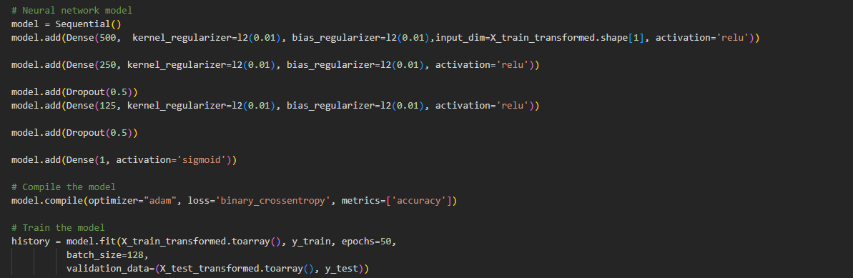
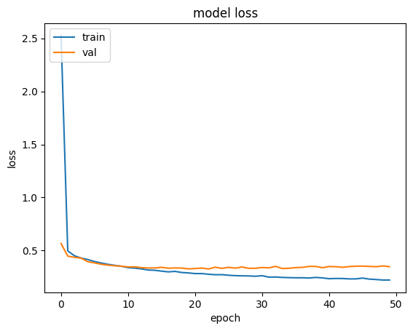
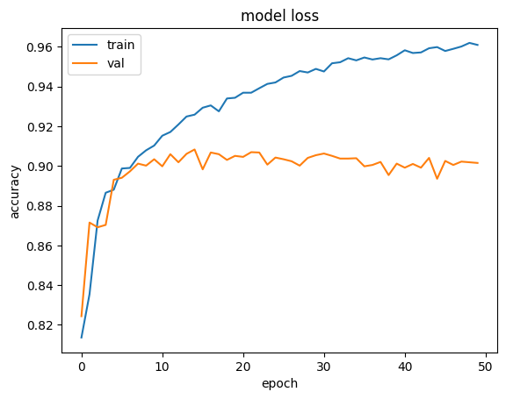
Neural Network Approach
I used l2 regularizer , dropout and batching to prevent overfitting
Notes:
L2 regularizer , dropout and batching are for preventing overfitting.

Slide 12
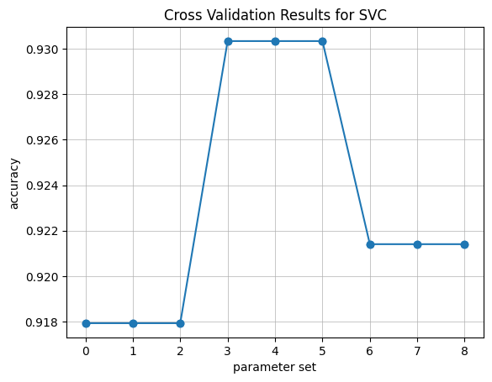
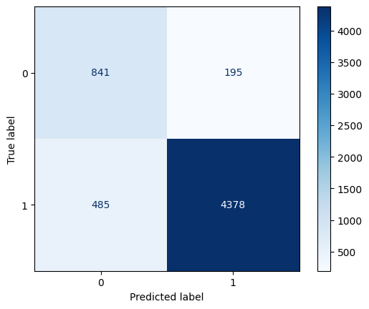
BEST MODEL
 | TPR | TNR | Accuracy | AUC
SVM | 0.90 | 0.81 | 0.88 | 0.86
Notes:
When we look at the best model’s cross validation results on train data , the averae is around 0.92 and the test data’s accuracy is 0.88 so i believe data is not overfitted

Slide 13
CONCLUSION
Utilizing text processing and classification algorithms enables effective sentiment analysis on customer reviews.
SVM outperformed the other algorithms.
Visualizing the feature importance for text data can be considered hard.
Although many of the algorithms performed well , we can still use sampling techniques to improve f1 score in minority class.
Working with tf-idf matrices is computationally expensive
Notes:
I also tried to create a pipeline to test our best model on any given review

