Slide 1

SRDC Software Research & Development and Consultancy Corp.
METU-SRDC (Software Research & Development Center), established in 1991
SRDC Corp established in 2007
European Commission supported R&D projects
Business contracts with the public and private sector
R&D partnerships

Slide 2
Java
Object oriented
Encapsulation
Abstraction
Inheritance
Polymorphism
JVM, byte code, .class files
Package names
Classpath
Compile & Run time
Entry point
Jar

Slide 3
Java build tools
ANT (~Make)
Deal with the jars
Imperative scripting
Maven
Central repository
Object-oriented
IDE
IntelliJ IDEA, Eclipse, Netbeans, …

Slide 4
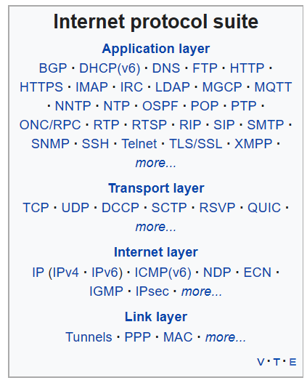
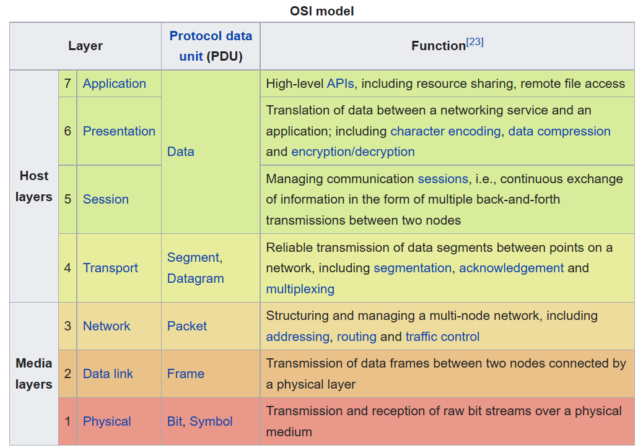
Computer Network Programming
IP
Port
Socket programming
Client – Server architecture

Slide 5
Databases
File system
Indexing (Hash index, b+ tree index)
Relational Databases (RDBMS)
Other types of databases…
SQL: SELECT * FROM Users U WHERE …
Network access
PostgreSQL, MySQL, MSSQL, Oracle, H2, Derby …

Slide 6
1st Assignment User Management & Messaging Tool
Client-Server model
Server has a default list of admin users maintained in an RDBMS (say, PostgreSQL).
Admin vs Regular users.
Admins can perform CreateReadUpdateDelete (CRUD) operations on users.
Users have a number of fields: name, surname, birthdate, gender, e-mail address.
Users can send messages to each other
Each user can read their messages (both Inbox & Outbox)
Every interaction with the Server must be authenticated
Username & password authentication
Command Line Interface for Clients
What to exchange between a client and a server??

Slide 7
Create your own protocol
You will need ‘actions’ like:
LOGIN, LOGOUT
INBOX, OUTBOX, SENDMSG
ADDUSER, UPDATEUSER, REMOVEUSER, LISTUSERS…
You will need some escape character(s) like:
:, |, ^
Examples (DO NOT copy these as they are):
LOGIN:::myuksel:::123456
ADDUSER|myuksel|Mustafa|Yuksel|1984-01-01|M| mustafa@srdc.com.tr|Ankara
SENDMSG^sender:myuksel^receiver:ali^title:N’aber?^message:Merhaba Ali, Staj nasıl gidiyor?

Slide 8
Key concepts for the 1st Assignment
Java socket programming
java.net.ServerSocket
java.net.Socket
Multi-threaded socket programming
Thread, Runnable
Server will be multi-threaded
Relational database access
Install DB server first (PostgreSQL)
JDBC (Java Database Connectivity)
RDBMS JDBC driver
Pay attention to Object-Oriented Principles (OOP)
User and Message entity classes are MUST HAVE
DB class is MUST HAVE
NO saveMessageInDB(String from, String to, String title ….)
YES saveMessageInDB(Message newMsg)

Slide 9
WWW
HTTP
HTML
Static, Dynamic, Rich Internet Applications
Javascript
AJAX
XML & JSON
CSS

Slide 10
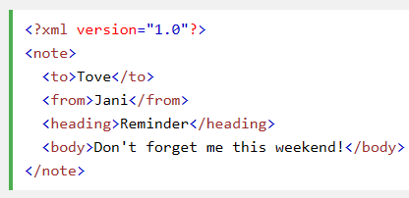
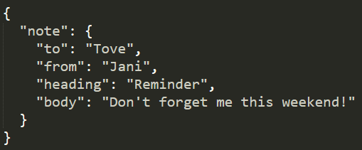
JSON
JSON (JavaScript Object Notation) is a lightweight data-interchange format
Serialized JavaScript objects
https://www.w3schools.com/js/js_json_intro.asp

Slide 11
REST
REST (REpresentational State Transfer) is an architectural style for providing standards between computer systems on the web, making it easier for systems to communicate with each other.
REST paradigm implies statelessness, meaning that the server does not need to know anything about what state the client is in and vice versa
Resources are the nouns of the Web - they describe any object, document, or thing that you may need to store or send to other services.
e.g. http://srdc.com.tr/staj/hw2/api/user/123

Slide 12
REST
A REST request mainly consists of:
an HTTP verb, which defines what kind of operation to perform
a header, which allows the client to pass along information about the request
a path to a resource
an optional message body containing data
Basic HTTP verbs:
GET - retrieve a specific resource (by id) or a collection of resources
POST - create a new resource
PUT - update a specific resource (by id)
DELETE - remove a specific resource by id

Slide 13
REST examples for your story
Create a user:
POST /messenger/user
Update a user:
PUT /messenger/user/<userid>
Read inbox of a user alternatives:
GET /messenger/user/<userid>/inbox
GET /messenger/message?receiver=<userid>
GET /messenger/message/inbox?user=<userid>
Read logs:
GET /messenger/log?start=2020-07-01&end=2020-07-14&sort:asc=date
NOTE: These are only some examples!

Slide 14
Javascript
Interpreted, dynamic typing, multi-paradigm, function scoping!
Not related with Java
Design principles from Scheme ;)
Client-side programming
Runs on the browser!!
Let the client do most of the job
Decrease the load of the server

Slide 15
Javascript Libraries & Frameworks
jQuery, BackboneJS, RequireJS, UnderscoreJS…
GWT, EmberJS, KnockoutJS, AngularJS…
Modern popular frameworks:
Angular, React, Vue.js
Javascript for server-side programming:
Node.js

Slide 16
2nd Assignment Web based User Management & Messaging Tool 1
Same functionality with a Web-based system
Backend: Spring Boot REST API
REST API with Spring Boot
Java Persistence API (JPA)
PostgreSQL
Frontend: Native HTML app
Native HTML and CSS
Native Javascript (AJAX with XMLHttpRequest())
No other JS framework like jQuery, for now
No CSS framework like Bootstrap

Slide 17
Key concepts for the 2nd Assignment
Install:
Maven
Postman for testing
Read:
JSON
REST
JPA
Tutorial: Spring Boot, JPA/Hibernate, PostgreSQL example: CRUD
https://www.bezkoder.com/spring-boot-postgresql-example/
Tutorial: Building REST services with Spring
https://spring.io/guides/tutorials/rest/
You can follow it until “What makes something RESTful?” section

Slide 18
Key concepts for the 2nd Assignment
Client (Web) side
w3schools HTML, JS, JSON tutorials
Google search: “XMLHttpRequest REST example”
IDE:
Intellij IDEA Ultimate or Webstorm
Visual Studio Code is also good
Sublime or Atom are more simple editors with JS support
User interface design beautifying
Write CSS yourself

Slide 19
3rd Assignment Web based User Management & Messaging Tool 2
Same functionality with a different stack
Server: REST web services
Node.js + Express
Client: Angular (latest stable release)
DB: MongoDB
You can use Studio 3T as a client app for MongoDB
You will use Mongoose as Node.js - MongoDB object modeling solution
To read:
MongoDB
Angular (https://angular.io/start)
JWT
Tutorial for a full MEAN (MongoDB, Express, Angular, Node.js) stack example using Bootstrap:
https://www.positronx.io/mean-stack-tutorial-angular-crud-bootstrap/

Slide 20
3rd Assignment Web based User Management & Messaging Tool 2
MUST haves:
Use Bootstrap
REST API will again have user authentication:
This time pass the token in HTTP Authorization header
Use JSON Web Token (JWT) as access tokens
Be more informative and user friendly
Do not just display nicknames of users in tables
Admin cannot know the id of the user by heart for deletion
Implement paging (both on the server side and client side)
Do more on the client side
All columns of all tables shall be sortable
Implement type-ahead search while finding a user to send a message
Be creative…
Reuse UI components: e.g. add user and update user shall use the same Angular component
Additional functionality: Admins will see the user access logs (username, login time, logout time, IP, browser …)

