Slide 1

Time to think
Coins in Round Table
Notes:
1. 2 buckets (4 liters and 9 liters) get 6 liters of water
2. 2 sandglasses (4 mins and 7 mins). Measure 9 mins

Slide 2

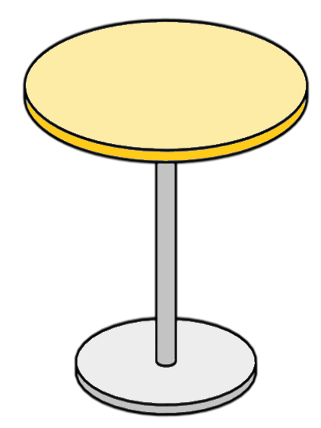

We are blindfolded in front of a table..

Slide 4

There is a coin under each mug..

Slide 5
Each round, we select one or two mugs..

Slide 6

The coins under the selected mugs
are flipped..

Slide 7
Then the table is rotated 90º random
number of times..

Slide 8
.. and the next round starts..

Slide 9
This continues until all coins are the same (head or tail)

Slide 10
How can I guarantee ending this game?

