Slide 1
SE 1105
Programming & Problem Solving

Slide 2

Goals
Notes:
Understand basic concepts of programming,
Understand how computers handle programs while they are running (compilers, memory management, function calls etc.)
Being able to understand existing programs
Being able to write our own programs solving simple computational problems
Being able to re-use existing code in our own programs

Slide 3

Prerequisites
Notes:
Basically nothing

Slide 4

Course Structure
Notes:
Going over MOODLE & syllabus

Slide 5

Homeworks
Notes:
Very important
Self-studies

Slide 6

Exams
Notes:
Open-sheet

Slide 7
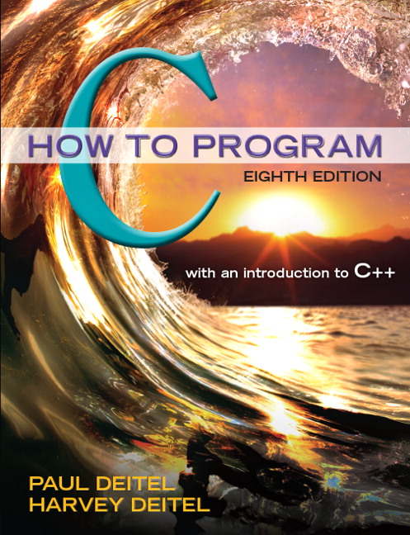
Textbook

Slide 8


Participate the class by
Asking questions,
Sharing ideas,
Making corrections
Notes:
Any questions upto now ?

Slide 9
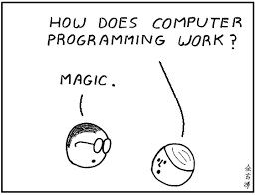
Computer Programming
Notes:
Computers are generic devices that can perform any computational task (programs).

Slide 10

Time to think
Bulbs & Switches

Slide 11




?
?
?
?
?
?
?
?
… and 8 lightbulbs on the top floor
A
B
C
D
E
F
G
H
There are 8 switches on the ground floor

Slide 12
?
?
?
?
?
?
?
?
A
B
C
D
E
F
G
H

Slide 13
How many times I need to climb up to figure out which switch operates which bulb?
?
?
?
?
?
?
?
?
A
B
C
D
E
F
G
H

Slide 14
?
?
?
?
?
?
?
?
A
B
C
D
E
F
G
H

Slide 15
Decimal vs Binary

Slide 16

Meet A-bot
Instructions
000 Wake up
111 Sleep
001 Write the letter in the 2nd panel on the board
010 Take the pen
011 Drop the pen
100 Raise your arm
101 Lower your arm
Notes:
An example of binary instruction and operands (opcode+operands)

Slide 17
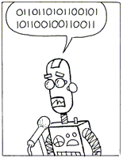
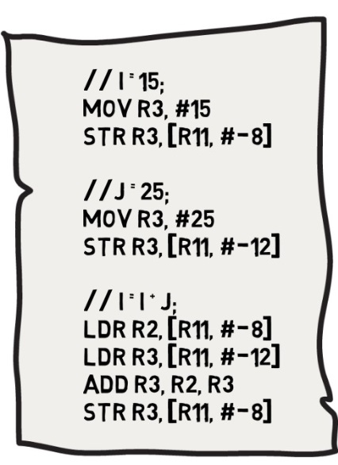
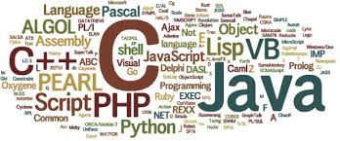
Machine Language
Assembly Language
High Level Languages
Assembler
Compiler
Notes:
Compilers may also convert high level languages directly to the machine language.

Slide 18

Notes:
Go over the helloworld.c (text editor)
Compile it with gcc
run

Slide 19

Integrated Development Environment

Slide 20
IDE
WRITE
DEBUG
COMPILE
DEPLOY
&
RUN
DOCUMENT

Slide 21







