Slide 1

Anatomy of a C program

Slide 2
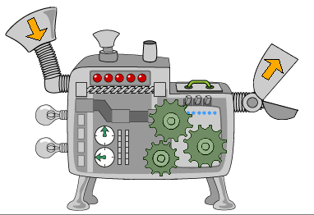
Functions
Notes:
List of statements
May have some inputs (parameters)
May have one output
printf() scanf()

Slide 3
Statements
Notes:
Unit of work in programs
Ends with a semicolon (;)

Slide 4
1. Variable Definition Statement
<type_of_var> <name_of_var>;
Notes:
Type of the variable
Name of the variable

Slide 5

Time to think
Buckets & Sandglasses
Notes:
1. 2 buckets (4 liters and 9 liters) get 6 liters of water
2. 2 sandglasses (4 mins and 7 mins). Measure 9 mins

Slide 6
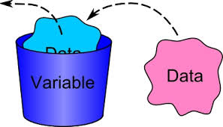
Variables

Slide 7
Integer (int)
<type_of_var>
Notes:
Memory representation
2. 2’s complement notation

Slide 8
Boolean (bool)
<type_of_var>

Slide 9
Can start with any letter or underscore(_)
Can contain any number of letters, digits or underscore(_)
Case sensitive
<name_of_var>
Notes:
Examples on the code

Slide 10
2. Assignment Statement
<name_of_var> = <Expression>;

Slide 11
Expressions
Notes:
Antyhing that has value
Type of the expressions is the type of the value
Examples:
Immediate values
Variable name
Operators
Function calls*

Slide 12
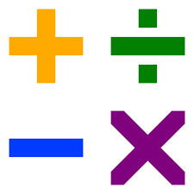
Arithmetic operators
Notes:
(Int expression) op (Int expression) -> (Int expression)
Give examples of complex operators with paranteheses
++ , +=

Slide 13
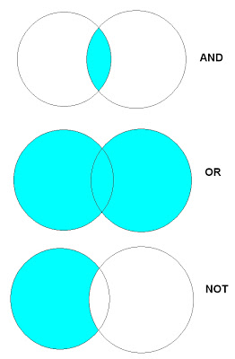
Logical operators
Notes:
(Boolean expression) op (Boolean expression) -> (Boolean expression)

Slide 14

Comparison operators
Notes:
(Int. Expression) op (Int. Expression) -> boolean expression
<, >, >=, <=, ==

Slide 15
3. Function call statement
<name_of_function>(Inputs*);
Notes:
Type of the variable
Name of the variable
Printf() function scanf function

Slide 16
3. Inputs of a function (Parameters)
(<type> name1, <type> name2 …)
Notes:
Type of the variable
Name of the variable
Printf() function scanf function

Slide 17

Exercises
Write a function that takes 3 integers as parameters and returns the sum of them.
Write a function that prints «Hello» to the screen
Write a function that prints 3 times “Hello” to the screen

Slide 18

Self-study
Solve the exercises int study-1.c

Slide 19
Optional
Integer data type – What is behind?

