Slide 1

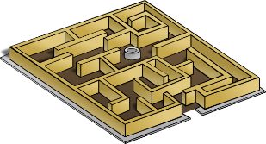
Maze (continued...)
Represent a maze using 2-D arrays
Notes:
Leave unfinished job as self study.

