Slide 1

Pointers

Slide 2
Type of Pointers

Slide 3
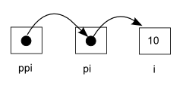
Pointer to Pointers

Slide 4
Pointers as Function Arguments

Slide 5
Pointers & Arrays

Slide 6
Arrays as Function Arguments

Slide 7
Character pointers

Slide 8

Exercises
Write strlen function with pointers
Write a function that returns if a given string is palindrome

Slide 9
Using Heap Dynamic Memory Allocation

