Slide 1

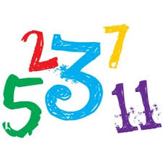
Prime numbers
Write a program that reads a positive number from the user as n and prints out the first n prime numbers
Notes:
divide&conquer

Slide 2

Self-study
Output Questions
Solve the exercises int study-3.c

