Slide 1

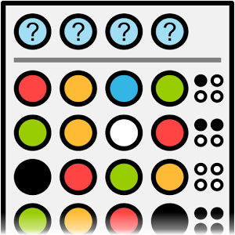
Mastermind
Write a program that plays a mastermind game with the user
Notes:
divide&conquer

