Slide 1
Defining custom data types
Notes:
Some examples:
tamsayi
Position
ipv4

Slide 2

Exercises (Revisited)
Define enumerated types for direction and coin-face.
Write a function that returns the opposite of a given direction
Define a double array of size 2 as the coordinate of a point in 2D

Slide 3
Character (char)
Notes:
Just brief definition of char’s without going into ASCII .
Printf ()

Slide 4
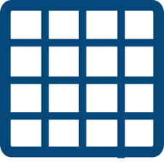
Multi-dimensional arrays
Notes:
Memory management of multi-dimensional arrays

Slide 5
Exercises
Write a function that takes 2-dimensional 20x20 integer array returns the sum of all elements.
Write a function that takes 2-dimensional 20x20 integer array returns the sum of all elements on the diagonal.

Slide 6

Self-study
Solve the exercises int study-8.c

Slide 7

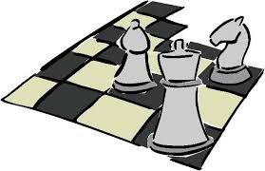
Chess
Represent a chess board using 2-D arrays.
Notes:
Make as much exercise as possible on chess.

Slide 8

Time to think
Golds of the Cave
Subtract the Divisor

